Slide 1
Notes:
Good morning, my name is Maricela and I am from deep South Texas. I am the TB and Hansen’s consult nurse for Region 11.

Slide 2
Managing the Patient’s Response to TB Treatment
Maricela Zambrano, RN
Tuberculosis and Hansen’s Disease Nurse Consultant
Public Healtion Region 11, Texas Department of State Health Services
Notes:
Today we will be discussing how to manage the patient’s response to TB treatment.

Slide 3
Maricela Zambrano, RN
Has the following disclosures to make:
No conflict of interests
No relevant financial relationships with any commercial companies pertaining to this educational activity
Notes:
I have no conflicts of interests or disclosures to make.

Slide 4
Objectives
By the end of this presentation, you should be able to:
Identify components that will determine response to treatment.
Identify reasons why there is NOT a response to treatment.
Identify next steps when there is no response to treatment.
Notes:
Today we will identify components that determine a response to treatment, the reasons why there may not be a response and what steps to take when there is not a response to treatment.

Slide 5
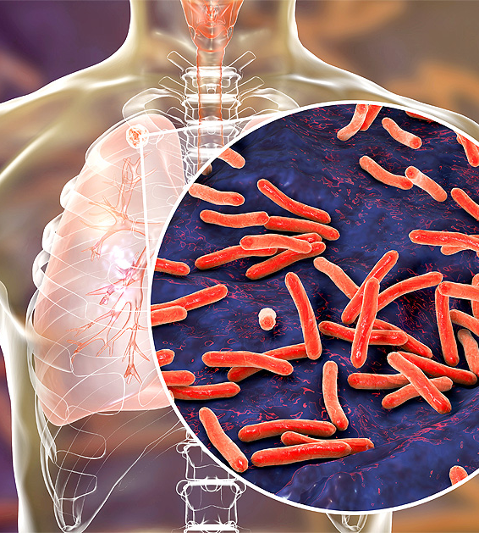
Introduction
Tuberculosis
Major Global Health Issue
Effective management requires careful monitoring of patient response.
Adherence to treatment is crucial to cure and prevent resistance.
Notes:
Tuberculosis is an old disease known by many names. It has been known as consumption; phthisis and others in the past. It continues to be a major global health concern. It’s imperative to have effective management to carefully monitor patient’s responses to treatment. Adherence to treatment is critical when it comes to adequately curing and preventing resistance.

Slide 6
Goals of TB treatment
Cure patient and minimize permanent disabilities, death and transmission.
Provide the safest, shortest effective patient centered therapy possible.
Develop a treatment and monitoring Plan to ensure adherence and completion of treatment.
Notes:
Of course, our goal for every patient is to cure TB and have the patient return to their normal lives. We want to obtain this goal without any secondary permanent effects. Some of these disabilities may include neurological damage from Spinal TB or meningitis, including developmental delays in pediatric meningitis cases. It may cause chronic lung conditions such as COPD due to permanent scarring. Hearing or vision loss may also be a factor due to medication side effects or TB of the eye. Unfortunately, some may even suffer from mental health issues such as depression or anxiety due to TB stigma or isolation. To prevent these conditions we should diagnose early, start treatment with safe, short and adequate treatment. When we develop a treatment and monitoring plan, we can promote greater adherence and have a higher probability of completing TB treatment. We would prevent drug resistance, reduce transmission and improve patient outcomes.

Slide 7
Treatment and Monitoring Plan should include:
Description of treatment regimen
Methods for assess/ensuring adherence
Methods to monitor adverse reactions
Methods for evaluating treatment response
Notes:
Let’s talk about treatment and monitoring plans. We want to know exactly what the treatment regimen plan will consist of. Of course, we know that TB is never a clear cookie cutter regimen. At times we may have reactions, resistance or other factors that may change the patient’s regimen throughout his/her care. Because of this, it’s important to assess for side effects, monitor adherence and know how to evaluate to ensure a good treatment response.

Slide 8

Treatment Regimens:
RIPE - 6 months vs 9 months
4 HPMZ – shorter regimen than RIPE
SHINE - pediatrics
Notes:
One way to promote adherence to treatment is to reduce pill burden or the length of treatment. So, it’s important to choose an adequate regimen. When we choose an adequate regimen, it increases adherence and improves completion of treatment rates. Standard RIPE, the 4 month regimen and the SHINE regimen are options for fully susceptible TB.

Slide 9
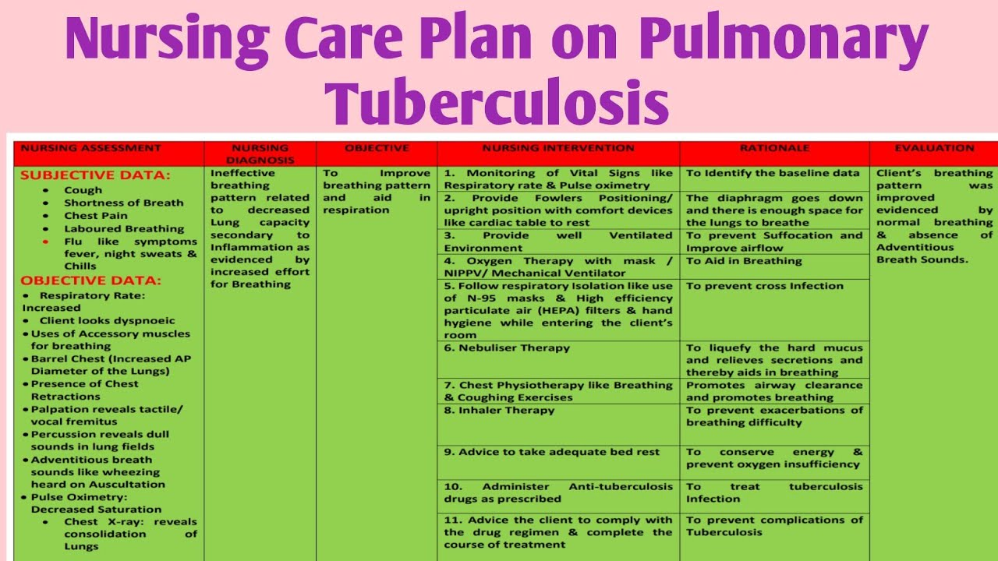
Nursing Case management
Initial Assessment
Treatment
Administrative
Monitoring
Patient care needs
Notes:
As we know nursing case management can be challenging. In public health we often wear many hats. Between administrative roles, patient care and even performing social work duties. It can be a difficult task to juggle. But in the end, what is most important is our patient. Let’s discuss what a nursing case management care plan consists of.

Slide 10
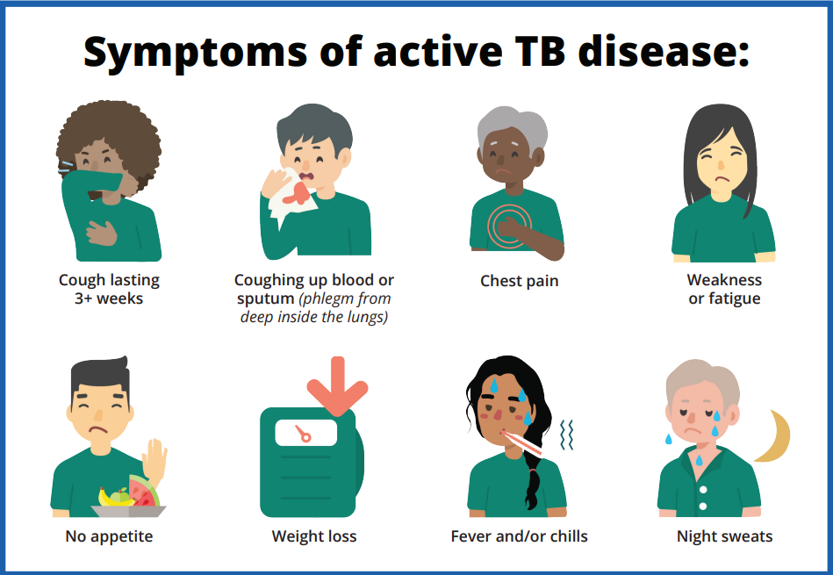
Monitoring Clinical Response to treatment
Clinical Evaluation:
Symptom improvement
Resolution of S/S
Weight gain
Overall improvement
Bacterial Examination
AFB smear results
Smear & culture conversion
Susceptibilities
Radiographic Results
CXR
Extrapulmonary TB
May require additional testing.
Notes:
It’s important to consider both subjective and objective data when evaluating symptom improvement. Our patient’s symptoms should start to resolve while on treatment. Some symptoms may take longer to resolve but the patient should have an overall improvement. You may notice a decrease in production of phlegm, gradual weight gain, increased appetite or an increase of energy. Bacteriology and radiology results should also be reviewed and considered. A decrease in AFB smears may indicate diminishing bacterial load. A culture conversion which is indicated by two consecutive negative specimens (at least one
month apart) with no further positive cultures implies a good response to treatment. Culture conversion may occur quickly or take a few months based on many factors. It is always important to have susceptibility results to verify the patient is on an appropriate regimen. Radiographic results should always be compared to baseline to ensure improvement of disease. And because we know that TB can grow in any part of the body, additional testing such as ultrasounds of the GI, CT’s, MRI’s, pathology of tissue, wound cultures, biopsies and more may be required.

Slide 11

Clinical Monitoring
Monthly Assessments
Monitor for side effects/toxicity
Assess for adherence of treatment
Determine treatment efficacy
Build rapport with patient and address holistic needs
Collection of laboratory specimens (sputum/blood etc)
Radiology as needed (baseline, 2 month & final)
Screenings (Visual Acuity, Ishihara & Hearing)
Vital Signs
Notes:
Our clinical monitoring should include monthly assessments for potential side effects and toxicity to medications prescribed. We would use this time to build rapport with the patient and assess adherence to treatment is >80%. We want to determine that the current treatment continues to be efficacious and effective. We would also use this time to collect any additional laboratory specimens needed to continue to monitor the patient. This may include blood specimens that are treatment based. A CBC/CMP is used to monitor liver enzymes to assess for hepatotoxicity, H&H and platelet counts to monitor for GI bleeding and BUN & Creatinine levels for kidney function. Vison and hearing screenings may be necessary and based on medication regimen prescribed. If a patient is on 2nd line medication additional bloodwork such as TSH, serum electrolytes including Magnesium and other screenings may be necessary.

Slide 12
Directly Observed Therapy vs Video Directly Observed Therapy
DOT
Keep open communication with DOT workers.
VDOT
Review VDOT videos next business day and maintain open communication with DOT worker.
Monitor for adverse reactions prior to every DOT dose
Report any adverse reaction to case manager
Report <80% adherence to case manager
Document Adequately
Notes:
It is important to work with your team. Maintain effective communication with your DOT workers. Whether the dose is directly observed in person or through video it’s important to report any changes in a timely manner. We should be verifying VDOT videos are being reviewed within the next business day. As nurses we are assessing for toxicity monthly, but our DOT workers are monitoring for adverse reactions and adherence with every dose. They truly are our eyes and ears, and we are appreciative of the work they do.

Slide 13
TB Nursing Case Management
Adverse Reactions
Hold medication
Obtain new orders
Assess patient
Follow up
Document
Notify treating MD
Collect labs as per SDO’s
Resume treatment if appropriate
Nursing Interventions
Resources
Drug Resistant TB: A Tool for TB Nurse Case Management
Nursing Guide for Managing Side Effects to Drug-resistant TB treatment
A Survival Guide for Clinicians, 3rd edition https://www.currytbcenter.ucsf.edu/products
Notes:
What steps do we take when we receive report of a potential adverse reaction? When in doubt hold your TB medications. It’s important to teach your patient to do the same. Keep them informed of possible side effects and the next steps to take. Provide your patient with contact information to report toxicity to you. Contact the treating physician and keep them informed. Make sure you assess the patient to provide adequate report. Heartland and Curry TB have great resources to assist. You may have to collect labs based on SDO’s, evaluation and medications prescribed. It’s important to document, follow up, obtain new orders and resume treatment as soon as possible, if appropriate. SDO’s for your jurisdiction may provide some additional guidance when it comes to elevated LFT’s based on symptoms and upper limit results.

Slide 14
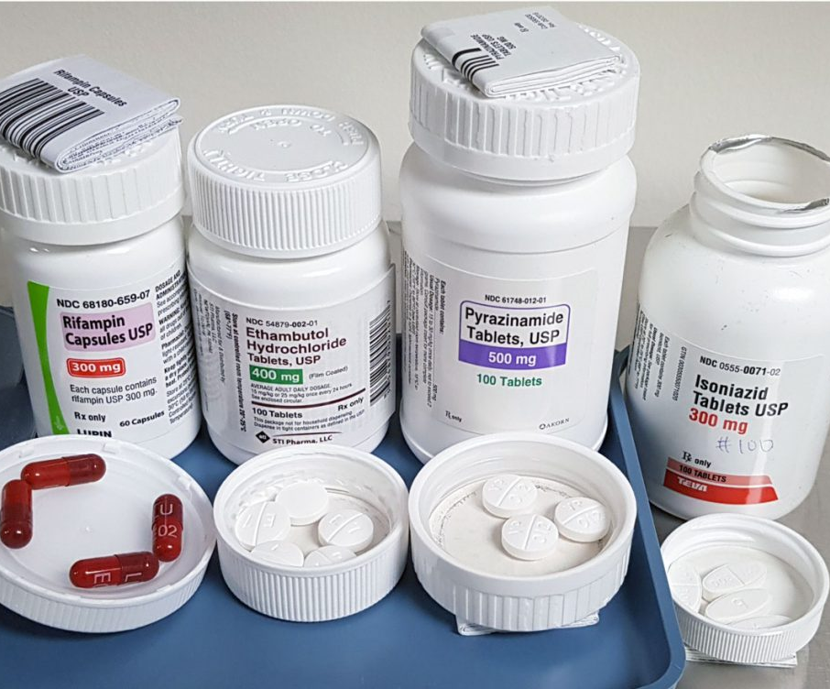
Managing Adverse Reactions
Hepatotoxicity (INH, RIF, PZA)
Peripheral Neuropathy (INH, LZD, CS, FQs, Injectables)
Vit B6 supplementation
Gastrointestinal Upset (INH, EMB, PZA, Eto/Pto, PAS, Bdq, Cfz, Dlm, LZD, Cs, Amx/Clv)
Vision Changes (EMB, LZD, Eto/Pto, Rfb, Rare w/Cfz & INH)
Notes:
Adverse reactions can be scary, especially to a patient. When we educate the patient on possible side effects and how to manage them, it can decrease anxiety. At times consultation may be needed. Once it is appropriate to restart medications, it may be necessary to start in a serial drug challenge manner. If we find out which drug is causing the reaction, we may have to replace that drug with another medication. Never treat active disease with mono therapy! Treating with one drug may cause resistance. On this slide you will see different potential reactions for different medications. Isoniazid, Rifampin and Pyrazinamide can cause elevated LFT’s. Isoniazid, Linezolid, Cycloserine, Fluoroquinolones and injectables may cause neuropathy. Vitamin B6 should be given with these drugs to prevent tingling of the fingers/toes. Isonaizid, Ethambutol, Pyrazinamide, Ethionamide, Para-aminosalicylic acid, Bedaquiline, Clofazamine, Delamanid, Linezolid, Cycloserine and Amoxacillin may be the culprit for GI issues. Ethambutol, Linezolid, Ethionamide, rifabutin and in rare cases clofazimine and Isoniazid may cause vision changes. There are many other potential side effects so it’s important to know and screen the patient based on the treatment regimen they are taking.

Slide 15
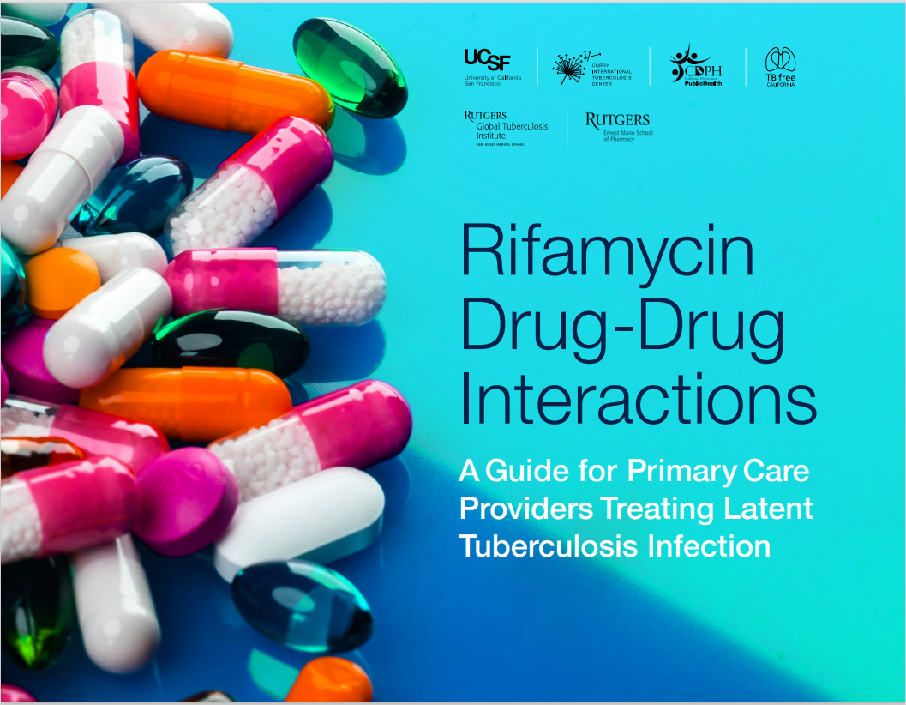
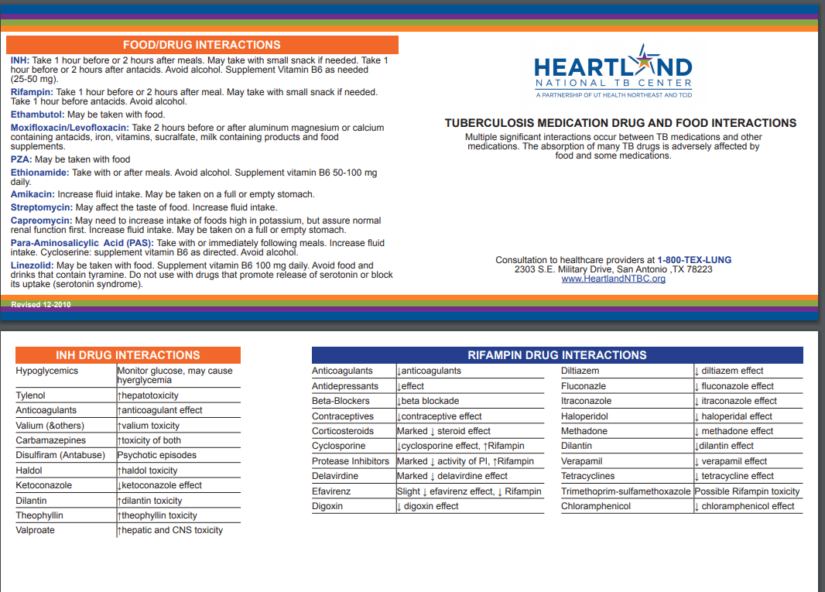

Drug Interaction Resources
DSHS Pharmacy Unit
Phone 512-776-2783
Pharmacists: Tracey Bronnenberg and Lester Mattson
Director: Sabrina Stanley
http://www.heartlandntbc.org/products/
https://www.currytbcenter.ucsf.edu/sites/default/files/2022-12/Rifamycin_2022.pdf
Drug Interaction Checker: Quickly Check Your Meds (drugs.com)

Slide 16
Care After Adverse Reactions
Address Patient Concerns
Reassure patient
Keep patient informed
Expert Consultation
Heartland TB Consultants
Resumption of TB medications
Drug Challenge
Document any Adverse Events
EF12-12274 Report of Serious Adverse Drug Reaction Resulting in Therapeutic Changes, Hospitalization or Death.
Notes:
To reiterate, please address any patient concerns and offer reassurance. When in doubt consult and restart medication by drug challenging. Remember any serious adverse event will require completion of the EF12-12274 form to notify central office.

Slide 17
Preventing Treatment Failure
Evaluate for Delayed Culture Conversion
Positive Cultures after 3 months of treatment
Reevaluate
Possible nonadherence to treatment (cheeking meds, emesis etc)
Possible unknown drug resistance
High burden of disease
Possible low serum drug levels
Seek consultation
Heartland consult prior to treatment failure
Notes:
What is treatment failure and how do we prevent it? Treatment failure is the lack of culture conversion after >4 months of treatment. It’s important to stay on top of your culture results. I personally start worrying if a patient has not converted after two months. If your patient’s culture results have not converted after 3 months of treatment its imperative to act on the delayed culture conversion. Re evaluate and verify that the patient is not cheeking medications or throwing up after DOT. The lack of culture conversion may be due to possible drug resistance, high burden of disease or low drug levels. Please seek consultation prior to treatment failure.

Slide 18
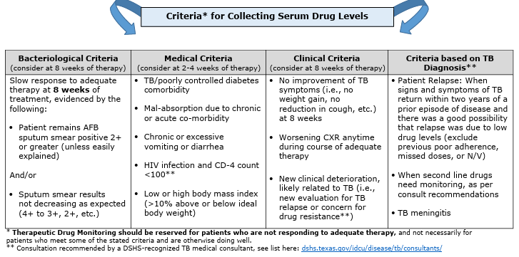
Therapeutic Drug Monitoring
Notes:
How do we assess for low serum drug levels? DSHS has the criteria for collecting serum drug levels on their website. Currently the University of Florida is processing our drug level specimens. Factors such as malabsorption, chronic diarrhea or vomiting, Low or high BMI and poorly controlled DM or HIV may impact drug levels. Your physician may decide to order drug levels for delayed culture conversion.

Slide 19
Bacteriology
Three consecutive sputum specimens
8-24 hours apart
At least one observed specimen
At least one early morning specimen
Ideally no more than 96hrs between 1st and 3rd specimen
Preferably prior to drug start date
Initial AFB positive specimens
Collect every two weeks until smear conversion
Initial AFB negative specimens
Collect monthly until culture conversion
End of Treatment Specimens
Collect one final early morning specimen
MDR-TB
At least one specimen in early morning monthly until end of treatment
Extrapulmonary TB Disease
Attempt to collect three consecutive specimens even if CXR is normal
Notes:
It’s important to know when and how to collect sputum specimens. They should be collected in a series of 3 consecutive specimens 8-24 hrs apart, with no more than 96hrs between the 1st and 3rd specimen. At least one specimen should be observed and collected in the early morning. Initial specimens should be collected prior to medication start date or no later than 7 days after initial dose. If baseline specimens are AFB (+) continue to collect every 2 weeks until smear conversion. If baseline specimens are AFB (-) continue to collect monthly until culture conversion. One final, end of treatment specimen should be collected in the early morning. If the patient is MDR then continue collecting at least one morning specimen monthly until end of treatment. Even if a patient has a normal CXR and is considered extra pulmonary there should be an attempt to collect 3 specimens at baseline. Please refer to your SDO’s for additional instructions.

Slide 20
Radiology
Final CXR – if previous CXR was abnormal
PRN CXR – Interruption of treatment or concern of progression
Initial CXR – All patients
2 month Follow up CXR – if baseline is abnormal
2V CXR for <18 y/o or HIV positive
Pregnant patients should not delay and use abdominal shield
Notes:
Radiology results are an important evaluation tool in documenting improvement of patient care. Every patient should have an initial CXR for baseline. If the baseline CXR is abnormal, a 2 month follow up CXR with comparison is needed. An end of treatment CXR is required if previously abnormal. In special circumstances such as interruption of treatment or progression of disease, a CXR should be obtained prior to resuming treatment. All pediatric and HIV positive patients, should have a 2V CXR performed. Pregnant moms should not delay a CXR with an abdominal shield even in the 1st trimester.

Slide 21
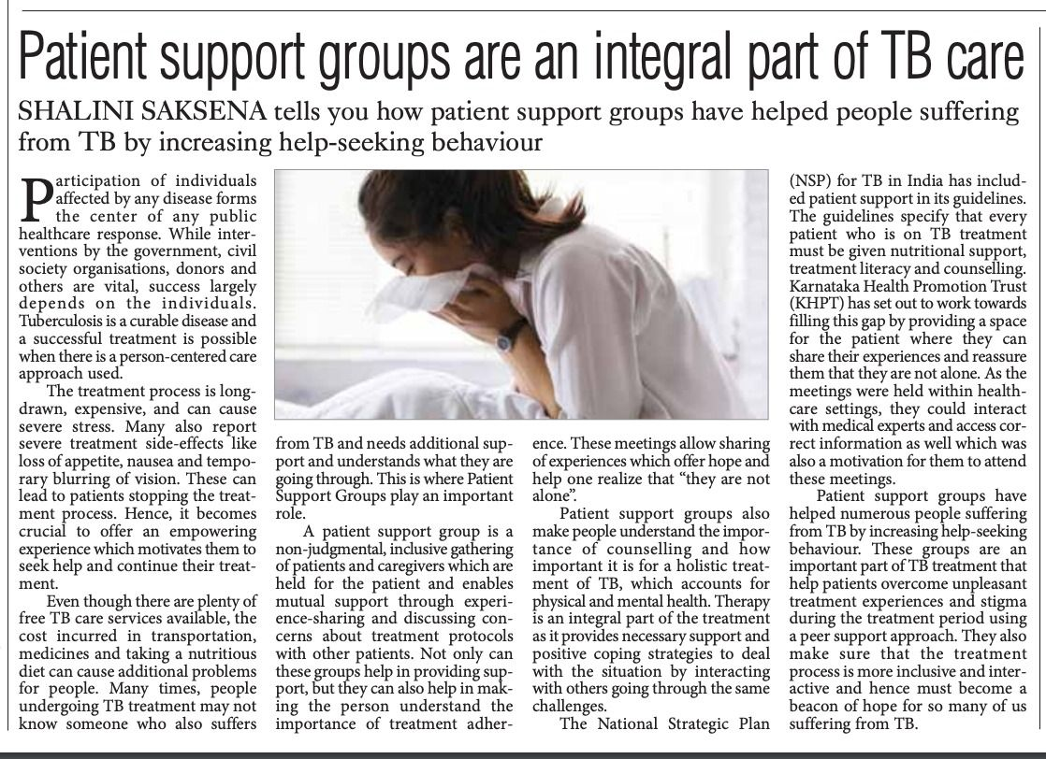
Support System
Private Medical Professionals
Public Health
Family
Friends
Mental Health
Support Groups
Food banks
Notes:
Let’s talk about Support Systems. Patients should be treated with dignity and respect. We want to give patients the choice to make informed medical decisions with confidence, privacy and respect of religious beliefs. We can increase patient knowledge by providing information in the patient’s own language, inform them about available services, their treatment, medications, potential side effects and social services available to assist with additional needs. Patients need access to good nutrition, transportation and a medical home. A good support system should include private physicians, public health, family, friends, access to mental health, food banks and support groups.

Slide 22
Reminders
No diagnostic test is 100% accurate
AFB (+) bacteriology results may be dead or live bugs
NAAT (+) results may occur in previously treated patients
MTB (+) patients may have a negative IGRA or PPD
Patients with a normal CXR may be MTB (+)
AFB (-) and culture negative patients may be clinical cases (pleural MTB, extrapulmonary)
Notes:
After all this, remember no diagnostic test is 100% accurate. You must look at the whole picture to effectively evaluate. AFB (+) bacteriology results may be dead or live bugs, NAAT (+) results may occur in previously treated patients, MTB (+) patients may have a negative IGRA or PPD, Patients with a normal CXR may be MTB (+), AFB (-) and culture negative patients may be clinical cases such as pleural MTB or extrapulmonary.

Slide 23
Conclusion
Monitoring is the key to successful outcomes.
Adherence prevents resistance and relapse.
Patient centered treatment promotes completion of adequate treatment.
Holistic approach improves patient response.
Notes:
In conclusion the key to successful outcomes is monitoring and looking at the whole picture. We can prevent resistance and relapse if we promote >80% adherence. When we involve our patient in his/her care with a holistic approach it improves patient responses and promotes completion of treatment.

Slide 24
Additional References
Texas Department of State Health Services:
TB Funded Programs | Texas DSHS
Texas Tuberculosis Manual
Texas Department of State Health Services Standing Delegation Orders for Tuberculosis Clinical Services Provided by Authorized Licensed Nurses, Fiscal Year 2025
TB Forms Resources | Texas DSHS
Rules and Regulations | Texas DSHS
TB Resources
Heartland National TB Center:
http://www.heartlandntbc.org/training/
Centers for Disease Control and Prevention:
https://www.cdc.gov/tb/media/pdfs/Self_Study_Module_7_Patient_Rights_and_Confidentiality_in_Tuberculosis_Control.pdf
Slide55.PNG (1280×720)
Additional Resources:
https://www.drugs.com/drug_interactions.html
https://www.currytbcenter.ucsf.edu/sites/default/files/2022-12/Rifamycin_2022.pdf
https://findahealthcenter.hrsa.gov/
Notes:
The resources available at Heartland and Curry are an invaluable tool available electronically or by ordering online.

Slide 25
Thank You! Maricela.Zambrano@dshs.texas.gov

