Slide 1
Tuberculosis Infection Control
Elizabeth Foy, MSN, RN
Nurse Administrator
Texas Department of State Health Services
Tuberculosis and Hansen’ Disease Unit
Heartland National TB Center
TB Nurse Case Management
September 17-19, 2025

Slide 2
Objectives
Identify three levels of an effective TB infection control program.
Identify when a TB patient is no longer infectious.

Slide 3
Infection Control Measures

Slide 4
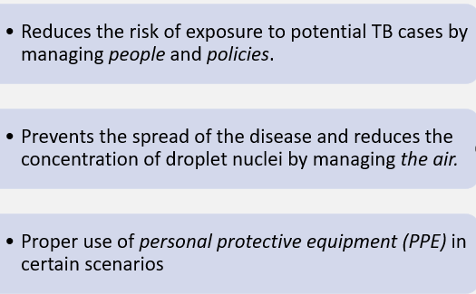
Hierarchy of Infection Control
Administrative Controls
Environmental Controls
Respiratory Protection
.

Slide 5
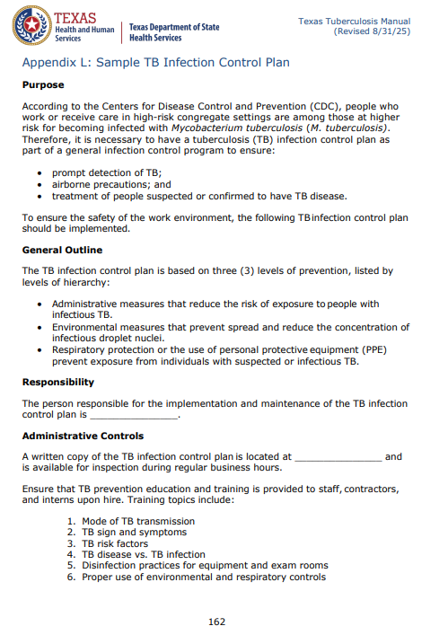
Administrative Controls
Primary Level
Recommended to reduce TB transmission through policy and practice:
  Assigning a person responsible for TB infection control
  Performing risk assessments
  Developing written TB infection control plans
  Triaging and separating people with TB symptoms
  Training and education of staff
  Screening healthcare personnel (HCP) for TB
https://www.dshs.texas.gov/sites/default/files/LIDS-TB/policies/TexasTBManual.pdf
Notes:
Administrative controls are the first and most important level of the hierarchy. These are management measures that are intended to reduce the risk or exposure to persons with infectious TB.
Assigning a person or a group (with expertise in TB, infection control, occupational health, environmental controls, and respiratory infection) the responsibility for TB infection control in the health care setting;
Conducting a TB risk assessment of the setting;
Developing and implementing a written TB infection control plan;
Ensuring the availability of recommended laboratory processing, testing, and reporting of results;
Implementing effective work practices for caring for patients who may have TB disease;
Ensuring proper cleaning, sterilization, or disinfection of equipment that might be contaminated with TB bacteria (e.g., endoscopes);
Educating, training, and counseling health care personnel, patients, and visitors about TB infection and TB disease;
Screening health care personnel for TB upon hire, baseline testing for TB infection, and re-evaluating personnel following occupational exposures to TB;
Applying epidemiology-based prevention principles, including the use of setting-related TB infection-control data;
Using posters and signs to remind patients and staff of proper cough etiquette and respiratory hygiene (covering mouth when coughing) or offering surgical or procedure masks to patients); and
Coordinating efforts between local or state health departments

Slide 6
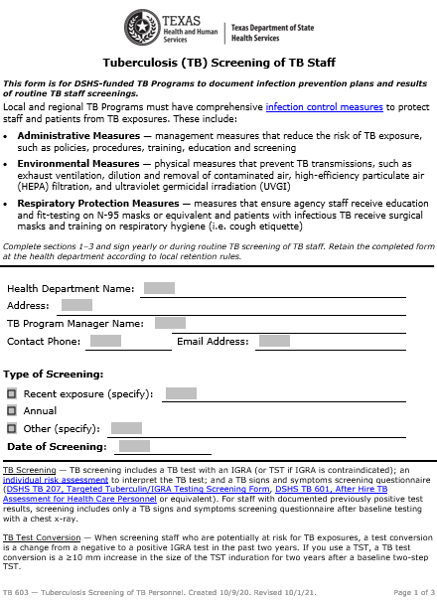
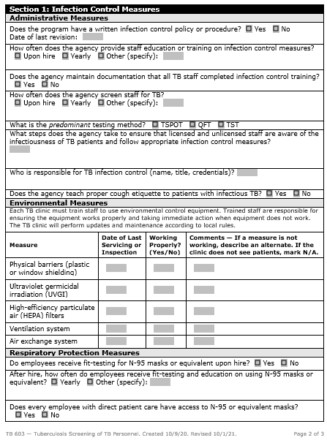
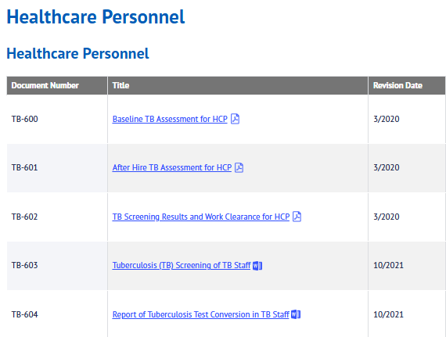
Healthcare Personnel TB Infection Control Forms
Source: www.texastb.org

Slide 7
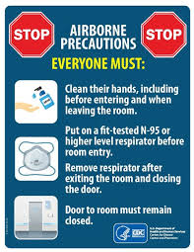

Environmental Controls
Second Level of Hierarchy
Prevents the spread of disease by reducing the number of droplets in the environment
Primary controls:
  Control source of infection – local exhaust, diluting and removing contaminated air, ventilation
Secondary controls:
  Controls airflow to prevent contamination in near-by areas – airborne isolation rooms (AII), high efficiency particulate air (HEPA) filtration, etc.
Notes:
Administrative controls are the first and most important level of the hierarchy. These are management measures that are intended to reduce the risk or exposure to persons with infectious TB.
Assigning a person or a group (with expertise in TB, infection control, occupational health, environmental controls, and respiratory infection) the responsibility for TB infection control in the health care setting;
Conducting a TB risk assessment of the setting;
Developing and implementing a written TB infection control plan;
Ensuring the availability of recommended laboratory processing, testing, and reporting of results;
Implementing effective work practices for caring for patients who may have TB disease;
Ensuring proper cleaning, sterilization, or disinfection of equipment that might be contaminated with TB bacteria (e.g., endoscopes);
Educating, training, and counseling health care personnel, patients, and visitors about TB infection and TB disease;
Screening health care personnel for TB upon hire, baseline testing for TB infection, and re-evaluating personnel following occupational exposures to TB;
Applying epidemiology-based prevention principles, including the use of setting-related TB infection-control data;
Using posters and signs to remind patients and staff of proper cough etiquette and respiratory hygiene (covering mouth when coughing) or offering surgical or procedure masks to patients); and
Coordinating efforts between local or state health departments

Slide 8
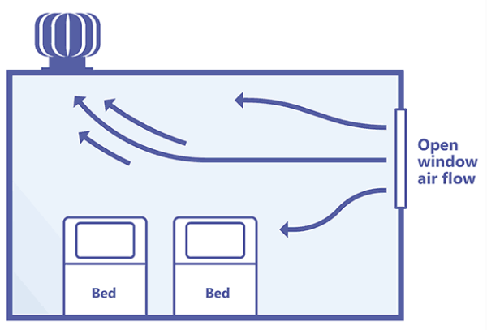
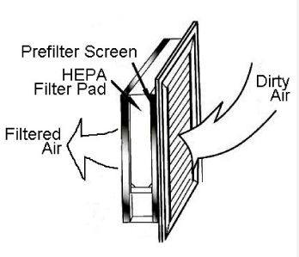
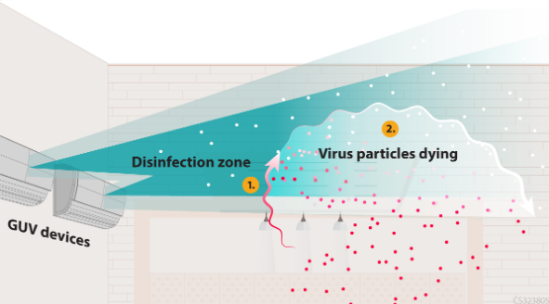
Environmental (Engineering) Controls
Reduce concentration of infectious bacilli in air in areas where contamination is likely:
Upper-room germicidal ultraviolet (GUV) systems – uses UV light to kill microorganisms
Ventilation systems (including natural, mixed-mode, mechanical ventilation and recirculated air through high-efficiency particulate air (HEPA) filters)
https://www.cdc.gov/niosh/ventilation/germicidal-ultraviolet/index.html
https://globaltb.njms.rutgers.edu/wmatbcourse/module07/07-06f.html
https://tbksp.who.int/en/node/2587

Slide 9
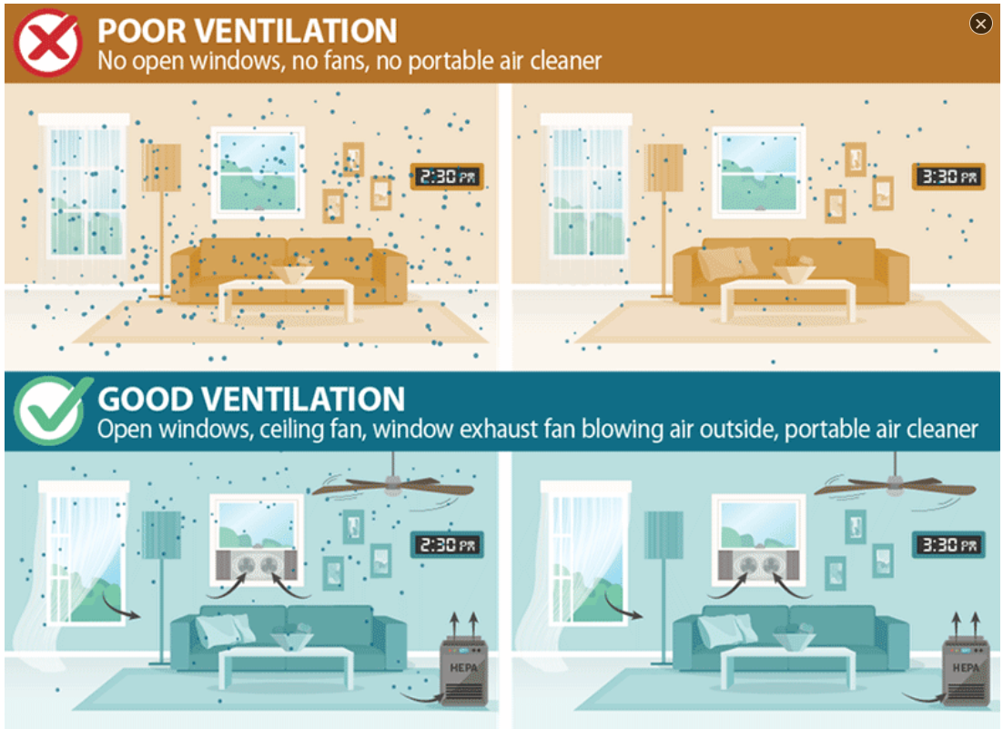
Examples of Ventilation in Home Settings
Photo Credit: https://www.cdc.gov/coronavirus/2019-ncov/prevent-getting-sick/improving-ventilation-home.html

Slide 10
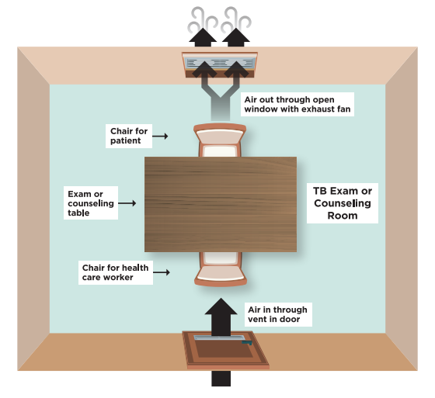
Natural Ventilation for Clinic Exam Rooms
Open doors, louvers, and windows to bring in fresh air from outside and allow for the escape of contaminated room air.
Fan-assisted natural ventilation in TB exam or counseling room.
Core Curriculum on Tuberculosis: What the Clinician Should Know (cdc.gov)
Notes:
Core Curriculum on Tuberculosis: What the Clinician Should Know (cdc.gov)

Slide 11
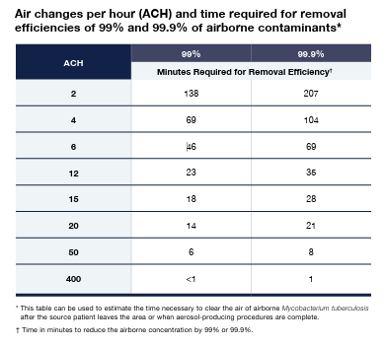
Airborne Containment Removal
Air change per hour (ACH) is the number of times that the total air volume in a room or space is completely removed and replaced in an hour.
www.currytbcenter.ucsf.edu/sites/default/files/2024-07/IC_2024_ONLINE.pdf
Notes:
Another environmental factor to consider is air change per hour. This is the number of times total airv volume in a space is removed per hour. For perspective, A large commercial jet aircraft typically provides about 20 air exchanges per hour during cruising.
In negative pressure rooms, the typical Air Changes Per Hour (ACH) is 12 ACH. Some sources suggest a range of 6-12 ACH, with 12 ACH being more common for new construction or renovations.

Slide 12
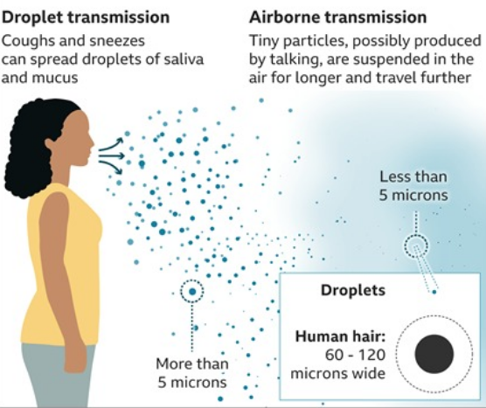
Respiratory Protection
Third Level of Hierarchy
Protect personnel who must work in environments with contaminated air.
Personal respiratory protection within framework of respiratory protection program.
      Protective masks
      Particulate respirators
https://tbksp.who.int/en/node/2587
Notes:
The third level of the hierarchy is the use of respiratory-protection control. It consists of the use of personal protective equipment in situations that pose a high risk of exposure to TB disease (such as entering rooms with or transporting patients with presumed or confirmed infectious TB disease, cough-inducing, or aerosol-generating procedures).
Use of respiratory protection equipment can further reduce risk the risk of infection of health care personnel with infectious droplet nuclei that have been expelled into the air from a patient with infectious TB disease.
The following measures can further reduce the risk of infection:
Implementing a respiratory protection program;
Training health care personnel on respiratory protection; and
Educating patients on respiratory hygiene and cough etiquette procedures (such as posters and signs to remind patients to cover their mouth when coughing or offering surgical or procedure masks to patients).

Slide 13
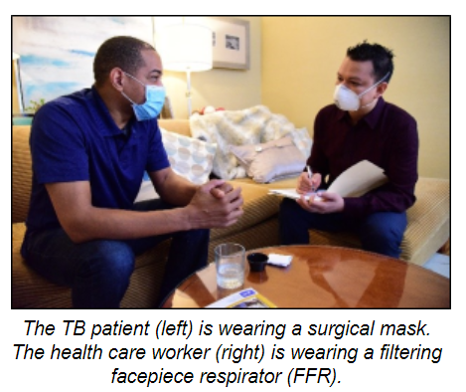
Respiratory Protection by Mask
Health care workers wear a filtering facepiece respirator (FFR) to prevent the inhalation of airborne droplet nuclei.
    FFR - better known as N95 respirator.
    FFRs are “single-use respirators”
Patients with infectious TB should wear a surgical mask to prevent expelling droplet nuclei into the air.
    Use of surgical masks on persons with TB has been shown to decrease transmission to guinea pigs by over 50%.
    N95s can increase work of breathing, as they have more resistance than surgical masks.
Photo Credit: https://www.cdc.gov/tb/webcourses/TB101/page1796.html
www.currytbcenter.ucsf.edu/sites/default/files/2022-12/IC_2022_PPE_December_2022.pdf
Notes:
The U.S. Centers of Disease Control and Prevention says health care workers can wear an N95 mask up to five times. But experts say how often the average person can safely wear one will vary depending on how it’s used.
Using the same mask to run to the grocery store, for example, is very different than wearing it all day at work.
“single-use respirators” - a respirator that is entirely discarded after excessive resistance, sorbent exhaustion, or physical damage renders it unsuitable for further use.

Slide 14
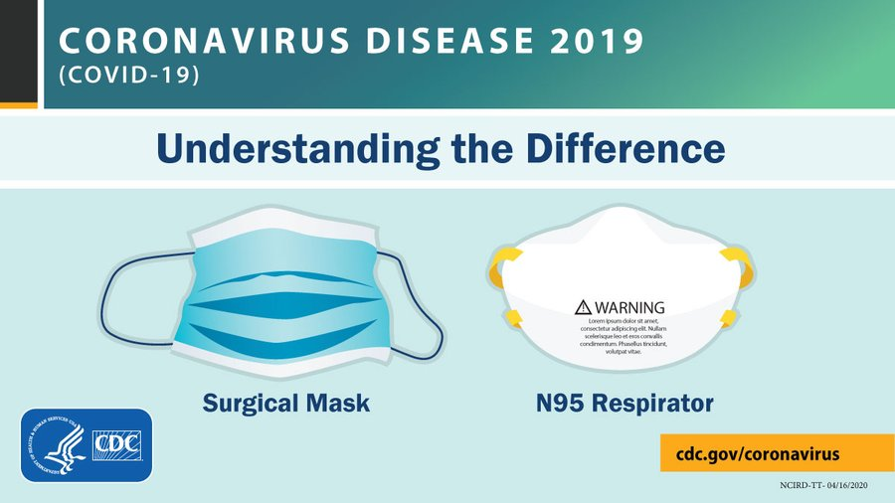
Understanding the Difference Between Masks
Surgical Mask for the patient:
If a TB patient is wearing an N95 they can have increased respiratory distress.
N-95 Respirator for the HCW:
National Institute for Occupational Safety and Health (NIOSH) requires fit testing to ensure fit.
Photo Credit: http://www.health.state.mn.us/divs/idepc/dtopics/infectioncontrol/cover/hcp/hcpposter.html IC#141-1428
Notes:
Patients with infectious TB should wear a surgical mask to prevent expelling droplet nuclei into the air.
There may be circumstances where it may be reasonable to ask a person with TB to temporarily wear a surgical mask inside an AIIR (e.g., if a procedure is being done close to the head of that person). However, due to the benefit of rapid dilution ventilation in the AIIR, constant use of a mask by a patient inside an AIIR is not normally required.
Having pts use a N-95 vs surgical mask can increase respiratory distress.
Health care workers should wear a filtering facepiece respirator (FFR) N95 mask to prevent the inhalation of airborne droplet nuclei.
N95 respirators are tested and certified by the National Institute for Occupational Safety and Health (NIOSH) to ensure they filter at least 95% of airborne particles.

Slide 15
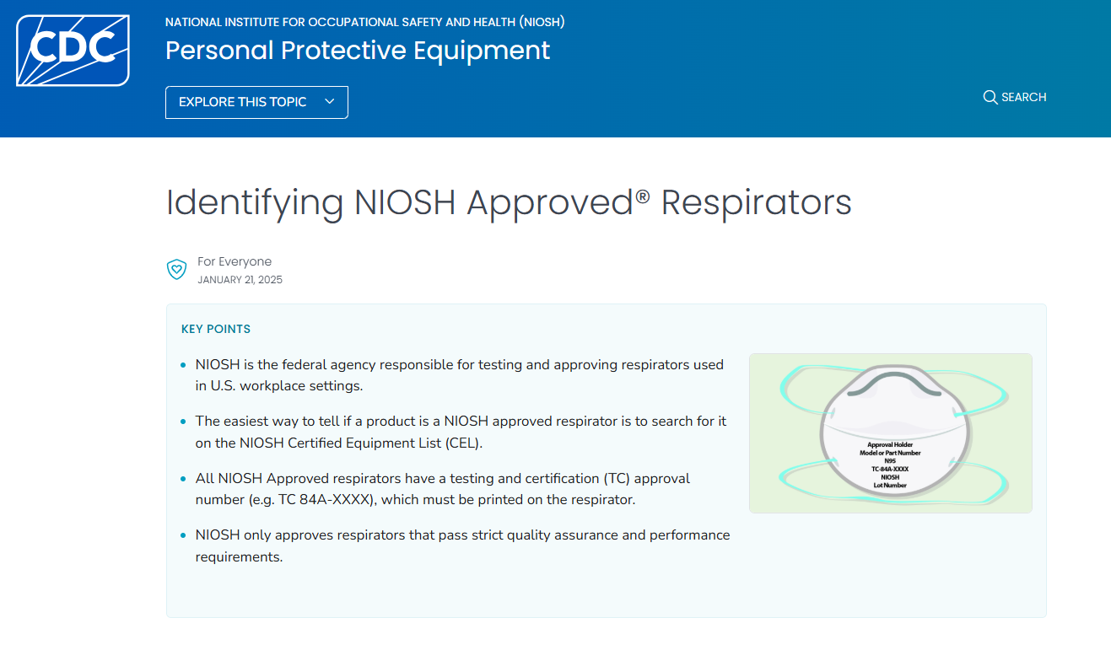
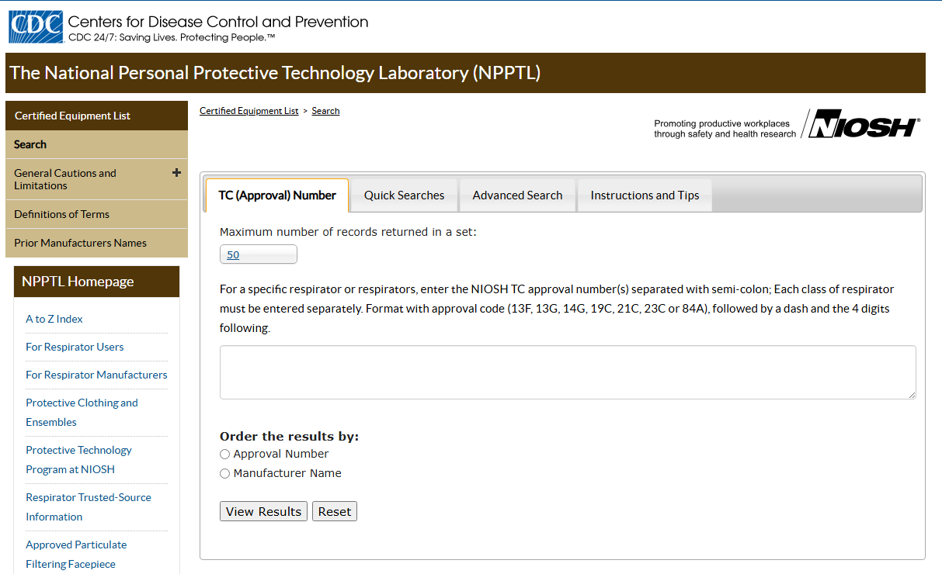
Using NIOSH Approved Respirators
All NIOSH approved respirators come with a NIOSH approval label on or within the respirator packaging. This label includes a testing and certification (TC) approval number (e.g., TC 84A-XXXX).
https://www.cdc.gov/niosh/ppe/niosh-approved-respirators/index.html
https://wwwn.cdc.gov/niosh-cel/
Notes:
Clinic employees are required to wear NIOSH-certified N-95 or equivalent respirators that have been designed to filter out infectious particles as the wearer inhales.

Slide 16
Factors Associated with Infectiousness

Slide 17
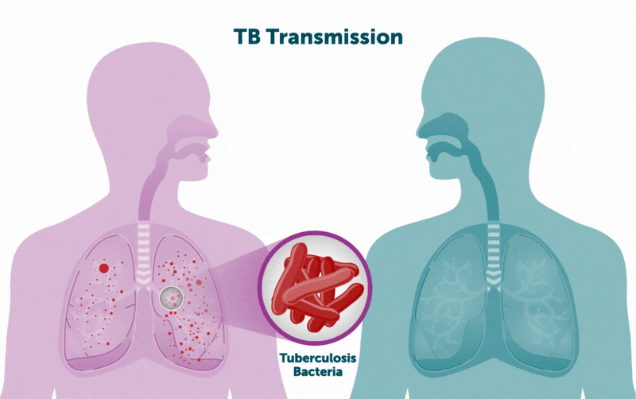
Identifying Factors Associated with Infectiousness
TB spreads person to person via shared air
Do they have TB disease?
Does the site of disease provide
opportunity for airborne spread?

Slide 18
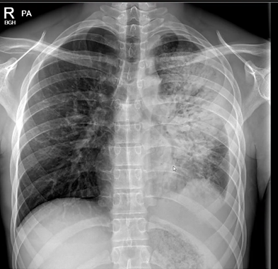
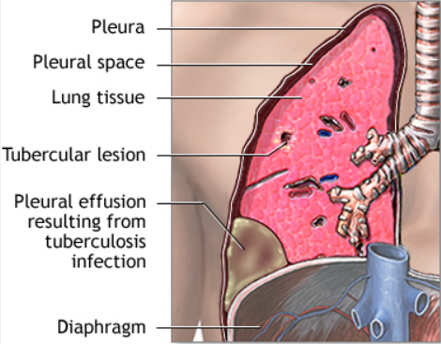
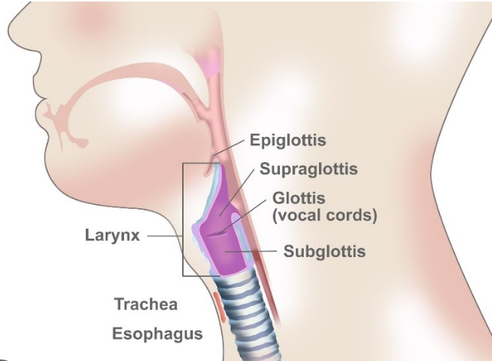
Sites of TB Disease Impact Infectiousness
Laryngeal TB
Pulmonary TB with or without cavitation
Pleural TB - not considered infectious unless pulmonary or laryngeal involvement
Notes:
Pleural TB is the 2nd most common form of extrapulmonary TB after lymphatic involvement.

Slide 19
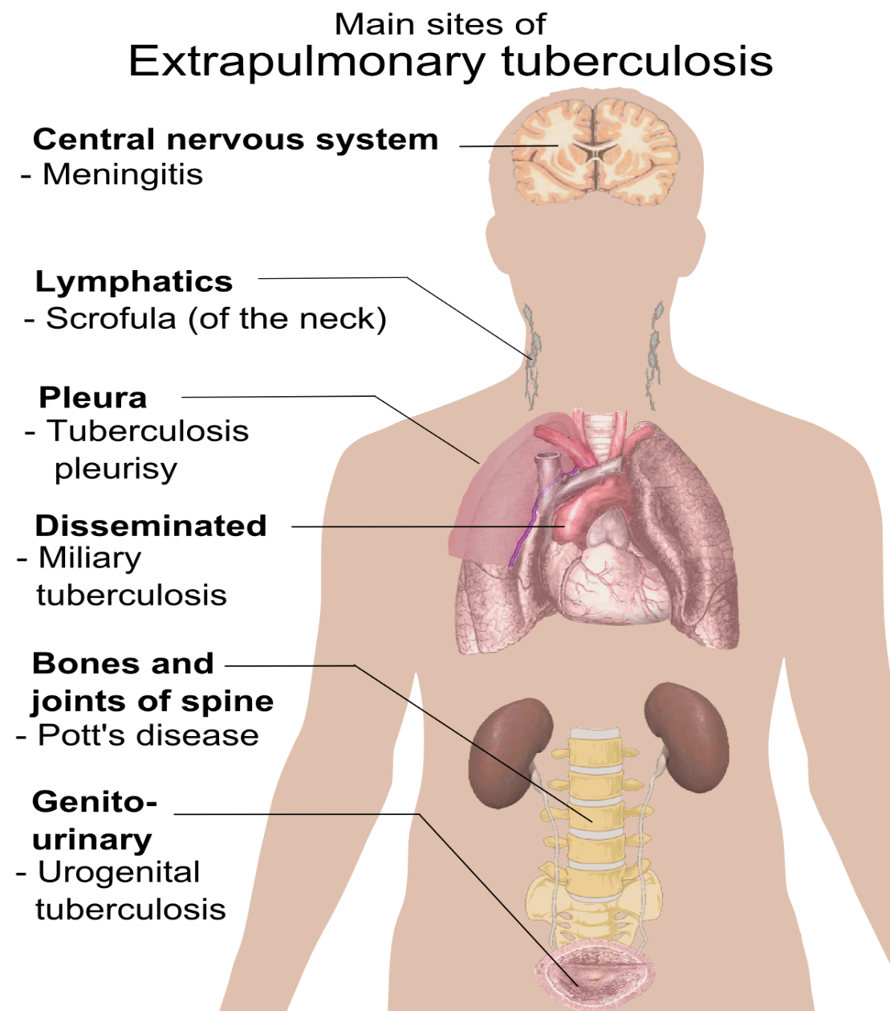
Extrapulmonary TB
Sites of the body outside the lungs
Not considered infectious except in procedures where aerosols can be generated
Pulmonary TB must be ruled out:
  Obtain three negative sputum smears, a negative nucleic acid amplification (NAA), normal radiology with no respiratory symptoms
Photo credit: https://commons.wikimedia.org/wiki/File:Extrapulmonary_tuberculosis_symptoms.png
Notes:
Could have case of both pulmonary and extrapulmonary TB

Slide 20
Risk of Infectiousness
Increased Risk | Decreased Risk
Cavitation, sputum smear positive Laryngeal TB Coughing (3+ weeks), cough inducing procedures, aerosolizing procedures Small enclosed space Poor ventilation Increased airspace sharing time (duration/frequency during infectious period) Not on effective therapy for TB | Good cough hygiene Sputum smear negative Appropriate and effective TB therapy
Notes:
Using nebulizer to get induced sputums.
Irrigating a wound which could cause aerosolization of the bacteria.
Some extrapulmonary lesions could be draining and therefore contagious - If the drainage fluid from a draining TB lesion is aerosolized (e.g., by coughing, talking near the drain, or irrigating the wound), the bacteria can be inhaled by others and cause infection. Or direct contact with draining lesion with open skin wounds or mucous membranes can lead to infection.
large numbers of droplet nuclei containing M tuberculosis bacteria to be generated during the surgical drainage, débridement, and syringe irrigation of abscesses caused by M tuberculosis. These procedures can produce such a high concentration of droplet nuclei that the ventilation system cannot remove them fast enough to protect the surgical staff from infection.
Talk to your patient and get a good medical history from them. It’s through the nursing assessment and subsequent contact investigation that you’ll get a better understanding of how infectious your patient is.
Standard Therapy for Drug Susceptible TB
Regimens without Isoniazid (INH)
Regimens without a Rifamycin
Patient must be on:
At least isoniazid (INH) and rifampin (RIF)**
with or without ethambutol (EMB), pyrazinamide (PZA).
Patient must be on:
Fluroquinolone (FQN)/ RIF**/EMB/ PZA
OR
RIF**/EMB/PZA
OR
FQN/RIF**/EMB
Seek medical consultation regarding effective regimens that do not include a rifamycin, as per DSHS TB Unit’s SDOs.
To be considered effective, the regimens must be:
Administered by the R/LHD via directly observed therapy (DOT) (can be video DOT [VDOT]), consecutively with no missed doses.
Considerations may be made by the R/LHD to accept in-patient medication administration records (MARs) on a case-by-case basis.
Well-tolerated by the patient, including no vomiting, with each dose fully taken and ingested.
Likely to be effective, based on presumed M.tb specimen susceptibility**
Patient is not likely to be drug resistant if starting multi-drug therapy with at least INH and RIF***.

Slide 21
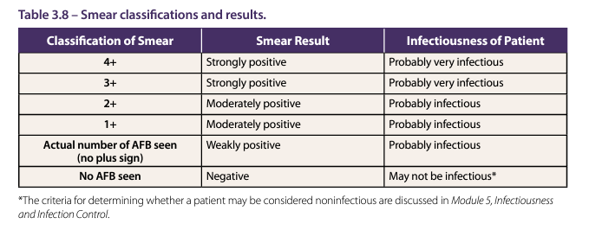
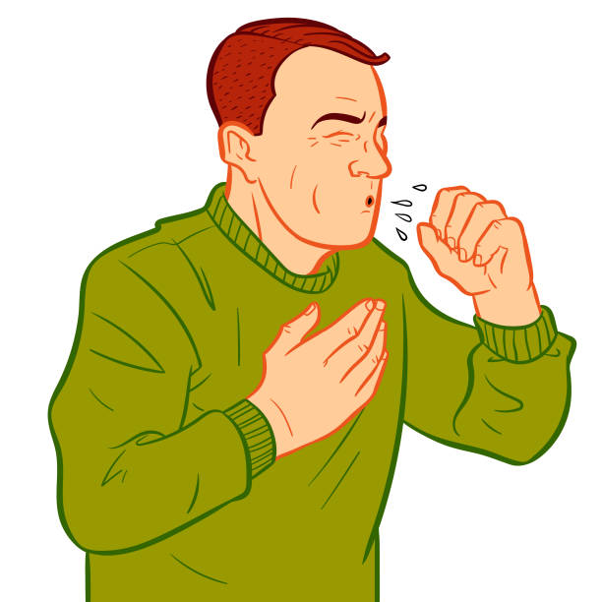
Pre-Therapy Sputum Smear Results and Degrees of Infectiousness
www.cdc.gov/tb/media/pdfs/Self_Study_Module_3_Testing_and_Diagnosis_of_Latent_TB_Infection_and_TB_Disease.pdf

Slide 22

Nucleic Acid Amplification Testing (NAAT)
Molecular test used to detect the DNA (deoxyribonucleic acid) of M. tb in a sputum or other respiratory sample
Tiny amounts of DNA/RNA are amplified (copied) until there is enough for easy detection
  Polymerase Chain Reaction (PCR) is a common form of NAAT.
GeneXpert® MTB/RIF test is a PCR that simultaneously detects MTBC and the genetic mutation that confers rifampin (RIF) resistance.
www.health.pa.gov/topics/Documents/Diseases%20and%20Conditions/TB/TB%20Insights_NAAT_FINAL_07.26.19.pdf
Notes:
A positive AFB smear test tells us the patient is infected with a mycobacterium. However, it doesn’t tell us if that mycobacterium is MTB or some other mycobacterium – NTM. That’s where the NAAT comes in.

Slide 23


TB Disease In Children
Typically, paucibacillary TB.
Children don’t typically have a productive cough or are unable to provide a sample.
Even if they do, their samples are less likely to contain visible TB bacteria – even when the bacteria are present in their bodies.
*Unless adult type presentation (cavity, smear positive), usually not considered to be infectious.
Children <10 years not considered infectious*
Perform source case investigation:
  How did they get exposed to TB?
  Is there an accompanying adult with them that has infectious, untreated TB?
Notes:
The U.S. Centers for Disease Control and Prevention (CDC) typically considers individuals under 15 years of age as children or pediatric cases of tuberculosis (TB).
This definition is commonly used for surveillance and reporting purposes. However, in some clinical contexts or guidelines, "pediatric" can extend up to 18 years of age, depending on the setting (e.g., hospitals or pediatric clinics).
Per TX SDOs. Page 10 - Verify appropriate weight-based dosage calculations for all patients. For purposes of dosage calculations and treatment regimen selection, a patient is considered a child if the patient is less than 18 years old and should receive pediatric weight-based dosing of medications as described in Attachment 7: Medications.

Slide 24
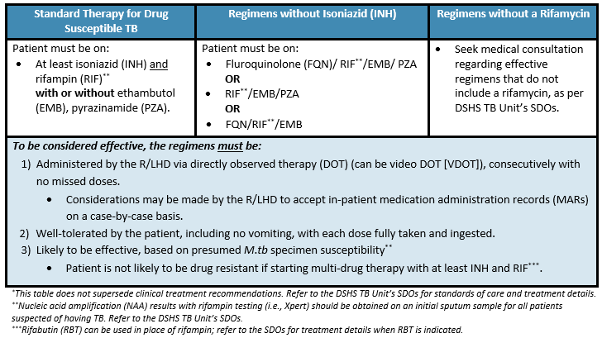
Effective TB Therapy

Slide 25
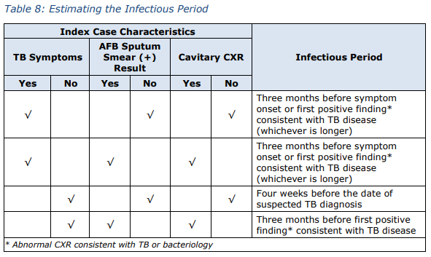
Determining the Infectious Period
Start:
  3 months before first respiratory symptom or first diagnostic finding depending on respiratory symptoms, smear status, and CXR status
  If smear negative, asymptomatic (non-cavitary): 1 month before date of suspected diagnosis
End:
  Once the patient is no longer considered infectious.
  For contact investigation purposes: three negative sputum smears, symptom improvement, effective treatment for 10-14 doses.

Slide 26
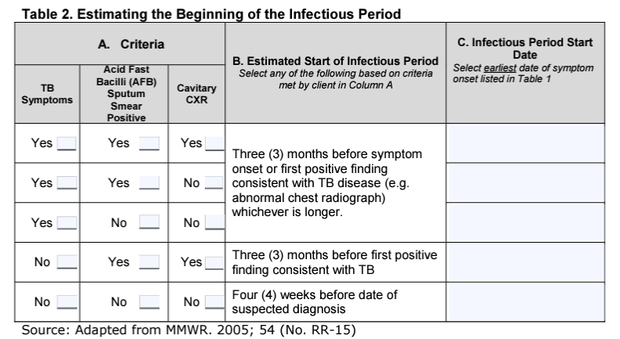
TB 425 – Determining the Infectious Period Tool
https://www.dshs.texas.gov/tuberculosis-tb/texas-dshs-tb-program-tb-forms-resources

Slide 27
When Is Isolation Discontinued?

Slide 28
Considerations Before Discharge
Patient returning to a congregate setting without negative pressure room.
Patient does not have a safe location while on TB isolation.
TB medication coordination has not been established.

Slide 29
From the Hospital to the Home
Follow-up with local TB program and DOT has been arranged
All household members, who are not immunocompromised, have been previously exposed and evaluated
Patient is willing to not travel outside the home until negative sputum smears, other isolation release criteria
No infants or children younger than 5 years of age or persons with immunocompromising conditions are present if evaluation has not been completed (an therapy not started if it is necessary)

Slide 30
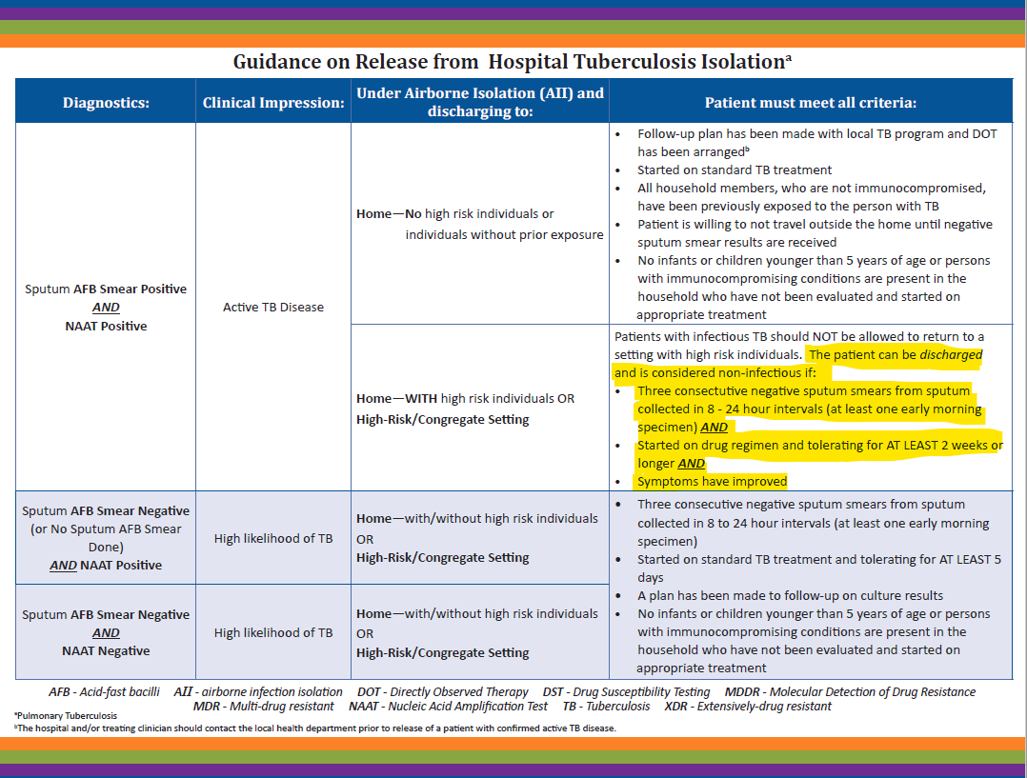

Discharge from Hospital to Home
https://www.heartlandntbc.org/wp-content/uploads/2021/12/guidelines_home_hospital_infectious_patients.pdf

Slide 31
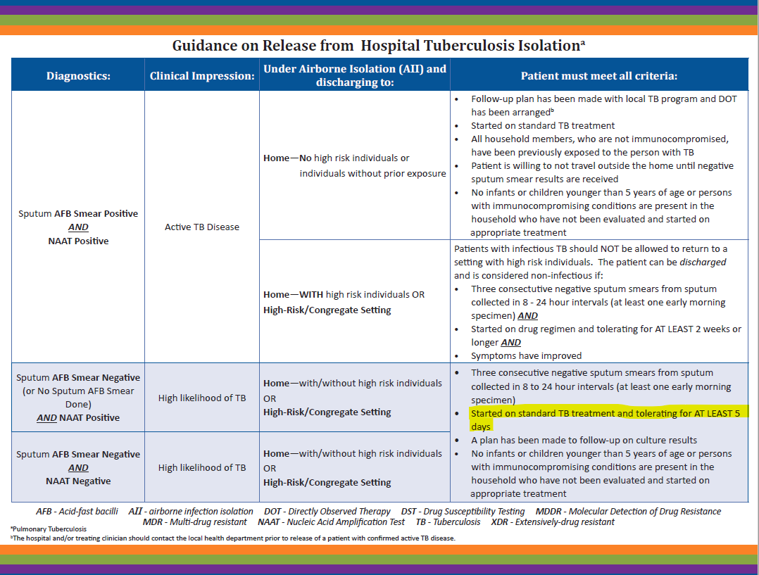




https://www.heartlandntbc.org/wp-content/uploads/2021/12/guidelines_home_hospital_infectious_patients.pdf
Notes:
Would an extrapulmonary case fall into this category?

Slide 32
Current Practice for Community-Based Patients Released from Isolation
If the patient never had a positive sputum smear, release after:
Three negative sputum smears
5 doses of TB medications via DOT
No worsening TB symptoms
Compliance with DOT
If the patient was initially sputum smear positive, release after:
Three negative sputum smears
10-14 doses of TB medications via DOT
No worsening TB symptoms and
Compliance with DOT

Slide 33
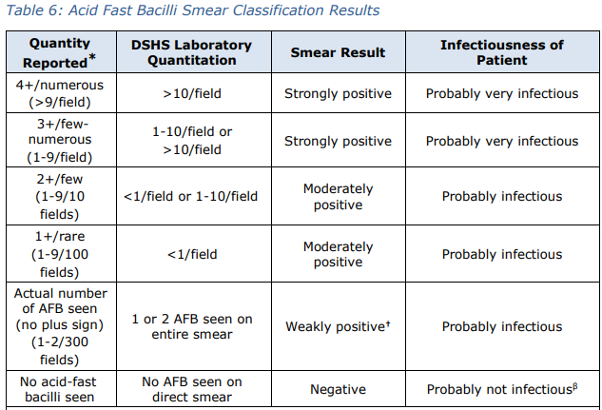

What Current Practice Assumes
Assumption: AFB sputum smear positivity = contagiousness even after starting TB therapy

Slide 34

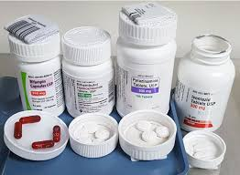
What New Evidence Suggests
Duration of TB therapy reduces and eventually eliminates infectiousness despite positive AFB sputum smear results.

Slide 35

Newly Released TB Isolation Guidelines, 2024
Guidelines for Respiratory Isolation and Restriction to Reduce Transmission of Pulmonary Tuberculosis in Community Settings
  Evidence found that tracking AFB sputum smear results after treatment initiation was not likely the predominant indicator of TB infectiousness
  Placing patients in prolonged isolation posed an increased risk of negative mental health outcomes.
  Starting effective anti-TB therapy (ATT) rapidly reduced TB infectiousness.
  In most cases, the TB isolation and restriction period could be reduced to just a few days for patients in community settings.
Notes:
On April 18, 2024, National Tuberculosis Coalition of America (NTCA) released updated

Slide 36
Scenarios

Slide 37

Scenario #1
A 45-year-old man with confirmed pulmonary TB was admitted to the hospital and started on standard 4-drug TB therapy 4 days ago. He is clinically improving and is now afebrile with no cough.
What else do you need to know before he can be released from AII?
Can he be discharged on isolation and take the remaining doses at home?
Would it make a difference if you knew he has a 2-month-old child at home who the health department hasn’t yet been able to screen?
What should occur with the patient or the 2-month-old child before he can be discharged home?
Notes:
Since his sputum smears were originally positive, he would need 14 days of RIPE AND 3 negative sputum smears AND clinical improvement before he can be released from AII.
However, he could potentially be released home on home isolation.
However, discharge planning raises additional concerns:
Household Risk: His home environment includes a very high-risk individual:
A 2-month-old infant, who is vulnerable to severe disseminated TB
What should occur with the patient or the 2-month-old child before he can be discharged home?
Patient would have to achieve smear conversion and 14 DOT doses, OR
Child would need to be screened for TB with an IGRA or TST and CXR and then placed on appropriate treatment (active, LTBI or window).

Slide 38
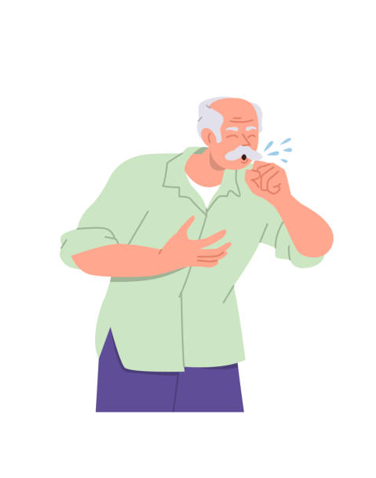
Scenario #2
64-year-old, U.S. born male. History of foreign travel while serving in the military, including deployments in Asia. Current smoker. Hospitalized with chronic cough, hemoptysis. Sputum 3+ on smear. History of untreated M. avium.
Results: NAAT did NOT detect MTB
Can they release patient from AII
  Obtain a second NAAT. If that too is negative and MTB is not highly suspected, yes, most likely a tubercular mycobacteria (NTM).
Notes:
Since his sputum smears were originally positive, he would need 14 days of RIPE AND 3 negative sputum smears AND clinical improvement before he can be released from AII.
However, he could potentially be released home on home isolation.
However, discharge planning raises additional concerns:
Household Risk: His home environment includes a very high-risk individual:
A 2-month-old infant, who is vulnerable to severe disseminated TB
What should occur with the patient or the 2-month-old child before he can be discharged home?
Patient would have to achieve smear conversion and 14 DOT doses, OR
Child would need to be screened for TB with an IGRA or TST and CXR and then placed on appropriate treatment (active, LTBI or window).

Slide 39
Scenario #3
38-year-old U.S. born female with a history of volunteering in medical settings in Africa. You have just received a lab report that an intestinal biopsy sample has been identified to have MTB. Can she continue to work at a daycare?
Chest Xray is normal. What is the next step?
Sputum are smear negative x 3, NAAT negative. She has no pulmonary symptoms. What other details would you want to know before determining when she can return to work?
Notes:
**Ruling out pulmonary TB includes obtaining three negative AFB sputum smears, a negative nucleic acid amplification (NAA), normal radiology, with no respiratory symptoms. Refer to DSHS TB Unit’s Standing Delegation Orders (SDOs) for more details.

Slide 40
Final Points
Ensure your clinic or hospital setting has appropriate infection control measures in place.
It’s important to determine your patient’s risk of infectiousness.
Become familiar with guidelines on when it is safe to allow your patient to return to work/school/community activities.
Be mindful of providing patient-centered care, especially while helping them through their infectious period.

Slide 41

Questions?
TB Infection Control
Elizabeth Foy, MSN, RN
Elizabeth.foy@dshs.Texas.gov

