Slide 1



TB & comorbidities
Andrew DiNardo, MD PhD
Baylor College of Medicine
Radboud UMC
Assistant Professor
Infectious Diseases
dinardo@bcm.edu

Slide 2
Take home points:
Diagnosis can be more challenging if disseminated disease
Make use of TDM!
Clinical pharmacists: use them!
Steroids help: Antibiotics are required, but not sufficient
Both Hyper-inflammatory +/- anergic
Cure ≠ improved health

Slide 3
First presentation
Dec 2022
32 yr M, recently emigrated from Venezuela via the Darrien Gap, presented with 20lb weight loss, anorexia, productive cough, diarrhea, and abdominal pain. Diffuse 1-2 cm violaceous lesions on skin.
Multiple sub-cm nodules in RUL on chest CT
New diagnosis of HIV/ AIDS w VL log5, CD4 of 12, HLA-b5701 negative, HBsAg+, Gene Xpert+, Stool AFB smear+
Started on RHZE+azithromycin (1200mg RIF). 2 weeks later BID DTG & Truvada started
Empiric prednisone not started. Would anyone have?

Slide 4
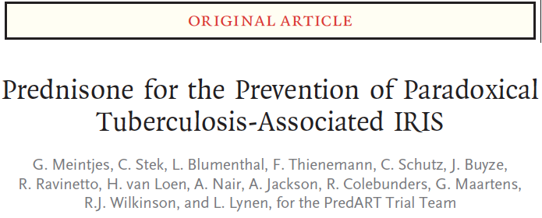
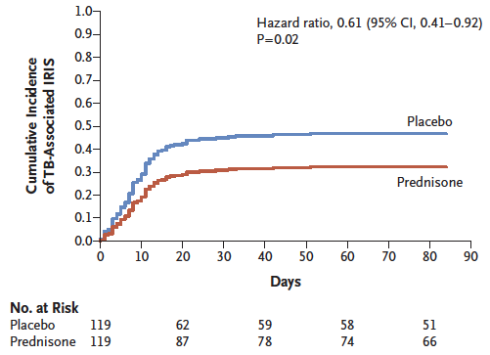
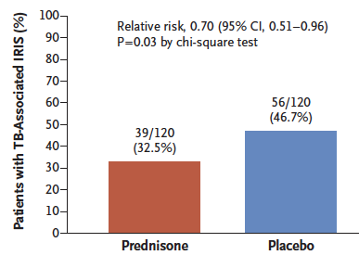
For high-risk individuals, should we be giving prophylactic prednisone to prevent IRIS?

Slide 5
Jan 2023
Worsening abd pain, re-admitted, found to have contained perforated duodenum, and CT concerning for multiple enteric-enteric fistulas.
GI EGD & c-scope: no evidence of KS by endoscopy
Previous stool & sputum cultures both with M. bovis. Repeat sputum and stool cultures later culture positive.
Switched to LZD, Moxi, RIF, Amikacin. (INH discontinued due to hepatotoxicity).
Persistent fevers, anorexia, and Abd pain.
Management? Steroids, tocilizumab, or anakinra?

Slide 6
Antibiotics kill bacteria
Antibiotics do not adequately address inflammation
Add anti-inflammatories if necessary
NSAIDS
Steroids
Anakinra
Infliximab

Slide 7
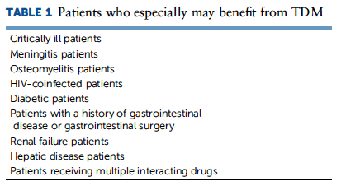
Notes:
After years of cod liver oil, sanitoriums, and ineffective homeopathic medicines, Selman Waksman received the Nobel Prize in 1952 for the discovery of the first anti-tuberculosis (TB) antibiotic therapy, streptomycin. Unfortunately, it was quickly recognized that mono and dual antibiotic therapy would result in drug resistance,¹ prompting the initiation of the classic four drug regimen which remains the recommended approach for drug-susceptible TB today. Since 1972, studies have documented that drug penetration into the center of the TB cavity, where the highest inoculum of Mycobacterium tuberculosis (Mtb) organisms persist, is low, especially in the cavity walls.² A typical cavity of an individual with TB has approximately 10⁶ to 10⁹ Mtb organisms, with less than 0.01%, an estimated 10² to 10³, being resistant to isoniazid or rifampicin.³ This creates a challenge to have an appropriate treatment plan that minimizes side effects but ensures effective drug levels that can reach Mtb organisms and eradicate them.

Slide 8
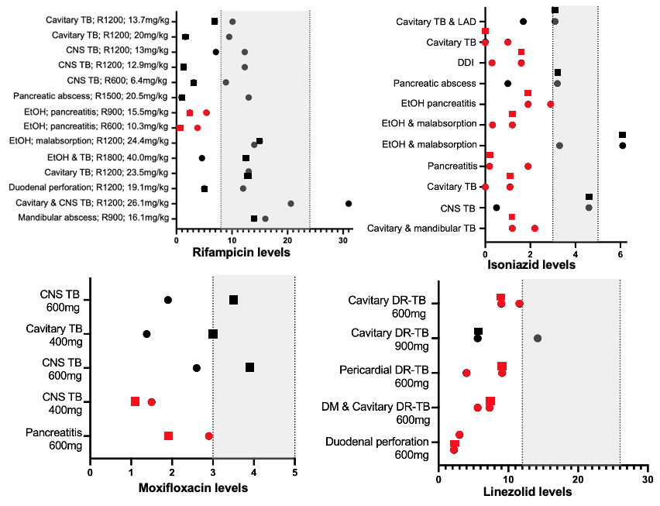
Sub-therapeutic
PMID: 39754280

Slide 9

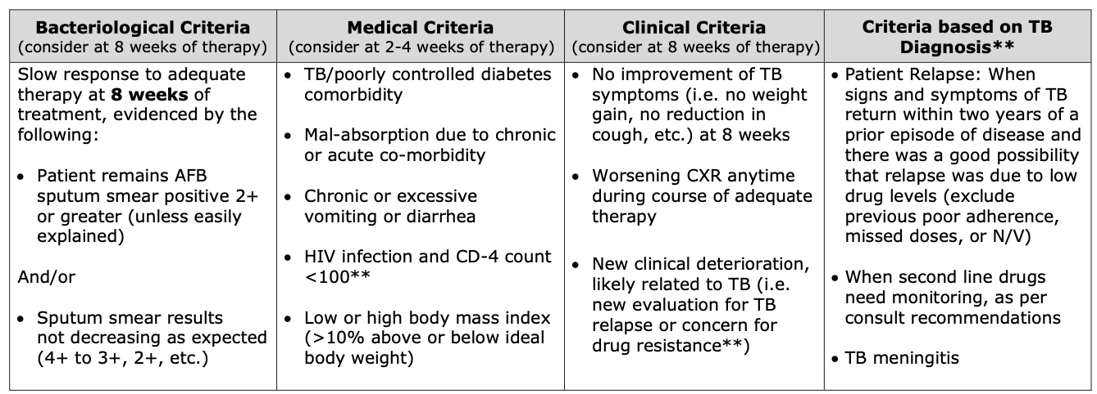
Therapeutic Drug Monitoring
>50% TB pts need dose adjustment when starting HRZE w 1200mg RIF
https://www.dshs.texas.gov/sites/default/files/IDCU/disease/tb/forms/PDFS/TherapeuticDrugMonitoringProcess.pdf

Slide 10
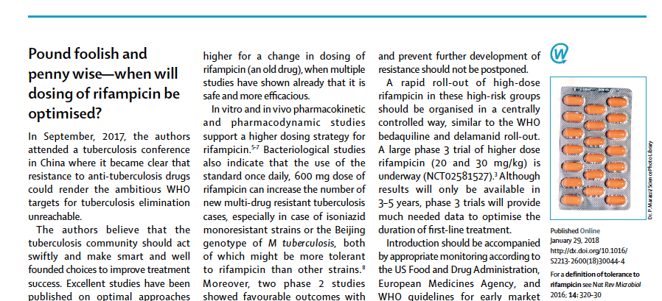

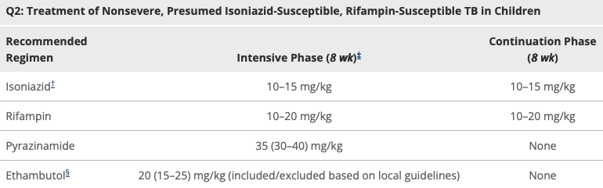

1972
2025 TB Treatment Guidelines
2025

Slide 11
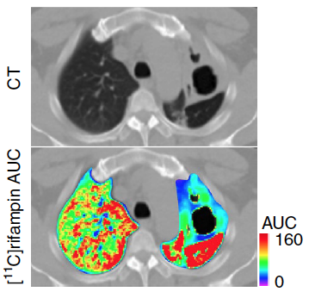
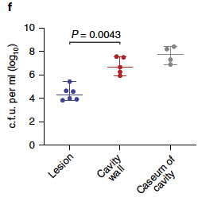
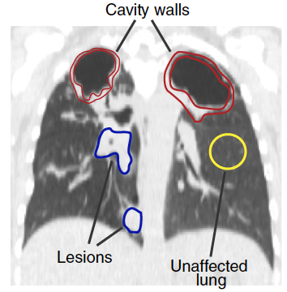
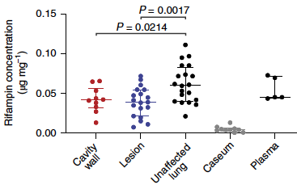
Dose rifampicin 20mg/kg; liver toxicity is not dose dependent
Ordonez & Jain 2020
Caseum - highest CFU
- lowest drugs

Slide 12
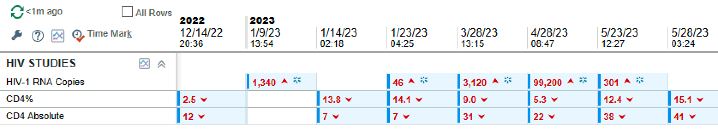
May clinic
Ryan White paperwork not filled out; ART held for >1 month and then restarted
Weeks after restarting ART, he has worse headache of his life
Re-admitted & diagnosed with CNS histoplasmosis; s/p 3 wks amBisome and transitioned to itraconazole
Sputum & stool AFB smear & culture negative since Feb
ATT on itraconazole? TB pan-sensitive. DILI on INH. Switched to Linezolid and moxifloxacin

Slide 13
TB & HIV; some DDI
Engage a clinical pharmacist if possible!
Dr. Dominque Brewster at Quinton Meese clinic
RHZE: BID dolutegravir
Is Biktarvy ok? INSIGHT. Avoid for now.
BPLM
RIF: CYP450 induction: ↓ Azoles: switch to non-RIF regimen; consider isavuconazole; PharmD; TDM

Slide 14
CG: Finishing Case 1
Scrofula IRIS at month 12 of ATT→ more prednisone
~2-3 yrs later: permanent neuropathic pain
Working landscaping
Smiling!
HIV VL undetectable
No further KS treatment other than ART

Slide 15
HIV & TB summary
Often disseminated
Often multiple organs
Frequent IRIS, can be fatal or debilitating
Get TDM
Don’t be afraid of steroids
Diagnosis more challenging due to “paucibacillary sputum”
Don’t rely on diagnostic tests requiring immunity (TST, QFT, Tspot)

Slide 16
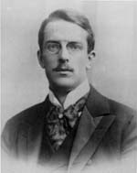
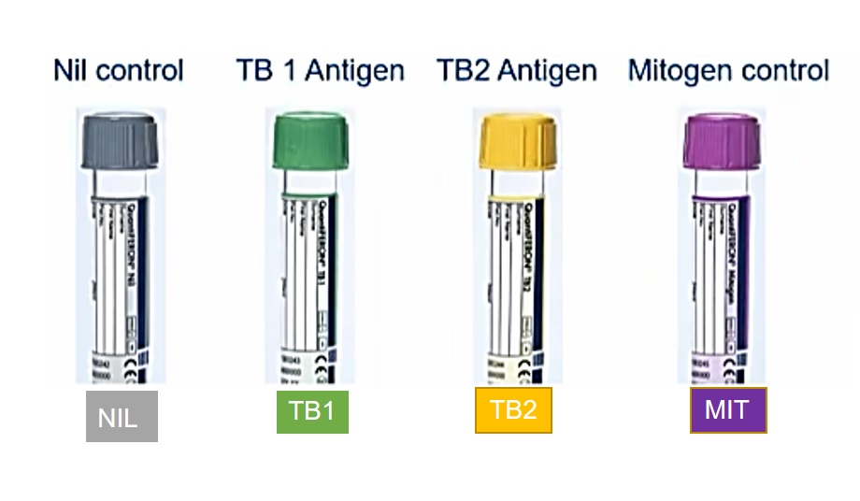
Anergy & tests of infection
Pirquet
5-45% of microbiologically confirmed TB patients are anergic at diagnosis. Good or bad?

Slide 17
Duration of ATT for HIV/TB?
Do all cases need 9 months?
Only pulmonary or extrapulmonary
Follow up imaging to confirm abscesses resolve

Slide 18
When to start ART during TB?

Slide 19
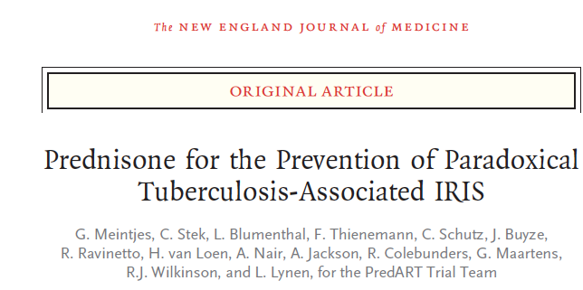
When to start ART during TB?
CNS TB: beware fatal IRIS: start
Severe disease near certain organs
If “simple” HIV-TB: 1-2 weeks pending ADAP
If not simple, especially CNS
Delay 4-6 weeks
Consider pre-emptive steroids

Slide 20
IRIS: How much steroids is enough?
Dexamethasone 8mg q 8 hours, taper 1 mg per week for 24 weeks
Or
Prednsione 40mg/ day x 2 weeks x 2 weeks; 20mg x 2 weeks
Or
Based on symptoms, signs, and response to steroids?

Slide 21
TB & Diabetes
Surpassed HIV as most common comorbidity assoc w TB worldwide
Hyper-active lymphocytes with myeloid immune deficiency
Diminished glutathione stores; manage ROS worse
Worse outcomes; increased mortality
More MDR TB on primary infection. Why???

Slide 22
TB, diabetes & metformin
Decreases all cause mortality!
Maybe improves lung healing (Met-RIF study India)
Improved time to culture conversion???
If used, be cautious with nausea
250mg daily x 3-5 days, then increase very gently
Make sure GFR >45

Slide 23
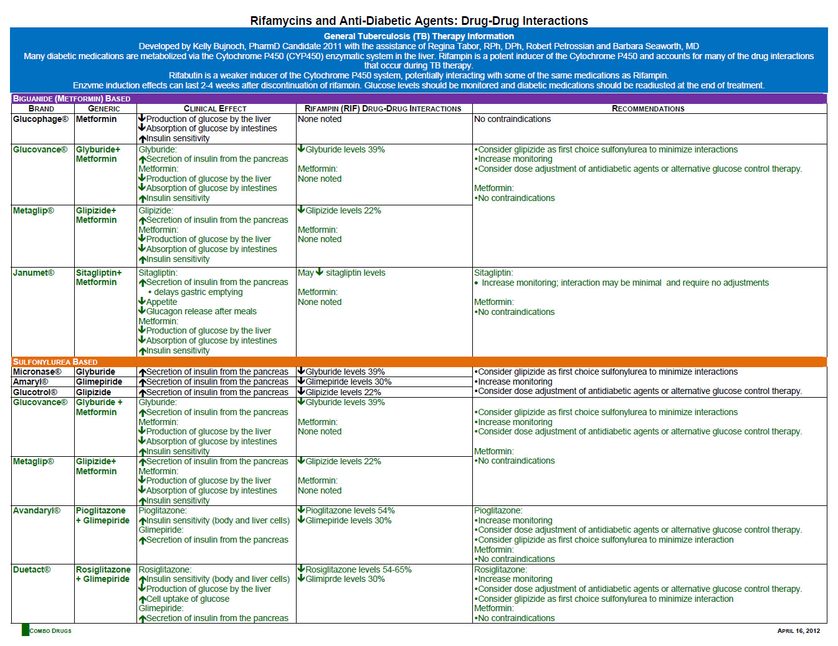

Slide 24
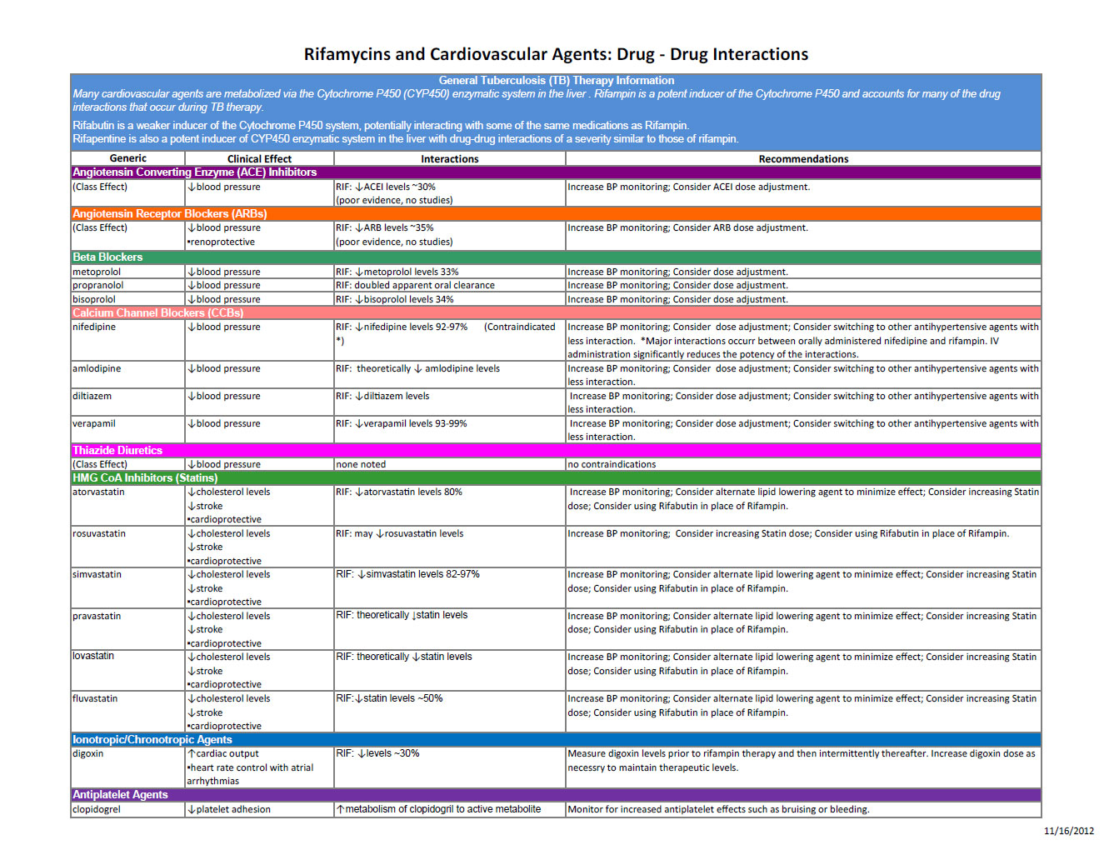

Slide 25
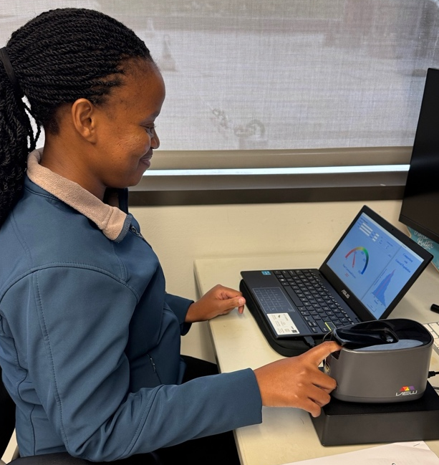
TB, diabetes & malabsorption
Check TDM early: ~10-14 days
Start with 1200mg RIF (maybe 1800 if known poor absorption)
Talk to patients about fruits and Veggies every visit
Encourage exercise every visit
B6 to decrease neuropathy

Slide 27
Case Study # 2
55 yr M w HTN develops new ESRD
2019-2020: testicular abscess not improved s/p 2 courses Abxs
March 2021: mild fevers and weight loss
November 2021: further weight loss and new renal failure
Peri-renal abscess; CXR no disease
QFT: indeterminant
Urine Gene Xpert positive w Ct 18; Culture TTP 19 days
Started on RHZE
Symptoms first improve and then 2 months later:
Nausea, anuric→ found to have bilateral hydronephrosis
Urine Gene Xpert positive w Ct 17; Culture Negative
Improved on prednisone
Notes:
QFT was indeterminant because the mitogen was too low to be valid. This doesn’t mean the person has TB, but that they are anergic.
Gene Xpert demonstrates a high bacillary burden and the culture turns positive in < 3 weeks.
Guesses on Gene Xpert demonstrating similar bacillary burden, but the culture not growing?

Slide 28
Case Study # 2
55 yr M w HTN develops new ESRD
2019-2020: testicular abscess not improved s/p 2 courses Abxs
March 2021: mild fevers and weight loss
November 2021: Diagnosed w TB; started RHZE
Peri-renal abscess; CXR no disease; 2cm scrotal fluid collection; TB+
Jan 2022: Developed IRIS
Jan 2023
Anorexia not resolved
Still with 2cm fluid collection in scrotum→ Abxs won’t treat an abscess
What is the right time to allow for Abx resolution before draining?
Notes:
QFT was indeterminant because the mitogen was too low to be valid. This doesn’t mean the person has TB, but that they are anergic.
Gene Xpert demonstrates a high bacillary burden and the culture turns positive in < 3 weeks.
Guesses on Gene Xpert demonstrating similar bacillary burden, but the culture not growing?

Slide 29
Diagnostic accuracy depends on: 1. Specimen quality 2. Quantity of specimens evaluated
Notes:
The point of the next few slides is that diagnostic accuracy depends on boht the Specimen quality and the quantity of specimens evaluated

Slide 30
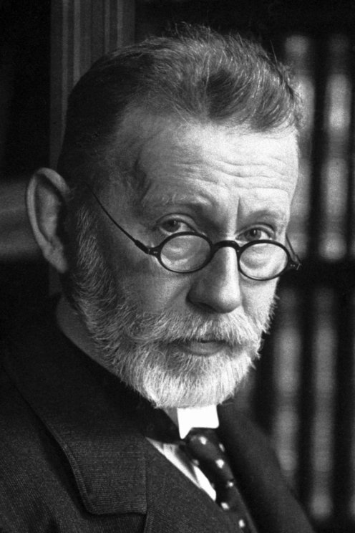
Diagnosis, 1882 to 2006…
Test | Turn around time | LOD (organisms/mL) | Sensitivity
AFB smear | < 2 hours | 5,000 | Low
Culture | 14-42 days | 1-10 | Good Not perfect
PCR (Xpert ultra) | 1h 42 min | 18 | Good Not perfect
Notes:
When thinking about TB diagnosis, I like to consider turn around time, limit of detection, and sensitivity. On future slides we will discuss sensitivity in more detail, but in general, smear has a low sensitivity and a limit of detection of 5,000 organisms per mL of sputum for the AFB smear.
The acid fast smear was developed by Paul Erhlich when he was the equivalent of a post-doc in Robert Koch’s microbiology lab. Interestingly, he was a smoker and had a chronic cough→ Cairo→ Nobel Prize.
Not much major advances until the development of PCR. Since 2006, because of the improved sensitivity of PCR, the CDC has recommended the first sputum being sent for both PCR and acid fast stain. Now the next major advance was approximately in 2010 with the development of a ”locked-in” design cartridge. Inside these cartridges, there is automated DNA isolation, and PCR performed with microfluidics for a PCR test that is completed in < 2 hrs.
The locked in design of the cartrdige avoids human error involved w DNA isolation & PCR
TAT < 2 hrs
Same machine is used for MRSA nasal swab testing, C.dif testing; Covid PCR test; same machine, just dif cartridge; The machine comes in 1 module, 4 module, 8, and 64 module systems. At the VA this same system runs C. diff and MRSA testing. At Ben Taub the system is only used for covid while for reasons that are beyond my understanding, the sputum is sent to LBJ where the automated Xpert occurs.

Slide 31
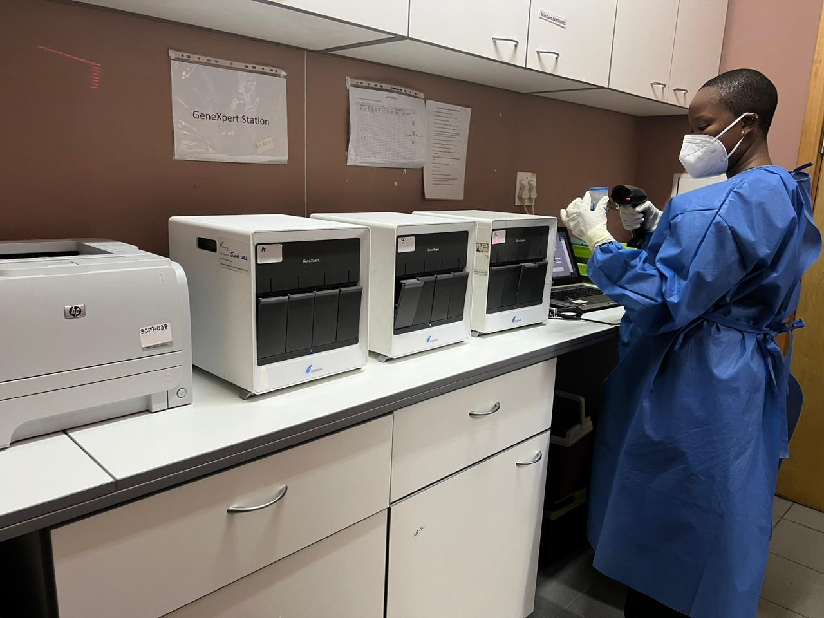
Gene Xpert work-station
At Baylor-Eswatini TB Clinic
Notes:
Here is the Gene Xpert workstation at the Baylor-Eswatini TB clinic, where I spend 3 months each year.

Slide 32
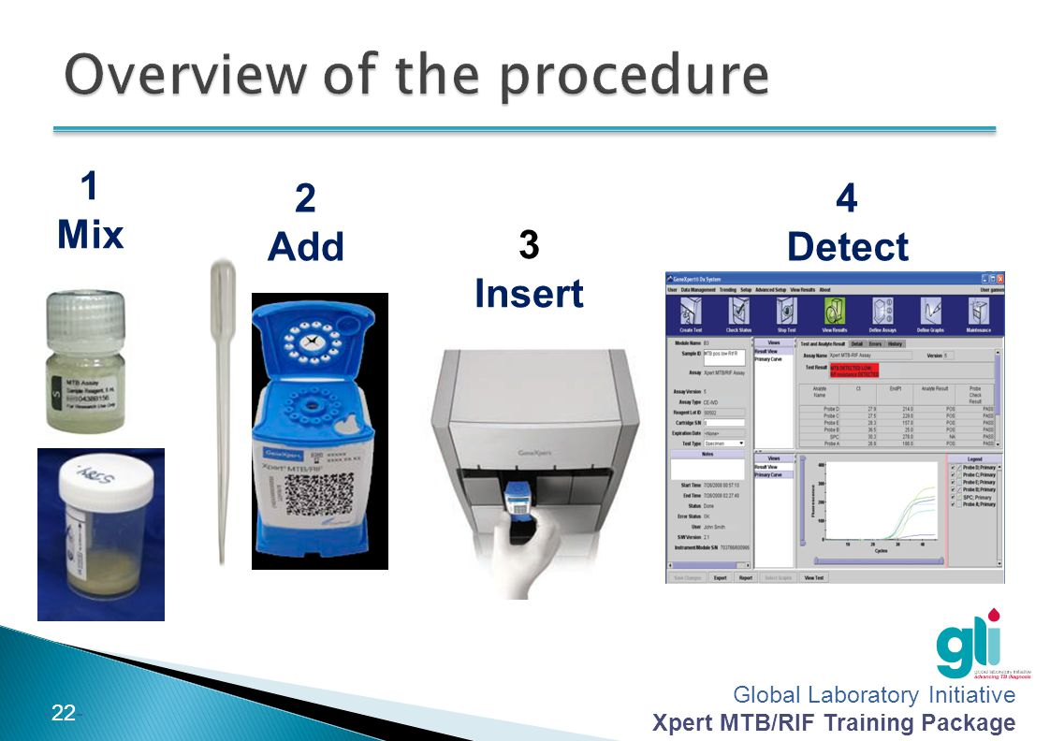
Notes:
To run the test, the lab techs mix the sputum 1:1 with a decontamination fluid, vortex for 5 seconds, wait for 5 minutes, then place the cartridge into the machine, and come back 1hr and 42 minutes later to have the Mtb PCR results.

Slide 33
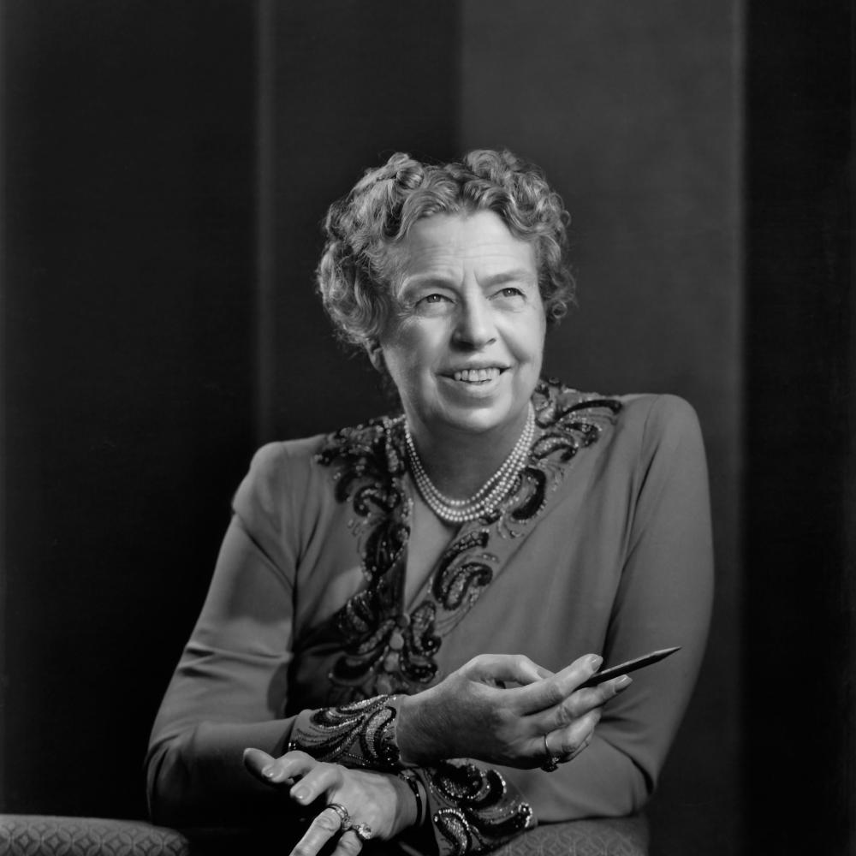
Notes:
In 1962, Eleanor Roosevelt was diagnosed with aplastic anemia. She was briefly treated with prednisone, but clinically worsened, developing a fever of unknown origins. The Mtb culture turned positive weeks after she died. Roosevelt had an initial bout of TB 40 years early, which recrudesced without antibiotics, and then reactivated at age 78 in a disseminated form that eluded the best clinicians of the time.

Slide 34
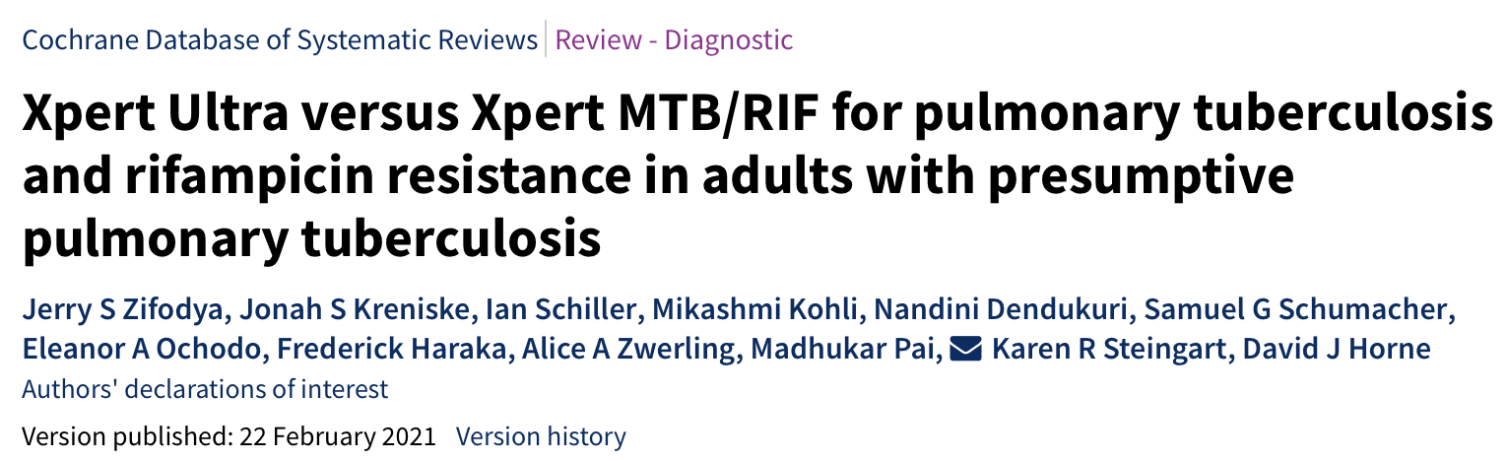
Original
Gene Xpert
LOD 112 CFU/mL
Ultra
LOD 15 CFU/mL
Gene Xpert (ULTRA) on Sputum
Specimen Type | Summary Sensitivity
Smear-positive | 99%
Smear-negative | 77%
All | 91%
PLWHIV | 87%
7 studies; 2834 patients
Notes:
The original Gene Xpert Cartridge was upgraded in 2017 to the Gene Xpert “ultra” cartridge, which improved the LOD from 112 to 15 CFU. The following slides will review the diagnostic accuracy of the Ultra cartridge which is the only cartdige still available and the one used in the United States.
In general, from sputum, the assay has excellent sensitivity for smear-positive disease, but still only detects 77% of smear-negative disease, and the sensitivity is decreased to 87% for PLHIV, due to the more paucibacillary nature of the sputum of HIV assoc disease.

Slide 35
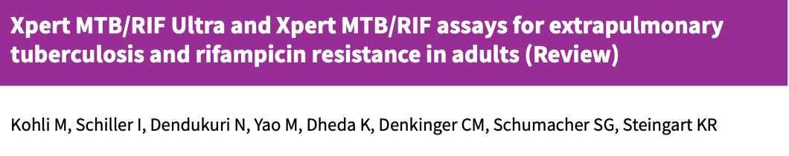

Xpert for Extra-pulm TB
Specimen Type | # Studies | Number evaluated | Summary Sensitivity
CSF Xpert | 33 | 3774 | 71%
CSF Ultra | 6 | 475 | 89%
CSF 1 specimen* | 4 | 496 | 63%
Pleural fluid Ultra | 4 | 398 | 70%
Lymph node | 14 | 1588 | 88%
Urine | 9 | 943 | 85%
Bone | 6 | 471 | 97%
Peritoneal fluid | 13 | 580 | 59%
Pericardial fluid | 5 | 181 | 61%
Single PCR + 3 smears is for rule out, not if high suspicion
Send multiple specimens for PCR if high suspicion
* Culture vs composite reference standard; 1 vs multiple samples
Notes:
When evaluated for extra-pulmonary TB, the sensitivity depends on the disease site. Notice for TB meningitis, the sensitivity is only 63% when evaluating a single specimen, but increases up to 89% when evaluating multiple specimens.
The take home point here is that the general rule of ordering a single PCR and 3 smears is what is required by the Infection Control team to rule out a patient and allow them out of negative pressure isolation room. But if you have a patient that you have a high index of suspicion that they have TB, pelase send multiple specimens.
In particular, for TB meningitis, it is recommended that you perform serial LPs and collect 20-30mL of CSF, and then pellet the CSF by centrifuging the CSF at 10kg x 10 minutes and then using the cell pellet for the culture and molecular PCR testing.

Slide 36
Case Study # 2: Abxs & Kidney disease
Chronic kidney disease increases risk of TB
How? Malnutrition? Anergy?
Symptoms often atypical due to disseminated disease
Fever only!
Screen with TST or IGRA
(?preferably IGRA for patient effort? And mitogen? )
Xpert can be used on almost any specimen type!
Sputum
Stool
Urine
CSF
Notes:
QFT was indeterminant because the mitogen was too low to be valid. This doesn’t mean the person has TB, but that they are anergic.
Gene Xpert demonstrates a high bacillary burden and the culture turns positive in < 3 weeks.
Guesses on Gene Xpert demonstrating similar bacillary burden, but the culture not growing?

Slide 37
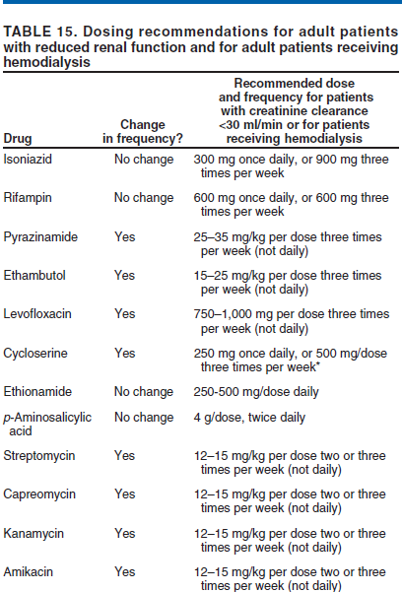
Get TDM
Engage your clinical pharmacist!

Slide 38
Very brief case…
62 yr M with stage 3 CKD, not on HD admitted BTGH w STEMI
3v disease→ bypass
Post-op, intermittent fevers, no localizing signs or symptoms
Normal CXR
NO ID or pulm consult
Gets better on Levofloxacin prescribed for tracheitis
Gets 6 courses of levofloxacin for recurrent tracheitis over 4 months
Pulm consult: BG to the rescue…

Slide 39
TB & EtOH
n of 2
Young male, single
Severe binge drinking
4-6 cm cavitary TB
Pancreatitis
1800mg RIF
One sub-therapeutic, one therapeutic

Slide 40
TB & liver disease
Untreated HCV increases TB risk
HCV is easy to treat now!!!
Increased DILI if untreated hepatitis;
screen universally, not based on assumed risk factors
Liver disease in general increases TB risk

Slide 41
TB & end stage liver disease
Liver injury due to ATT
Best ATT?
Depends on degree of liver injury
When to empirically avoid INH & PZA?
RIF + INH + EMB 2mo + 7 mo RIF + INH? ??
RIF + EMB + Moxi + Linezolid???

Slide 42
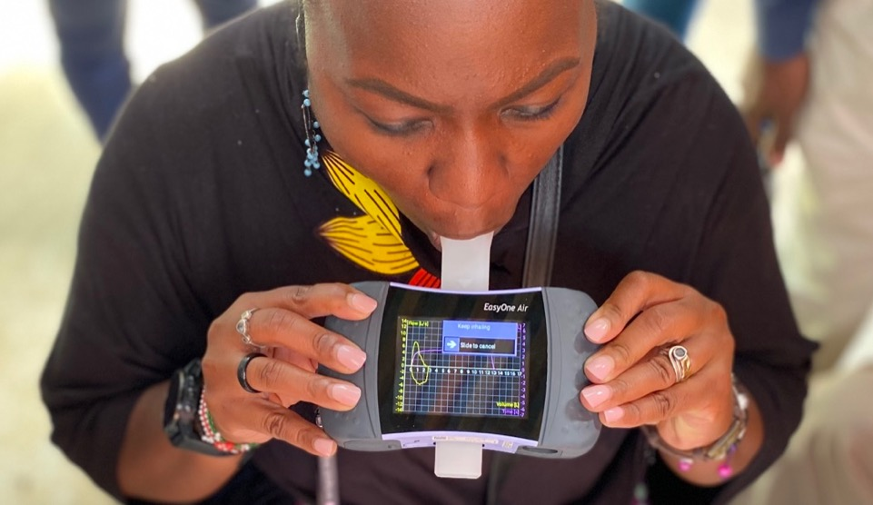
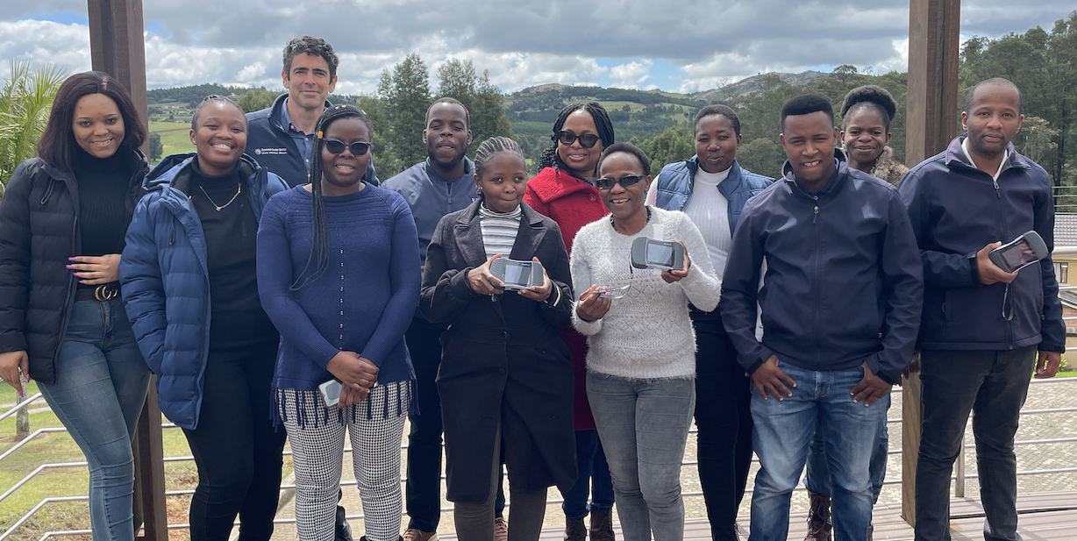
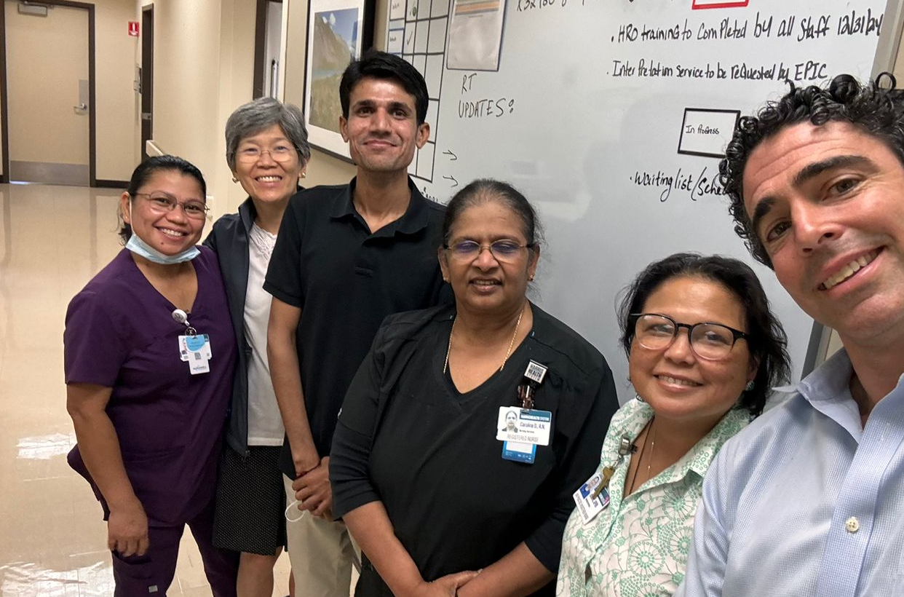
Questions and comments?
Thank you….

