Slide 1

What Nurses Need to Know
TB Medications:
Presented by: Barbarah Martinez, MSN, APRN, FNP-BC
Date: 09-18-2025

Slide 2
Barbarah Martinez MSN, APRN, FNP-BC has the following disclosures to make:
No conflict of interests
No relevant financial relationships with any commercial companies pertaining to this educational activity

Slide 3
Objectives
First-line Tuberculosis (TB) Medications
  Medication Dosages
  Side Effects
  Nursing Considerations

Slide 4
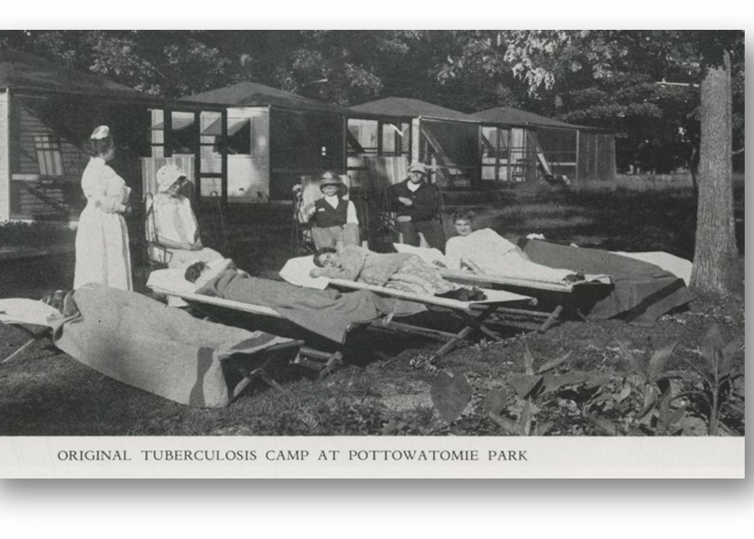
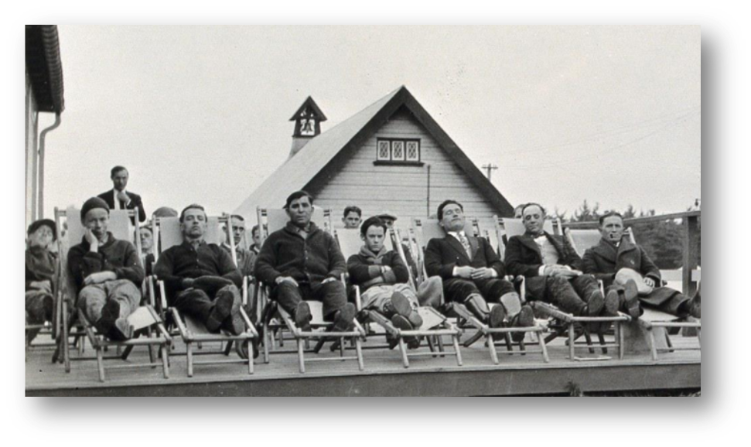
TB Treatment before anti-tuberculosis drugs
Sanatoriums Provided
Fresh air
Sunlight
Relaxing surroundings
Good nourishment
Notes:
Before the use of anti-tuberculosis medications TB was treated in sanatoriums.
As you can see in these pictures, the patients were sent away to live in these sanatoriums where their method of treatment was through fresh air, sunlight, relaxing surroundings and proper nutrition.
Patients would be outside where they could be exposed to these natural elements with the hopes of healing their disease.

Slide 5
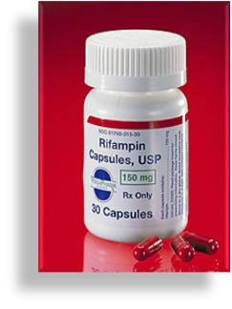
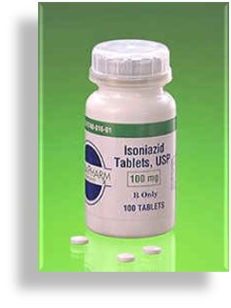
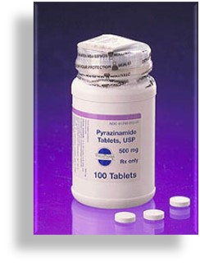
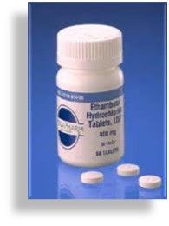

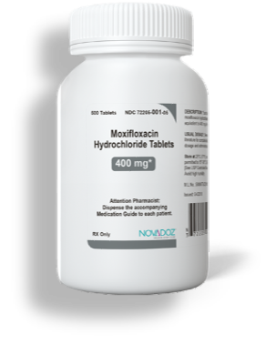
First-line Tuberculosis Drugs
Rifamycins
Isoniazid
Pyrazinamide
Ethambutol
Fluoroquinolones
Rifampin
Rifabutin
Rifapentine
Moxifloxacin
Levofloxacin
Notes:
Fortunately, today we have several medications that are used to treat TB. Per the CDC, the standard treatment regimen for drug susceptible tuberculosis is with these First-line drugs which are Rifamycin's such as RIF, RBT, or Rifapentine, Isoniazid, Pyrazinamide, Ethambutol, and more recently used now, fluoroquinolones such as Moxifloxacin and Levofloxacin.

Slide 6
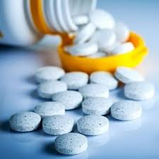
Mycobacterium tuberculosis (MTB) produces resistant mutations during replication
Multi-drug TB treatments provide cross-coverage against these various mutations
Different actions of TB drugs
  Bactericidal
  Early Bactericidal
  Bacteriostatic
  Sterilizing
Why use a Multi-Drug Therapy?
Notes:
So, Why use a Multi-Drug Therapy to treat TB?
__the reason is because tuberculosis produces mutations during replication and multi-drug treatments provide the cross coverage needed against these mutations.
__TB drugs have different mechanisms of action…some are Bactericidal, early bactericidal, bacteriostatic or sterilizing
__Remember the key to multi drug therapy is to attack the bacteria from different ends

Slide 7
Actions of Anti-TB drugs:
Bactericidal
Directly kills the bacteria.
Bactericidal
Early
Early reduction in colony forming units found in sputum; isoniazid has the highest EBA
Bacteriostatic
Prevents multiplication and growth
Sterilizing
Kills off “persisters”; rifampin and PZA have sterilizing activity
Notes:
To briefly explain what these drugs do, lets do a quick review.
__Bactericidal drugs directly kill the bacteria
__Early bactericidal drugs help in early reduction in colony forming units found in sputum and Isoniazid has the highest early bactericidal activity
__Bacteriostatic drugs work by preventing multiplication and growth
__and Sterilizing drugs kill off the “Persisters” -Rifampin and PZA have sterilizing activity
__So now that you know how these drugs work you can understand why they are used together to cure TB
https://www.sciencedirect.com/topics/medicine-and-dentistry/pyrazinamide#:~:text=Sterilizing%20activity%20refers%20to%20the,essential%20processes%20in%20dividing%20bacteria.
__With that said, lets get started with our first TB drug Rifampin

Slide 8
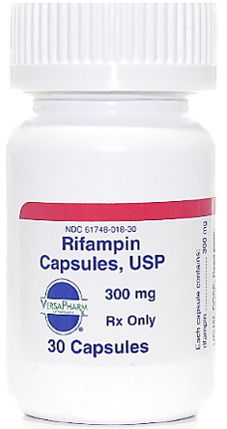
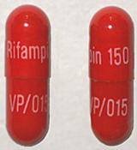
RIFAMPIN
Bactericidal (kills bacteria)
  Highest sterilizing activity against rapidly dividing and semi-dormant bacteria
Dose:
  Adult: 10 mg/kg/dose (usually 600 mg PO)
  Child: 15-20 mg/kg/dose
  Infant/Toddler: 20-30 mg/kg/day
  High Dose: 20-30 mg/kg (serious forms of TB such as meningitis/disseminated)
  Renal failure/dialysis: no dose adjustment
Rapid absorption
  May be decreased by high-fat meals
  CSF penetration
Increases metabolism of many drugs
  Hormonal contraception, methadone, anti-seizure medications, anti-coagulants, antiretrovirals
Notes:
Rifampin is a bactericidal drug meaning that it directly kills the bacteria;
__It has the highest sterilizing activity against rapidly dividing AND semi-dormant bacteria.
__it is the most important drug that will have the greatest impact on treatment when it can be used.
Rifampin like the rest of the TB drugs is dosed according to weight.
__For adults the dose is 10 mg/kg/dose which is usually 600 mg PO
__For children it is 15 to 20 mg/kg/dose
For infants and toddlers Many experts recommend using a daily rifampin dose of 20–30 mg/kg/day, and for serious forms of TB such as meningitis and disseminated disease.
__and there is no dose adjustment for patients with renal failure
__it has a rapid absorption, however it may be decreased by high-fat meals
__and it is able to penetrate through the cerebral spinal fluid
__It is also important to note that Rifampin does increase the metabolism of many drugs such as hormonal contraception, methadone, anti-seizure medications, anticoagulants and antiretrovirals… so it is always important to educate patients on this.

Slide 9
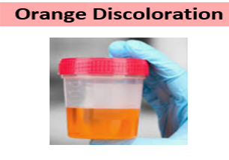
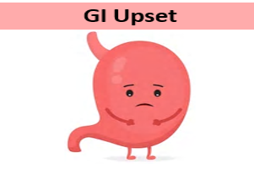
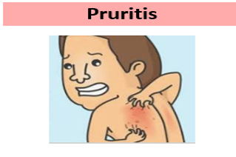
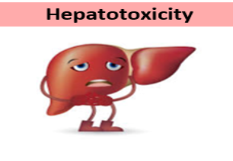

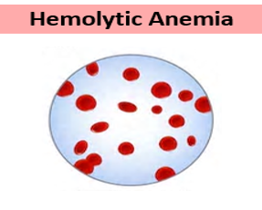
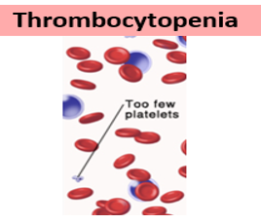
RIFAMPIN:
Side Effects
Less Common
Side Effects
Flu-like symptoms
<1% of patients usually 3-6 months of starting treatment
Notes:
Some of the side effects of rifampin include orange discoloration of body fluids to include sweat, tears, and change in the color of urine, GI upset which is very common with all drugs as is hepatotoxicity
__LESS common side effects include flu-like symptoms, hyperbilirubinemia, hemolytic anemia and thrombocytopenia

Slide 10
RIFAMPIN
Monitoring:
  Liver enzymes AST/ALT if there are symptoms of hepatotoxicity
  Therapeutic drug monitoring is recommended if you suspect malabsorption or treatment failure
Drug to drug interactions:
  Certain rifamycins cannot be given with other medications due to the drug interactions such as antiretrovirals, antiarrythmics, anticoagulants, antidepressants; be sure to consult with an expert
  Ensure patient identifies all other medications they are taking as they may interfere with rifampin
Patient Education
  Best taken without food, however, can take with a small amount of food for upset stomach
Notes:
With Rifampin, you want to ensure you are monitoring liver enzymes and if there are symptoms of hepatotoxicity with your patient
__Sometimes it is necessary to check drug levels when a patient is not showing improvement clinically to ensure they are absorbing the medication and determine if the dose needs to be increased
__Now we are seeing more patients on higher doses of Rifampin when needed and not just the standards 600 mgs.
__As far as drug to drug interactions, certain rifamycins cannot be given with antiretroviral drugs…so be sure to consult with an expert.
__AND Ensure your patients identify all other medications they are taking as they may interfere with rifampin
It is very important to educate patients, Rifampin is Best taken without food; however, it can be taken with a small amount of food for an upset stomach

Slide 11
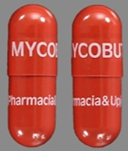
RIFABUTIN
Bactericidal (kills bacteria; same mechanism as rifampin)
Dose:
    Adult: 5 mg/kg/dose
    Children: 5-10 mg/kg/day * (no pediatric dose has been established)
    Renal failure/dialysis: no dose adjustment in mild renal insufficiency
    Dosage adjustment may be required with anti-retroviral therapy
  Substitute for rifampin for patients receiving antiretrovirals or any drug with significant interactions
  Penetrates inflamed meninges
  Well absorbed from the GI tract
  Possibly toxicity:
    Leukopenia (decrease WBC’s) thrombocytopenia (decrease PLT’s) uveitis (redness, irritation, blurred vision, eye pressure)
Notes:
Rifabutin is also a rifamycin and is similar to rifampin….it is bactericidal as well…..the dosing is a little lower at 5 mg/kg per dose for adults and 5-10 mg/kg/day for children
in mild renal insufficiency, no dose adjustment is required
Dosage adjustment may be required with anti-retroviral therapy
Rifabutin is a substitute for rifampin for patients receiving antiretrovirals
It also Penetrates inflamed meninges
And is Well absorbed from the GI tract
Signs of Possible toxicity can include Leukopenia, thrombocytopenia, and uveitis

Slide 12
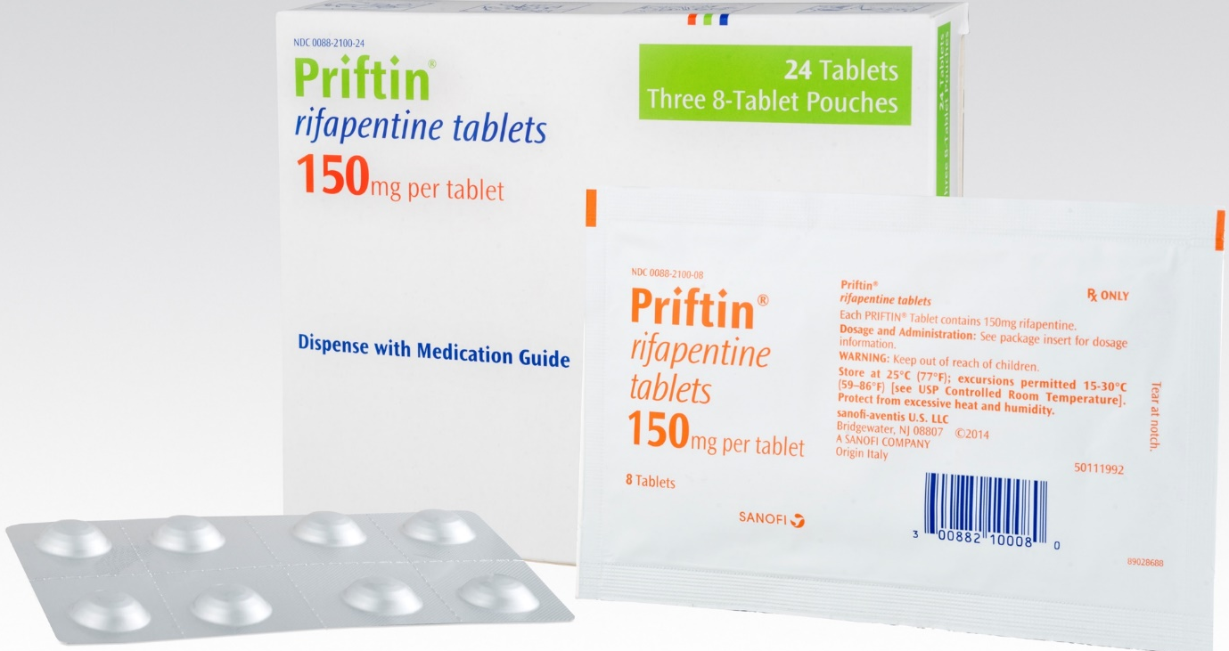
RIFAPENTINE
Bactericidal activity (kills bacteria; same mechanism as rifampin)
Approved for treatment of LTBI (3HP) and more recently for TB disease in a new shorter course treatment regimen; dose varies on treatment regimen
Adverse effects similar to rifampin
Notes:
Rifapentine is the third rifamycin, so it is also bactericidal drug and is approved for the treatment of LTBI and more recently for TB disease in a new shorter course treatment regimen; the doses vary based on the treatment regimens.
And the adverse effects are similar to rifampin

Slide 13
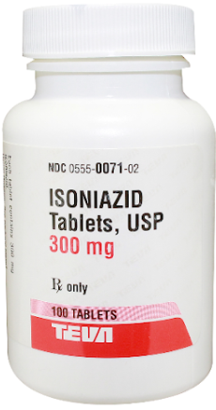
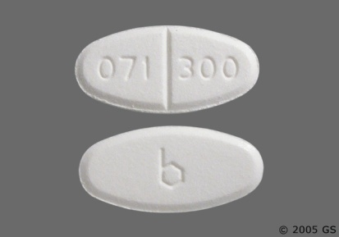
ISONIAZID
Bactericidal (kills bacteria)
  Accounts for majority of early bactericidal activity; greatest early reduction in colony forming units found in sputum
  Activated by katG enzyme
Dose:
  Adult: 5 mg/kg/day (300 mg/daily)
  Child: 10-15 mg/kg/day
  Renal failure/dialysis: 300 mg daily or 900 mg thrice weekly
Used for treatment of latent TB infection (LTBI) and active disease
Notes:
Now moving on to Isoniazid
_INH is a bactericidal Drug that works to kill the bacteria
_It accounts for the majority of early bactericidal activity and has the greatest early reduction in colony forming units found in sputum
_It is activated by the katG enzyme
The dose is 5 mg/kg/day for adults usually 300 mg/daily
10-15 mg/kg/day for children
And in patients with renal failure, it is usually 300 mg daily or 900 mg thrice weekly
INH is also used for the treatment of LTBI and active TB disease

Slide 14

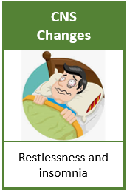
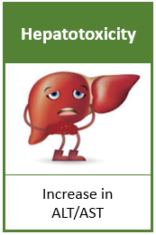
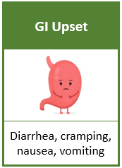
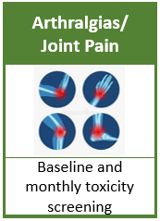
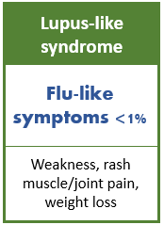
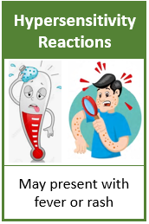
Isoniazid:
Side Effects
Notes:
INH side effects can include peripheral neuropathy, CNS changes like restlessness and insomnia, and along with other TB medications it can cause hepatoxicity or GI upset
Other side effects include Arthralgias, Flu like symptoms, and hypersensitivity reactions like fevers or rashes

Slide 15


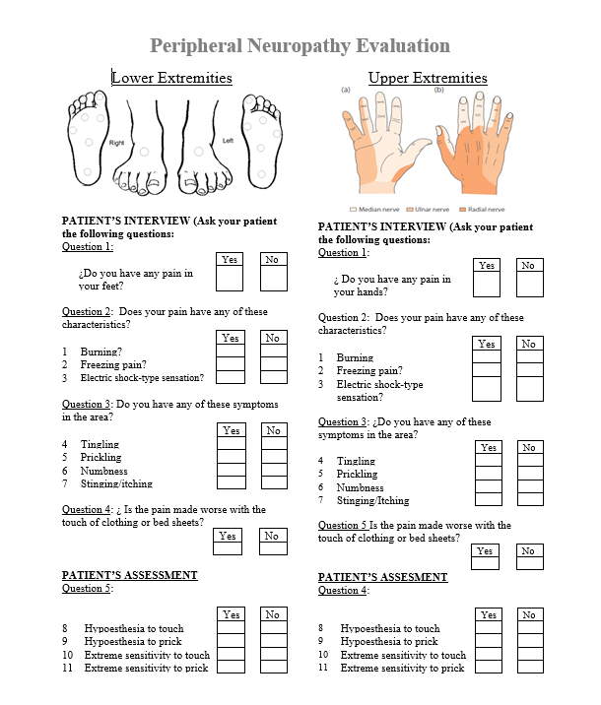
ISONIAZID:
Patient Education and Monitoring
Patient Education:
Avoid alcohol
Do not take antacids within one hour of medication administration
Some patients may benefit from supplemental Vit B6
Drug interactions:
  levodopa, phenytoin, valproic acid, carbamazepine
Monitor:
LFTs: baseline and monthly, especially if underlying liver disease exists
Peripheral Neuropathy (high-dose INH)
Therapeutic drug monitoring is recommended if you suspect malabsorption or treatment failure
Notes:
Patient education for patients on INH should include..
It is important to monitor…
INH increases phenytoin concentrations
Carbamezapine – risk of hepatotoxicity

Slide 16
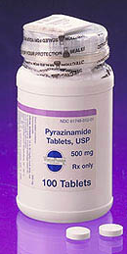
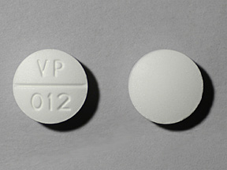
PYRAZINAMIDE
Bacteriostatic/sterilizing agent:
  Greatest activity against dormant or semi dormant (slow growing) organisms
Daily Dosing
  Adult 25 mg/kg
  Children 30-40 mg/kg
Renal Dosing: 3 Times per Week
  25 mg/kg TIW
  Cleared by the kidneys
  If patent on dialysis, provide after dialysis
Use in pregnancy/breastfeeding:
  In the U.S. PZA is avoided in pregnancy for drug susceptible disease due to lack of data regarding teratogenicity, however
  Should be used for drug-resistant TB when isolate is susceptible to PZA
  When in doubt, please consult with an expert
Notes:
Pyrazinamide is a bacteriostatic/sterilizing agent and has the greatest activity against dormant or semi dormant organisms
PZA comes in a 500 mg scored tablet
Adult dosing is typically 25 mg/kg/day
For children 30-40 mg/kg/dose
And for patients with renal failure a dose of 25 mg/kg/ 3 times per week is used. PZA is cleared by the kidneys, and it should be given after dialysis
In the U.S PZA is avoided in pregnancy for drug susceptible disease…

Slide 17
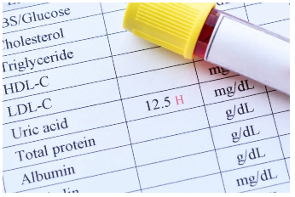
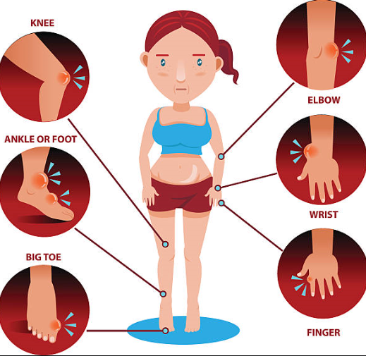
PYRAZINAMIDE
Adverse Reactions:
  Gout (hyperuricemia) and arthralgias
  Hepatotoxicity
  Rash
  Photosensitivity
  GI upset
Monitor
  Monitor transaminases and uric acid
Patient educations:
  May be taken with or without food
  Limit sun exposure
  Notify nurse or healthcare worker if they experience severe pain or swelling in joints
Notes:
Adverse reactions with PZA include:
Gout and arthralgias
Hepatotoxicity –
Rash – usually self limited
GI: nausea/vomiting, mild at standard doses
It is important to monitor transaminases and uric acid
Important patient education includes to limit sun exposure, it can be taken with or without food, and to notify their nurse or healthcare worker if they experience severe pain or swelling in the joints

Slide 18
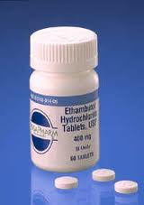
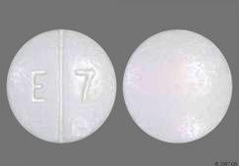
ETHAMBUTOL
Bacteriostatic (prevents multiplication/growth)
  Bactericidal only at the high end of the dosing range
Prevention of rifampin resistance:
  Ethambutol protects the emergence of RIF resistance when INH resistance may be present
Daily Dosing:
  Adults: 15-25 mg/kg
  Children: 15-25 mg/kg
Renal Dosing: 3 times weekly
  15-25 mg/kg TIW
Remember: EMB can be discontinued as soon as the results of drug susceptibility studies demonstrate that the isolate of susceptible to INH and RIF

Slide 19

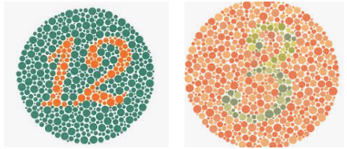

ETHAMBUTOL
Toxicity
  Retrobulbar neuritis
    Can be in one or both eyes
  Peripheral neuropathy
  Cutaneous reactions (<1%)
Monitor
  Baseline and monthly visual acuity (Snellen) and color discrimination (Ishihara) should be performed
  Monitor blurry vision (squinting during exam or difficulty seeing traffic signs)
  If changes from baseline occur, stop medication and refer to ophthalmologist
Patient Education:
  Counsel patient to report any visual changes
Notes:
Ethambutol can cause toxicities such as
_retrobulbar neuritis (optic nerve in the back of the eye becomes inflamed) it can happen in one or both eyes
_ peripheral neuropathy can occur
_and cutaneous reactions are also a possibility although not typical
It is important to monitor…

Slide 20
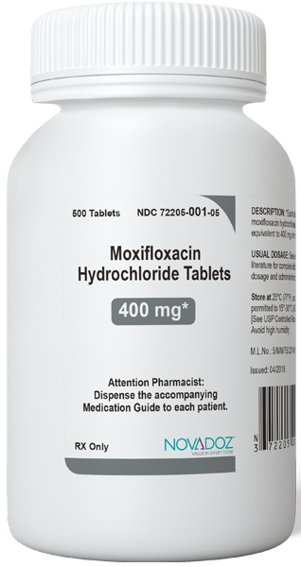
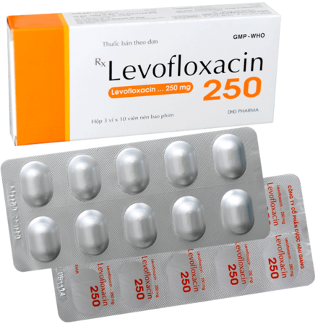
FLUOROQUINOLONES
Moxifloxacin
Levofloxacin
Notes:
Fluoroquinolones include Moxifloxacin and Levofloxacin

Slide 21
FLUOROQUINOLONES
Moxifloxacin
Bactericidal
Metabolized in part by the liver
Dose: 400 mg/day; no dose adjustment required with renal insufficiency
Levofloxacin
Bactericidal
Excreted unchanged by the kidneys;
Dose: 750-1000 mg/day; adjust dose in renal insufficiency (750-1000 mg/dose 3 times weekly for creatinine clearance < 30 mL/min).
Side Effects:
Abdominal discomfort, Diarrhea, Nausea/Vomiting, Mouth Sores, Headache, Dizziness, Skin Itching, QT Prolongation, Blurred Vision, Nervousness, Anxiety, Agitation
Notes:
Moxifloxacin and Levofloxacin are both bactericidal drugs
Moxifloxacin is metabolized by the liver and the dosage is 400 mg/day with no dose adjustments required with renal insufficiency
Levofloxacin is excreted unchanged by the kidneys and the dose is 750-100 mg/day. The dose is adjusted with renal insufficiency to 3 times weekly and not daily for creatinine clearance less than< 30 mL/min
Side effects of both of these medications include…

Slide 22
Fluoroquinolone
Toxicity
Hepatotoxicity (rare with levofloxacin)
  Reversible transaminase elevation
Tendonitis/Tendon Rupture; rare
  Usually achilles
  Risk benefit evaluation
Neurologic Effects
  Insomnia, dizziness, headache, tremors
Patient Education:
  Avoid milk-based products or antacids within 2-hours of ingesting medication
  Avoid vitamin supplements
Notes:
Toxicities with fluoroquinolones include…
Tendonitis or Tendon ruptures which is rare. The patient may complain of pain in the back of their ankle or elbow and they may also complain of muscle or joint pain if this occurs. It is important to evaluate the risk vs the benefits
Neurological effects can include insomnia, dizziness, headache, or tremors
It is important to educate patients to avoid milk-based products or antacids within 2 hours of ingesting medication and avoid vitamin supplements as well. Because calcium can bind the fluoroquinolone antibiotic and make it ineffective.

Slide 23
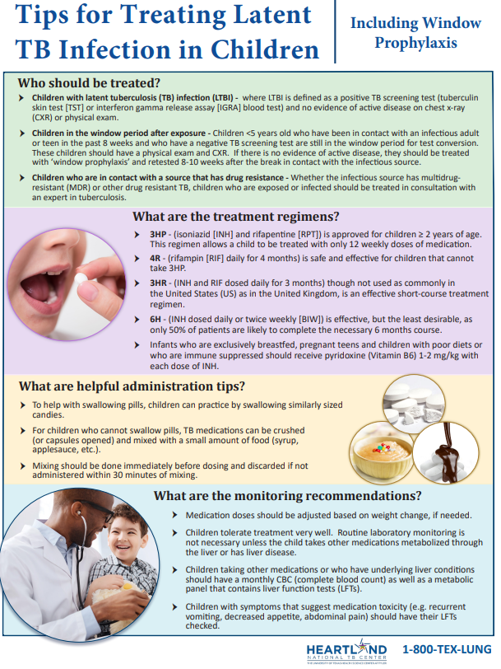

Don’t forget to visit
Heartland National TB Center:
Products and Tools
Products – Heartland National TB Center (heartlandntbc.org)
Notes:
Don’t forget to visit HNTC website for product and tools that can help with medication administration for patients as well.

Slide 24

All TB medications have side effects
Baseline and monthly toxicity assessments for visual acuity and color discrimination aid in preventing toxicities (TB 205 form DSHS)
When changes from baseline occur
  Hold medications and reassess the patient to find likely cause
Patient Education
Notes:
The take home message is to remember….
Idea about what to tell patients when they asked why do I take so many meds and not just one…

Slide 25
References
Texas Department of State Health Services Standing Delegation Orders for Tuberculosis Clinical Services Provided by Authorized Licensed Nurses, Fiscal Year 2025

Slide 26
Thank You
Barbarah.Martinez@bcm.edu
832-824-4324

