Slide 1
Tuberculosis Screening and Testing
Best Practices
Jennifer DiMaggio, MPH, MSN, APRN, FNP-C
Notes:
MPH, MSN, RN, APRN, FNP-C

Slide 2
Special acknowledgment to Dr. Lisa Armitage in the preparation of this presentation.

Slide 3
Objectives
Discuss appropriate populations that should be screened for TB infection.
Screening tools (TST IGRAs) and how to interpret results
Current guidelines when using screening tools

Slide 4
Who Should be Tested for TB Infection? Targeted Testing

Slide 5
Targeted Testing
Persons who are at increased risk for M. tuberculosis infection
Persons at increased risk for progression to active disease if infected with M. tuberculosis (even if not at increased exposure risk)
And those who tend to be tested in addition:
Persons tested for administrative reasons (e.g., mandatory employment testing)
Persons with symptoms of active TB disease (fever, night sweats, cough, and weight loss)

Slide 6
Targeted Testing
Contacts of persons with active TB
HIV positive individuals
Immigrants from high prevalence countries
Injection Drug Users
Patients considering treatment with TNF-α Antagonists
Patients that are needing organ transplant
Residents and Employees of high risk congregate settings:
Correctional facilities and Homeless Shelters
Hospitals, Clinics, Nursing Homes, Substance Abuse Facilities
Children exposed to high-risk adults or environments

Slide 7
Examples of TNF-α Antagonists
Adalimumab (Humira),
Etanercept (Enbrel),
Infliximab (Remicade)

Slide 8
Examples of other Biologics
Less evidence/data on other Biologics but there are recommendations to screen:
IL-6 inhibitors
IL-1 inhibitors
JAK inhibitors
Notes:
Tuberculosis screening for patients on biologic Medications: A Single-Center experience and Society guideline Review, Monroe County, New York, 2018–2021
Journal of Clinical Tuberculosis and Other Mycobacterial Diseases
Volume 36, August 2024, 100460

Slide 9
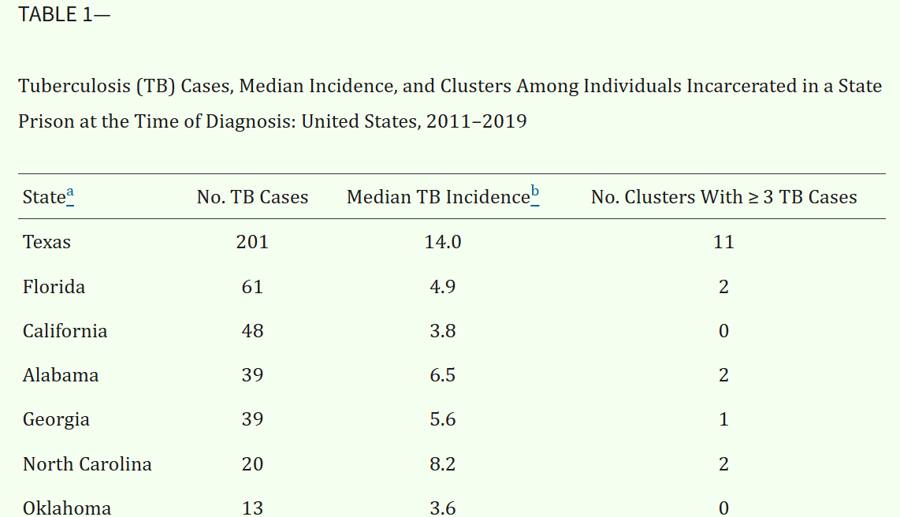
Notes:
Am J Public Health. 2022;112(8):1170–1179
https://doi.org/10.2105/AJPH.2022.306864

Slide 10
Contacts of Individuals with Active Tuberculosis

Slide 11
Among close contacts to a TB Case:
30% have TB Infection
1-3% have active TB disease
Without TB Infection treatment:
10% with TB Infection with develop Active TB
Approximately 5% of contacts with newly acquired TB Infection progress to TB disease within 2 years
The other 5% activate > 2 years after acquisition
Examination of contacts is one of the most effective strategies for TB Infection diagnosis and TB control.
Contacts

Slide 12
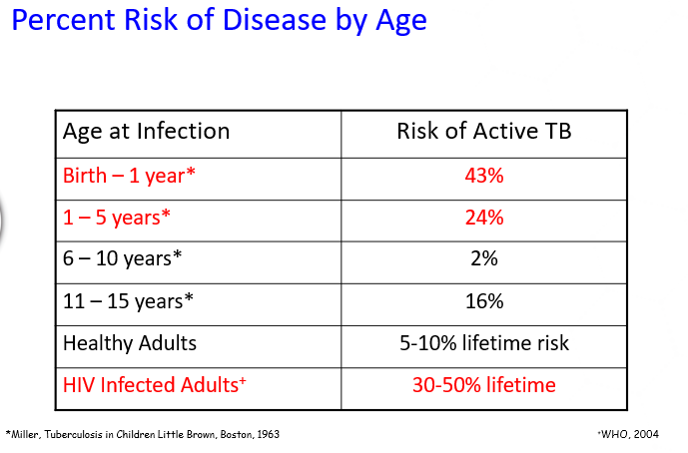

Slide 13
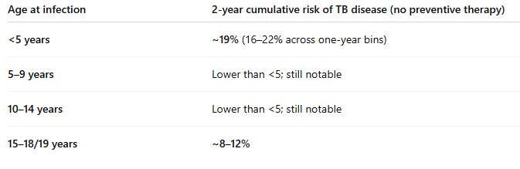
Meta analysis – Children Exposed to Active Tuberculosis
Notes:
The risk of tuberculosis in children after close exposure: a systematic review and individual-participant meta-analysis
Lancet 2020 Mar 21;395(10228):973-984
Included 46 countries
137 647 tuberculosis-exposed children were evaluated at baseline and 130 512 children were followed
To be eligible for inclusion in the final analysis, a dataset needed to include: (1) individuals below 19 years of age; (2) follow-up for tuberculosis for a minimum of 6 months; (3) individuals with household or close exposure to an individual with tuberculosis; (4) information on the age and sex of the child; and (5) start and end follow-up dates.

Slide 14
TB Infection Diagnostics

Slide 15
TB Skin Test (TST)
Interferon Gamma Release Assays (IGRA)

Slide 16
Immune system is exposed to MTB
T cells arrive on the scene and assist in fighting MTB organism
ALARM RAISED
Macrophages try to eliminate MTB and then send out signals for T cells to come help
What hopefully happens is the bacteria becomes “walled off” and creates a dormant like state. Forming a granuloma
Notes:
Very simplified graphic about the immune response when someone is exposed to MTB. Many other things are taking place. The main
Thing to remember: Screening tools are evaluating if there is a response when and if immune system is reexposed via antigens used in respective testing.
Essentially when we are using a TST screening tool or IGRA tool we are assessing to see if a patient’s immunity has been primed due
To active tuberculosis exposure. Each respective screening tool uses different antigens. If the immune system has been exposed to tuberculosis, it will remember and hopefully produce a response.

Slide 17
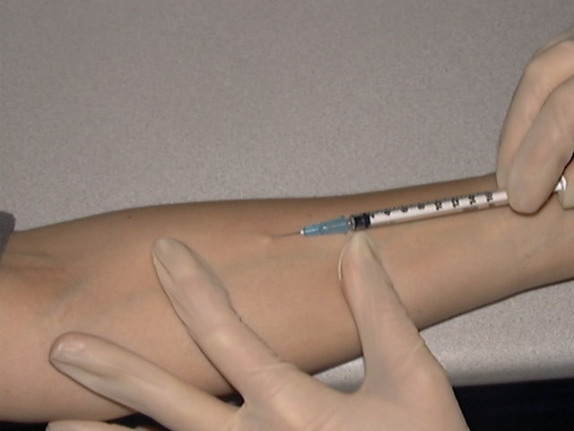
TST Testing
0.1 ml of 5 TU PPD tuberculin injected intradermally
Induration in millimeters read 48-72 hours after injection
Notes:
PPD also known as a “purified protein derivative” is a tuberculin antigen.
Problem with PPD – there is some cross reactivity with BCG vaccine and NTMs (later slide)
Your T cells if exposed will remember the protein and react – creating inflammation (induration)

Slide 18
TST Testing
Measure induration,
not erythema!!
Notes:
Induration: meaningful inflammation
Erythema: non specific response, could be due to irritation of skin

Slide 19
TST Testing
Pros:
Inexpensive
Simple to perform
Cons:
Must return in 48-72 hrs
Interpretation is somewhat subjective
False Negatives:
Elderly
Immunosuppressed
False Positives:
Low risk populations
Non-tuberculous mycobacteria
BCG vaccination

Slide 20
Classifying the Tuberculin Reaction

Slide 21
Classifying the Tuberculin Reaction
Induration | Population
5 mm | HIV-positive persons Recent contacts of TB case Persons with fibrotic changes on CXR consistent with old TB | Patients with organ transplants and other immunocompromised patients
10 mm | Recent arrivals from high-prevalence countries IV drug users Residents/employees of high risk congregate settings. | Persons with clinical conditions that place them at high risk Children<4 years of age or children/adolescents exposed to adults in high risk categories
15 mm | Persons with no known risk factors of TB

Slide 22
The Use of IGRAs in Screening

Slide 23
Immune system is exposed to MTB
T cells arrive on the scene and secrete INF-y which helps with immune response
ALARM RAISED
INF-y
INF-y
INF-y
Macrophages try to eliminate MTB and then send out signals for T cells to come help
What hopefully happens is the bacteria becomes “walled off” and creates a dormant like state. Forming a granuloma
Notes:
IGRAs use INF-y production to evaluate for TB infection. Quantiferon Gold and T spot test both utilize this but in different ways.

Slide 24
IGRA Screening
Negative control or nil (e.g., saline, heparin), no antigens
Positive control or mitogen: non-specific immune response stimulator (e.g., phytohemagglutinin). Assess for competence
M. tuberculosis-specific antigens
Unlike PPD used in TST, do not cross-react with BCG or NTM (some exceptions)
ESAT-6, CFP-10, TB 7.7 (actually simulated using overlapping peptides)
Notes:
NIL tube: Negative control Meant to measure the baseline or background of interferon gamma produced by patients' immune cells without stimulation
Mitogen: Positive control. Contains a non specific T cell stimulant – it helps verify if patient’s immune system can respond adequately.

Slide 25
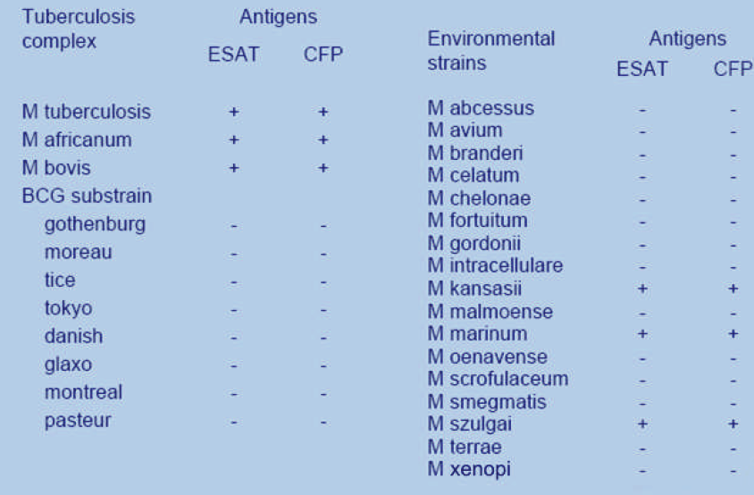
Antigens for Gamma-Release Assays
Notes:
This slide shows that there is little cross reactivity with NTMs and antigens for gamma release assays. This is not the case with TST testing.

Slide 26
IGRA Screening
QuantiFERON®-TB Gold Plus (QFT-Plus)
FDA approved 2017
T-Spot®.TB (T-Spot)
FDA approved July 2008
Notes:
There are three generations of Whole Blood IGRAs that have been commercially available. The first generation test measured response to tuberculin PPD. It became available in the U.S. after FDA approval in 2001.
The second generation test, called QuantiFERON-TB Gold, measure IFN-g response to 2 TB proteins called ESAT-6 and CFP-10. It was approved by the FDA in 2005.
The third generation test is called the QuantiFERON-TB Goid “In-tube” test. It was approved by the FDA in 2007. It assess response to 3 TB proteins within tubes used to collect the blood.

Slide 27
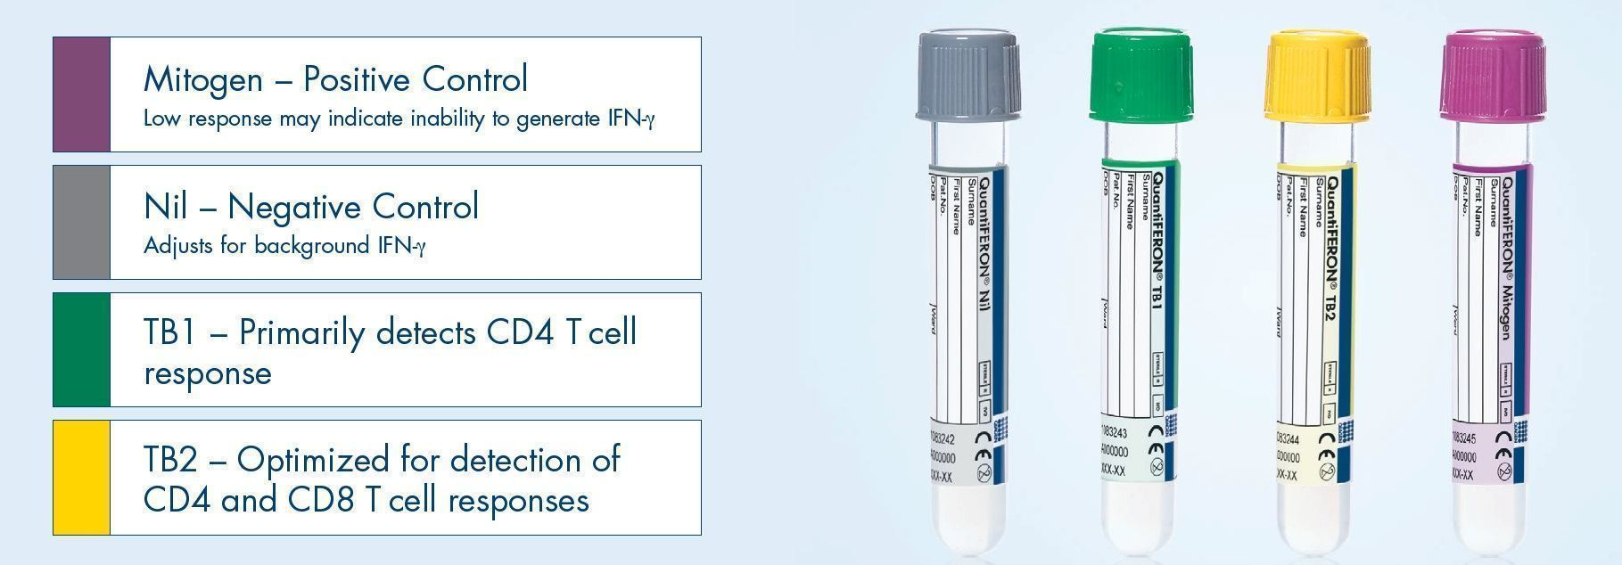
QuantiFERON®-TB Gold Plus
Essentially 2 tests in one blood draw
TB1 and TB2 should be close in value
Notes:
For the QuantiFERON-TB Gold In-Tube test, a single cocktail of overlapping peptides that represent ESAT-6, CFP-10, and part of a third Mtb protein called TB7.7, are included in a blood collection tube. Blood is collected into this tube and 2 similar tubes, one without the antigen and one with PHA. After mixing, the tubes are incubated for 16 to 24 hours. After incubation, the tubes are centrifuged to separate blood cells from plasma. Once centrifuged, the IFN-g is stable for several weeks if refrigerated or during shipping on ice. The test is considered positive if the amount of INF-G released by the TB antigens is 0.35 IU or greater, and at least 1.25 times the negative control.
(TB1 – Nil) or (TB2 – Nil) ≥ 0.35 IU/mL

Slide 28
Interpretation Criteria for the
QuantiFERON Gold Plus
Nil (IU/ml) | TB1 minus Nil (IU/ml) | TB2 minus NIL (IU/ml) | Mitogen | Result
< 8.0 | >0.35 and >25% of Nil | Any | Any | Positive
 | Any | >0.35 and >25% of Nil
 | <0.35 or >0.35 and <25% of Nil | <0.35 or >0.35 and <25% of Nil | >.50 | Negative
 | <0.35 or >0.35 and <25% of Nil | <0.35 or >0.35 and <25% of Nil | <.50 | Indeterminate
>8.0 | Any
Notes:
(TB1 – Nil) or (TB2 – Nil) ≥ 0.35 IU/mL and ≥ 25% of Nil
Also looking at Mitogen: if too low, may imply that there is not immunocompetence

Slide 29



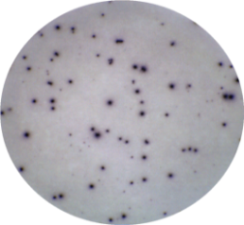

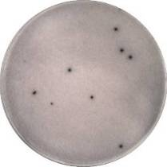
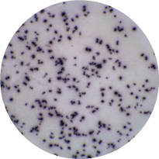
Interpretation of Results
Nil Control
ESAT-6
Panel A
CFP 10
Panel B
Positive Control
Negative
Result
Positive
Result

Slide 30
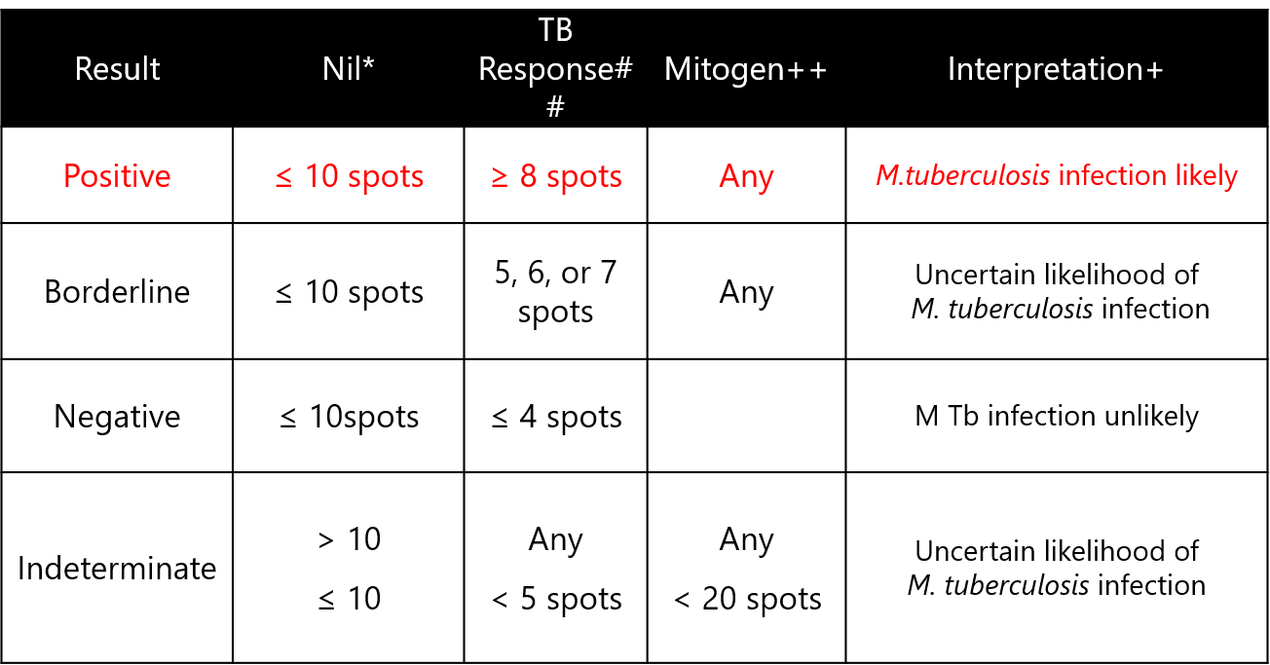
Interpretation Criteria for the T-Spot.TB

Slide 31
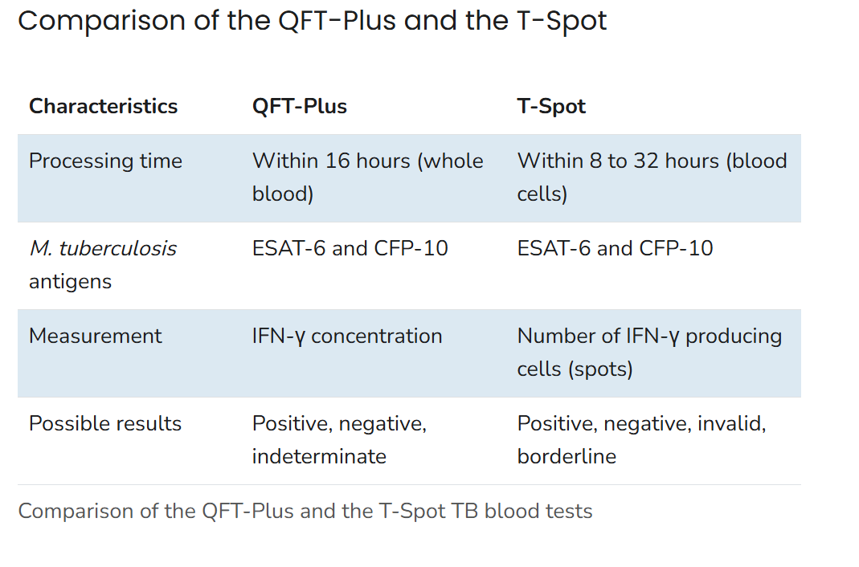
Notes:
Centers for Disease Control and Prevention. (2024, May 9). Clinical testing guidance for tuberculosis: Interferon gamma release assay (IGRA). Retrieved from https://www.cdc.gov/tb/hcp/testing-diagnosis/interferon-gamma-release-assay.html

Slide 32
Indeterminate and Borderline Results
Indeterminate
Negative control result is too high
High background production of IFN-γ
Positive control result is too low
Immunocompromised patients may not respond to mitogen
Borderline (T-Spot only)
Falls within borderline zone close to negative/positive cut point

Slide 33
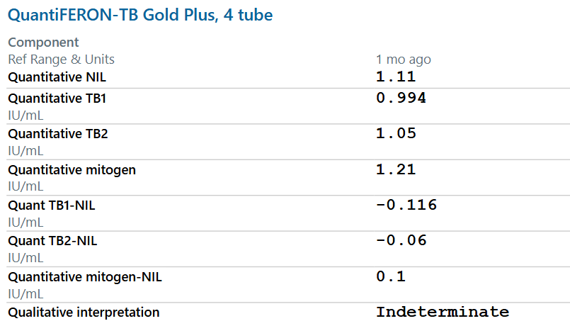
Notes:
Confirmed case that is currently being treated.

Slide 34
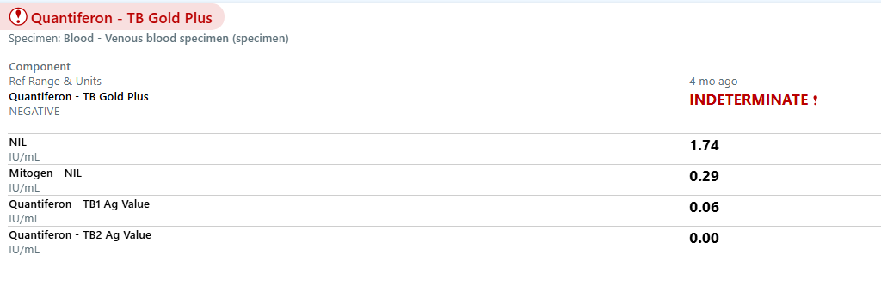
Notes:
Patient with HIV and pulmonary tuberculosis

Slide 35
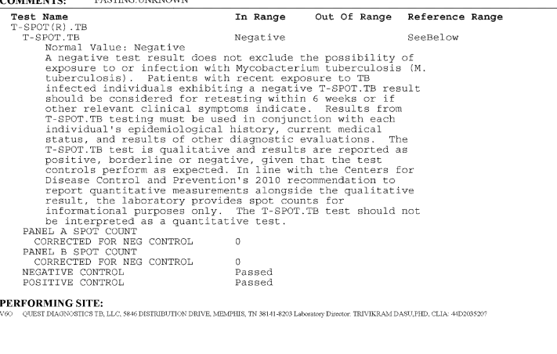
Notes:
Confirmed TB Case we are treating

Slide 36
Indeterminate and Borderline Results
Approaching indeterminate or borderline result – test should be repeated.
If repeat testing produces indeterminate or border result again, other information should be used (other clinical information). For example: if patient if a household contact of an active tuberculosis case. Can repeat with another IGRA.
Boosting: Repeated testing using the IGRA does not cause boosting. There is some evidence to suggest a prior TST may cause increase interferon and may boost a subsequent IGRA. The IGRA should be done within three days of previous test or delayed in three months.
Notes:
Heartland National TB Center, Texas Department of State Health Services Laboratory Services Section. (2013). A clinician’s guide to the TB laboratory. Heartland National TB Center. https://www.heartlandntbc.org/wp-content/uploads/2021/12/clinicians_lab_guide.pdf

Slide 37
Current ATS/CDC/IDSA Guidelines

Slide 38
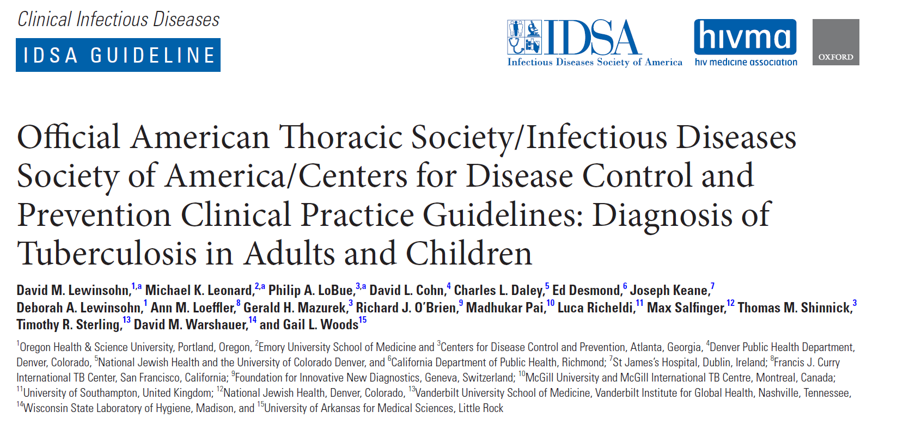

Slide 39
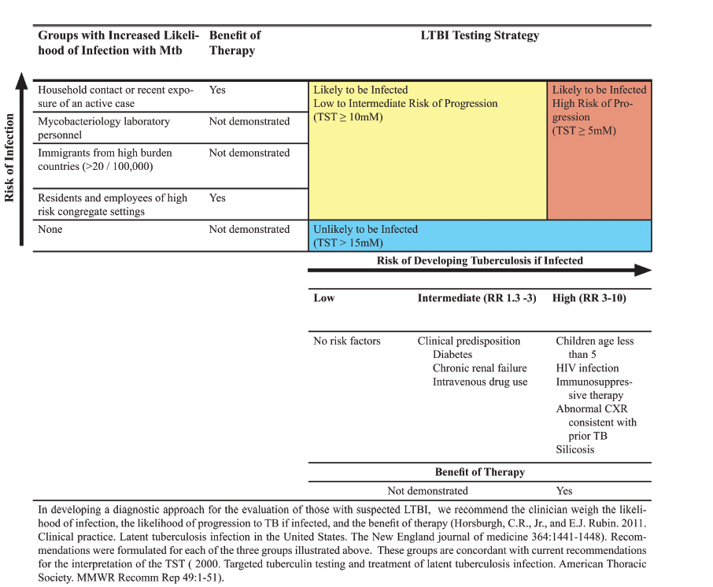
Notes:
Recommendations to test are based on several factors that have already been discussed: populations that are at risk for being infected and are individuals who are at risk of progressing to disease.
IGRA recommended over TST

Slide 40
Current Diagnostic Guidelines
Decisions to test or treat are based on likelihood of infection and likelihood of progression
IGRAs were recommended for TB infection in individuals ≥ 5 years old with low or moderate risk if infection or progression
UPDATE! American Academy of Pediatrics Red Book suggests IGRA can be used in children at any age
Notes: IGRAs are a ‘better’ choice
When TST administration is questionable
In BCG vaccinated populations (increased specificity)
In populations with a poor rate of return
Testing in low-risk populations is still not recommended. If needed (HCW screening) however IGRA is suggested instead of TST if possible.
In populations at high risk for infection or progression, TST or IGRA is acceptable.

Slide 41
FINAL THOUGHTS
Screening populations that are at low risk for TB infection is not recommended. Screening is based on increased risk of being infected or those who are at risk of progressing to disease.
There are several tools for screening (TST and IGRA). Based on new recommendations IGRA is becoming the preferred method of screening. In populations with high risk of progression TST and IGRA are both acceptable.
The tests are not perfect. When assessing each individual, consider the whole picture (history, other clinical data).
\
Notes:
Decision to choose which screening tool may depend on population, cost, circumstances.

Slide 42
Questions

