Slide 2
Collaboration for Tuberculosis Disease Care
Maricela Zambrano, RN
Tuberculosis and Hansen’s Disease Nurse Consultant
Public Healtion Region 11, Texas Department of State Health Services

Slide 3
Objectives
By the end of this presentation, you should be able to:
Understand tuberculosis (TB) reporting and prioritization requirements in Texas.
Discuss the comorbidities and social dynamics that commonly affect patients with TB disease in Texas.
Review TB case management milestones that should be achieved for all TB patient in Texas.
Learn case management resources that are available within and outside of the TB program.
Discuss opportunities for improving collaboration between public health programs, private providers and outside facilities when treating patients with known or suspected TB disease.

Slide 4
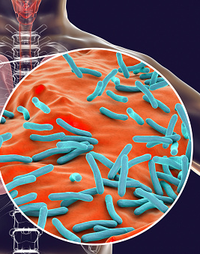
Tuberculosis: Disease of the Past or Present?
Global Increase: WHO reported 8.2 million people diagnosed with TB in 2023
World’s leading infectious disease killer with an estimated 1.25 millions deaths globally in 2023.
Nationally TB outbreaks continue to occur. In 2024 Kansas reported 67 active cases and two deaths as of January 2025.

Slide 5

In the news..
https://www.respiratorytherapyzone.com/largest-tuberculosis-outbreak-kansas/
Notes:
Facts and headlines like these, remind us of the importance of continuing to work with our public health partners to effectively test, identify and treat both active TB and LTBI.

Slide 6
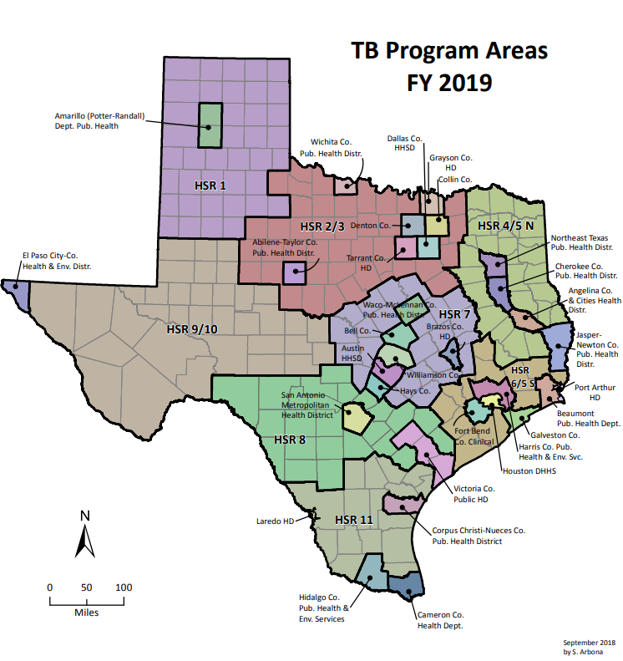
Impact of TB in Texas, 2022
1,097 people diagnosed with TB disease
  Texas ranks #2 among U.S. states with the highest incidence of TB
  Increase of 9.9 percent from 2021
2,900 people with latent TB infection (LTBI) were treated in local or regional health departments (L/RHD)
60 people (5.5%) diagnosed with TB disease in congregate setting
23 people (2.1%) diagnosed with TB disease in a city or county jail
84 people (7.7%) diagnosed with TB disease in other correctional facilities
Notes:
As Texans we often say, “everything is bigger in Texas” and with such a large state, we also see larger numbers. Texas was ranked #2 in the US for the highest case counts. (#1 is California). We have 3 of the country’s top 10 largest cities(Houston- 4; San Antonio – 7; Dallas - 9). Texas also has the longest stretch of border with Mexico compared to any other US state.

Slide 7

Texas Priorities
Vision: A Texas free from tuberculosis
Mission: To eliminate tuberculosis as a public health threat
Find and treat people with TB disease
Find and treat people exposed to TB
Find and treat people at high-risk for TB
Perform active TB surveillance to:
Foreign-born individuals referred from the Electronic Disease Notification (EDN) System
Targeted populations based on local epidemiology
Notes:
Our Texas TB vision and mission for a healthier Texas focuses on eliminating TB. We hope to accomplish this by prioritizing our focus on active TB surveillance activities in the following order:
Our primary focus is to find and treat TB disease adequately.
Perform Contact investigations when deemed necessary to find and treat persons who have been exposed to TB.
And actively search and treat high-risk individuals with LTBI.
As a community it’s important to work together to ensure we can meet our vision and mission.

Slide 8
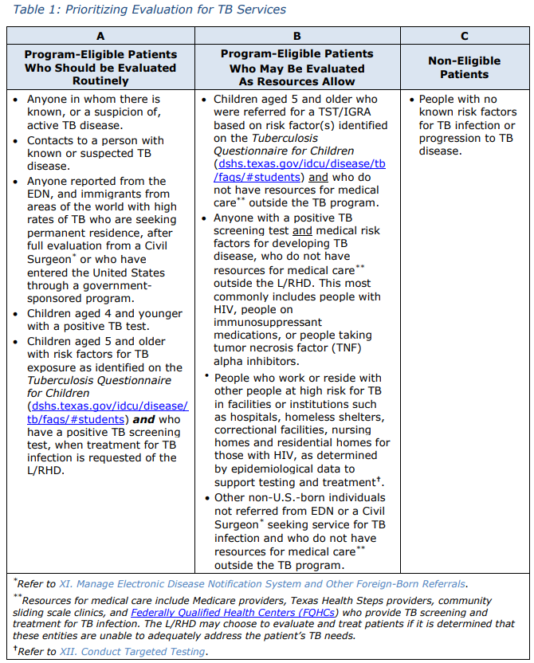
Priority Populations Managed in L/RHDs
Other Risk Factors
Contacts
Known, Suspected TB Disease
High-Risk Individuals, e.g., Foreign-Born
https://www.dshs.texas.gov/sites/default/files/LIDS-TB/policies/TexasTBManual.pdf
Notes:
Our vision and mission is to eliminate TB and by focusing our efforts on those who are at higher risk of developing contagious active disease, we could all take a part in stopping TB transmission. Let’s review those priority populations and high-risk factors.

Slide 9

How did I get here?
Many complex factors can contribute to latent TB infection and disease progression.
Notes:
There are many factors that contribute to LTBI and active disease. Currently the CDC is reporting up to 13 million people living with LTBI. These individuals don’t have symptoms and most likely never know they are infected unless they are tested. Without preventive treatment 10% of persons living with LTBI will develop active TB. 10% of 13 million equals 1,300,000. And 650,000 of those individuals will develop active TB within the first 2 years of infection.

Slide 10
TB High Risk categories
People at higher risk of being exposed to TB:
Were born in or frequently travel to countries where TB is common, including some countries in Asia, Africa, and Latin America
Live or used to live in large group settings where TB is more common, such as homeless shelters, prisons, or jails
Work in places where TB is more likely to spread, such as hospitals, homeless shelters, correctional facilities, and nursing homes
People at higher risk of developing active TB disease once infected:
HIV infection
Substance use (such as injection drug use)
Specialized treatment for rheumatoid arthritis or Crohn's disease
Organ transplants
Severe kidney disease
Head and neck cancer
Diabetes
Medical treatments such as corticosteroids
Silicosis
Low body weight
Children, especially those under age five
Notes:
So who is at greatest risk? TB Risk Factors are placed in two categories. High Risk factors are determined by places and conditions that increase risk. If an individual is born in a country where TB is prevalent, they are at higher risk of being exposed. The country where they are from may also determine if there is a higher probability of being exposed to a resistant form of TB. People who live or work in congregate settings and our homeless population is also at a higher risk. Persons with comorbidities that suppress the immune system fall into our 2nd high risk category as seen here. Furthermore those with a weakened immune system such as children <5y/o or HIV positive individuals will have an increased risk for complicated TB disease. They may suffer from TB meningitis, disseminated disease or other complications. So, it’s important to identify, screen and treat those high-risk infected persons before they become ill.

Slide 11
Reported Risk Factors in Texas Patients, 2024
Medical
Diabetes (21.5%)
Below Ideal Body Weight (10.9%)
Not HIV-related Immunocompromise (3.2%)
Human Immunodeficiency Virus (2.3%)
Gastrectomy (1.9%)
End Stage Renal Disease (1.7%)
Social
Correctional Facility Resident (13.6%)
Non-Injection Drug Use (10.5%)
Heavy ETOH Use (10.5%)
Experiencing Homelessness (5.2%)
Long-Term Care Resident (1.1%)
Injection Drug Use (1%)
Notes:
This slide provides the medical and social risk factors by percentage in 2024. The highest social risk factor listed are correctional facilities.

Slide 12

Collaboration with Correctional Facilities
Identify early to prevent transmission.
Consult and give guidance to successfully treat and monitor patients.
Facilitate and provide recommendations for contact investigations.
Required reporting should be sent to jail liaisons.
Notification of transfer/DC with POC should be reported for continuity of care.
Notes:
TB in correctional facilities affects our communities. This high transit population can be challenging to diagnose and treat but should be a high priority. Texas has multiple facilities including chapter 89 facilities, local jails, ICE detention centers and unaccompanied minor facilities. Collaboration with correctional facilities may include: identifying persons who have a suspicion of TB early to prevent transmission, provide consultation and guidance for treatment and monitoring, facilitate and provide recommendations for contact investigations, reporting should be sent to jail liaisons and timely notifications of transfers with point of contact should be reported for continuity of care.

Slide 13
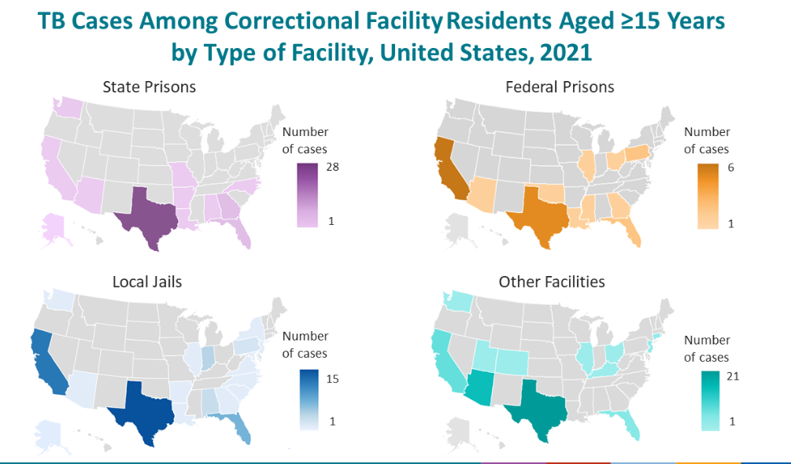
https://www.cdc.gov/tb/statistics/surv/surv2021/images/Slide55.PNG?_=75551?noicon
Notes:
Texas has some of the highest numbers in state prisons….
Currently Texas has the largest TB outbreak in correctional facilities in the country.
We have 3 large outbreaks of TB associated with state prisons in Texas.

Slide 14

The road to TB recovery
may require more than RIPE (rifampin, isoniazid, pyrazinamide, and ethambutol).
Notes:
Now that we have identified our highest risk factors, what does the road to recovery look like? Let’s start with, it’s never as easy as just providing DOT.

Slide 15

TB Case Management
Milestones
Initial Assessment
TB Medication and DOT Adherence
Monthly Assessments
Isolation
Initial Phase Completion
Drug Susceptibility Results
Diagnostics
Contact Investigation
Completion of Therapy
DSHS Resources
√ TB 201 Case Management Form
√ TB Manual Table 19: Milestones and Nursing Interventions
Notes:
TB case management entails an array of milestones. It includes initial and monthly assessments, diagnostic tests, isolation precautions, intensive and continuation phase of treatments via DOT or VDOT, contact investigations and much more.

Slide 16
Resources Available to Support TB Care
DSHS Laboratories
Bacteriology, chemistry, hematology, TB HIV, and hepatitis
Radiology and Imaging
Consultation Services
Heartland, clinical care, epidemiology, surveillance, and continuing quality improvement teams
Appointments
Medical and directly observed therapy
Federal Express (FedEx)
Cold-box shipping for specimens
University of Florida
Therapeutic drug monitoring (TDM)
Accurint
Verifying patient addresses
Quest Services
Interferon Gamma Release Assay (IGRA)
DSHS Pharmacy
TB medications and TST supplies
https://www.dshs.texas.gov/sites/default/files/LIDS-TB/publications/TBResources.pdf
Notes:
We need all the resources we can get and DSHS does provide the above resources.

Slide 17
Additional Resources TB Patients May Need
Primary Care Services
  Diabetes, hypertension, malnutrition
Non-TB Medications
Dialysis
Specialists
  Pediatrician, cardiologist, neurologist, oncologist
Infectious Disease Management
  HIV, chronic hepatitis
Hospitalization
Medical Procedures
  Surgery, bronchoscopy, tissue biopsy, interventional radiology
Addiction Treatment
Mental Health
Vision and Dental Care
Social Services
  Financial hardship, homelessness, food insecurity
Notes:
Due to limited funding and resources there may be additional resources that are needed. How many times have we had a patient that doesn’t have a PCP or can’t afford their non-TB medications. TB patients often have other comorbidities that are not addressed due to lack of insurance or high copays and deductibles. TB often affects vulnerable groups such as children, HIV positive persons, migrants, prisoners, or those individuals with mental health or addiction concerns. Tb can also be an additional financial hardship to these vulnerable populations.

Slide 18
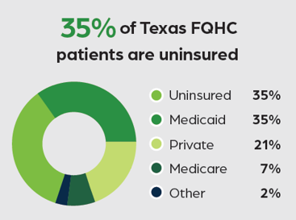
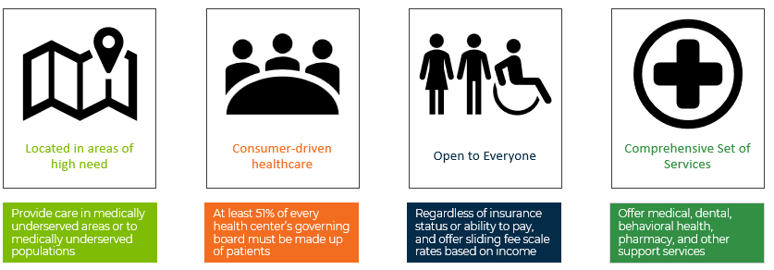
Federally Qualified Health Centers (FQHC)
Provide comprehensive services to insured and uninsured patients regardless of the ability to pay.
Find a FQHC: https://findahealthcenter.hrsa.gov/
Notes:
How do Federally Qualified Health Centers play a role to help bridge the gap? These centers are able to provide services to both insured and uninsured patients.

Slide 19
Establishing a Medical Home and Other Community Resources*
Aging and Disability Resource Center ADRC@hhs.texas.gov
Dial 211 or www.211texas.org
https://findhelp.org/
Federally Qualified Health Centers (FQHCs)
County Indigent Health Care Program (CIHCP)
*Additional resources listed in the DSHS Texas TB Manual, Appendix F
Notes:
Community Health Workers may be able to assist with bridging the gap between patients and linking to a medical home.

Slide 20

Barriers to Care
Outside the TB Program
Medical records requests
TB stigma
Isolation requirements
No health insurance
Lack of transportation
Misinformation
Mental health diagnosis
Language barrier
Notes:
Limited resources, TB stigma, weak health systems add to the obstacles TB programs face.

Slide 21
TB Nurse Collaboration
Notes:
So what can help us collaborate?

Slide 22

Keys to Collaboration
Professionalism
Plan of Care
Partnership
Point of Contact
Notes:
Maintaining professionalism, having an organized plan of care, building rapport while establishing partnerships and obtaining point of contacts are key when collaborating care.

Slide 23

Obtaining Medical Records
Health Insurance Portability and Accountability Act of 1996 (HIPAA) Title 45 CFR part 164.512
Indicates that protected health information (PHI) can be disclosed to public health authorities, without individual authorization, for public health surveillance, investigations, and interventions.
See Texas TB Manual, Appendix D: Correspondence Letter
CDC Self Study Modules on TB, Module 7: Patients Rights and Confidentiality in TB Control
Notes:
As the health department we are able to obtain medical records without individualized authorization for surveillance, investigations and interventions.

Slide 24
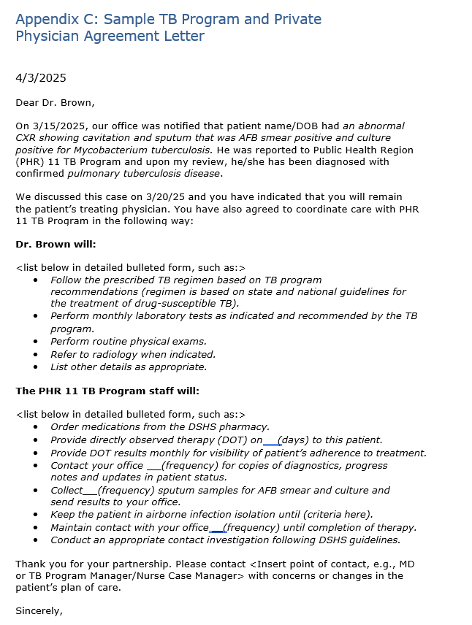
Formalizing Coordination of Care
A letter between provider and the program can clarify the roles and responsibilities of both entities to ensure successful coordination of care.
Key elements of a coordination letter:
  Patient and diagnoses
  Expectations for the private provider
  Expectations for the TB program
Texas DSHS TB Manual, Appendix C
https://www.dshs.texas.gov/sites/default/files/LIDS-TB/policies/TexasTBManual.pdf
Notes:
Coordination of care should be documented with clear roles and responsibilities.

Slide 25
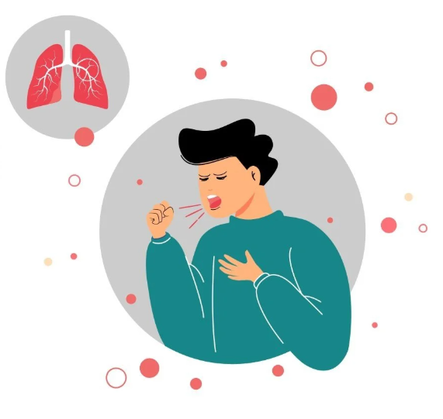
Role of TB Nurse Case Manager in Infection Control
Patients with suspected or confirmed TB disease should receive a “TB Control Order”
  Texas DSHS TB 410
  https://www.dshs.texas.gov/tuberculosis-tb/texas-dshs-tb-program-tb-forms-resources
Educate providers on isolation guidelines and release criteria:
  Texas DSHS Clinical Standing Delegation Orders (section F11)
  https://www.dshs.texas.gov/sites/default/files/LIDS-TB/policies/TB-SDO-ClinicalServicesforNurses-25.pdf
Notes:
Prevention of continued transmission of disease is part of the nurse case management role. It’s important to educate the patient, family and providers on isolation guidelines and criteria to be released from isolation.

Slide 26
Coordinating Care with External Facilities
Chapter 89 Facilities
Immigration and Customs Enforcement (ICE)
US Marshal Service (USMS)
Texas Center for Infectious Disease (TCID)
Unaccompanied Children (UAC) Shelter
Bureau of Prisons (BOP)
Inpatient Care (i.e., hospital, long-term care, rehabilitation center)
Private Providers
Case management milestones must be achieved regardless of where patient is managed.
Milestones
Initial Assessment
TB Medication and DOT Adherence
Monthly Assessments
Isolation
Initial Phase Completion
Drug Susceptibility Results
Diagnostics
Contact Investigation
Completion of Therapy
Texas DSHS Manual Table 2 https://www.dshs.texas.gov/sites/default/files/LIDS-TB/policies/TexasTBManual.pdf
Notes:
Our patients are mobile at times and may even cross jurisdictions. It’s important to coordinate with external facilities to verify that a patient’s continuity of care is being met.

Slide 27

Providing State TB Medications
√ Purchased Under 340 B Drug Pricing Program
√ Facilities (jails, hospitals) need to have a plan in place access TB medication
√ Intended for outpatient use by Texas TB programs
Note: State purchased medications cannot be distributed outside the local and regional TB programs.
Notes:
Remember that state purchased medications purchased under the 340B program can’t be distributed outside TB programs.

Slide 28

Maintaining Standards of Care
What to do when an external provider’s care does not align with established standards of care?
  Engage your Medical Director and/or Local Health Authority(LHA) for support.
  Consultation services can support your TB program in following standards of care
Texas DSHS TB Manual Section V
https://www.dshs.texas.gov/sites/default/files/LIDS-TB/policies/TexasTBManual.pdf

Slide 29
Case Scenarios

Slide 30

Collaboration Opportunity #1
The Private Provider
Scenario:
A family physician diagnoses an 60-year-old male with pulmonary TB. He orders self-administered therapy (RIF, INH and EMB) and does not report him to the TB program. He decides DOT is not needed since the patient is trustworthy.
You first learn about this patient two months after treatment initiation, when susceptibility results are reflexively faxed to your TB program.
Nurse Actions May Include:
Educate the patient and provider on your role and the role of your local public health TB program.
Schedule a provider-to-provider meeting or call to review the plan of care.
Perform a new baseline assessment.
Draft a coordination of care letter.
Verify correct medication regimen, obtain orders, and transition to DOT.

Slide 31
Collaboration Opportunity #2
The Jail
Scenario
A jail nurse calls your TB program because an inmate transferred to their facility today from a larger jail. The patient stated he needs his TB medications, but the current jail can't find any records of treatment. The nurse asks, “Should we just put him on RIPE?"
TB Nurse Actions May Include
Locate the patient’s NEDSS investigation.
Contact the provider from the previous jail for case details.
Instruct the jail on isolation recommendations.
Ensure a new baseline assessment is performed.

Slide 32
Collaboration Opportunity #3
The Community Clinic
Scenario
During your initial assessment of a new patient, she reports seeing a doctor at a local clinic although she hasn’t been to the clinic in awhile because her medications were too expensive.
Assessment findings include:
Blood glucose 386
5’8” and 40kg
Blood pressure 190/95
Next appointment is scheduled to see this clinic in one week
Nurse Actions May Include
Collect history and physical, share TB treatment plan with clinic provider after L30 signed.
Review medications to ensure no drug interactions.
Identify social services in the community.
Draft a coordination of care letter.
Provide isolation guidance to the clinic provider for in-office visits.

Slide 33

Take Home Points for Collaborating with Private Providers
Nurse case managers play an important role connecting patients to outside care.
Be prepared to educate and collaborate with the non-TB medical community.
Seek consultation when external provider orders conflict with Texas standards.
Good collaborators make great leaders!
Notes:
Public Health plays an important role in linking patients to care, educating the community and seeking consultation when there is a conflict in standards of care.

Slide 34
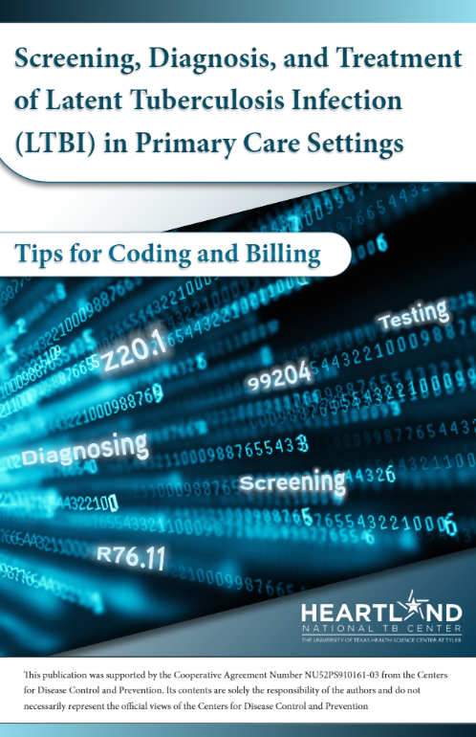
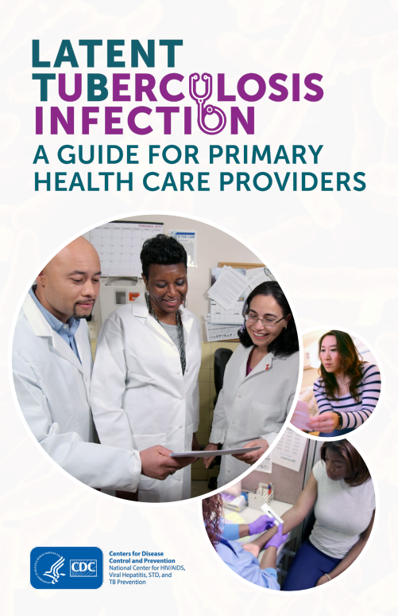
Provider Education
Heartland
https://www.heartlandntbc.org/products/
CDC
https://www.cdc.gov/tb/education/FAQforProviders.htm
https://www.cdc.gov/tb/publications/ltbi/default.htm
https://www.cdc.gov/tb/publications/slidesets/ltbi/default.htm
https://www.cdc.gov/mmwr/volumes/69/rr/pdfs/rr6901a1-H.pdf - Guidelines for the Treatment of Latent Tuberculosis Infection: Recommendations from the National Tuberculosis Controllers Association and CDC, 2020
https://www.cdc.gov/tb/publications/guidelines/pdf/clin-infect-dis.-2016- nahid-cid_ciw376.pdf - Official American Thoracic Society/Centers for Disease Control and Prevention/Infectious Diseases Society of America Clinical Practice Guidelines: Treatment of Drug-Susceptible Tuberculosis. Clinical Infectious Diseases (2016), 63 (7): e147-e195.
DSHS – TB Unit
https://www.dshs.texas.gov/tuberculosis-tb
  Resources for Healthcare Professionals - Frequently Asked Questions
Notes:
Several educational materials are available at the tip of our fingers. Together we can strive to eliminate TB and have a healthier, happier community.

Slide 35
Additional References
Media Headlines:
https://www.respiratorytherapyzone.com/largest-tuberculosis-outbreak-kansas/
Texas Department of State Health Services:
TB Funded Programs | Texas DSHS
Texas Tuberculosis Manual
Texas Department of State Health Services Standing Delegation Orders for Tuberculosis Clinical Services Provided by Authorized Licensed Nurses, Fiscal Year 2025
TB Forms Resources | Texas DSHS
Rules and Regulations | Texas DSHS
TB Resources
Heartland National TB Center:
http://www.heartlandntbc.org/training/
Centers for Disease Control and Prevention:
https://www.cdc.gov/tb/media/pdfs/Self_Study_Module_7_Patient_Rights_and_Confidentiality_in_Tuberculosis_Control.pdf
Slide55.PNG (1280×720)
Additional Resources:
https://www.drugs.com/drug_interactions.html
https://www.currytbcenter.ucsf.edu/sites/default/files/2022-12/Rifamycin_2022.pdf
https://findahealthcenter.hrsa.gov/

Slide 36
Thank You!
Maricela.Zambrano@dshs.texas.gov

Slide 37
Thank you to
Amanda Decimo, RN, MSN, MPH, Nurse Consultant
Texas Department of State Health Services
Tuberculosis and Hansen’s Disease Unit for providing slides for this presentation.

