Slide 1
Components of TB Patient Assessment
TB Nurse Case Management
Presented by Vickie Fuller, ADN, RN Texas DSHS Region 6/5 S TB Nurse Consultant
Developed by Jacquline I Maldonado, DNP, RN

Slide 2
Disclosures
Vickie Fuller, ADN, RN has the following disclosures to make:
No conflict of interests
No relevant financial relationships with any commercial companies pertaining to this educational activity

Slide 3
Objectives
Identify components of TB patient assessment
Medical history
TB history
TB signs and symptoms
Co-morbidities

Slide 4

Nurses Assessment

Slide 5
Purpose of Nurse Assessment
Identifies the needs, preferences, and abilities of a patient.
Includes an interview with and observation of a patient and considers the symptoms and signs of the condition, the patient's verbal and nonverbal communication, the patient's medical and social history, and any other information available.
Provides the scientific basis for a complete nursing care plan.
medical-dictionary.thefreedictionary.com/nursing+assessment
Notes:
Helps to identify potential problems that could affect a patient’s outcome.
The initial assessment helps to set the foundation that the patient’s care is built on.

Slide 6

Nurse Assessment
Done initially
Updated and ongoing
Physically view patient.
Appearance (i.e., thin, frail)
Assess symptoms.
Clinically improving or worsening
Manage side effects/toxicities.
Prevent adverse reactions.
Intervene rapidly.
Address issues immediately.
Notes:
This begins at initial contact, often by phone. Are they able to hold a conversation without becoming SOB? We can also assess some level of understanding during that first conversation. Do they have the resources to get to the clinic?
We use all our senses when assessing our patient: what do we see (gait, dress, grooming, are they making eye contact), hear (audible breath sounds, does what they say match with what we see) smell and feel?

Slide 7
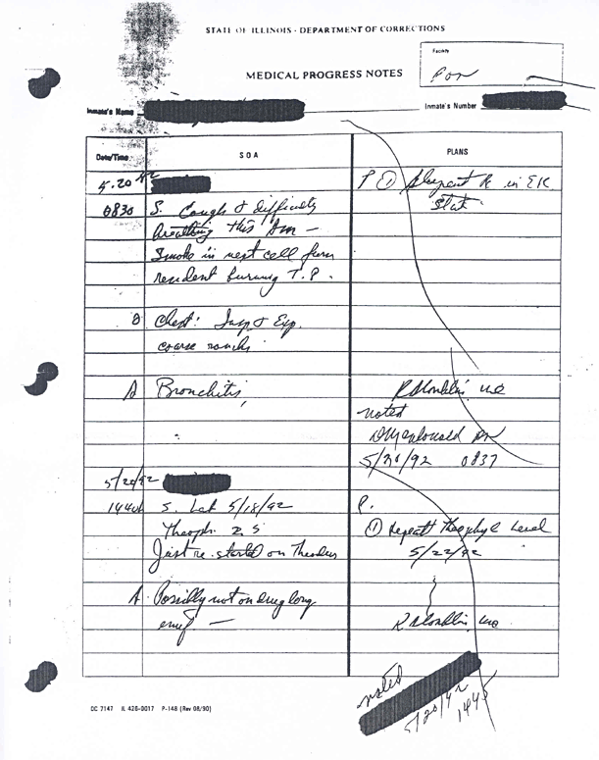
Assessment
Gather data
Collect medical history from all medical providers to determine onset of symptoms.
Hospital
H&P, admission notes, discharge summaries, microbiology results, lab reports, radiology reports
Health dept. records
Prior screenings
Prior CXR
Treatment of LTBI or TB disease
PCP notes
Prior c/o TB symptoms
Allergies
Cough
Notes:
Did they have a check up with their PCP recently? Within the last year? This could help establish a period of wellness or onset of symptoms. Have they been treated for the past year for recurrent pneumonia? Gather those records, may help show symptom onset dates.
We use all our senses when assessing our patient: what do we see (gait, dress, grooming, are they making eye contact), hear (audible breath sounds, does what they say match with what we see) smell and feel?

Slide 8

Confidentiality and Privacy
Maintain confidentiality and privacy.
Ensure that the patient is comfortable.
If done at the clinic or home:
Can do assessment outdoors.
Do not have to use mask.
Build rapport.
Notes:
This is important at every patient interaction, in person or by phone.
Comfortable patients may feel “safer” to share details and this can be vital to the contact investigation.

Slide 9

Building Rapport
Obtaining essential information to develop a treatment plan specific to that patient:
Medical
Social
Do not interrogate.
Do not use judgmental tone.
If the patient feels interrogated or judged, the patient is likely to be closed and unresponsive to questions and may disregard advice and instructions.
Keep an open mind!
Notes:
Building rapport: Are you making eye contact with your patient? Are you checking your watch? Do you allow them time to speak and express concerns? Ask questions? Are you communicating with them in their preferred language and on their “level”? Are you using patient centered language? (compliance vs adherence, suspect vs person being evaluated for TB)

Slide 10
Person-Centered Care
Empowers Recipient of Care
Promotes Respect
Improves Quality of Life
Person- Centered Care
Honors Choice
Supports
Independence
Promotes Positive
Well-Being
Notes:
Person-centered care (PCC) is often equated with patient-centered care.
The Institute of Medicine describes patient-centered care as including qualities of compassion, empathy, respect and responsiveness to the needs, values, and expressed desires of each individual patient. It is inclusive of care that ensures that patient values guide clinical decisions (IOM, 2001, pp. 48-50).
However, person-centered care is more holistic and includes family, significant others, context, prevention, promotion, and preferences, among other elements (Santana et al., 2018).

Slide 11
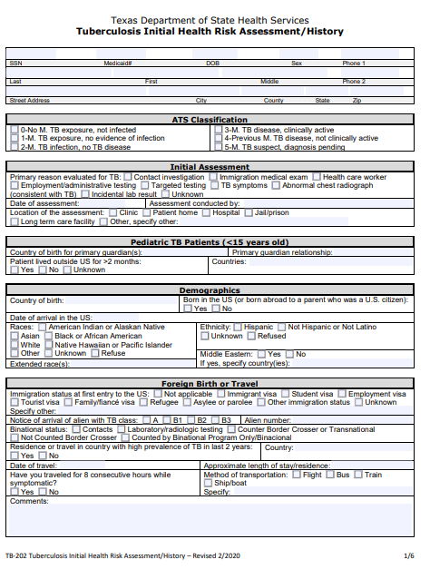
Nurse Assessment
Notes:
TB202 guides us while collecting information during our assessments

Slide 12
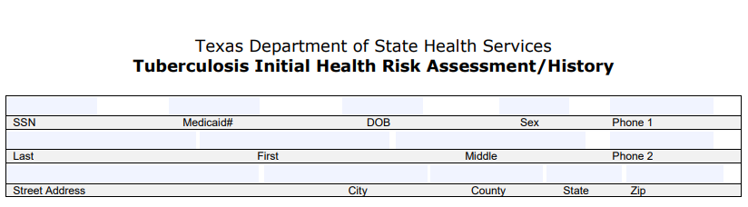
Demographics
Get as much information as you can about where patient can be located.
How long at this address?
Previous address
Alternate address
Get emergency contact information.
Who can be contacted to locate patient if:
Unable to locate
In case patient moves

Slide 13
Demographics
Notes:
Important information for contact investigations: help to identify contacts.
Could be useful information for treatment decisions: have they traveled to or spent time in areas with high incidences of DR?

Slide 14
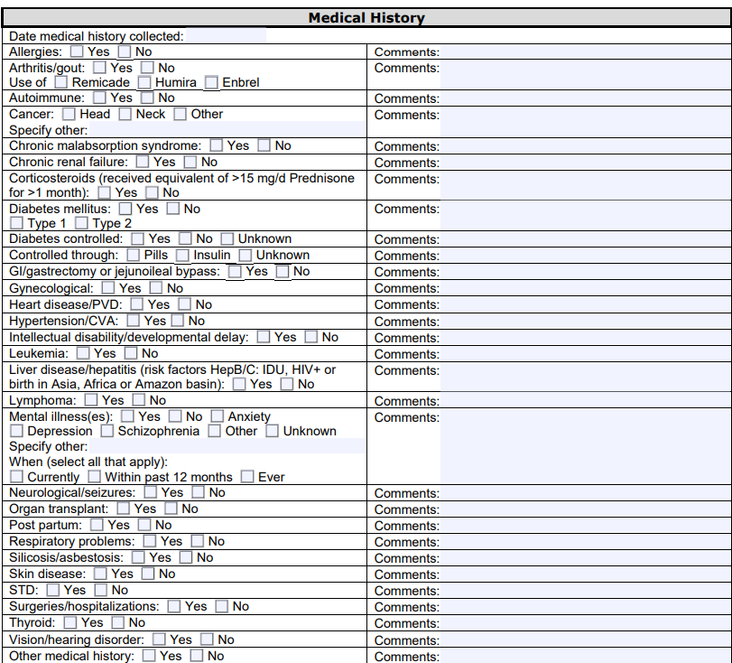
Demographics
Notes:
Get the details: when were they diagnosed with diabetes? Cancer treatment dates? Steroid use dates? Biologic names as well as first dose, last dose and next dose due dates.
Get names and contact information of physician specialists the patient sees/has seen.

Slide 15
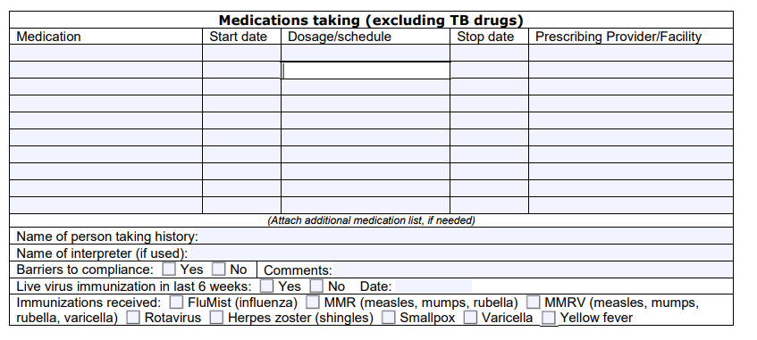
Medication List
Assessment should also collect information about all medications your patient is taking.
Collect information about both prescribed and over-the-counter medications:
Start date
Dose
Schedule
Prescribing physician
Update as needed
Notes:
Don’t forget to ask about any and all supplements used.

Slide 16
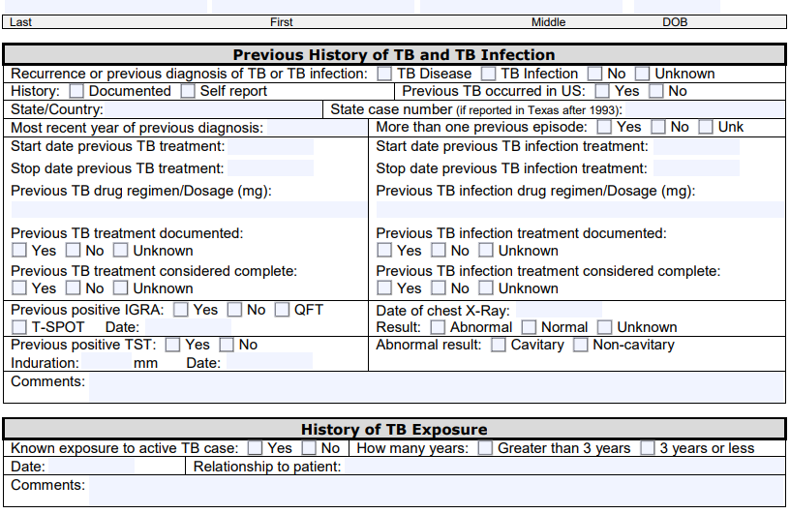
TB History
May have to contact local health department in city/county that patient lives in.
May have previously been screened as a contact to a case.
Contact to an MDR case.
Determine if patient previously treated for LTBI or TB disease.
How long?
Six, nine, 12, 18, 24 months
What drugs?
Supporting documentation
Notes:
If known exposure, ask for details: name, where do they live.
Refer to slide on maintaining confidentiality, privacy and rapport. (#7 and #8)

Slide 17
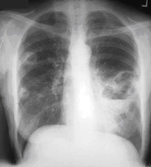
Radiology
Gather all radiology reports.
X-rays, CT scans, PET scans, MRIs
Reports show cavities? Infiltrates? Scarring?
Films for comparison?
Notes:
If the patient has “normal” chest imaging in the past, gather those also.

Slide 18
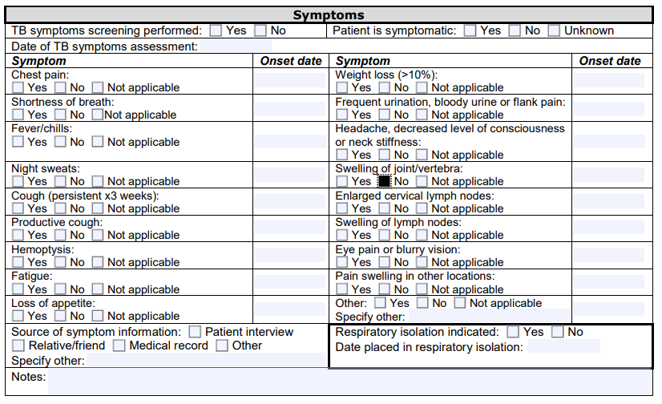
TB Symptoms
Notes:
Ask patients to be as specific as possible about their symptom onset dates. (season, around a special event – birthday, holiday).
Important to educate the patient on the importance of symptom onset identification.

Slide 19



Gathering Information
Gather chronological history of presenting signs and symptoms.
Most patients will have difficulty remembering when symptoms began.
Refer back to important dates and times.
Christmas, Thanksgiving, birthday, birth of a baby
These cues may prompt patient memory and give us more accurate dates to when symptoms began.
Important in determining infectious period and conducting contact investigations.
Notes:
All while reassuring the patient that their privacy will be honored.
That established rapport early in the assessment may affect patient’s openness/information sharing.

Slide 20
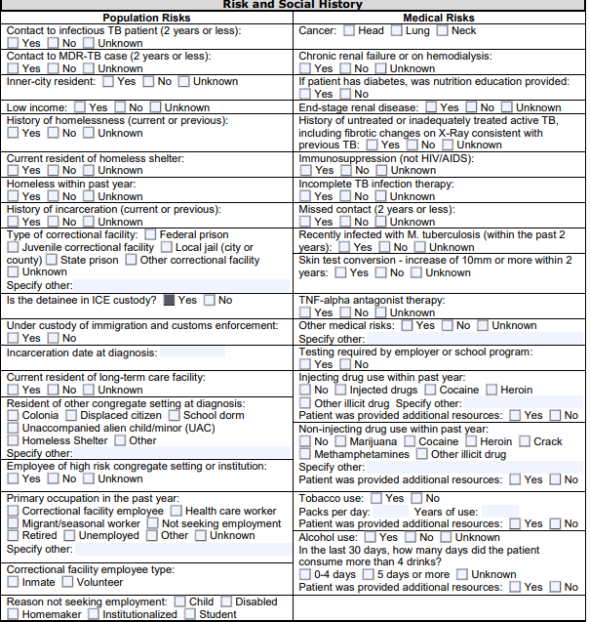
Social History
Notes:
Again, establishing rapport early in the process is important.
Reassure patients that information is being gathered to help guide treatment decision and not for punitive purposes.
Use non-judgmental communication: verbal and non-verbal

Slide 21
Summary
The TB case manager should conduct a face-to-face interview with the patient to develop a plan of care.
Assessment is ongoing and dynamic and should be continuous throughout the course of the patient’s treatment.
The purpose of assessment is to develop a treatment plan with a goal for successful completion of treatment.
Notes:
Again, establishing rapport early in the process is important.
Reassure patients that information is being gathered to help guide treatment decision and not for punitive purposes.
Use non-judgmental communication: verbal and non-verbal

Slide 22
References
American Association of Colleges of Nursing. (n.d.) Person-centered care. aacnnursing.org/5b-tool-kit/themes/person-centered-care#:~:text=The%20Institute%20of%20Medicine%20describes,48%2D50).
Institute of Medicine. 2001. Crossing the Quality Chasm: A New Health System for the 21st Century. Washington, DC: The National Academies Press. doi.org/10.17226/10027.
The Free Dictionary. Nurse assessment. medical-dictionary.thefreedictionary.com/ nursing+assessment
Debbie Davila
Notes:
Again, establishing rapport early in the process is important.
Reassure patients that information is being gathered to help guide treatment decision and not for punitive purposes.
Use non-judgmental communication: verbal and non-verbal

Slide 23
Thank you!
Components of TB Patient Assessment
Vickie Fuller, ADN, RN Texas DSHS Region 6/5 S TB Nurse Consultant

