Slide 1
Heartland National TB Center’s Stop the Stigma Campaign Lauren Fields, MEd, BA September 19th, 2025
TB Nurse Case Management ∙ September 17th - 19th, 2025 ∙ Houston, Texas
Notes:
Hello!
My name is _________ and I will be presenting on stigmatizing language and terminology in TB care.

Slide 2
Objectives
Define Stigma
Discuss the effect of stigma healthcare and preferred terminology
Discuss Heartland National TB’s Center’s “Stop the Stigma” campaign within the TB Care Movement
Notes:
Objectives for this presentation are to…
define stigma by discussing stigma in TB care…
the impact of stigma on treatment outcomes and substance use disorder…
And discuss the stop the stigma movement in TB care…

Slide 3
What is Stigma?
“Stigma is a mark of disgrace that sets a person apart from others. When a person is labelled by their illness they are no longer seen as an individual but as part of a stereotyped group. Negative attitudes and beliefs toward this group create prejudice which leads to negative actions and discrimination.”
Stigma-Free Society. https://stigmafreesociety.com/stigma/ Accessed June 16, 2020.
“A sign or a mark that designates the bearer as spoiled and therefore as valued less than normal people.” - Goffman E. (1963)
Notes:
So what is Stigma?
Stigma is defined as a mark of disgrace that sets a person apart from others due to a particular illness or circumstance.
Stigmatizing groups individuals by labels and stereotypes, causing the person to feel less of themselves or less of an individual.
Sociologist Erving Goffman personally describes stigma as a sign or a mark that designates the bearer as spoiled and therefore valued less than normal people

Slide 4

Everything is Tuberculosis: The History and Persistence of Our Deadliest Infection, written by John Green
A compelling story about the science and history behind the world’s deadliest infectious disease through the memoir of a patient he met in Sierra Leon, highlighting the social factors that allow a curable disease to prevail in the world.

Slide 5
Food for Thought from Chapter 9: Not A Person
“People who are treated as less than fully human by the social order are more susceptible to tuberculosis. But it’s not because of their moral codes or choices or genetics; it’s because they are treated as less than fully human by the social order.” (pg. 86)
“Stigma is a way of saying, ‘You deserve to have this happen,’ but implied with the stigma is also, ‘And I don’t deserve it, so I don’t need to worry about it happening to me.’” (pg. 86)
“A young woman who was abandoned by her family told me, ‘To
them I am not a person.’ There were times that she wished she had died of TB rather than being cured of it, because the ongoing stigma was so profound.” (pg. 88)

Slide 6
How Can Stigma Affect Healthcare?
Stigma is linked to poor health.
Stigma is associated with greater social isolation.
Social isolation increases risk for poor health outcomes.
Stigma-health relationship is significantly strained after adjustment for social isolation.
Hatzenbuehler, M., Phelan, J., Link, B., Stigma as a Fundamental Cause of Public Health Inequalities, American Journal of Public Health, May 2013, Vol 103, No.5
Notes:
So how exactly can stigma affect healthcare?
The fundamental cause theory proposes that some social factors or circumstances remain persistently associated with health inequalities.
Stigma meets fundamental cause criteria and deserves consideration as a major and persistent influence on population health.
Stigma can also be associated with greater social isolation, which leads to social and health inequalities for individuals.
Last but not least, social isolation can increase the risk for poor health outcomes due to the decrease in access to resources, such as education, money, and beneficial social connections, which in turn could be used to minimize the consequences of disease once it occurs.

Slide 7
How Can Stigma Affect TB Care?
Contributes to a delay in diagnosis
“At-risk individuals report that fear of TB stigma and the social and economic impact of stigma affects their willingness to undergo TB screening and to seek medical care after the onset of symptoms associated with TB.”
“Individuals with TB and their health-care providers also identify TB stigma as a cause of non-completion of treatment.”
Courtwright, A., & Turner, A. N. (2010). Tuberculosis and Stigmatization: Pathways and Interventions. Public Health Reports, 125 (Suppl 4), 34–42.
Notes:
So people wonder how can Stigma affect TB care?
Well, there is a widely held view that TB stigma contributes to the delay in TB diagnosis and negatively impacts treatment compliance.
At-risk individuals reported that fear of TB stigma and the social and economic impact of stigma, sometimes affects their willingness to undergo TB screening and to seek medical care after the onset of symptoms.
Often, individuals with TB-like symptoms may first seek private physicians, in an effort to avoid TB stigma.
A significant cause of non-completion of treatment has been linked to TB stigma by Healthcare providers and individuals with TB.

Slide 8
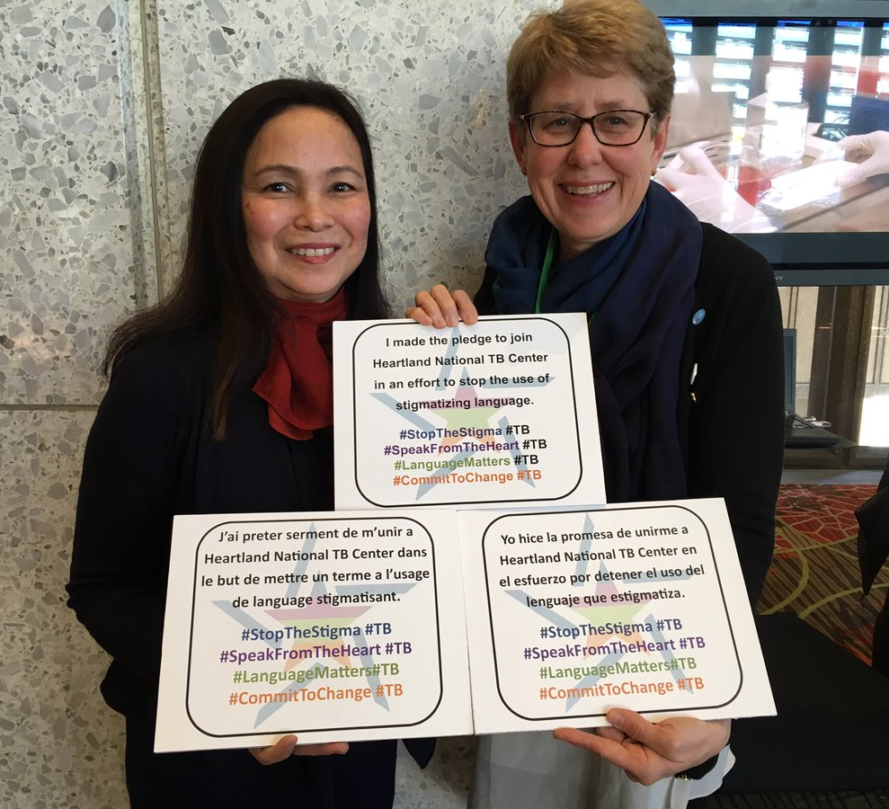
The Stigma of Tuberculosis
“Fear of infection is the most common cause of TB stigma”
By using non-stigmatizing language, we can begin to breakdown the stigma associated with TB.
Courtwright, Andrew, and Abigail Norris Turner. “Tuberculosis and Stigmatization: Pathways and Interventions.” Public Health Reports 125.Suppl 4 (2010): 34–42. Print.
Notes:
The stigma of tuberculosis
Fear of infection is the most common cause of TB stigma
“Stigmatization is a complex process involving institutions, communities, as well as inter- and intrapersonal attitudes. While it has been recognized as an important social determinant of health and health disparities, the difficulties in identifying, characterizing, measuring, and tracking changes in stigmatization over time has made it challenging to justify devoting interventions to the problem.”

Slide 9
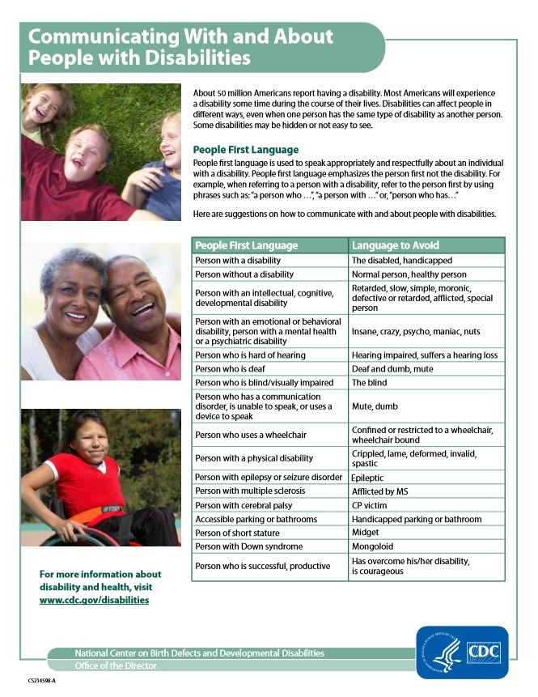
People First Language
For example:
When referring to a person with a disability, refer to the person first by using phrases such as:
A person who …
A person with …
Person who has…
Notes:
Here we have a document from the CDC which breaks down communicating with and about people with disabilities. People first language is used to speak appropriately and respectfully about an individual with a disability. People first language emphasizes the person first, not the disability.
The same can be applied when speaking about someone with TB
For example:
when referring to a person with suspected TB or a person affected by TB, refer to the them first, by using phrases such as: “a person who … is blind”, “a person with … epilepsy”, or “person who has… a learning disorder”

Slide 10
Where It All Began
Roots of the Language Change Movement in TB Care
Notes:
Let’s take a moment to reflect and understand where the roots of the language change movement in TB care came from

Slide 11
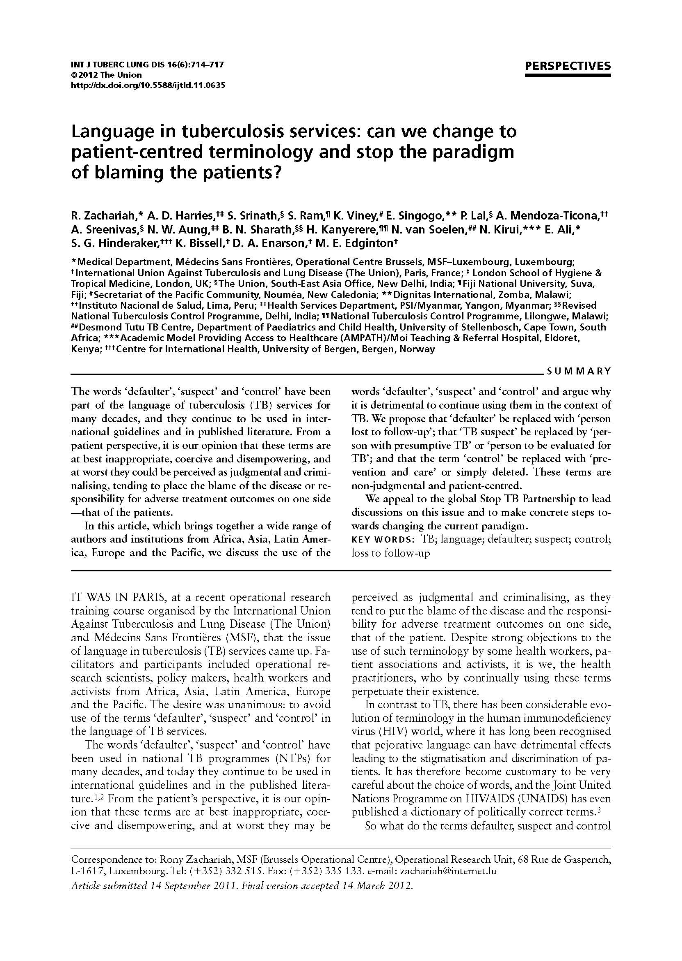
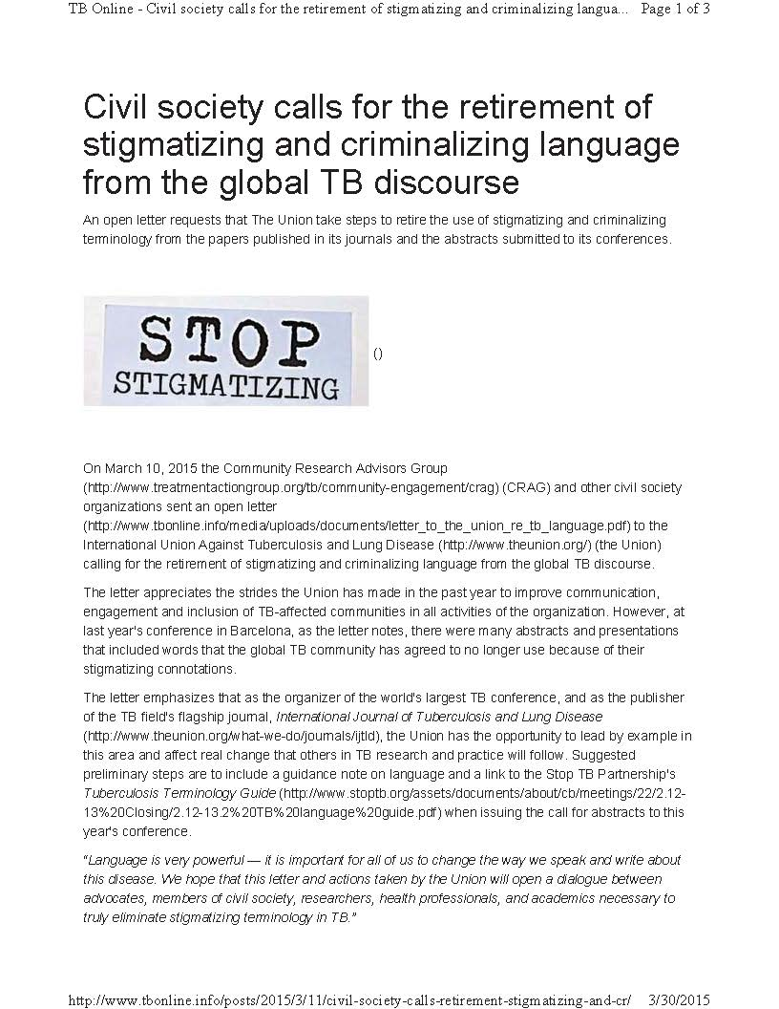
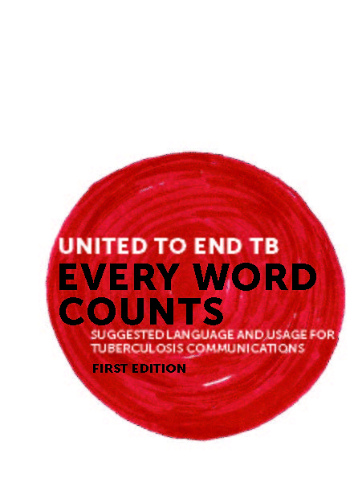
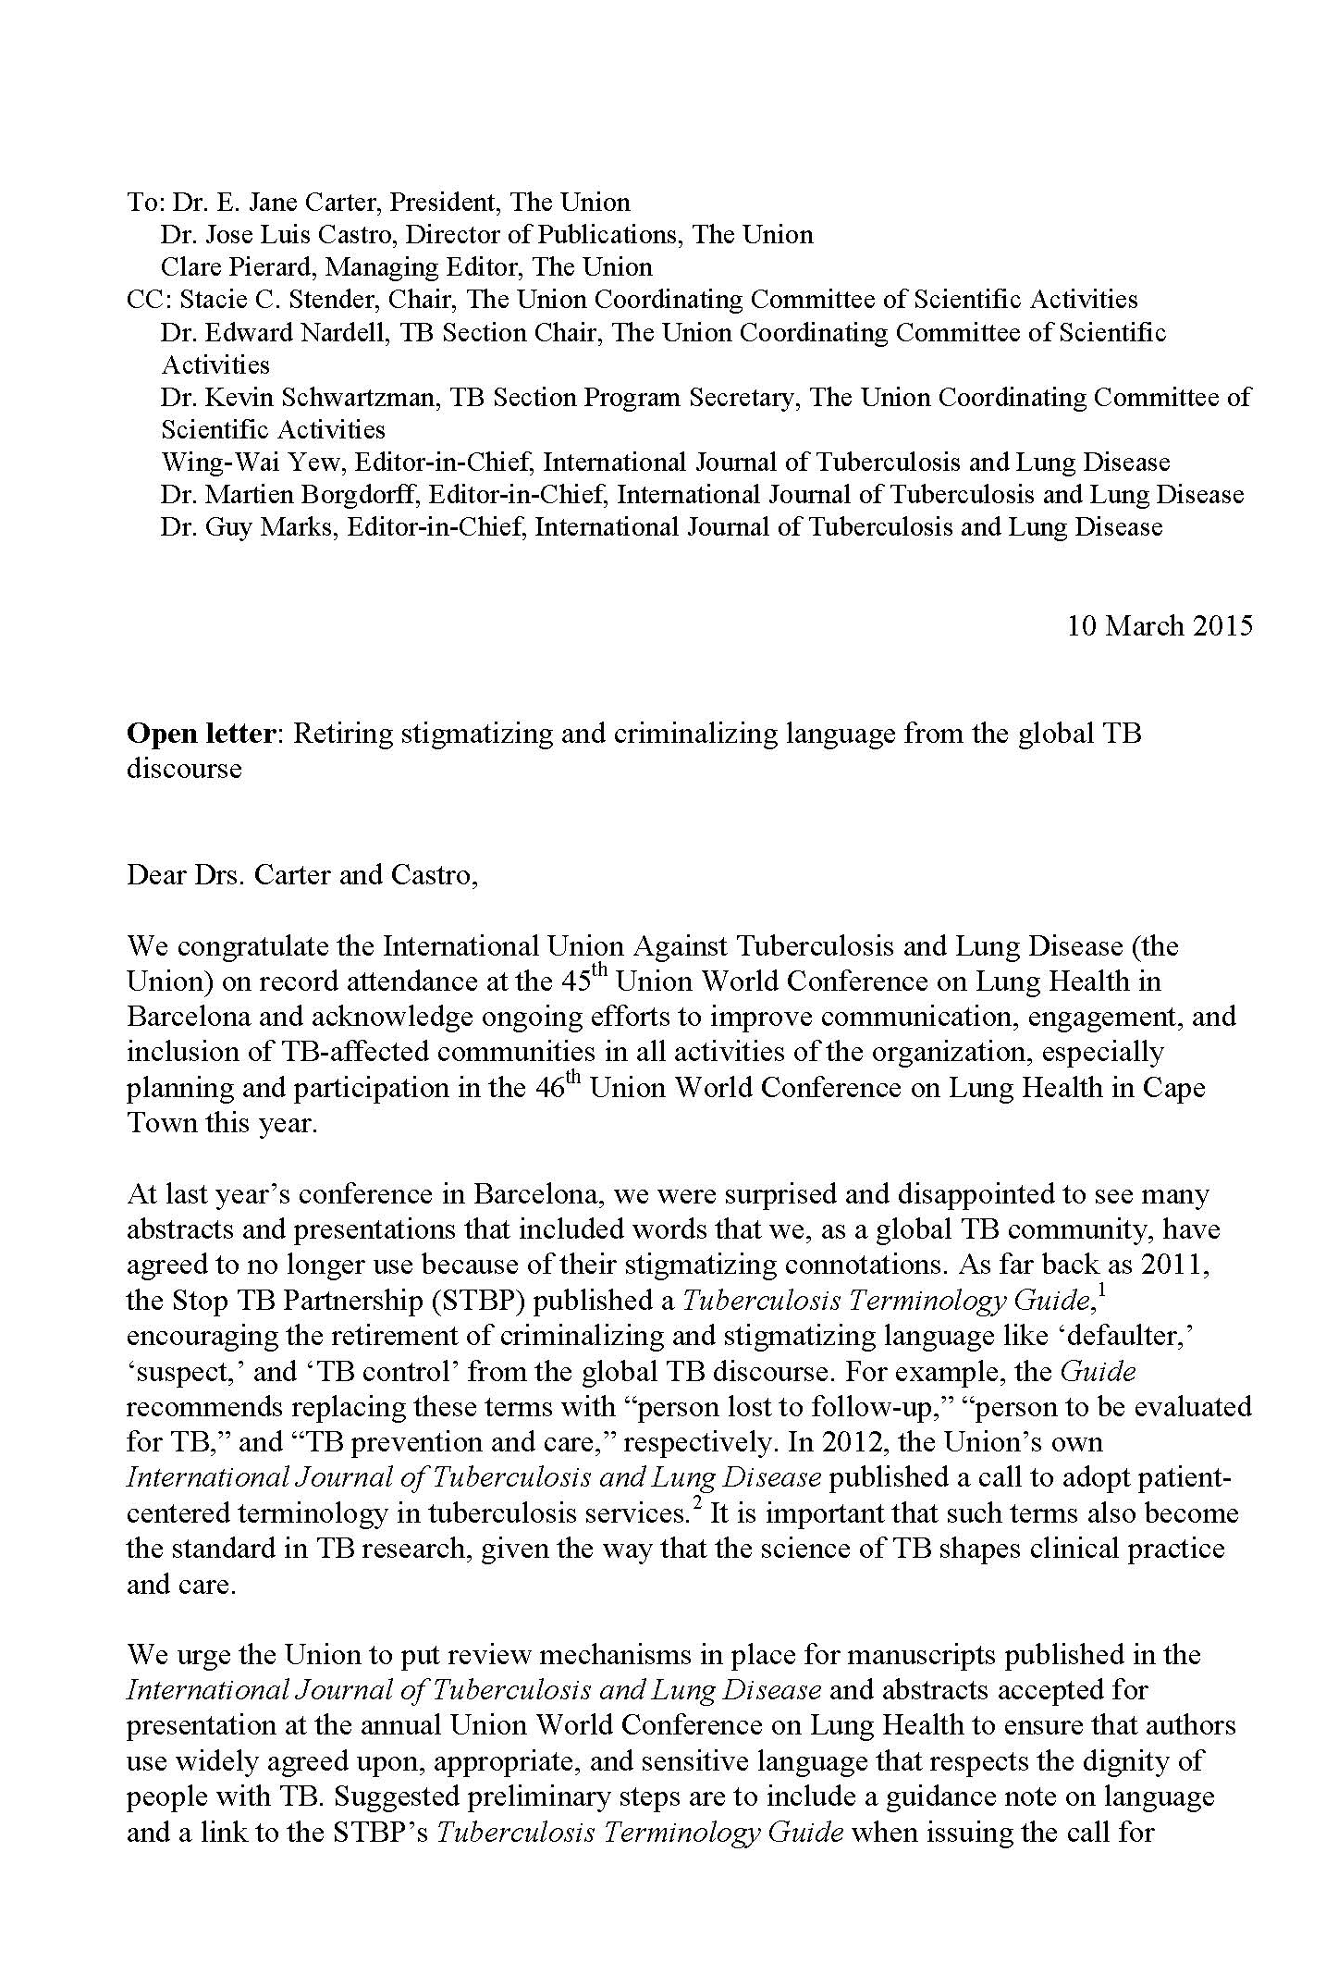
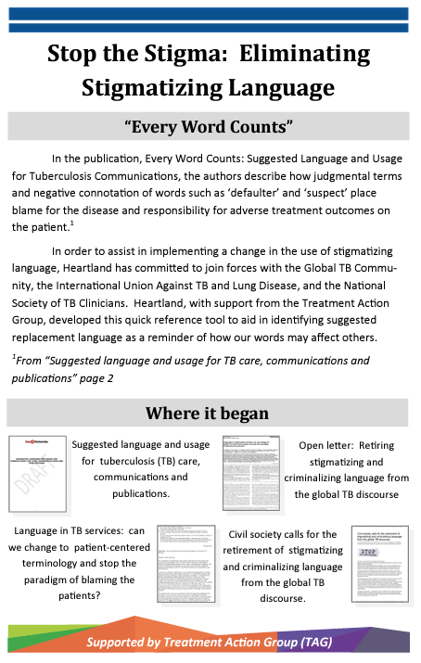
Timeline
Defaulter
Suspect
Control
Open Letter Retire Stigmatizing and Criminalizing Language from Global TB Discourse
Every Word Counts
TB Language Guide
Heartland National TB Center creates the “Stop the Stigma” campaign.
2012
2012
March
2015
2015
2015
Language in TB Services: can we change to patient-centered terminology and stop the paradigm of blaming the patients?
Civil Society Calls for Retirement of Stigmatizing and Criminalizing Language from Global TB Discourse
Notes:
Members of the public health community have been working to promote the avoidance of harmful and stigmatizing language used in TB care.
Heartland is committed to joining forces with these patient advocates to eliminate stigmatizing language.
The usage of words such as “defaulter”, “suspect”, and “control” is not only hurtful (click) but also judgmental, criminalizing, and places blame on patients.
This timeline shows major events and their occurrence in the language change movement.
(Click) In 2012, The United Nations office for Project services published Every word counts, a guide on suggested language for TB communication
(Click) Also in 2012, The International Journal of Tuberculosis and Lung Disease published an article proposing better patient-centered terminology that stops patient blame.
(Click) In 2015, the International Union Against TB and Lung Disease, and The Community Research Advisors Group, both disclosed in an open letter, the retiring of stigmatizing and criminalizing language from the global TB discourse.

Slide 12
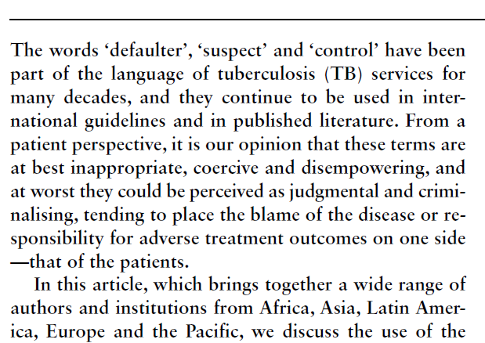
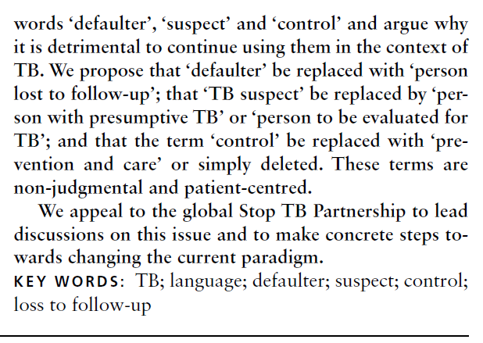
A Call to Change
Defaulter
Person lost to follow-up
Suspect
Person with presumptive TB
Control
Prevention and care
Notes:
In this International Journal of TB and Lung Disease article, (Click) special attention is given to non-judgmental and patient-centered alternative language for TB services.
(Click) The word defaulter should be replaced with…person lost to follow-up
(Click) The word suspect should be replaced with…person with presumptive TB
(Click) And the word control should be replaced with…prevention and care
These words have been part of the language of tuberculosis services for many decades and continues to be used in international guidelines and in published literature.

Slide 13
Suspect
Suspect (verb)
To believe or feel that (someone) is guilty of an illegal, dishonest or unpleasant act, without certain proof
Suspect (noun)
Person thought to be guilty of a crime or offense
Why did the TB community decide to transfer the ‘suspicion’ of the disease to the patient?
Default/a defaulter
Oxford English dictionary
A person who fails to fulfill a duty, obligation or undertaking
Banking context
To fail to repay a loan
Legal context
Failure to appear in court when summoned by a judge
Context of competition
Failure to take part in or complete a scheduled contest
Common feature:
blame is designated by someone in a decision-making position upon another in the community
Control
National TB ‘Control’ Programs
Control
To limit, regulate or restrict an activity or a process
To maintain influence and authority over behavior
Synonymous terms:
power, to dominate, and be in charge of
Notes:
Now let's take a closer look at the definition of defaulter, suspect and control.
In the English language, the word (Click) ‘suspect’ is used as a verb, adjective and noun. ‘Suspect’ has several meanings and usages. As a noun, ‘a suspect’, is defined as a person thought to be guilty of a crime or offence.
The word (Click) defaulter has many meanings. If you look at the different categories, they all mention the word fail or failure.
The common feature here is that blame is designated by someone in a decision-making position upon another in the community.
(Click) ’Control’ can often be referred to or understood as having power, to dominate, and to be in charge.
In TB services, (Click) the word “control” is even used as the title of a specific program.

Slide 14
“Control”
What is being controlled here?
TB? The patient? The affected community?
‘control of tuberculosis’ may inadvertently lead to programs trying to take control of patients with tuberculosis by infringing on their rights and autonomy
May be interpreted as something done to, rather than something done for, the patient
R. Zachariah. INT J TUBERC LUNG DIS 16(6):714–717
Notes:
So what is actually being controlled here?
Is it the TB?
The patient?
The affected community?
‘Control of tuberculosis’ may inadvertently lead to programs trying to take control of tuberculosis patients by infringing on their rights and autonomy.
This term may and can be interpreted as something done to, rather than something done for, the patient

Slide 15

Tackling TB stigma – a necessary step toward humanizing TB
“I would like people who have been affected by stigma to be influencing decisions about how it should be addressed. There is no easy recipe for tackling stigma, it is about changing the behavior of society and that’s not going to happen overnight. It needs to start with, not only addressing TB in a way that upholds the rights of the person…”
“I want the TB world to recognize that, as long as we only focus on the bio-medical, that alone is not going to end TB…”
Blessina (Blessi) Kumar Global Coalition of TB Activists The Union, 2018
Notes:
It is also important that in the efforts of stopping TB stigma we continue to raise up the voices of people living with TB and use their words and experiences to support and influence others.

Slide 16
Who are our patients, and what do we do for them?
Are they defaulters?
Or are they lost to follow up?
Are they TB suspects?
Or are they persons we suspect have TB disease?
Do we ‘control’?
Or do we ‘care and prevent’?
Notes:
So to recap, who are our patients and what do we do for them?
Are they defaulters? (Click) Or are they lost to follow-up
Are they TB suspects? (Click) Or are they persons we suspect have TB disease
Do we control them? (Click) Or do we care for them and prevent progression of TB disease
Remember that they are a person first, not the disease.

Slide 17

Heartland’s “Stop the Stigma” Campaign
“We all recognize the stigma our patients face - what I did not realize for too long is how I may have added to that with my words.”
– Barbara Seaworth, MD
(Co-Medical Director, HNTC)

Slide 18
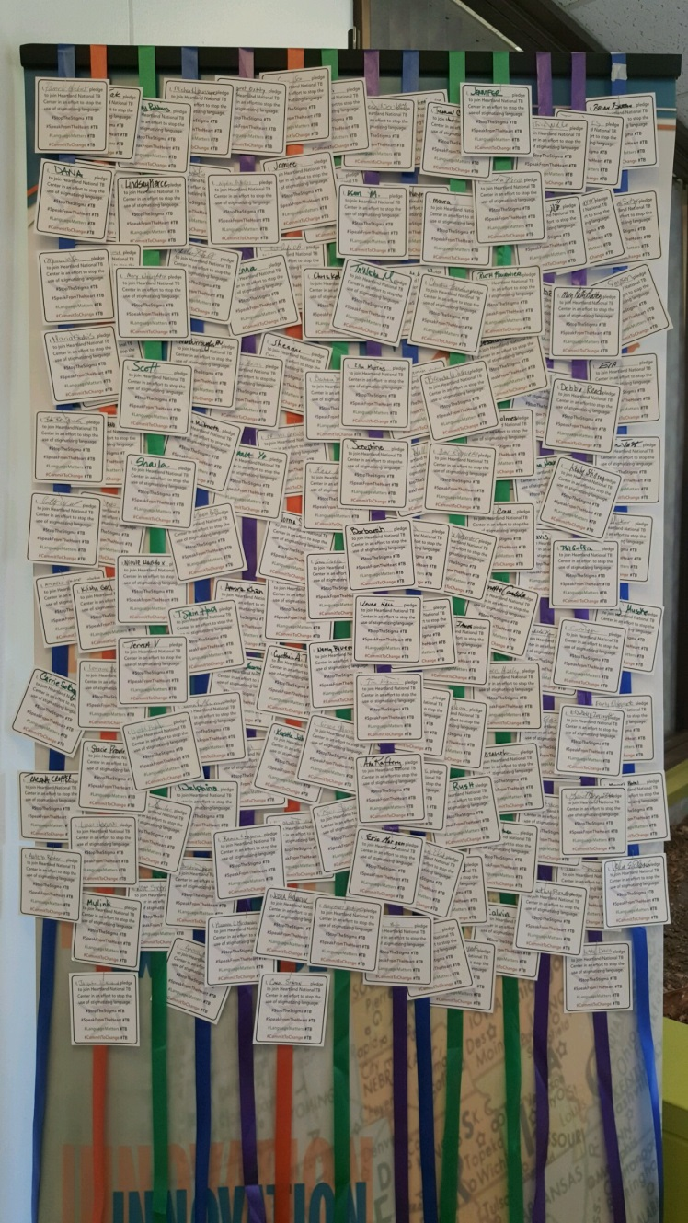
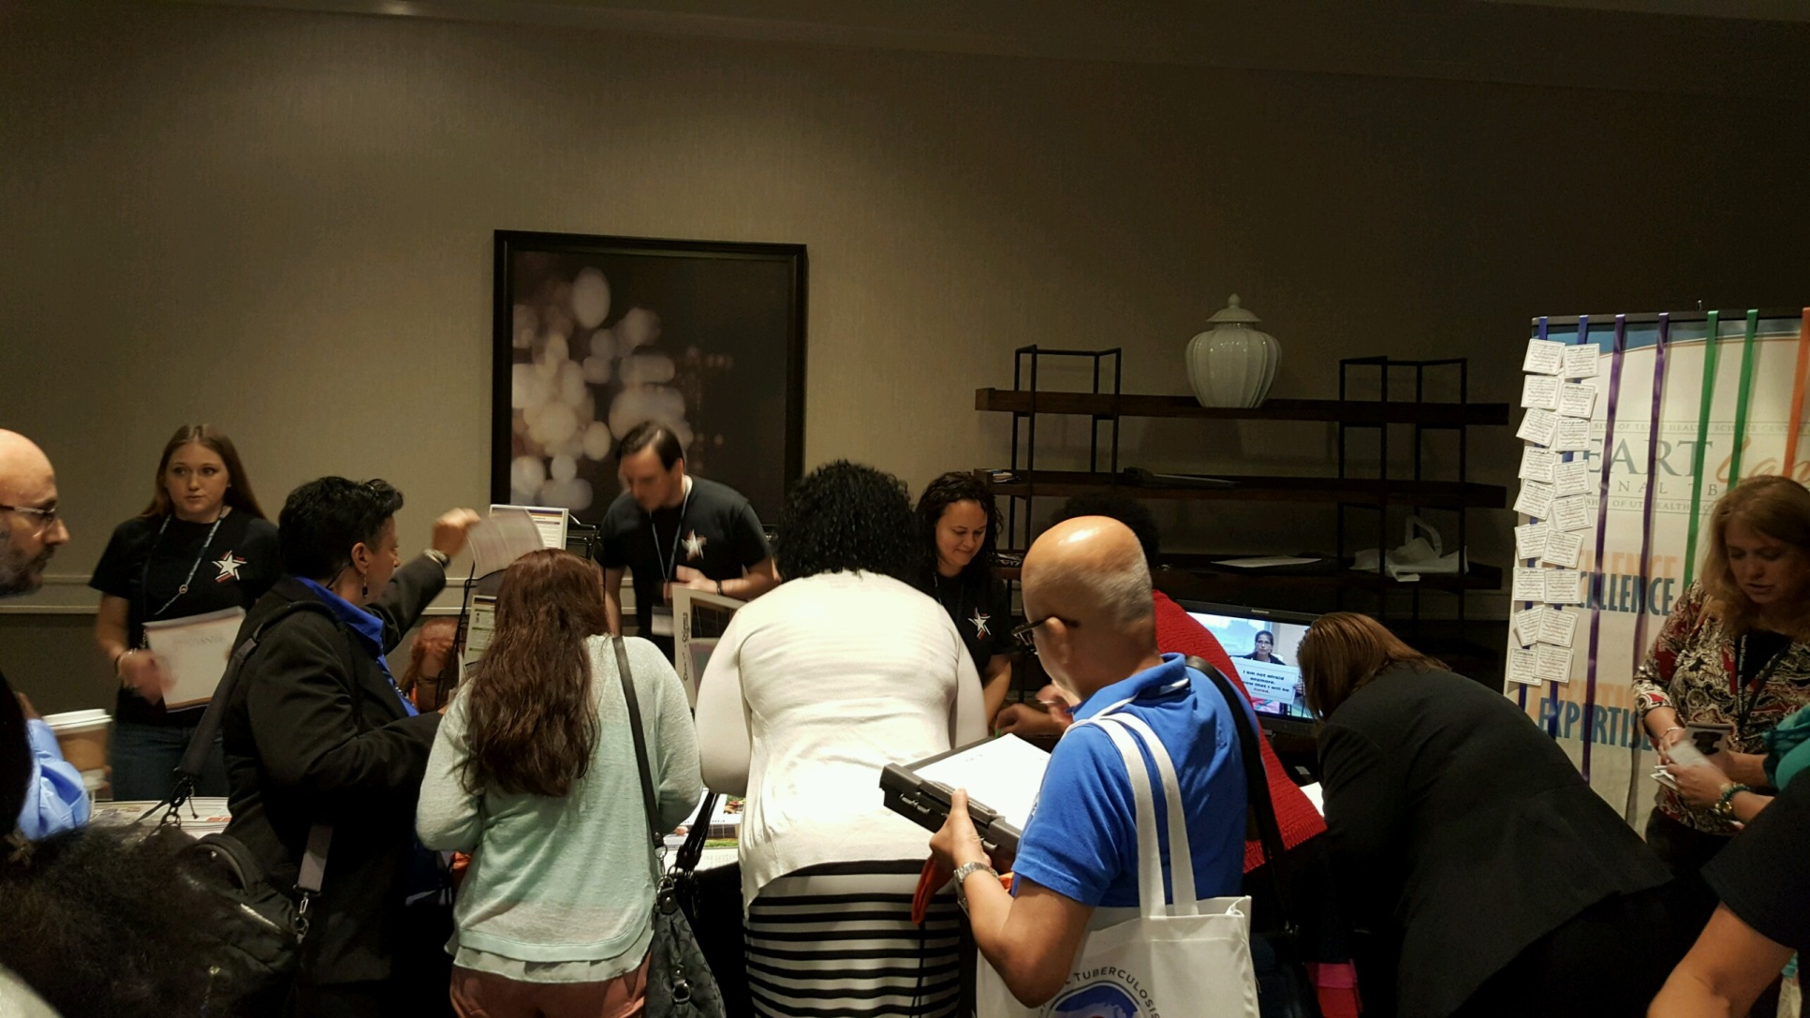
Heartland’s “Stop the Stigma” Campaign
Hearing the call and taking the initiative
Officially launched in 2015
Committing to change
Notes:
Having heard the call to action, Heartland National TB Center was amongst the first early adopters to change and launched it’s “Stop the Stigma” campaign back in June of 2015 at the National TB Conference in Atlanta.

Slide 19

We are committed to make a change
Members of the public health community worldwide have been working for almost five years to promote the avoidance of harmful and stigmatizing language used in TB care. Language such as “defaulter”, “suspect”, and “control” is not only hurtful but also judgmental, criminalizing, and places blame on patients.
Heartland has committed to join forces with patient advocates from the Global TB Community, the International Union Against TB and Lung Disease, and the National Society of TB Clinicians’ to eliminate stigmatizing
language. We are proud to introduce “Stop the Stigma”, a campaign to spread awareness and promote elimination of the use of stigmatizing language by the public health workforce. We would like to invite you to join us and pledge yourself, your organization, and challenge others to pledge as well.
Notes:
Official “Stop the Stigma” statement from Heartland National TB Center
Can be found on our website

Slide 20
Where We Are
Changes to the Language Culture in TB Care
Notes:
Let’s take a moment to see where currently are within the language change movement in TB care

Slide 21
Our commitment to you:
Use language that is patient-centered, appropriate and sensitive and represents the dignity of people with TB and their families.
Implement the use of non-stigmatizing language in the creation of our published materials including products, posters, marketing materials and speaking engagements.
Promote the use of non-stigmatizing language by working with our speakers to ensure all presentations are free of words such
as, “suspect,” “TB control,” “defaulter,” “noncompliant,” and “TB case”.
Notes:
At Heartland National TB Center, we strive to honor our following commitments to you in all we do.

Slide 22
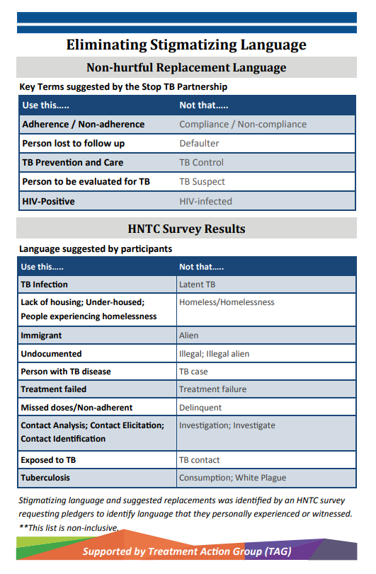

Stop the Stigma Fact Sheet
Heartland offers educational material on preferred language to help eliminate TB stigma.
If you would like a copy, please visit Heartland’s website for a downloadable copy.
https://heartlandntbc.org/
Notes:
Heartland offers educational material such as our fact sheet on preferred language to use when helping to eliminate TB stigma.

Slide 23
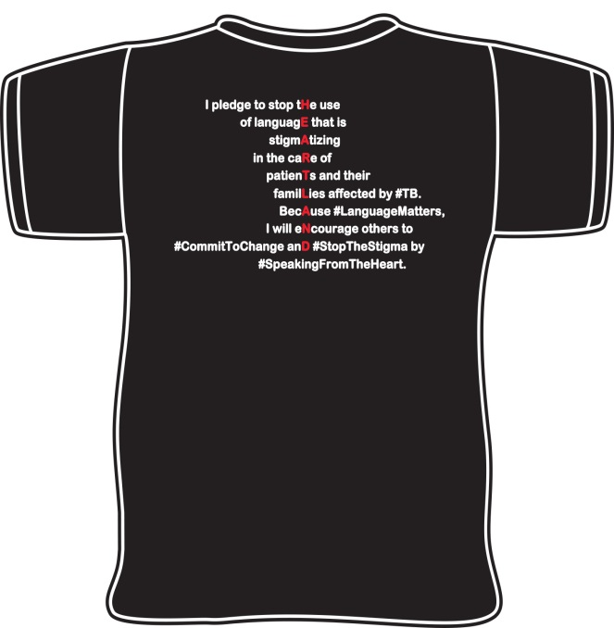
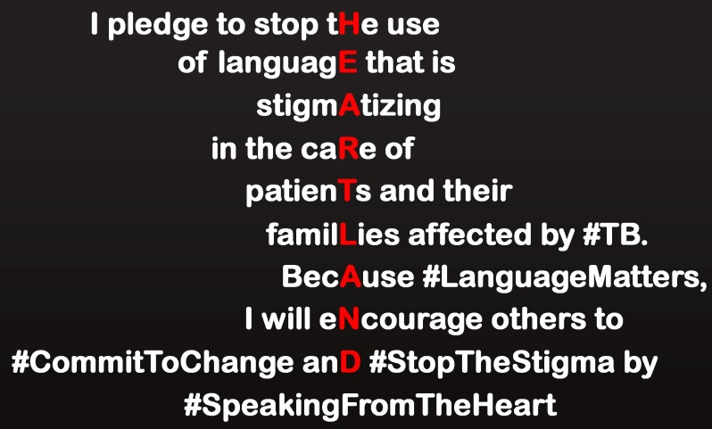
Stop the Stigma T-Shirts
T-shirts promoting the Stop the Stigma campaign have been distributed.
If you would like to receive a t-shirt, please contact one of our administrative or education team members.
https://heartlandntbc.org/
Notes:
“Stop the Stigma” campaign t-shirts have been distributed throughout the previous years, and new versions are planned to be developed soon.

Slide 24
Where We’re Going
Expanding Our Reach within the Language Change Movement in TB Care
Notes:
Let’s take a moment to discuss our plans for expanding our reach and influence within the language change movement in TB care

Slide 25
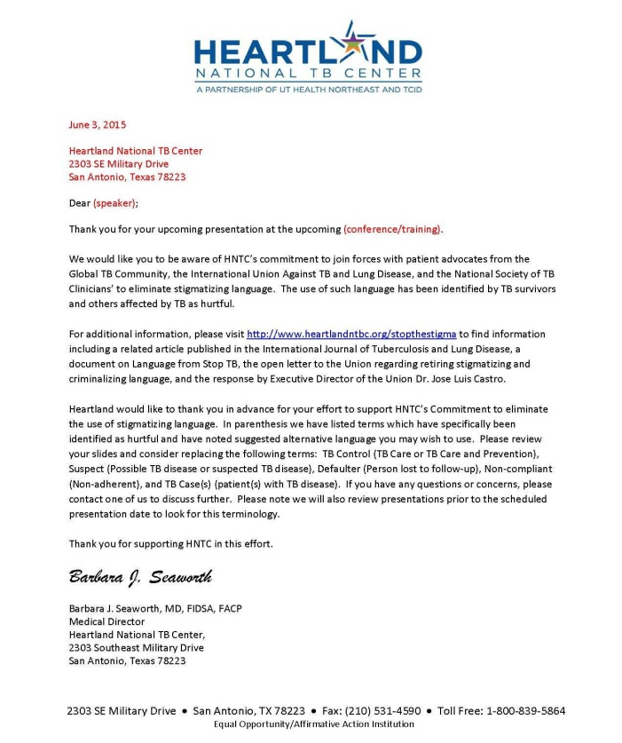
Stop the Stigma Speaker Letters
All speakers who collaborate with Heartland for training events are asked to review their content and materials for any stigmatizing language and are encouraged to join the “Stop the Stigma” campaign.
https://heartlandntbc.org/
Notes:
All speakers who collaborate with Heartland for training events are sent a letter asking for them to review their content and materials for any stigmatizing language and are encouraged to join the “Stop the Stigma” campaign.

Slide 26
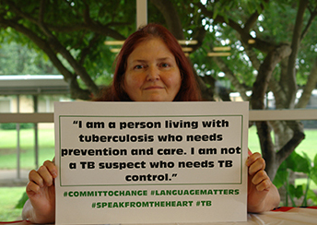
Stop the Stigma Training & Education
Every presentation’s content and our educational materials are thoroughly reviewed to ensure non-stigmatizing language in used throughout trainings and products and teach our participants about the harmful effects that stigmatizing language can have on those affected by TB.
https://heartlandntbc.org/

Slide 27
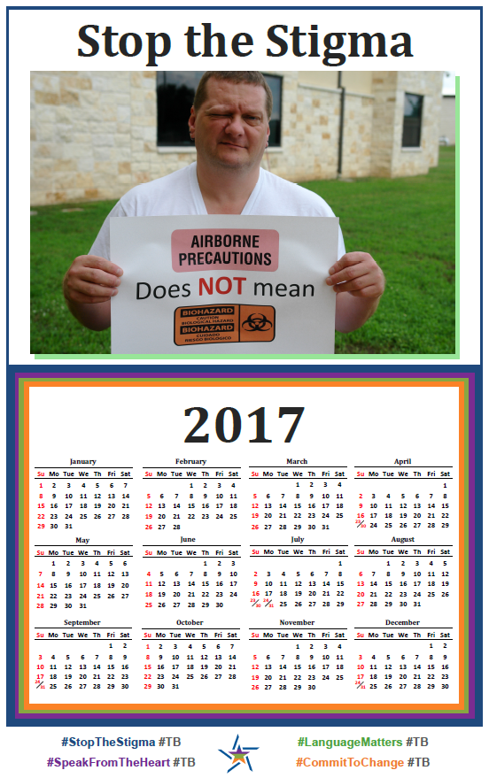
Stop the Stigma Calendars
Heartland is looking to update our “Stop the Stigma” calendars for the upcoming year.
Stay tuned for announcements by following us on Facebook and visiting Heartland’s website.
https://heartlandntbc.org/
Notes:
We are looking to update and develop new and prior materials for our “Stop the Stigma” campaign.

Slide 28

Our challenge to you:
Commit to using language that is patient centered, appropriate and sensitive and represents the dignity of people with TB and their families.
Challenge others to join you in your commitment.
Promote the “Stop the Stigma” campaign.
Notes:
At Heartland National TB Center, we strive to honor our following commitments to you in all we do.

Slide 29

Our challenge to you:
Commit to using language that is patient-centered, appropriate and sensitive, and represents the dignity of people with TB and their families.
This Photo by Unknown Author is licensed under CC BY
Notes:
At Heartland National TB Center, we strive to honor our following commitments to you in all we do.

Slide 30
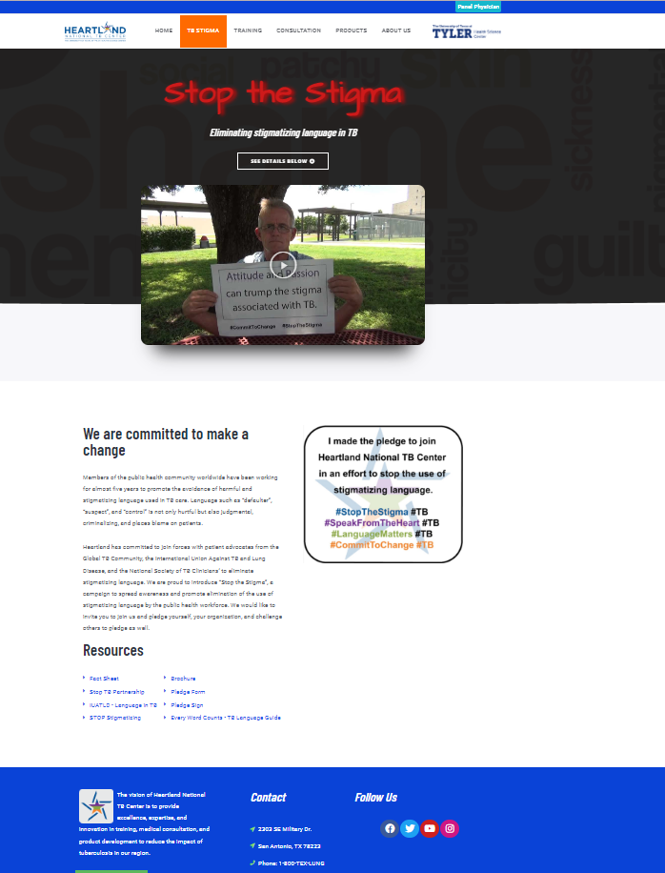
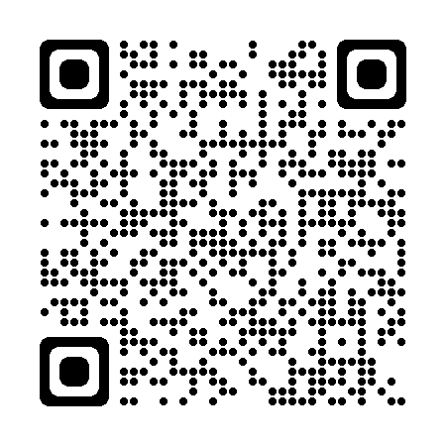
Eliminating Stigmatizing Language in TB
Please be sure to visit our “Stop the Stigma” page for updates and additions to our “Stop the Stigma” Campaign!
https://www.heartlandntbc.org/stopthestigma/

Slide 31
Testimonials from Our Campaign
“Instead of TB suspect, I use the term ‘patient with presumptive TB’”
“Increased awareness. Stronger review of materials and presentations. Changed language in trainings and communications of policies.”
“We have incorporated the requests to stop referring to our patients as ‘cases’ or ‘suspects’...”
“Being more respectful in addressing the needs of our patients”
“We all stop and think prior to calling an individual a ‘suspect’. It seems to be a trigger for pause and thoughtfulness before we speak.”

Slide 32

Thank You!
Lauren Fields
Lauren.Warren-Fields@uthct.edu
(210) 531-4543

