Slide 1

Completion of Treatment
Presented by: Barbarah Martinez, MSN, APRN, FNP-BC
Date: 09/18/2025

Slide 2
Objectives
The learner will be able to verbalize the importance of directly observed therapy (DOT).
The learner will identify considerations for administering DOT in various settings including: in clinic, in field and DOT
The learner will list strategies available for successful DOT
DOT tool kit
Medication preparation
Incentives and Enablers
Patient Education

Slide 3
Let’s Start With
Why do we treat TB?
Cure the patient
Minimize risk and disability
Reduce transmission of Mtb to others

Slide 4

Directly Observed Therapy
The main strategy to
Ensure TB patient adherence
Tolerability of prescribed regimen
DOT can be in person or eDOT (VDOT)
ALL patients with TB disease should participate in DOT
All immune compromised patients
All children under 5 y.o even those on window period treatment
If VDOT is not working, switch to in person

Slide 5
Title Factors Influencing Medication AdherenceSlide and Content
Factors:
Patient Related
Condition Related
Therapy Related
Health System Related
Socioeconomic

Slide 6

Adherence and Completion of Therapy
Adherence and completion of therapy intersect

Slide 7
What is treatment completion?
It is the appropriate number of doses ingested at a specified frequency within a specified time frame (duration).
Duration will depend on:
Patient’s response to treatment
Smear results
Culture Conversion
X-ray results
Weight
Symptoms
Site and Extent of Disease
Patient Comorbidities
Drugs used
Drug susceptibility test results of the isolate

Slide 8
When should EMB and PZA be discontinued?
EMB can be discontinued once susceptibilities are known, and patient organism is identified as being susceptible to INH and Rifampin.
PZA can be discontinued after 2 months.
If PZA is stopped too soon, the patient has to complete 9 months of therapy

Slide 9
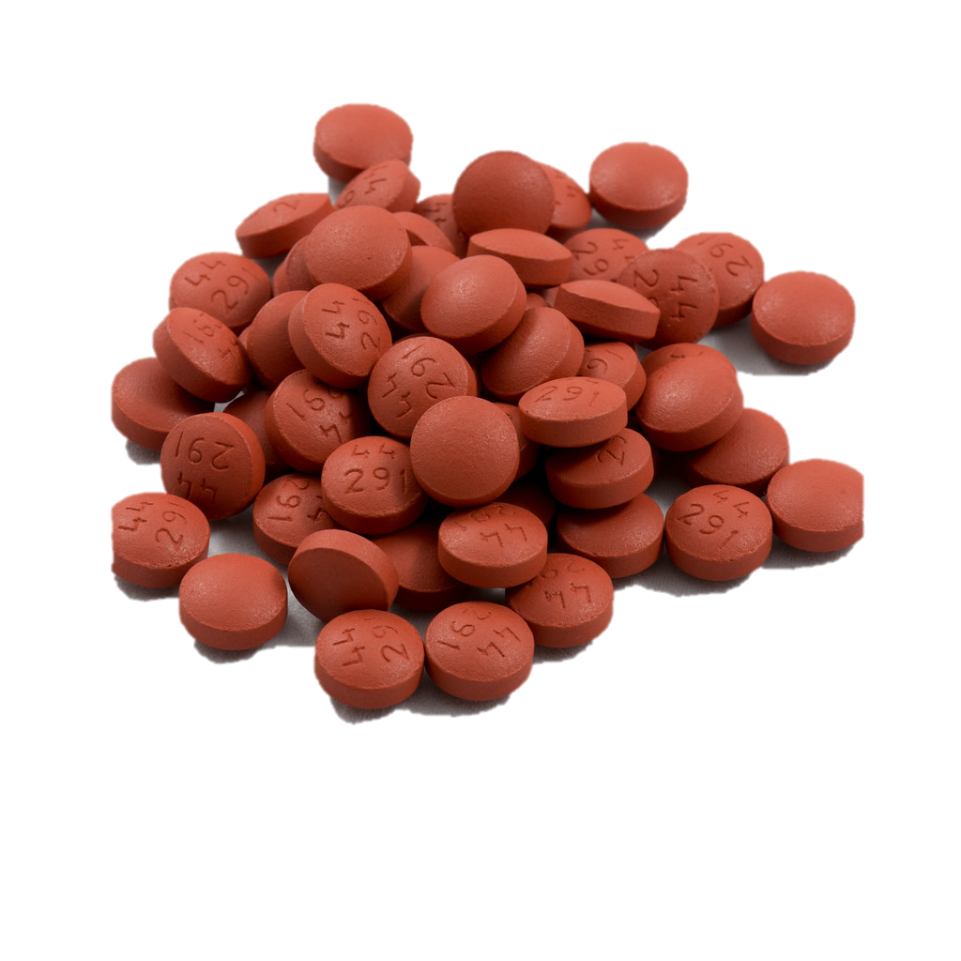
How to calculate:
Number of doses needed to complete therapy

Slide 10
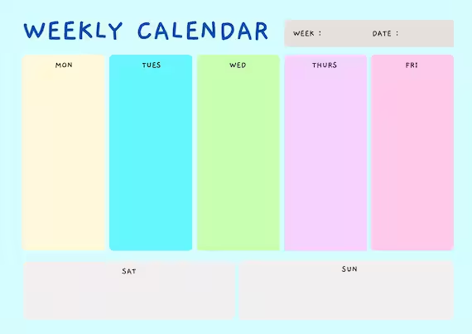
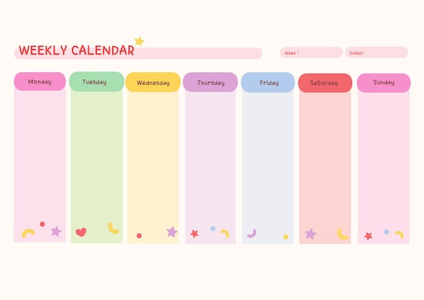
FIRST
How many times a week are you observing the patient taking TB meds?
WORK WEEK? = 5 days
CALENDAR WEEK? = 7 days

Slide 11
Work vs. Calendar Week
When might you use a work week (5 days a week) to provide DOT?
Synchronous video DOT – an employee is watching the video while the patient is taking meds.
Delivered DOT by staff
When might you use a calendar week (7 days a week) for DOT
In hospital
In correction facility
Asynchronous video DOT : the patient uploads the video, and a staff watches the video at a later time.
Remember the frequency of DOT is as important as the duration of DOT when calculating the completion of treatment.

Slide 12

WAIT… Why are we making those on DOT Finish more Doses?
Patients receiving in-person Directly Observed Therapy (DOT) are expected to take their own medications on weekends. While these doses cannot be counted in completion totals since they are not observed, they do aid in the overall cure.
Therefore, it is essential to
Regularly remind patients that completing all doses is vital for curing the disease. Do not tell them they only need to complete 130 doses or that their weekend doses “do not count”. All doses ingested whether observed or self-administered count towards CURE .
The expectation is that all patients complete aa total of 182 doses, including the self-administered weekend doses.

Slide 13
How to figure out how many total doses of therapy are needed for completion of therapy

Slide 14
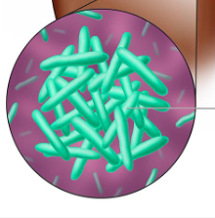
Duration
x
Frequency
=
# of doses needed

Slide 15
Patient 1 - needs 26 weeks of treatment, and they will get DOT via VDOT 7 days a week. How many doses will they need?
182 doses
Remember I am an hourly employee, if I do not work, I do not get paid. So, if the patient misses any doses (i.e. does not upload video) they do not get credit for the work.
Let calculate # of doses needed for 2 patients
Duration
X
Frequency
=
# of doses
Patient 2 - needs 26 weeks of treatment, and they will get DOT via in person DOT 5 day a week. How many doses will they need?
130 doses
Remember I am a salaried employee, I do not get “credit” for weekend meds because they are not observed. But we do encourage our patients to take the meds on the weekend to “get the job done”

Slide 16
Calculating the number of doses: Work week (5 days) vs. calendar week (7 days)
Total Treatment (26 weeks)
Work Week | 5 days | x | 26 | = | 130
Calendar Week | 7 days | X | 26 | = | 182
Initial phase of therapy (first 8 weeks)
DOT Work Week or Calendar week | Frequency # of times DOT is observed during the week | x | Duration # of weeks | = | Number doses
Work Week | 5 days (M-F) | x | 8 | = | 40
Calendar Week | 7 days (M-Su) | x | 8 | = | 56
Continuation Phase (last 18 weeks)
Work Week | 5 days (M-F) | X | 18 | = | 90
Calendar Week | 7 days (M-Su | X | 18 | = | 126

Slide 17
Calculating the number of doses: 9-month Regimen
Initial phase of therapy
DOT Work Week or Calendar week | Frequency # of times DOT is observed during the week | x | Duration # of weeks | = | Number doses
Work Week | days (M-F) | x | 8 | =
Calendar Week | 7 days (M-Su) | x |  | = | 56
5
40
8
Continuation Phase
Work Week | 5 days (M-F) | X |  | = | 155
Calendar Week | 7 days (M-Su | X | 31 | =
31
217
Total Treatment (39 weeks)
Work Week | 5 days | x |  | = | 195
Calendar Week | days | X | 39 | = | 273
39

Slide 18

Weeks of Treatment

Slide 19
How to figure out weeks of treatment
Total doses / Frequency (work (5 days) or calendar week (7 days) = number of weeks
Example:
14 days/7 days (calendar week)= 2 weeks
14 days/5 days (work week)= 2.8
OK, So why does this matter..

Slide 20
Total Doses
÷
Frequency
=
# of weeks

Slide 21
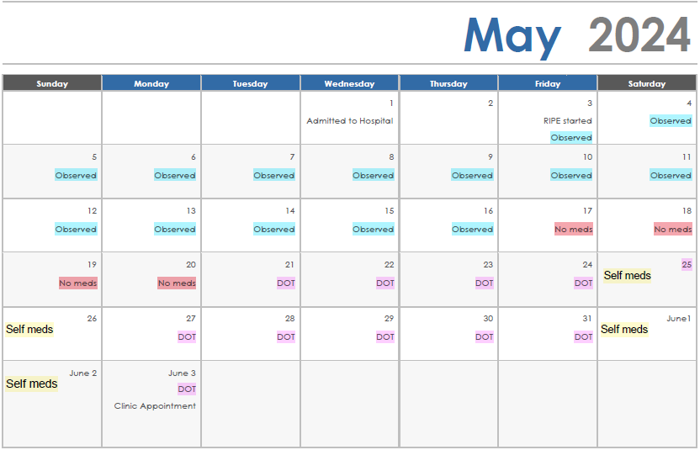
Breaking this scenario more...
How many days a week are patients observed taking medication while in the hospital?
7 days a week
2. Based on the scenario, how many days did the patient receive meds while in the hospital?
14 days
3. How many days a week does a health department provide DOT?
5 days a week
4. How many days of meds did the patient receive meds via DOT:
10 days

Slide 22
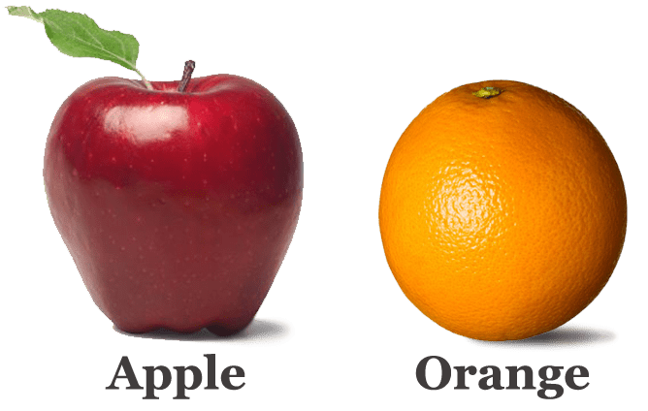
Let’s figure out how many weeks
The formula:
# of observed doses/frequency (calendar - 5 days/work week-7 days) = number of weeks
Hospital Stay : 5.3 to 5.16
14 doses/7 days = 2 weeks
DOT: 5.21 to 6.3
10 doses/ 5 days = 2 weeks
Total weeks = 2.0 + 2.0 = 4 weeks
This Photo by Unknown Author is licensed under CC BY-SA

Slide 23

The patient missed some days...
What happens since the patient did not have meds for 4 days after leaving the hospital?
You complete your first home visit 6 days after the patient is discharged and the patient says
I missed the four days because I couldn’t get anyone to
take me to the pharmacy to fill my prescription.
But I was
finally able to get a ride and this are my pills:
The patient has a bottle of INH and a bottle of EMB.
I could not afford the red capsules
The pharmacy said they were out of the other P medicine and did not know when they would get more in.
I decided some pills were better than no pills.

Slide 24
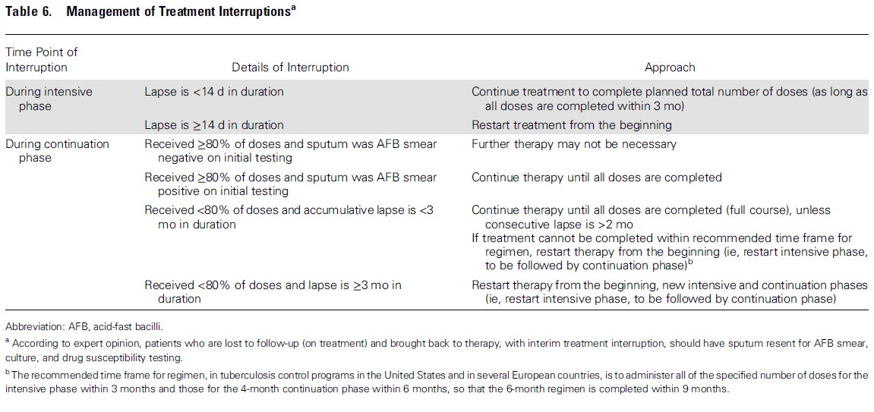
2016 Treatment of Drug Susceptible Tuberculosis

Slide 25


Slide 26
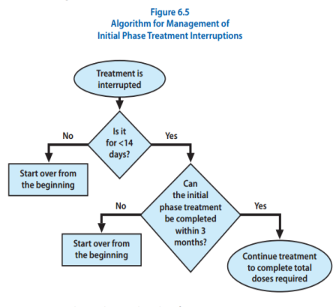
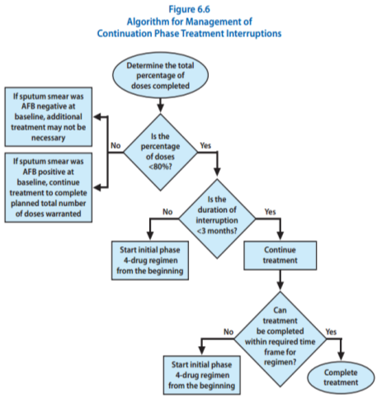
Things to Remember
Did the patient receive full 8 weeks PZA ( # doses)?
Periods of monotherapy/under dosing
Breaks in treatment?

Slide 27
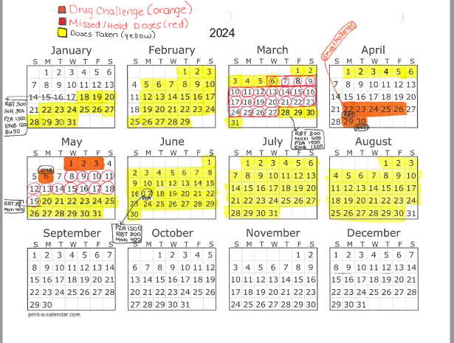
How to calculate the number of weeks left
First, use a calendar to organize yourself
Use a different color for doses taken, doses missed and self meds
Indicate when the initial phase of treatment was completed.
For each appropriate regimen or each phase of treatment:
Count the number of therapeutic doses given
Divide the number of doses by prescribed frequency per week
Add the number of weeks for each section for the Total number of weeks completed

Slide 28
Calculating Number of Weeks of Treatment Left
# weeks prescribed
# weeks of treatment received
# weeks remaining

Slide 29
Dates | Doses Administered | ÷ | Frequency (doses per week | = | Weeks of Treatment
1/6 to 1/25 | 23 | ÷ | RIPE 7 days/wk | = | 3.2 weeks
1/29 to 3/11 | 24 | ÷ | RIPE 5 days/wk | = | 4.8 weeks
 |  |  |  | Total weeks of initial phase | 8 weeks
3/14 to 5/15 | 32 | ÷ | Rif/INH 5 days/wk | = | 6.4 weeks
 |  |  |  | Total Weeks | 14.4 weeks
If the patient must complete 39 weeks of therapy, how many more weeks do they have to complete?
39 weeks-14.4weeks completed = 26.4 weeks left of therapy.
If it was 26 weeks of treatment?
26 weeks -14.4 weeks completed = 11.6 weeks left of therapy
Remember: DO NOT provide a final date to the patient because the date may change!

Slide 30
Dates | Doses Administered | ÷ | Frequency (doses per week | = | Weeks of Treatment
1/6 to 1/25 | 23 | ÷ | RIPE 7 days/wk | = | 3.2 weeks
1/29 to 3/11 | 25 | ÷ | RIPE 5 days/wk | = | 5.0 weeks
 |  |  | Weeks of initial phase |  | 8.2
3/14 to 5/15 | 13 | ÷ | Rif/INH 5 days/wk | = | 2.6 weeks
 |  |  |  | Total Weeks | 10.8 weeks
Another example:
If the patient must complete 26 weeks of therapy, how many weeks of therapy does the patient still need to complete?
26-10.8 = 15.2 weeks
Remember: DO NOT provide a final date to the patient because the date may change!

Slide 31
Dates | Doses Administered | ÷ | Frequency (doses per week | = | Weeks of Treatment
1/6 to 1/25 | 7 | ÷ | RIPE 7 days/wk | = | 1 weeks
1/29 to 3/11 | 38 | ÷ | RIPE 5 days/wk | = | 7.6 weeks
 |  |  | Total Weeks Initial Phase (RIPE) | = | 8.6 weeks
3/14 to 5/15 | 46 | ÷ | Rif/INH 5 days/wk | = | 9.2 weeks
 |  |  |  | Total Weeks | 17.8 weeks
Did the patient complete the appropriate number of weeks of the initial phase of therapy with RIPE?
YES
How many total weeks of treatment has the patient received?
17.8
How many weeks does the patient have left to complete to complete a 39 week?
21.2
How many weeks of treatment would the patient have received if all 91 doses were given 5 days DOT?
18.2
What about 7 days DOT?
13

Slide 32
How do we figure out how many doses (days) the patient has left?

Slide 33
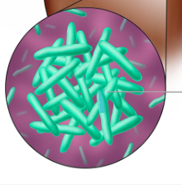
# of weeks remaining
X
Doses per week
=
# doses remaining

Slide 34
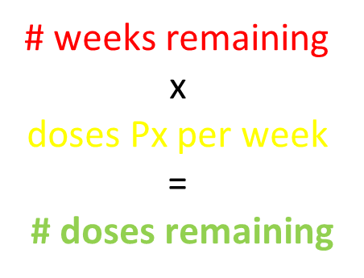
Dates | Doses Administered | ÷ | Frequency (doses per week | = | Weeks of Treatment
1/6 to 1/25 | 18 | ÷ | RIPE 7 days/wk | = | 2.5 weeks
1/29 to 3/11 | 28 | ÷ | RIPE 5 days/wk | = | 5.6 weeks
3/14 to 6/30 | 76 | ÷ | INH/RIF 5 days/wk | = | 15.2 weeks
 |  |  |  | Total Weeks | 23.3
The patient needs to complete 26 weeks of therapy:
How many doses do they still need to complete their regimen?
13.5 doses
How many doses would they have to complete if the frequency was 7 days a week?
18.9 doses

Slide 35
Dates | Doses Administered | ÷ | Frequency (doses per week | = | Weeks of Treatment
1/6 to 1/25 | 18 | ÷ | RIPE 7 days/wk | = | 2.5 weeks
1/26 to 1/29 | 0 | ÷ | RIPE 5 days/wk | = | 0
1/30 to 3/13 | 30 | ÷ | RIPE 5 days/wk | = | 6 weeks
3/13 to 5/28 | 54 |  | INH/RIF 5 days/wk |  | 10.8
 |  |  | Total weeks of initial phase |  | 8.5
 |  |  | Total weeks of treatment |  | 19.3
Patient was prescribed a 6-month regimen:
How many weeks of treatment do they have left ? 6.7
How many doses do they have left? 33.5 (roundup to 34 doses)
Do we need to worry about the interruption in therapy? No, because the interruption was only 4 days
What if the interruption was longer than 14 days? Yes, the patient would have to start treatment all over again

Slide 36
Let’s Break It Down Further - Initial Phase of Therapy
TB treatment is divided into two phases: the initial phase and the continuation phase
Initial Phase:
The initial phase of treatment consistently lasts for 8 weeks.
The patient must complete the required number of doses within a 12-week timeframe.
Therapy interruptions must not exceed 14 consecutive days or patients gets a “do over”.
Any doses taken prior to the interruption cannot be counted towards completion.
The patient cannot progress to the continuation phase until susceptibility results are received.
INH mono-resistance in US 9-11 %
Rifampin mono-resistance in US approximately 1%
If Rifampin resistance GET A CONSULT. Patient considered to have at least MDR TB.
During initial phase, the patient receives INH, Rifampin, EMB, PZA, and B6.
If PZA not included initially the patient MUST complete 9 months of therapy.

Slide 37
And - Continuation Phase of Therapy
The length of the continuation phase varies depending on the total length of therapy
For 6 months or 26 weeks – 18 weeks
For 9 months or 39 weeks – 31 weeks
DO NOT advance to continuation phase if you do not have susceptibilities
PZA may be dropped after two months if:
Negative Smear/Negative Culture
Clinical case of TB.
INH mono-resistance in US 9-11% of cases
Rifampin mono-resistance in US 1% of cases
If Rifampin resistance patient is to be treated as if they have MDR (OBTAIN A CONSULT)
Usually consists of INH, Rifampin and Vitamin B6
There cannot be an interruption longer than 3 months or patient must start all over again
Sputum collection, medical evaluation and CXR

Slide 38
Is it adequate treatment?

Slide 39
Things to be considered before closing the record as adequate treatment.
Full 8 weeks of PZA?
Under dosed or periods of monotherapy?
Weight?
Gaps in treatment?
What were DST’s?
X-rays results?
What were smear results?
When did patient culture convert?
Any significant comorbidities?
Site of Disease?

Slide 40
Case Study
Maria is a 36-year-old female born outside of the US who was reported by the local correctional facility after she was evaluated at the local hospital for signs and symptoms of TB.
Maria reported to the correctional facility staff:
Losing appetite x 2 weeks
Drenching night sweats
A wet cough that she has had for 3 months
Coughed up blood the night before
Maria denies any contributing PMHX
She denies any IV drug use or smoking
She has been unhoused
Currently lives with a friend and his children- no one at the house was sick.

Slide 41
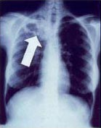

Slide 42
Maria’s Hospital Stay and Bacteriology Results
Maria was admitted for TB workup after a cavitary findings on the CXR.
Sputum was collected on 2/14, 2/15 and 2/16 and a NAAT was sent on the sputum collected on 2/14: Findings below
>10 AFB seen on smear
NAAT
MTB detected
Rifampin resistance not detected
HIV was non-reactive
Maria’s weight is 62 kg
A1C = 9.8

Slide 43
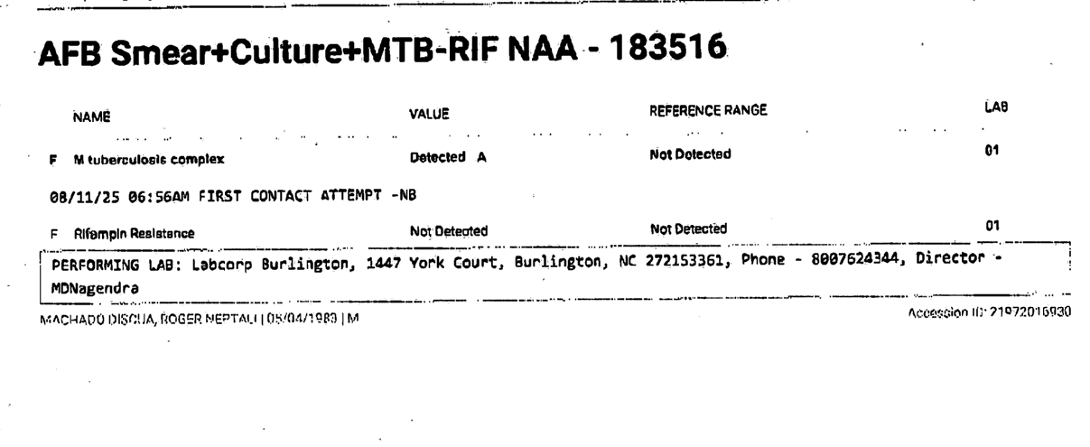

Slide 44
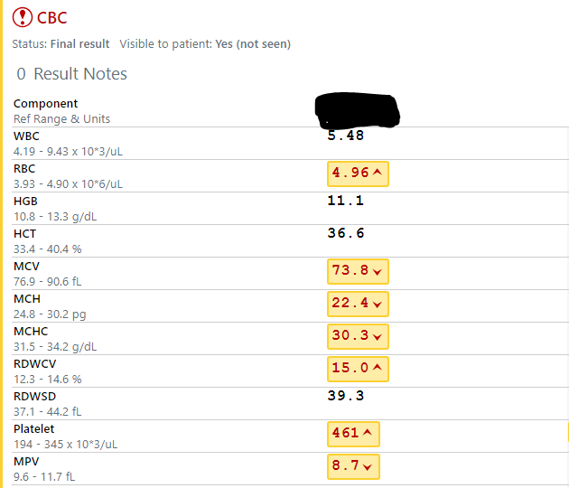

Slide 45
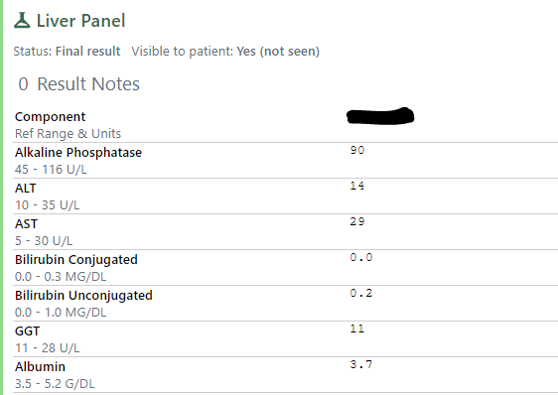

Slide 46
Maria’s TB Regimen While in Hospital
Maria was started on RIPE on February 15, 2025, with the following: Maria’s weight is 62kg
INH 300 mg po daily
Rifampin 600 mg po daily
EMB 800 mg po daily
PZA 1000 mg po daily
Vitamin B6 50 mg po daily
Are these doses correct for Maria?

Slide 47
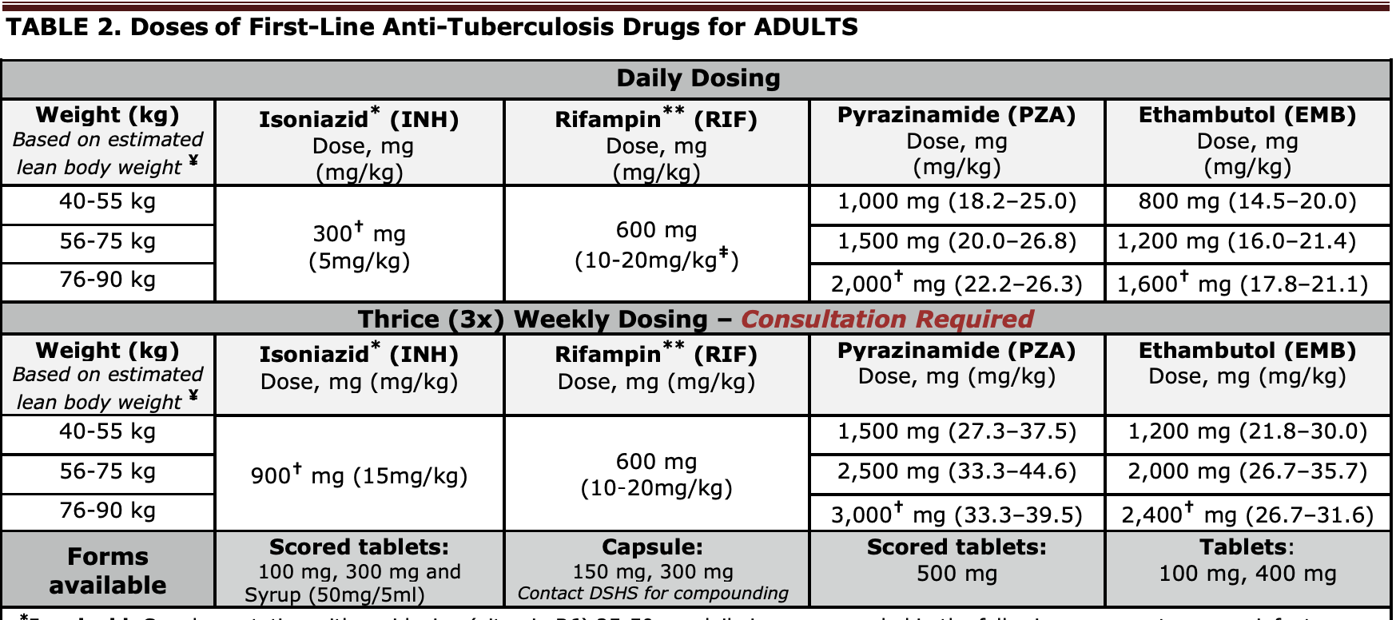
Dosing for Adults

Slide 48
Let’s Get Our Calendar’s Out.
Maria was in the hospital from 2/15/25 to 2/18/25. She received dosing below the recommended amounts on 2/15/25
Maria received all doses of TB meds as per below on 2/16/25 and 2/17/25
INH 300 mg po q am
Rifampin 300 mg po am and pm
EMB 600 mg q and 600 mg q pm
PZA 1000 mg po am and 500 mg q pm
Would you count these doses? Why or Why not?
The preferred frequency is once daily for both the intensive and continuation phases
All doses of TB meds should be given at one for maximum efficacy
Official American Thoracic Society/Centers for Disease Control and Prevention/Infectious Diseases Society of America Clinical Practice Guidelines: Treatment of Drug-Susceptible Tuberculosis

Slide 49
Let’s Continue
Maria stayed in the hospital from 2/15/25 to 2/22/25 but appropriate dosing was not started until 2/18/25
So how many doses did Maria complete in the hospital?
4 doses
Maria returned to the correctional facility and continued to receive her RIPE appropriately from 2/23/25 to 4/3/25
The current plan is to treat Maria for 9 months she has a cavitary CXR. She is newly diagnosed with T2DM with an A1C of 8.9

Slide 50
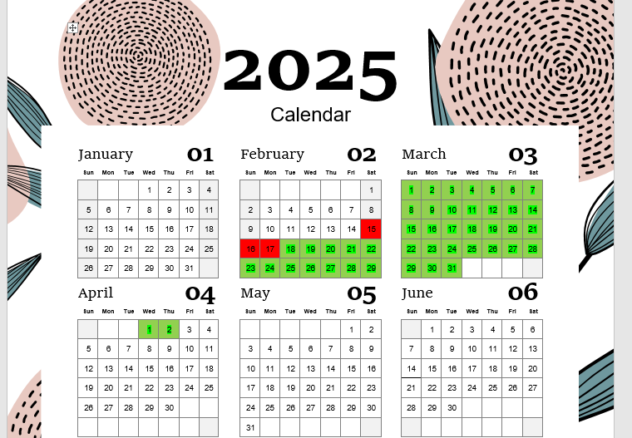

Slide 51
So how much treatment has Maria received so far?
How many doses?
46 doses
How many weeks?
6.5 weeks
Has she been adherent with her regimen?
Yes

Slide 52
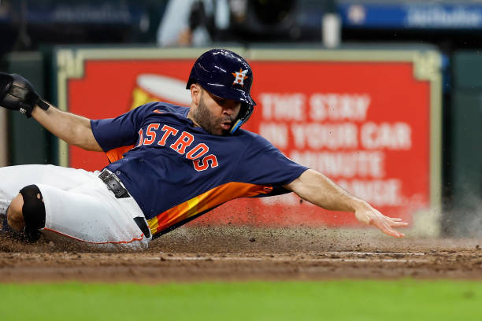
LET THE GAME BEGIN, CAN WE BRING MARIA ACROSS HOME PLATE?

Slide 53
Maria Is Released
Maria is released on April 3rd but you are not notified
The address you have for Maria is not correct
The phone is working but when you call, the man who answers the phone tells you Maria is not available.
You and your team continue to search Maria and find her on April 28th when she finally answers the phone, and you can get an accurate address.

Slide 54
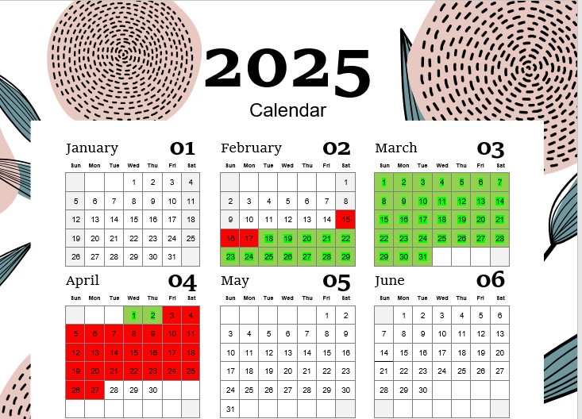

Slide 55
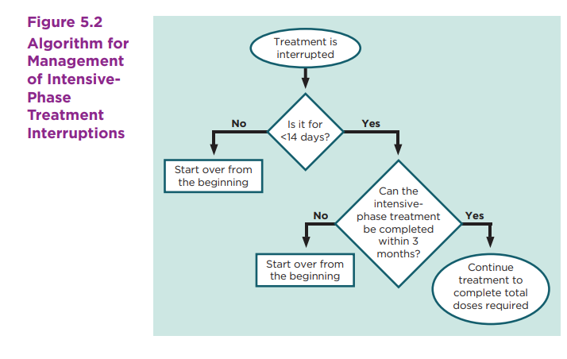
CORE CURRICULUM ON TUBERCULOSIS:
WHAT THE CLINICIAN SHOULD KNOW
SEVENTH EDITION 2021
THE DSHS SDO’s DIFFER FROM THE GUIDANCE
INTENSIVE PHASE MUST BE COMPLETED IN
10 WEEKS

Slide 56
Break in Treatment
How long was the break in treatment during the initial phase of therapy?
25
More or less than 14 consecutive days?
More
Does any of the treatment before you were unable to find her count towards completion of therapy?
No

Slide 57
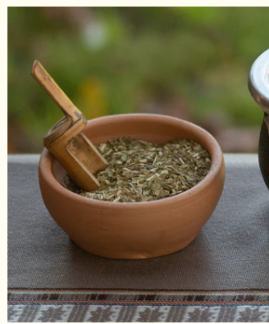
Home Visit
You make a home visit to Maria, and she tells you that she had not wanted to take her medicines because she went to her “curandera” who gave her some herbal medication that she said would cure her TB.
What would you do???
You also notice that there are three children in the home ages 3 months, 2 years and 7 years of age…. (Keep these ages in the back of your mind for now)

Slide 58
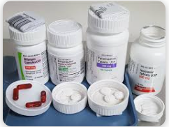
Home Visit
You have a long discussion with Maria, and you ask to see what the herbal medicines are. It is a mixture of basil, chamomile and rosemary. You encourage to keep taking the tea the curandera has provided her but also are able to educate her on the need for her to take her TB meds.
The patient verbalizes understanding and agrees to take the DOT
What question could you ask to ensure
patients tell you about all the pills/supplements
they take? Why is it important to know?

Slide 59
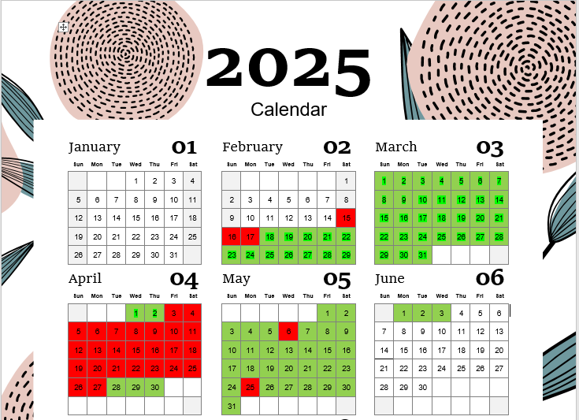

Slide 60
Reviewing Adherence
Based on the calendar, what is Maria’s start date of treatment?
4/28/25
How many weeks of therapy has she completed?
35 doses 35/7 = 5 weeks
As you start looking ahead since she is almost done with the initial phase of therapy what are some things that you should be reviewing before you advance?
Susceptibilities
Repeat CXR?
Symptom Improvement?
Adverse Drug effects?

Slide 61
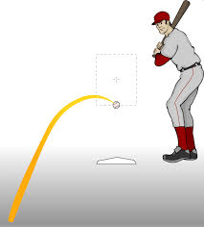
There is Always a Curve Ball…. Are you ready for it?
Maria has completed 5 weeks of DOT with RIPE without any complaints.
On June 4th Maria contacts you complaining of the following:
Nausea
Vomiting
Rash all over body
Fever of 101
Headache
N/V
NOW WHAT???

Slide 62
Medical Evaluation – What Do You Do?
You make an emergent appointment for Maria Your clinic provider asks to hold meds, draws a CBC and Liver enzymes with the following results:
WBC 11.28
RBC 4.70
Hgb 13.0
HCT 38.2
Platelets 150
ALT 191
AST 93

Slide 63

Here Comes the FASTBALL
The meds are on hold until the LFT’s are below 2 x ULN and the platelets have recovered to 195
You start the drug challenge with Rifampin and EMB on 6/15/25.
On the fourth day of the challenge, Maria calls with the following complaints:
Headache
Rash
Fever
Malaise

Slide 64
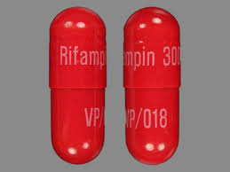
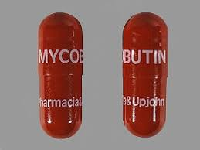
Because You Don’t want Dr. Armitige or Dr. Seaworth To Miss you….
You get a second consult.
This time the recommendation is to re-start the challenge but to substitute Rifabutin for Rifampin

Slide 65
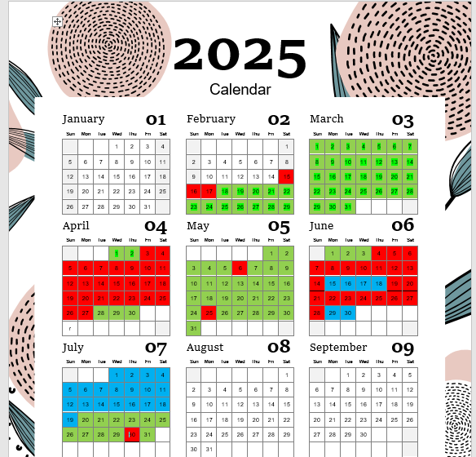
Rifabutin and EMB from 6/29 to 7/5
INH, Rifabutin and EMB from 7/6 to 7/12
INH, Rifabutin, EMB and PZA from 7/12 to 7/19
Do you count the doses of a drug challenge?
If so, when would you start counting doses?
Does the patient need to start treatment over?
How many doses of therapy has Maria completed?

Slide 66
I have been on treatment since February. I don’t want MORE…
Maria does not want to continue therapy because she has been on treatment for 8 months.
How would you encourage Maria to continue her therapy?
You have received the susceptibilities, and the specimen is found to be PAN sensitive
Maria took almost 3 months to convert her culture.
Maria’s CXR in April showed minimal improvement
Maria’s CXR in June showed improvement as compared to the April CXR but the cavitary lesion can still be seen
Today’s CXR shows complete resolution of the cavitary lesion.
Decision is made to treat for 9 months and to repeat the CXR before Maria completes therapy

Slide 67

Can we advance to the Continuation Phase, yet???
Things we know:
The organism is PAN-susceptible
Maria’s X-ray and symptoms are improving.
We have found a regimen that Maria can tolerate, and we are supporting her cultural beliefs

Slide 68
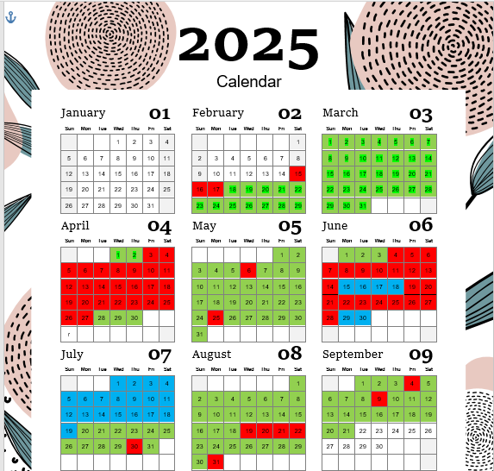

Slide 69


Slide 70
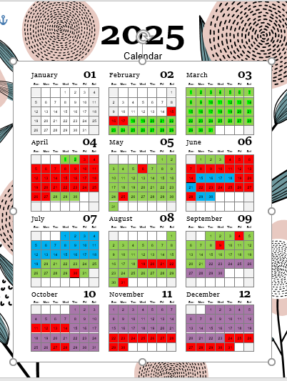

Slide 71
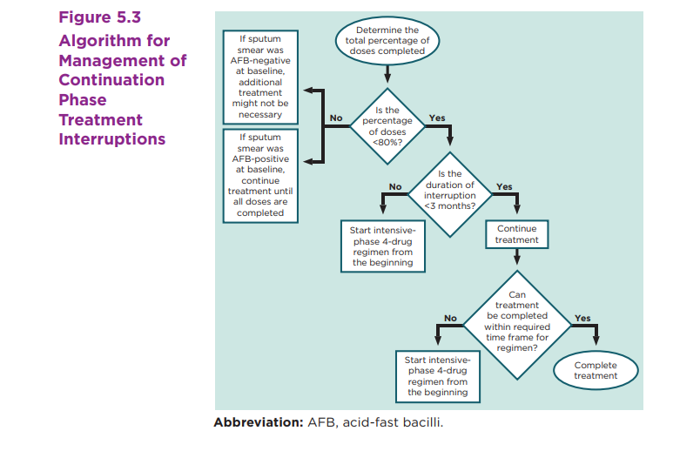

Slide 72
Am I done YET???
The patient completed
56 doses /7 days a week of RIPE = 8 weeks
78 doses/7 days a week of IR= 11 weeks
Total weeks completed =18
How many weeks does the patient have left?
39 weeks (9 months) -18 weeks of completed doses = 21 more weeks of therapy
How many more doses does Maria have left?
21x7= 147 doses

Slide 73
Adherence during Window Period Treatment
Look at adult adherence as it may impact the time of the infectiousness period
This prolongs the time of therapy for the child
Remember children under 5 years of age can progress quickly to disease
Children under two are at very high risk of progressing to disease as their immune system is very, very immature!
What can be done to help parents with adherence issues during window therapy?

Slide 74
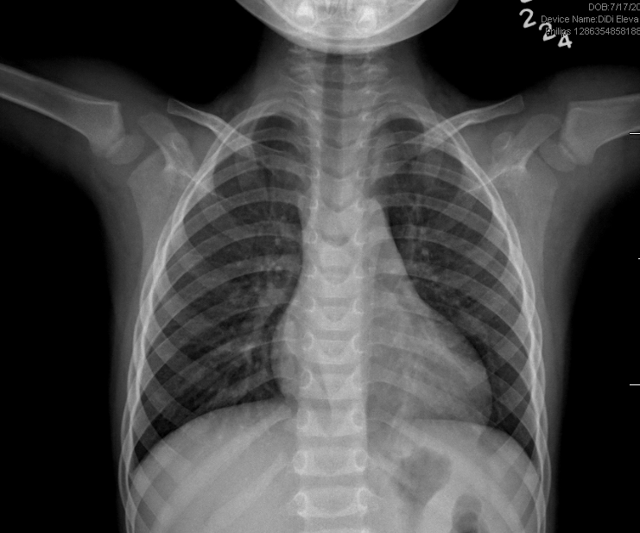
Original Chest X-ray from March

Slide 75
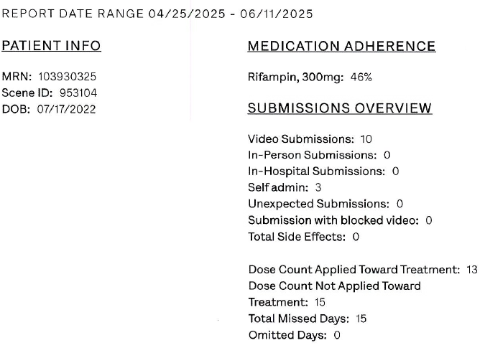

Slide 76
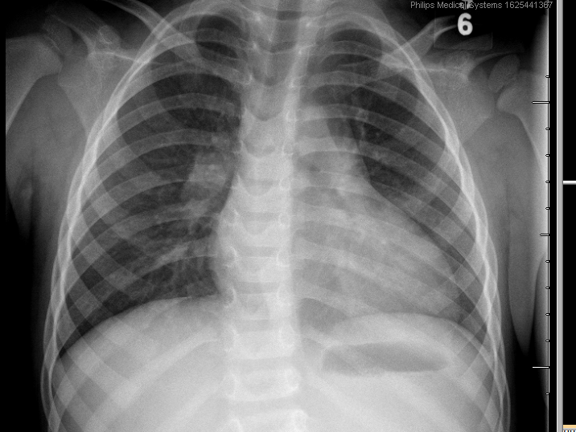
Repeat CXR after Adherence Report

Slide 77
LTBI Adherence- Rifampin
Complete 120 doses (OK so the math says complete 17.1 weeks of therapy but the SDO’s and most experts recommend 18 weeks)
All 120 doses must be administered in 6 months (26 weeks)
Capsules can be opened and sprinkled onto something the individual will eat.
Remember to check for food allergies!
Rocky Road Ice Cream works very well
A Tablespoon of Hershey’s chocolate syrup
A fall color Oreo, take the middle out and mix the Rifampin in it
If you give a child a cookie??
For adults mix with peanut butter

Slide 78
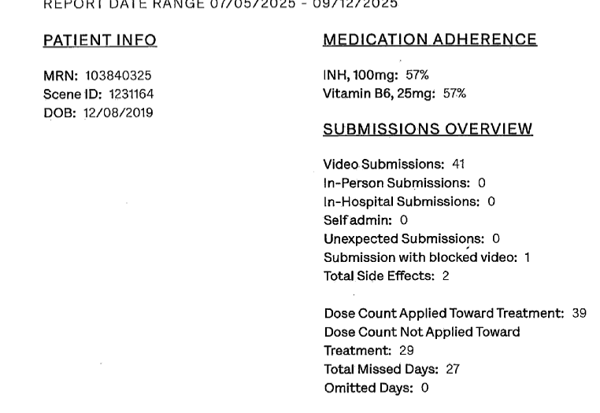

Slide 79
LTBI Adherence with 3HP
12 weekly doses should be completed in 16 weeks.
11 doses can be counted towards completion if completed within the 16 weeks
Tablets can be crushed and mixed with some food or drink the individual likes.
A small low fat meal an hour before can be recommended before taking 3HP to help with GI upset.

Slide 80
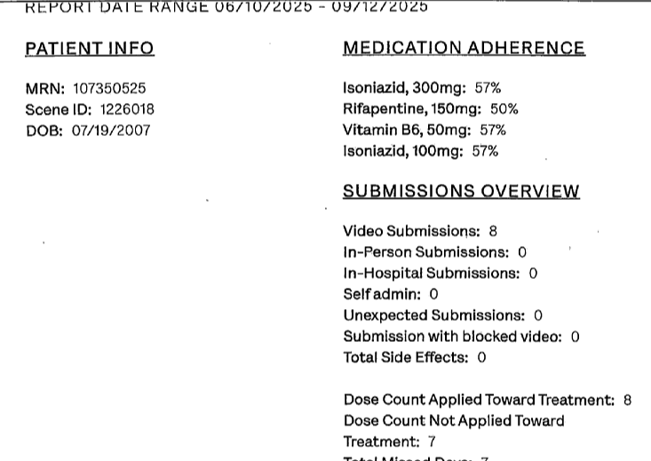

Slide 81
LTBI Adherence - INH
INH can be ordered for 6 or 9 months.
If ordered for 6 months (26 weeks) all doses must be completed in 9 months (39 weeks)
If it is a child on INH the pediatric provider can assist with support by informing the parents of the importance of the adherence.

Slide 82
Does the Adherence of the Adult Source Case Matter if there are children in the home?
If adult is not adherent, treatment may have to extended because of delay in smear or culture conversion
Impacting the time of infectiousness
The individual may have to start therapy all over again (sometimes more than once)
If there are children at home who are on window period treatment
The risk for the children for exposure goes up.

Slide 83
Remember the factor?
There is a lot that you as nurse case manager can do to help the patients modify their behavior, remain engaged in their DOT and medical care and successfully complete therapy!
The Four Pillars of Nursing:
Clinical Practice
Education
Research
Leadership

Slide 84
You are your patient's voice!
Patient Advocacy is a core and essential function of nursing.
It is fundamental to ethical practice and patient-centered care

Slide 85
I AM A NURSE
I give more than I take
I choose kindness over convenience
I help the voiceless be heard
I lead with heart, courage and empathy.
I speak up for what’s right
I push through exhaustion to give my best
I care deeply, even when it is hard.
I RISE, I SHOW UP, I SERVE

Slide 86







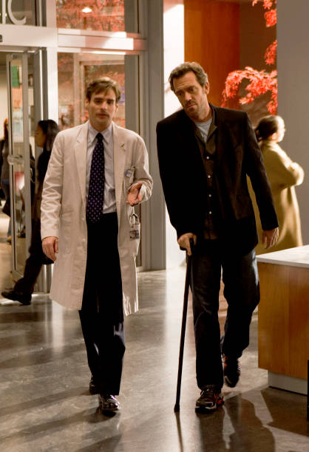
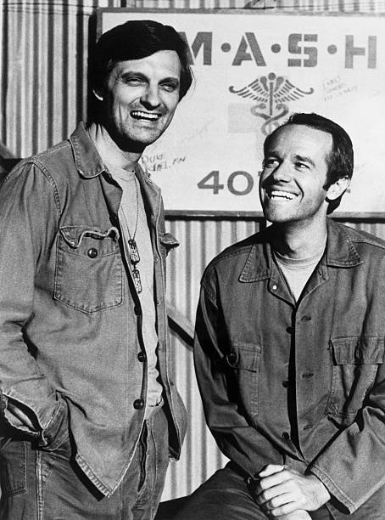

Slide 87
References
American Nurses Association. (2023). Code of ethics for nurses. American Nurses Publishing.
Centers for Disease Control and Prevention (2024). TB 101 for Health Care Workers. Retrieved from: https://www.cdc.gov/tb/webcourses/TB101/index.html
Centers for Disease Control and Prevention (2024). Core Curriculum on Tuberculosis: What the clinician should know. Retrieved from:
https://www.cdc.gov/tb/hcp/education/core-curriculum-on-tuberculosis.html
Texas Department of State Health Services (2024, August 30). Texas Department of State Health Services Standing Delegation Orders for Tuberculosis Clinical Services Provided by Authorized Licensed Nurses,. Retrieved from https://www.Dshs.Texas.gov/Sites/Default/Files/LIDS-TB/Policies/TB-SDO-ClinicalServicesforNurses-25.pdf.
Sazali, M. F., Rahim, S. S. S. A., Mohammad, A. H., Kadir, F., Payus, A. O., Avoi, R., Jeffree, M. S., Omar, A., Ibrahim, M. Y., Atil, A., Tuah, N. M., Dapari, R., Lansing, M. G., Rahim, A. A. A., & Azhar, Z. I. (2023). Improving Tuberculosis Medication Adherence: The Potential of Integrating Digital Technology and Health Belief Model. Tuberculosis and respiratory diseases, 86(2), 82–93. https://doi.org/10.4046/trd.2022.0148S

Slide 88
Thank You
Barbarah.Martinez@bcm.edu
832-824-4324

