Slide 1
Diagnosis of tuberculosis an introduction to radiology
RM Estrada-Y-Martin, MD MSc FCCP
Professor of Medicine
Divisions of Critical Care, Pulmonary and Sleep Medicine
McGovern Medical School – UT Health – The University of Texas at Houston

Slide 2
objectives
identify anatomic landmarks in a chest radiography
Recognize classic radiographic presentations of pulmonary tuberculosis

Slide 3
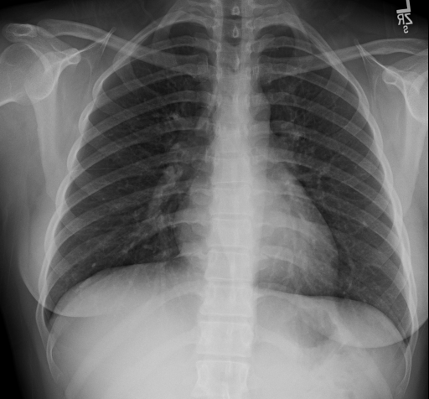

Slide 4
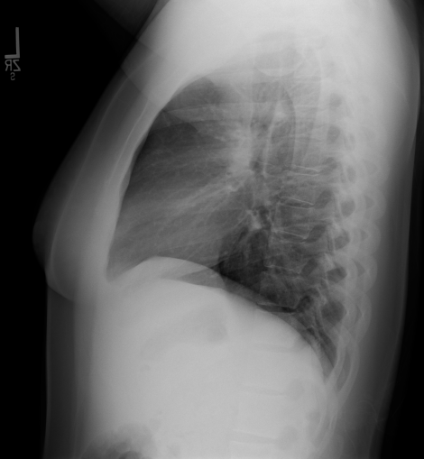

Slide 5
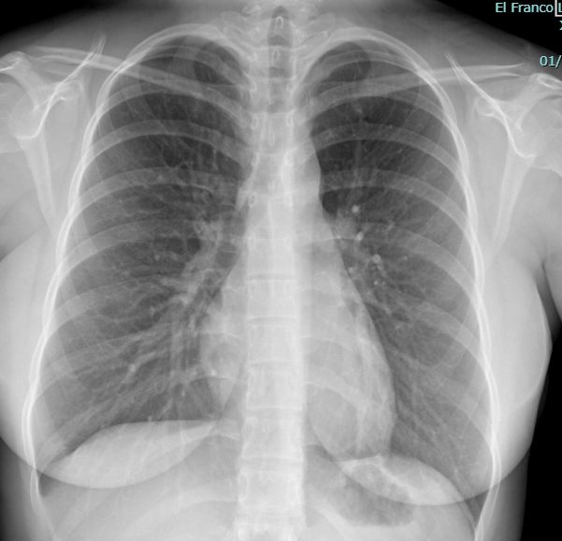

Slide 6
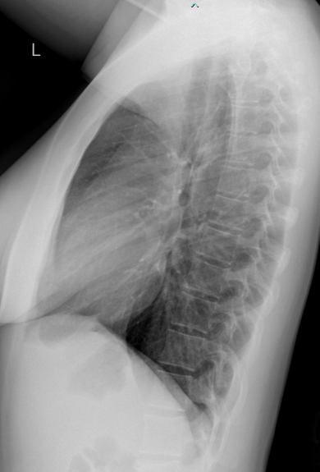

Slide 7
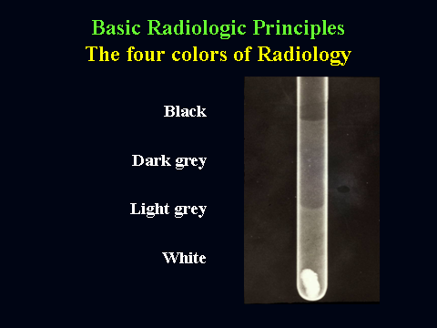
The four colors of a radiograph
black
dark grey
light grey
White
air
fat
soft tissues/H2O
calcium, bone, mineral
Courtesy Dr Sandra A Oldham

Slide 8

The colors of Radiology
X-ray
CT scan
4 colors only:
air – black
fat – dark grey
water – light grey
bone - white
Expanded grey
scale
see many shades of grey
Courtesy Dr Sandra A Oldham

Slide 9
Right Clavicle
Lung Apex
Lung Apex
Left Clavicle
Trachea
Pleural Strip
Aortic arch
Azygos Vein
Carina
AP Window
Right hilum
Left hilum
Left bronchus
Right Bronchus
Heart border
Heart border
Spine
Heart
Diaphragm
Diaphragm
Costophrenic sulcus
Liver
Stomach
Costophrenic sulcus

Slide 10
Esophagus
Trachea
Retrosternal space
Spine
Heart
Diaphragms
Costophrenic Sulci

Slide 11
LOBES
Right lung:
Right upper lobe
Middle lobe
Right lower lobe
Left lung:
Left upper lobe (includes the lingula)
Left lower lobes

Slide 12
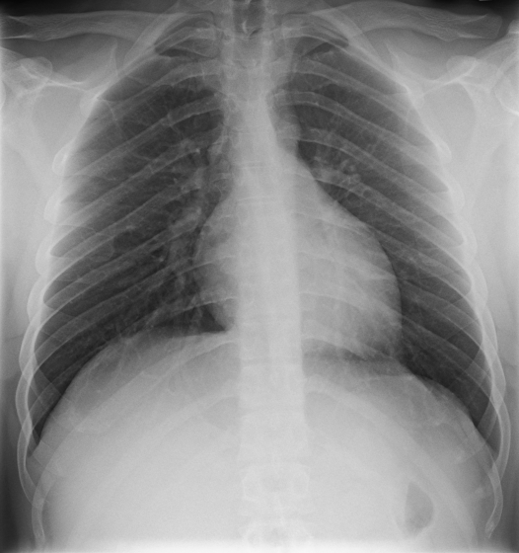
Lordotic

Slide 14
CXR findings in tuberculosis
Most common CXR finding in adults:
- Lung cavities, mainly in the upper lobes and superior segments of the lower lobes
- Tree in bud more commonly immunocompromised persons
Less common:
- mediastinal/hilar lymphadenopathy
- pleural effusion
- miliary lung opacities
- Pneumonia (rare)

Slide 15
Lung Cavitation

Slide 16
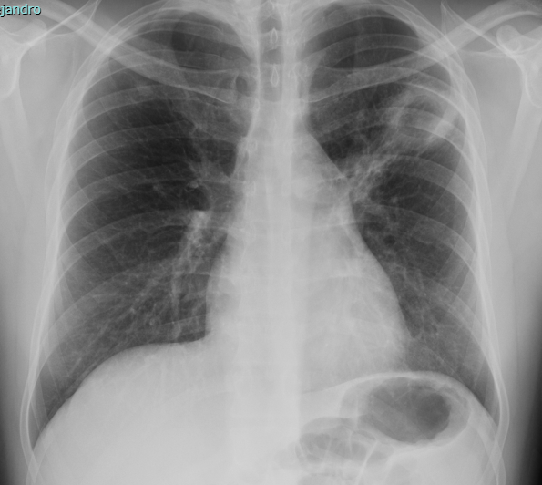
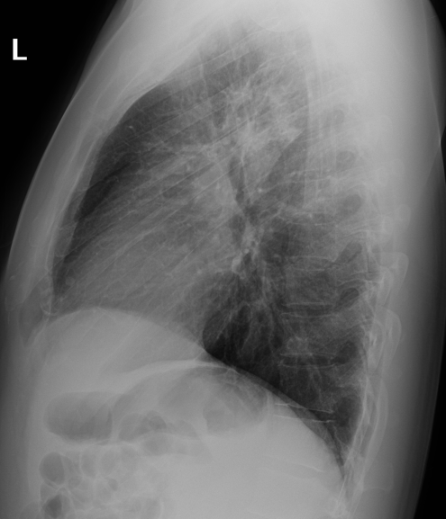
32 yo man

Slide 17
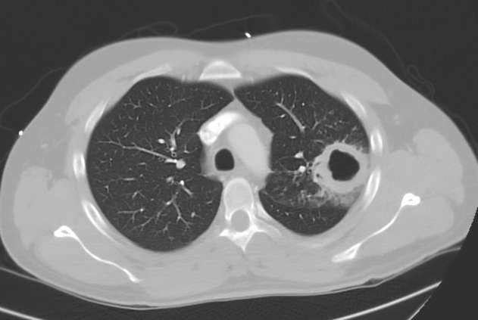
32 yo man

Slide 18
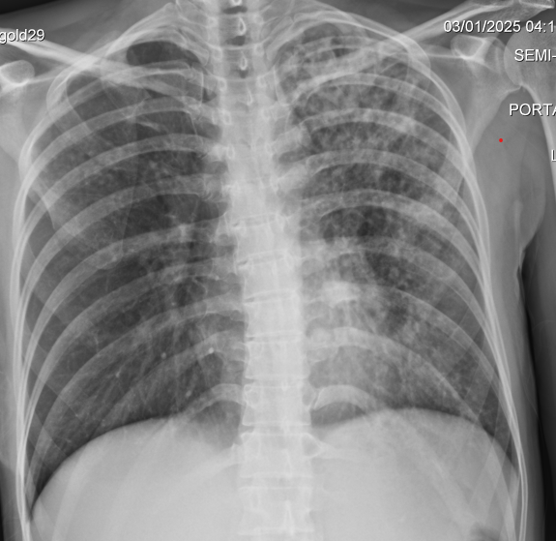
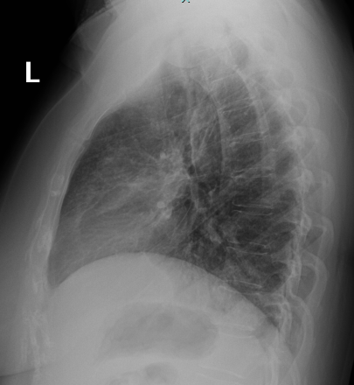
45 yo woman

Slide 19
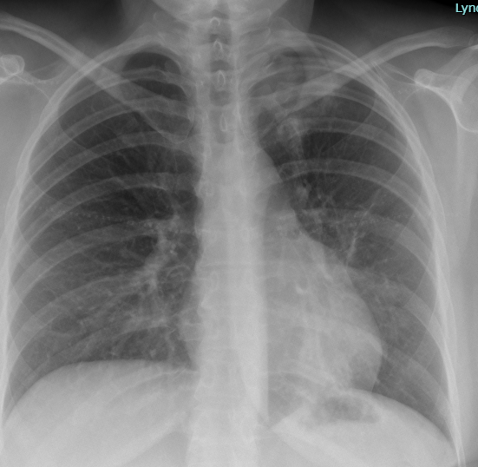
45 yo woman
Pre-treatment
Post-treatment

Slide 20
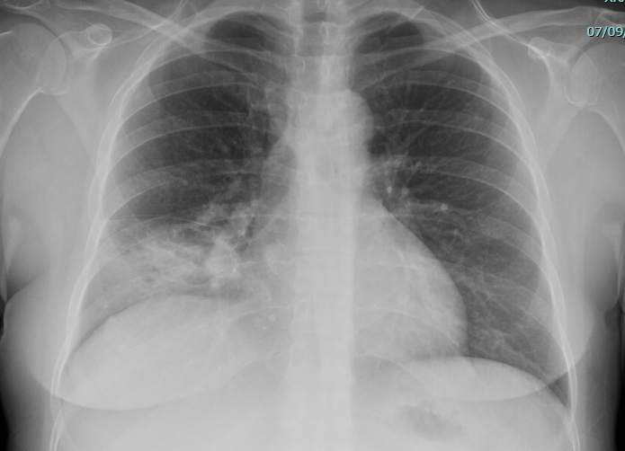
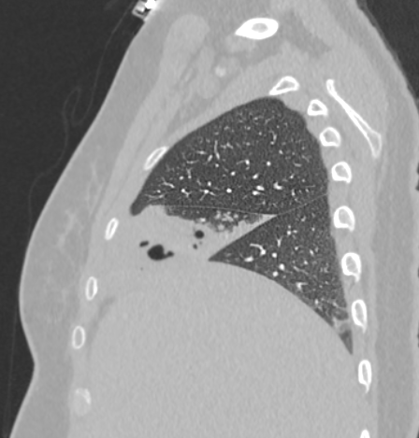
45 yo woman poorly controlled DM

Slide 21
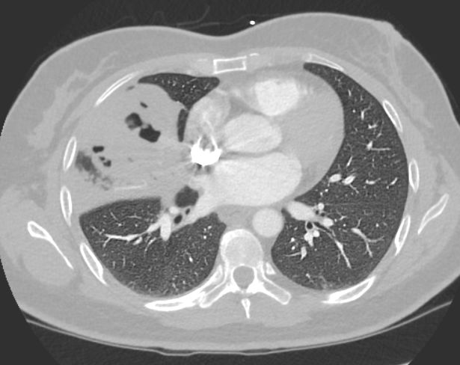
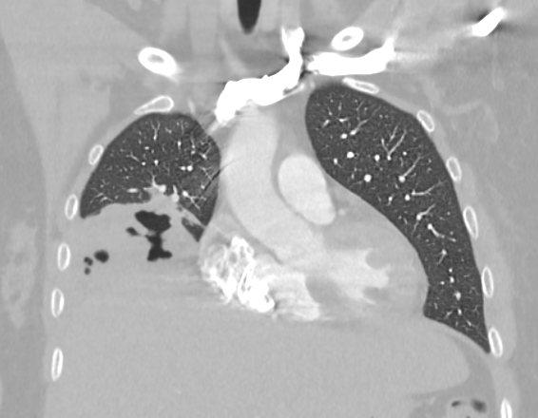
45 yo woman poorly controlled DM

Slide 22
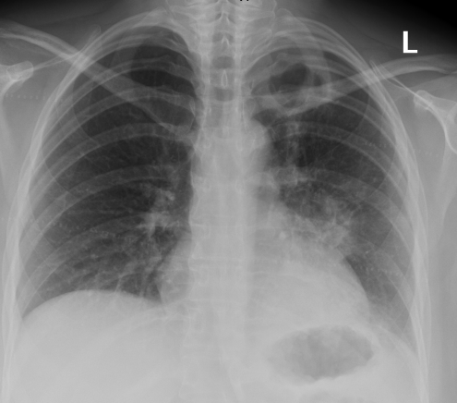
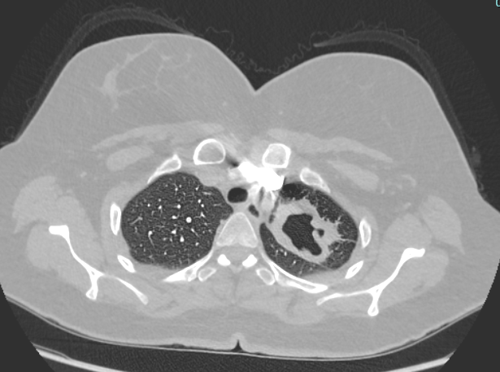
45 yo woman

Slide 23
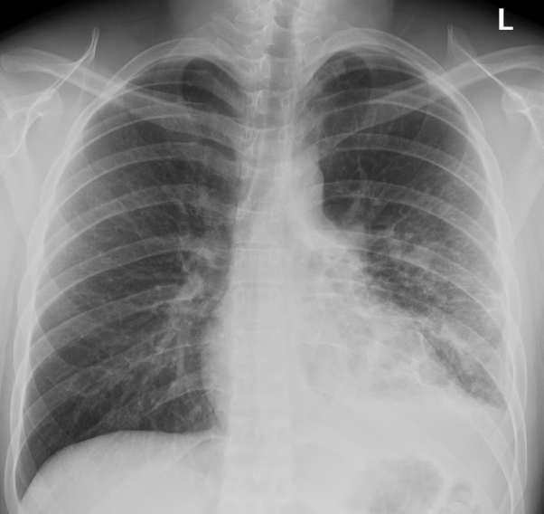
19 yo man

Slide 24
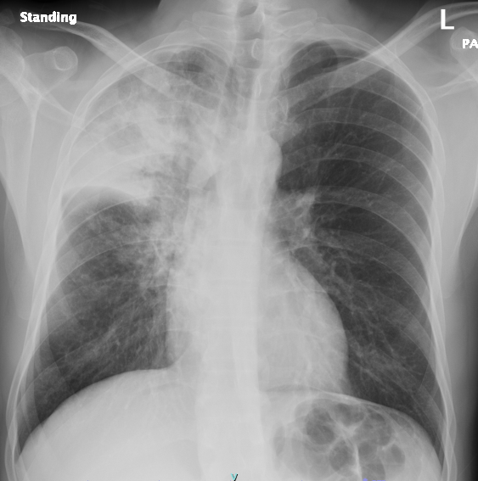
45 yo man

Slide 25
Pneumothorax

Slide 26
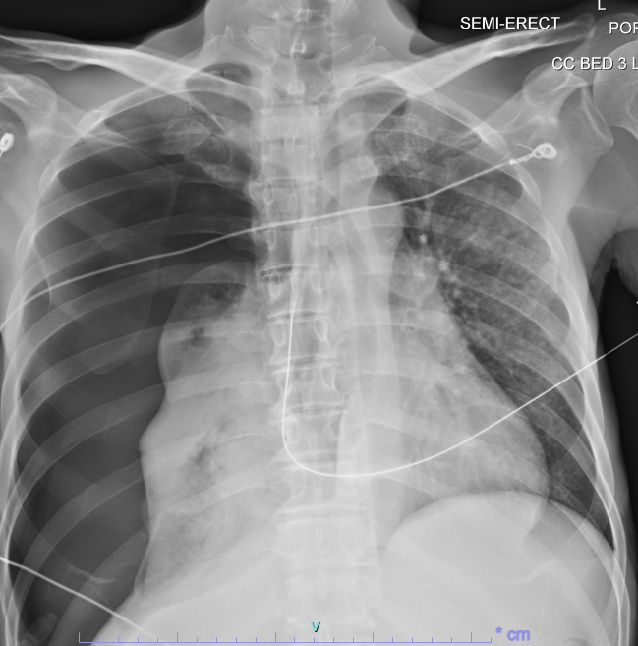
46 yo man

Slide 27
Tree in bud

Slide 29
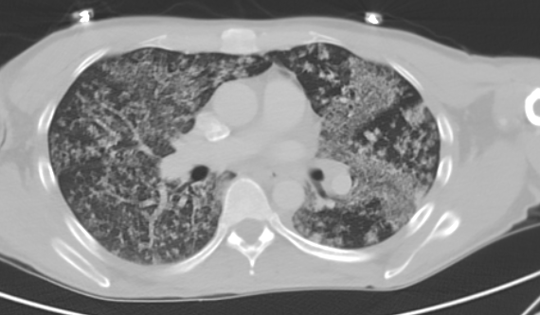
43 yo man

Slide 30
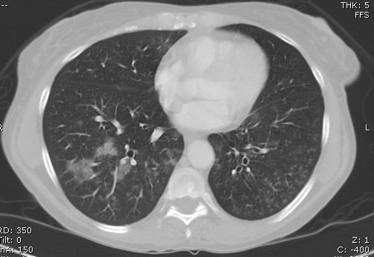
50 yo woman

Slide 31
Mediastinal and hilar LAD

Slide 32
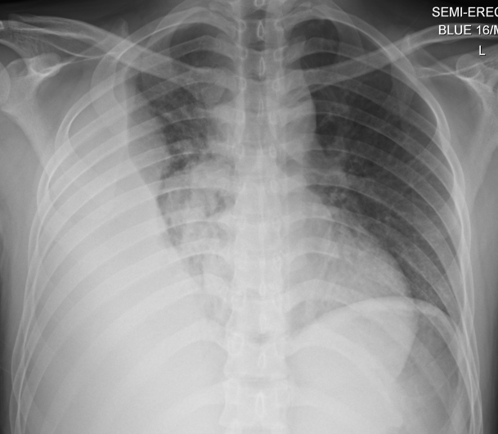
25 yo man

Slide 33
Pleural effusions

Slide 34
25 yo man

Slide 35
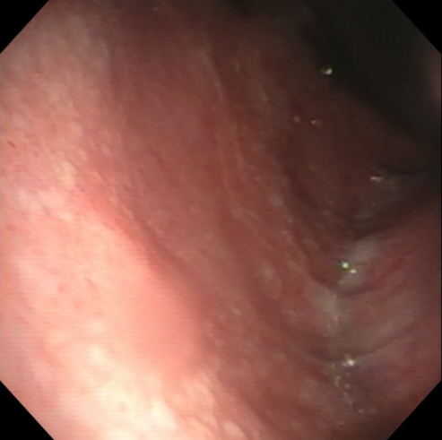
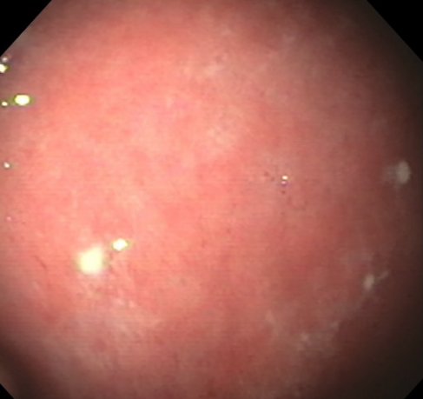

Slide 36
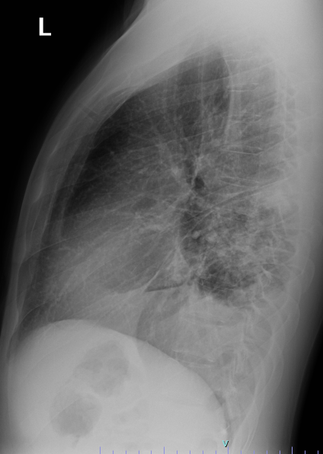
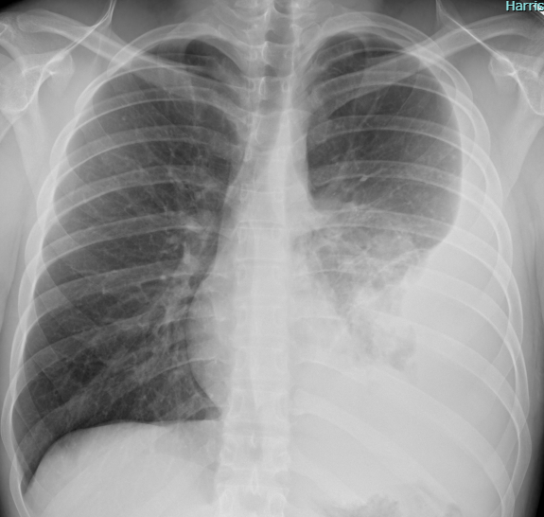
19 yo man

Slide 37
Miliary pattern

Slide 38

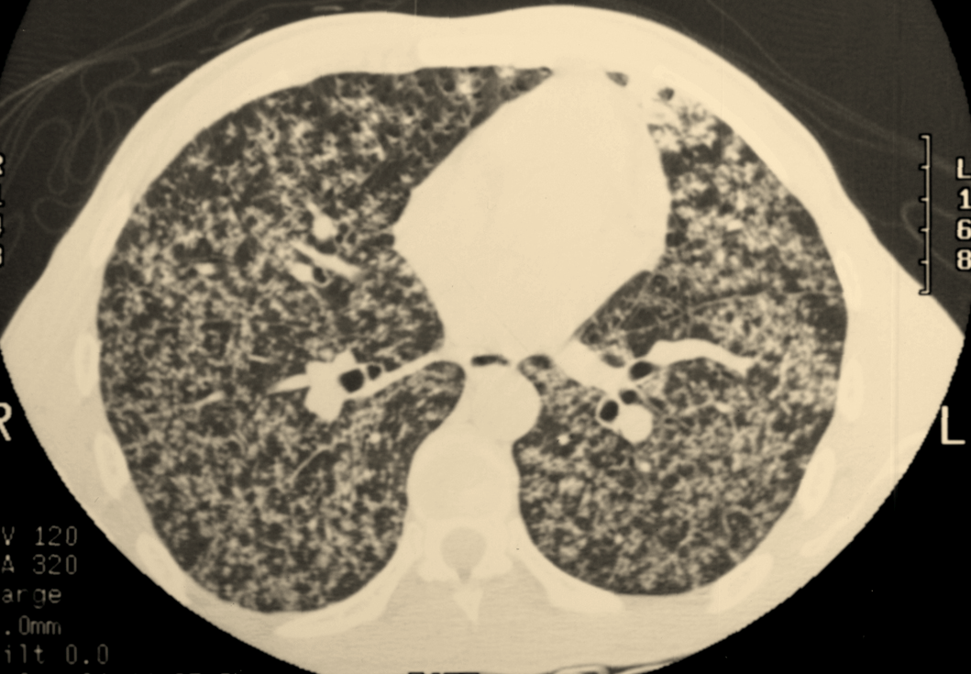

Slide 39
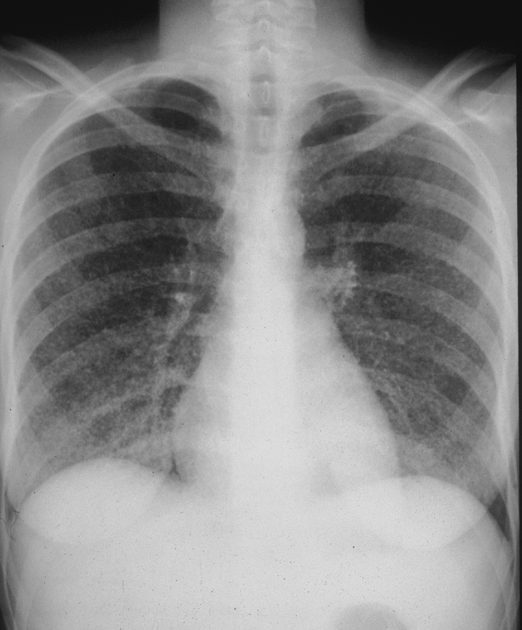
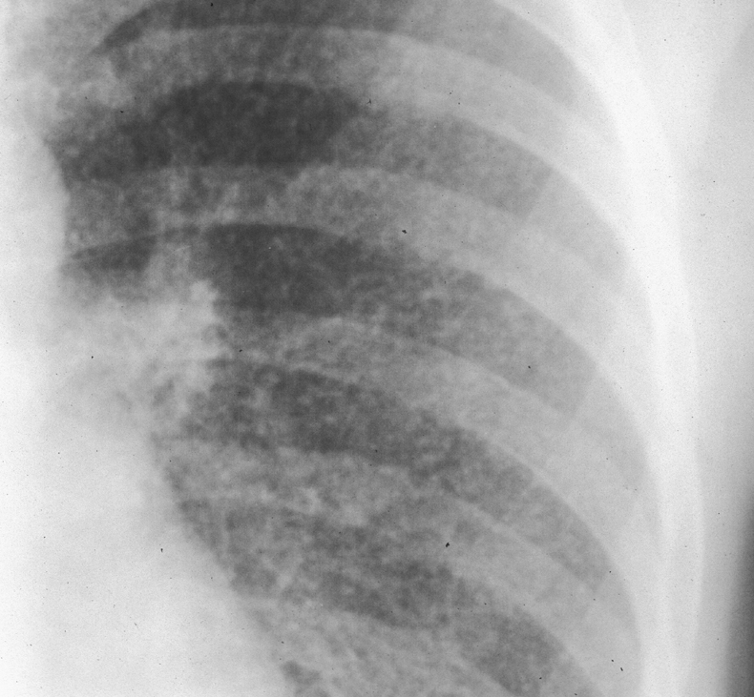

Slide 40
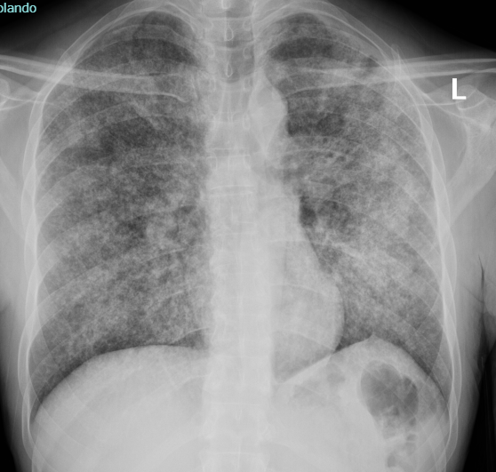
43 yo man

Slide 41
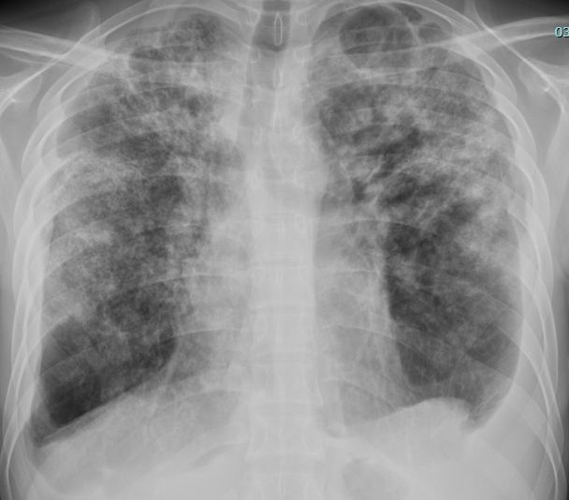
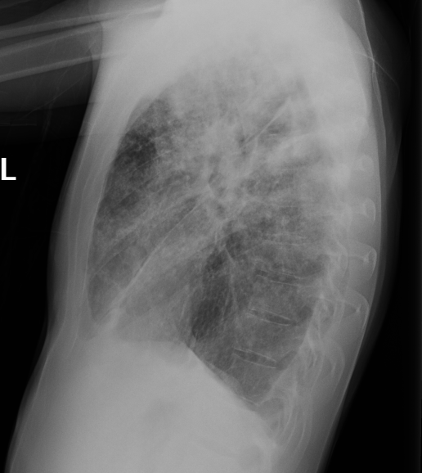
22 yo man

Slide 42
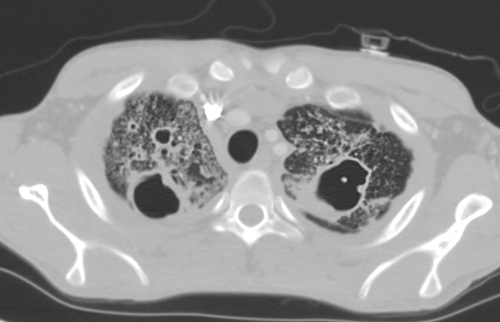
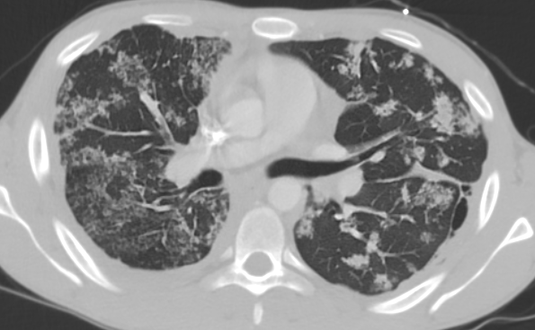
22 yo man

Slide 43
Pneumonia

Slide 44
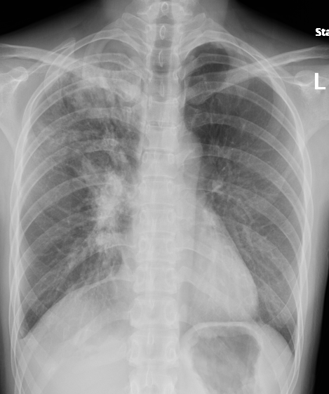
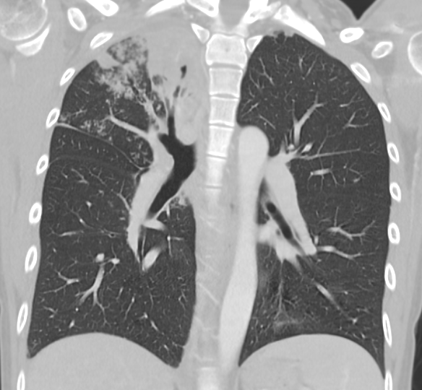
32 yo woman

Slide 45
Pott’s disease

Slide 46
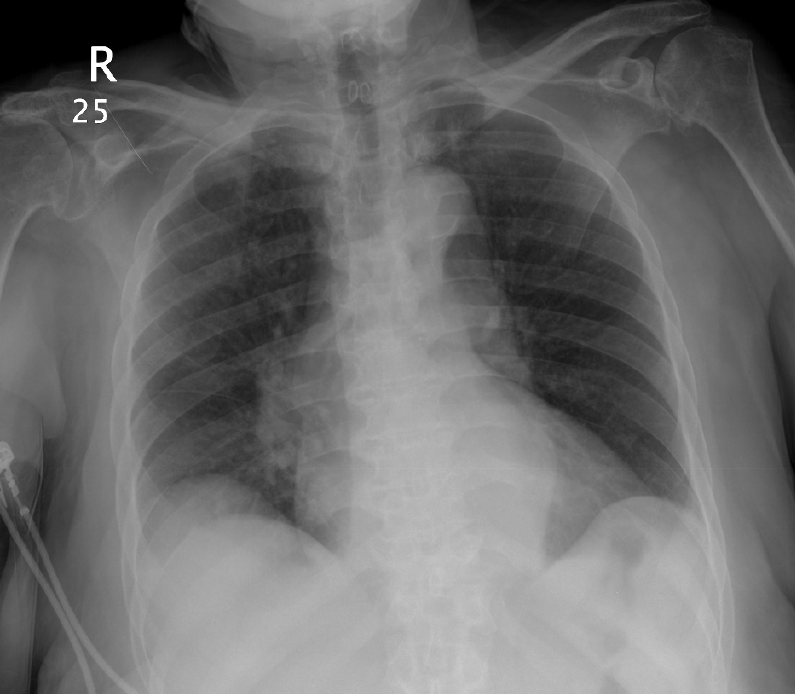
78 yo woman

Slide 47
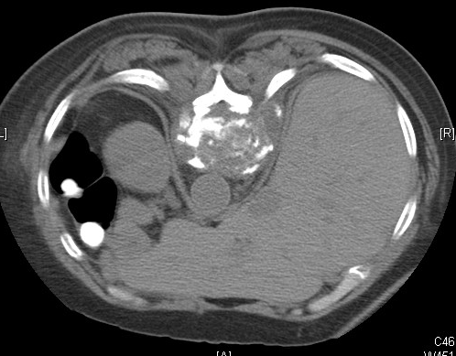
78 yo woman

Slide 48
Thank you ☺

