Slide 1
Susceptibility Was the Case
Understanding Lab Methods and Reports Regarding Drug Resistance

Slide 2
Ben Alpers has the following disclosures to make:
No conflict of interests
No relevant financial relationships with any commercial companies pertaining to this educational activity

Slide 3
WHO Classification of Drug Resistant TB
Rifampin Resistant (RR)/MDR (INH and rifampin resistant)
Pre-XDR-TB: TB caused by M. tuberculosis strains that fulfill the definition of MDR/RR-TB and are also resistant to any fluoroquinolone
XDR-TB: TB caused by M. tuberculosis strains that fulfill the definition of MDR/RR-TB and that are also resistant to any fluoroquinolone and at least one additional Group A drug, i.e. bedaquiline or linezolid

Slide 4
Specimen Quality
Accurate laboratory results are directly proportional to the quality of the specimen
Sputum
Recently discharged material from the bronchial tree, with minimal amounts of upper respiratory tract secretions
Well coached patient, collect at least 3ml
Label tube, form, and indicate test:
Initial Dx: Smear, NAAT, & Culture
Follow-up: Smear and Culture
Release from respiratory isolation?
Order Smear only
Transport to lab cool and quickly
Notes:
88% of specimens received in CY2013 were respiratory
Social & cultural stigma
The average person produces about a liter of mucus per day
4

Slide 5
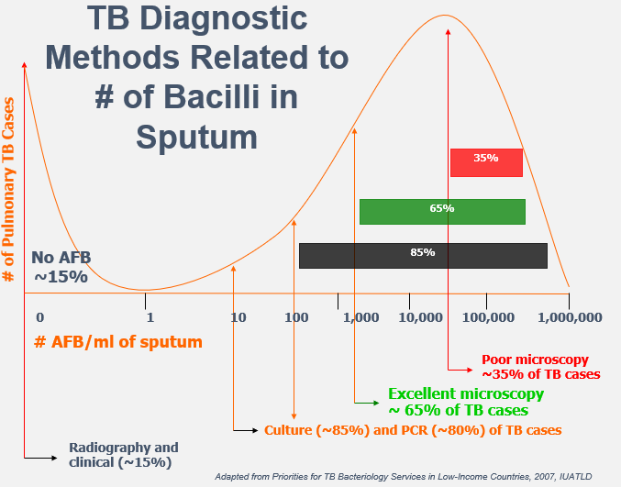


Slide 6
Case #1
Typical TB presentation from patient in SE Texas:
Fever
Productive cough for a few weeks
Fatigue
Loss of appetite

Slide 7
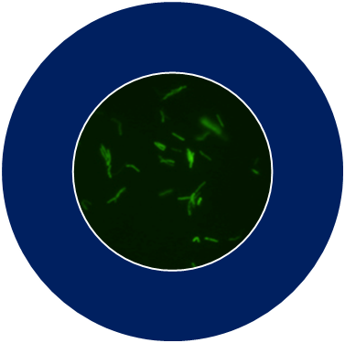
Acid Fast Bacilli Microscopy
(AFB Smear)
Has many qualities of an ideal diagnostic test
Rapid & universally available
Detects the most infectious cases
Used to support diagnosis and identify need to isolate
Helps monitor response to therapy
Identifies priority cases for nucleic acid amplification (NAA)
Problems
Not sensitive - misses ~50% of TB
Not specific in low TB prevalence areas (e.g. Texas)
Positive smear may be NTM
Highly specific where TB is highly prevalent

Slide 8
Smear Result
AFB Smear (Fluorochrome) POSITIVE: AFB seen on direct smear, >10/field
Strongly positive
>1,000,000 AFB/ml sputum
Probably very infectious
Although, great collection!

Slide 9
Nucleic Acid Amplification Tests (NAAT)
Tiny amounts of DNA are amplified (copied) until there is enough for easy detection
Examined for both Identification and Detection of Drug Resistance
Test turnaround time measured in hours
9
Notes:
9

Slide 10
Nucleic Acid Amplification Test (NAAT)
Detects M. tuberculosis complex nucleic acids; does not distinguish between live and dead bacilli
For initial Dx specimens only
Not suitable for follow-up specimen or monitoring; cured patients may be NAAT + for years!
Sensitivity compared to TB culture
>95% for AFB smear-positive
Only 55-75% for AFB smear-negative
Does not replace culture for bacteriological Dx

Slide 11
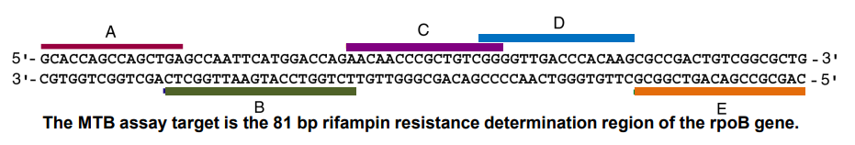
Cepheid GeneXpert® Target Region
Approx. 10% of rifampin resistant predictions are false
(ex. Phe433Phe silent mutation)
GX Rifampin resistant results must be confirmed

Slide 12
NAAT Result
MTB Direct Detection, NAA POSITIVE: M.tuberculosis complex DNA detected
Rifampin by Direct NAA Rifampin resistance mutation not detected; likely rifampin susceptible.
Note the wording—”likely” rifampin susceptible
No mutation detected in the area of the genome probed

Slide 13
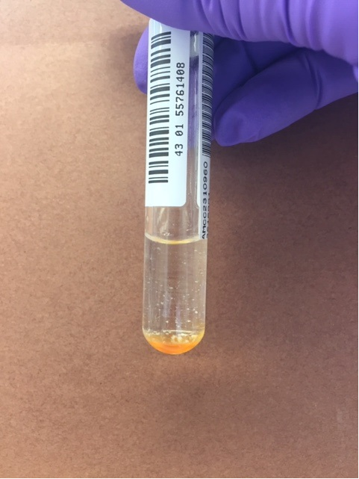
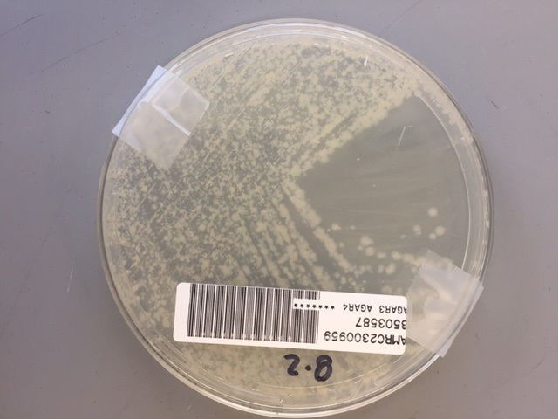
AFB Culture
More sensitive than smear
5,000 to 10,000 AFB/ml for smear
~10 viable AFB/ml for culture
Positive for only ~85% of Pulmonary TB
Requires a quality specimen
May be invalid due to contamination
Used to monitor patient response to treatment (like smear)
Required for conventional drug susceptibilities & genotype
Lengthy
1-6 weeks by liquid media
2-8 weeks by solid media

Slide 14
Culture Result
Organism ID by HPLC Mycobacterium tuberculosis complex
High Performance Liquid Chromatography is the primary means of organism identification at this time
HPLC is performed on culture

Slide 15
Conventional Drug Susceptibility Testing (DST) by Agar Proportion
A standardized suspension of M. tuberculosis is inoculated to quadrant plates of drug-containing Middlebrook 7H10 agar and a drug-free control.
If growth of M. tuberculosis on the drug quadrant is 1% or greater than the growth on the control, the drug can no longer be counted on as being effective for treatment.

Slide 16
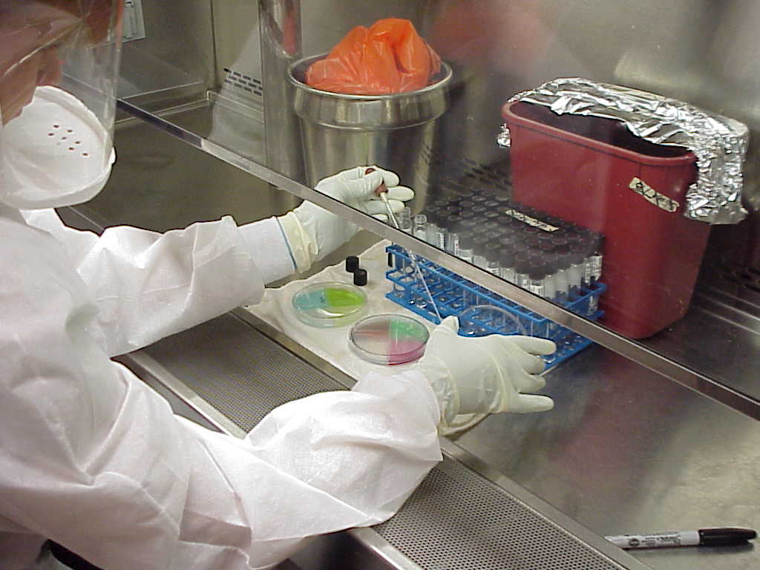
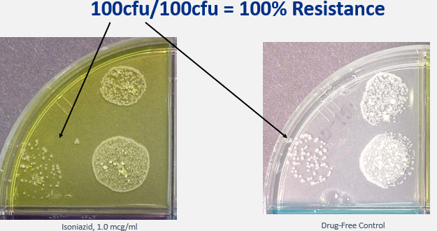

Slide 17
Conventional DST Result
Isoniazid 0.2 mcg/ml by Agar Proportion Resistant
Rifampin 1.0 mcg/ml by Agar Proportion Susceptible
Ethambutol 5.0 mcg/ml by Agar Proportion Susceptible
Isoniazid 1.0 mcg/ml by Agar Proportion Susceptible
Ofloxacin 2.0 mcg/ml by Agar Proportion Susceptible

Slide 18
Genotyping by Whole Genome Sequencing (WGS)
2,690 genetic loci examined and compared
Those that are 99.7% similar clustered by wgMLSType
This translates as <8 SNPs difference to at least one isolate in cluster
Phylogenic trees can be created within clusters
Not indicative of drug resistance pattern!

Slide 19
Genotyping Result
Date of Specimen Collection | Submitter Number | State Case Number | Date Received | wgMLSType
04/10/2019 | AMCC1904827 | 2019TX201913191 | 04/30/2019 | MTBC001328
01/15/2020 | AMCC2000665 | 2020TX202014246 | 02/06/2020 | MTBC001328
11/13/2021 | AMCC2113031 | 2021TX202116989 | 12/16/2021 | MTBC001328
02/24/2022 | AMCC2202387 | 2022TX202219420 | 03/16/2022 | MTBC001328
08/04/2022 | AMCC2210398 | 2022TX202222140 | 09/01/2022 | MTBC001328
08/16/2022 | AMCC2211152 | 2022TX202222139 | 09/01/2022 | MTBC001328

Slide 20
Case #2
Patient is high risk for drug resistance due to contacts and place of birth (Mexico)
Submitted by local health department on the border
NAAT requested
Will perform GeneXpert on request regardless of smear result
One negative smear NAAT per patient per 2 months

Slide 21
Smear and NAAT Results
AFB Smear (Fluorochrome) NEGATIVE: No AFB seen on direct smear
Low burden or poor collection
MTB Direct Detection, NAA POSITIVE: M.tuberculosis complex DNA detected
Rifampin by Direct NAA Rifampin resistance mutation detected; likely rifampin Resistant; confirmatory testing in progress.
Due to limited amount of DNA will need to wait for better candidate or culture for further testing

Slide 22
Culture Result
Organism ID by HPLC Mycobacterium tuberculosis complex
Patient’s only NAAT positive, culture positive specimen
Suggests low-burden TB
2½ weeks from Xpert result to culture

Slide 23
Molecular Detection of Drug Resistance (MDDR)
Can provide rapid detection of drug resistance
Both NAAT positive and culture positive specimens are candidates
Particularly useful for high-risk patients, RMP positive Xpert sediment, contaminated specimens, or those specimens that do not grow well or are non-viable in standard TB media
Examines 24 amplicons across 16 genes providing information on more than 12 antituberculosis drugs

Slide 24
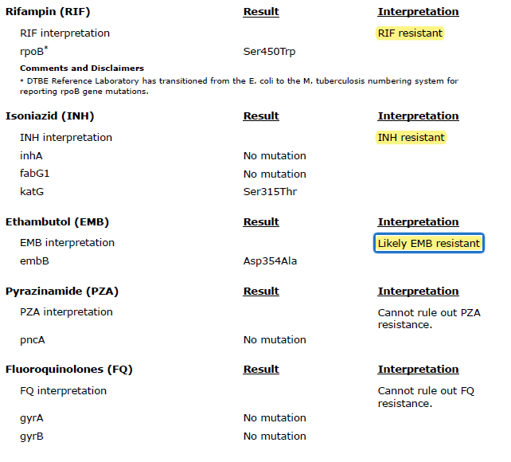
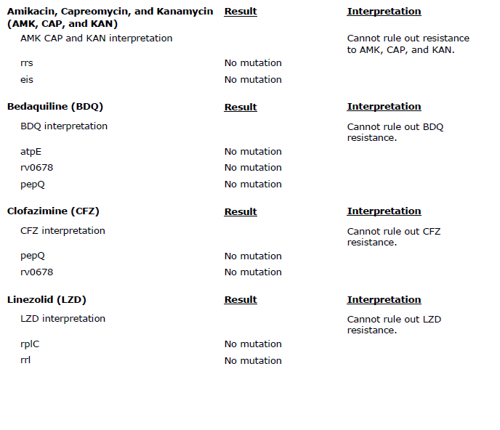
MDDR Report

Slide 25
Conventional DST Result (DSHS)
Isoniazid 0.2 mcg/ml by Agar Proportion Resistant
Rifampin 1.0 mcg/ml by Agar Proportion Resistant
Ethambutol 5.0 mcg/ml by Agar Proportion Resistant
Isoniazid 1.0 mcg/ml by Agar Proportion Resistant
Ethionamide 5.0 mcg/ml by Agar Proportion Susceptible
Streptomycin 2.0 mcg/ml by Agar Proportion Susceptible
Ofloxacin 2.0 mcg/ml by Agar Proportion Susceptible
Rifabutin 2.0 mcg/ml by Agar Proportion Resistant
Kanamycin 5.0 mcg/ml by Agar Proportion Susceptible
Capreomycin 10.0 mcg/ml by Agar Proportion Susceptible

Slide 26
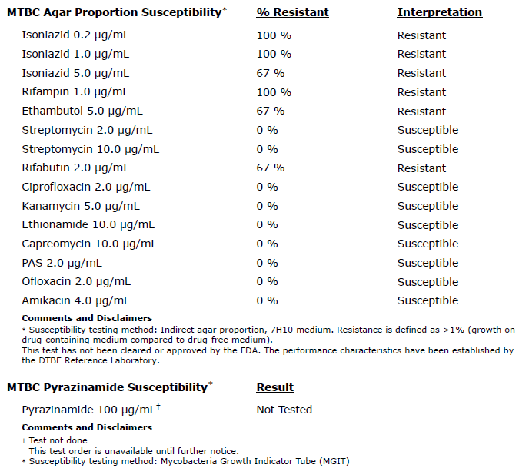
Conventional DST Result (CDC)

Slide 27
WGS (DSHS)
Sequencing performed in-house
Used primarily for molecular DST to first-line antibiotics
Currently only available means for PZA testing
Can detect low-level rifampin resistance that may not have been recognized by growth-based susceptibilities
Can detect variants with mutation associated with M. bovis or bovis BCG
pncA His57Asp

Slide 28
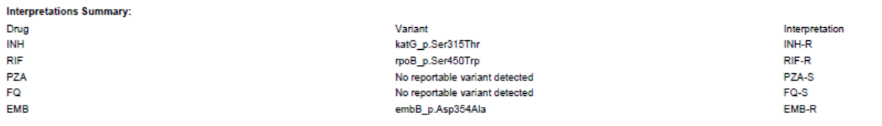
WGS Result (DSHS)

Slide 29
Case #3
Wife had TB disease and passed away
Patient diagnosed about one week later
Contact (wife) had resistance to critical concentration INH

Slide 30
Smear and NAAT Results
AFB Smear (Fluorochrome) NEGATIVE: No AFB seen on direct smear
MTB Direct Detection, NAA POSITIVE: M.tuberculosis complex DNA detected
Rifampin by Direct NAA Rifampin resistance mutation detected; likely rifampin Resistant; confirmatory testing in progress.
Low DNA, unable to send for MDDR until 1 month later (culture)

Slide 31
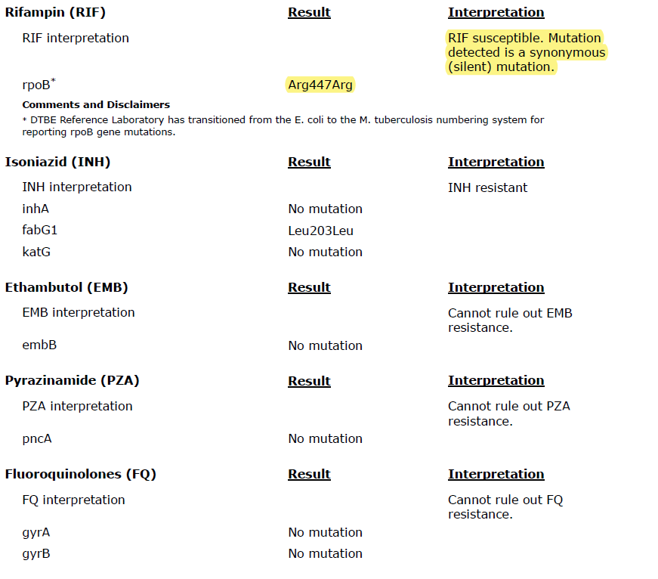
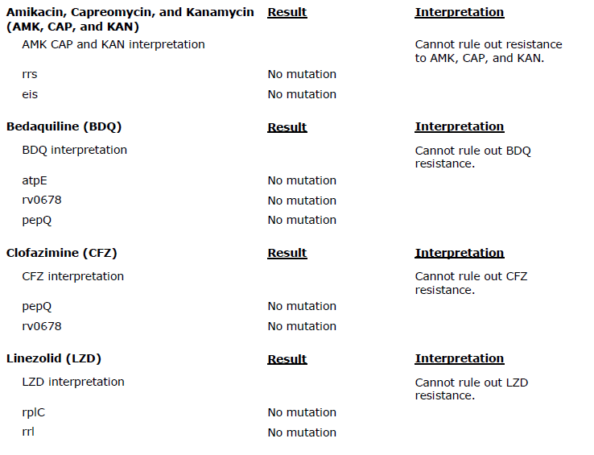
MDDR Report

Slide 32
Conventional DST Results
Both DSHS and CDC agar proportion results were consistent with the molecular findings

Slide 33
Genotyping Result

Slide 34
Genotyping Cluster Currently

Slide 35
Case #4
Father of son and daughter with pre-XDR TB five years prior
Refused evaluation then
Now symptomatic

Slide 36
Smear and NAAT Results
AFB Smear (Fluorochrome) POSITIVE: AFB seen on direct smear, >10/field
MTB Direct Detection, NAA POSITIVE: M.tuberculosis complex DNA detected
Rifampin by Direct NAA Rifampin resistance mutation not detected; likely rifampin susceptible.
Although rifampin susceptible by Xpert, patient still high risk and urgency to develop drug regimen

Slide 37

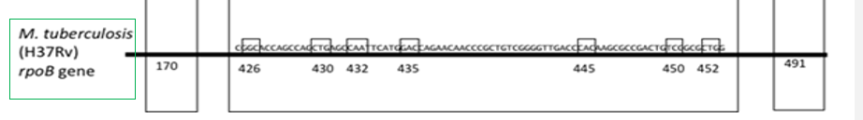
Xpert vs MDDR rpoB Evaluation
MDDR sequences 2 codons outside of RRDR known to be associated with rifampin resistance
MDDR can detect as low as 10% rifampin resistant population while Xpert limit of detection is 30%

Slide 38
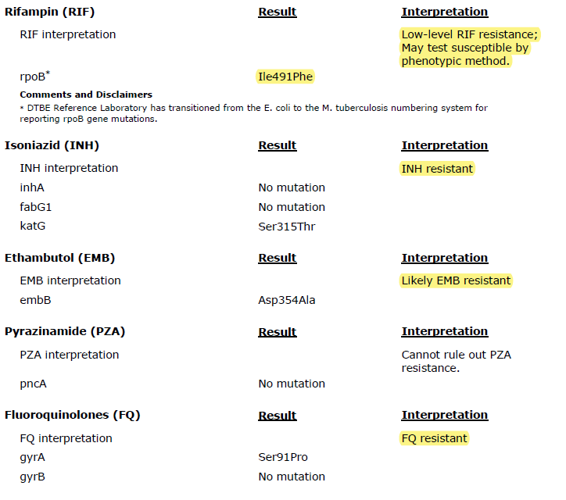
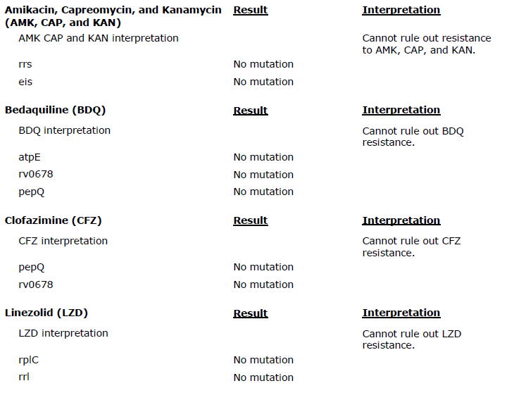
MDDR Report

Slide 39
Conventional DST Results
Both DSHS and CDC agar proportion results were consistent with the molecular findings
DSHS found isolate to be 10% resistant to rifampin
CDC found 8% resistance

Slide 40
Minimum Inhibitory Concentration (MIC) Testing
Lowest concentration of a drug which prevents detectable growth in vitro when tested in a series of concentrations
Only available at specialized laboratories such as CAHD and Wadsworth Center NYHD
Performed only by special request on select antibiotics
Can be tested by MGIT, AP, or Broth Micro-dilution (BMD)

Slide 41
MIC Result
California Health Department performed, moxifloxacin MIC=1.0 ug/ml
Intermediate resistance can be overcome with higher dose

Slide 42
Genotyping Result
Date of Specimen Collection | Submitter Number | State Case Number | Date Received | wgMLSType
11/12/2024 | AMCC2418101 |  | 12/12/2024 | MTBC001079
07/30/2024 | AMCC2412158 | 2024TXBN2426175 | 08/14/2024 | MTBC001079
06/07/2019 | AMCC1908001 | 2019TXBN1913136 | 07/02/2019 | MTBC001079

Slide 43
Case #5
Patient is a 71 y/o male from Mexico visiting family in Texas including a 2 y/o
Non-productive cough
Fatigue
Weight loss for a year
Xpert positive for rifampin resistance
MDDR shows isolate to be XDR (old definition)

Slide 44
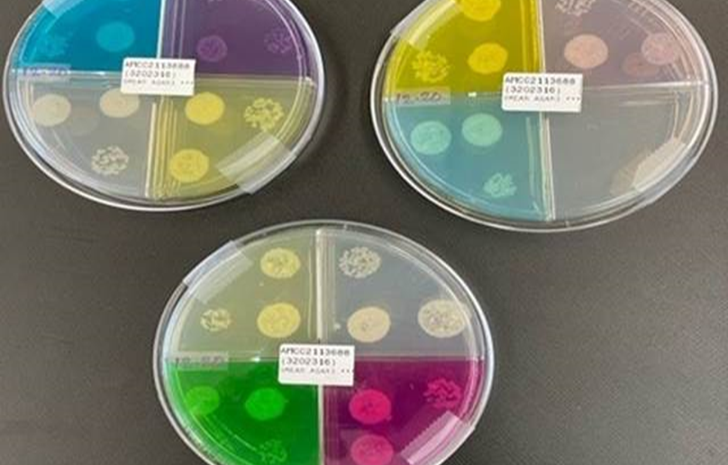
Conventional DST Result

Slide 45
Case #6
Eighty y/o male visiting from Mexico
Poor health
Rifampin resistant by Xpert

Slide 46
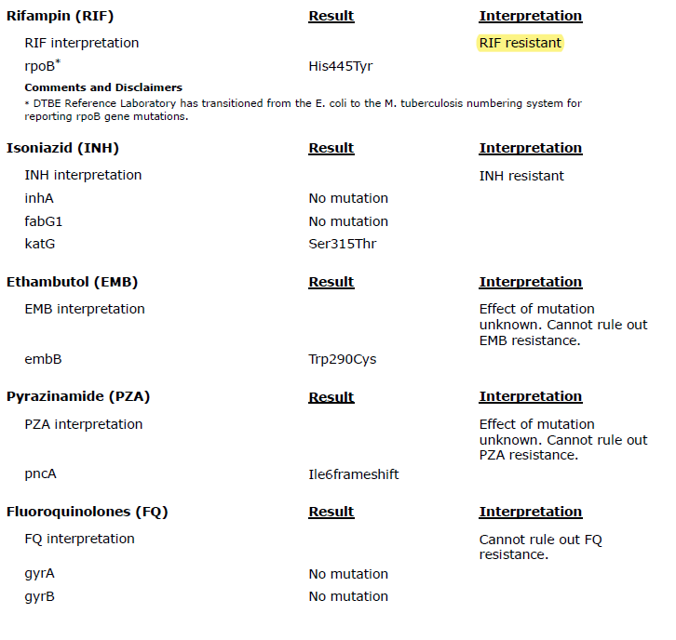
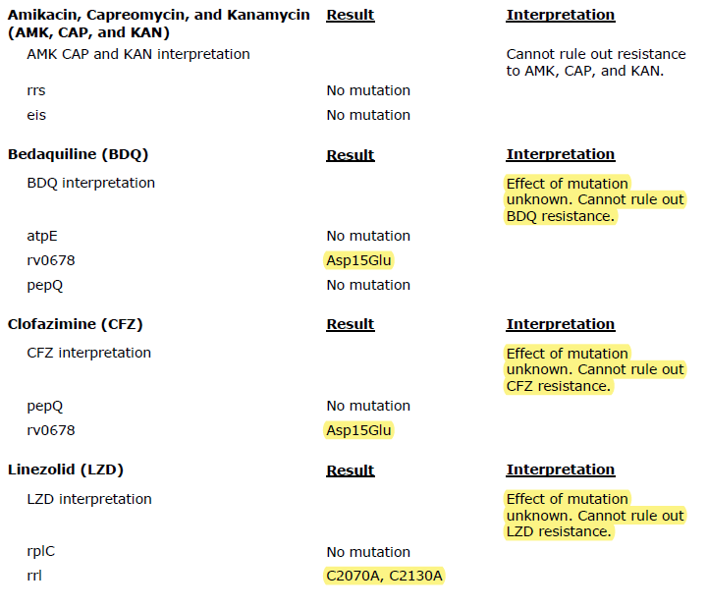
MDDR Report

Slide 47
Conventional DST Result (Wadsworth Center NYHD)
BPaL Susceptibility testing for M. tuberculosis complex (MGIT)
Bedaquiline [1.0 ug/ml]: Susceptible
Clofazimine [1.0 ug/ml]: Susceptible
Linezolid [1.0 ug/ml]: Susceptible
Very scary situation.

Slide 48
Summary
Each of these testing methods have individual benefits and disadvantages
Understanding these characteristics can reconcile seeming discordance
Integrating these methods provides a clearer understanding of patient’s situation and appropriate treatment especially with the rise of resistant and complex cases
If unsure how to interpret results, ask!

Slide 49
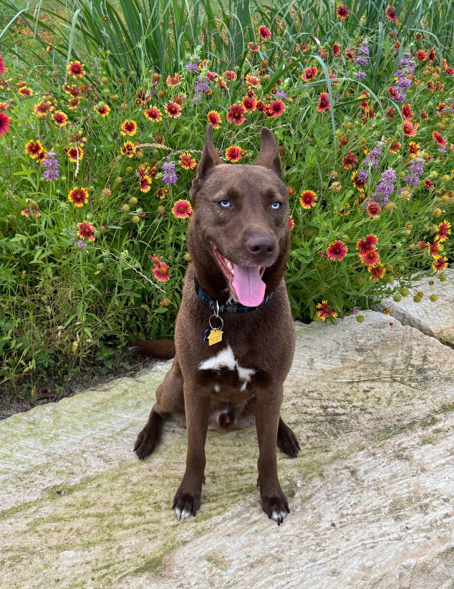
Thank You!
benjamin.alpers@dshs.texas.gov

