Slide 1


Kim C. Smith, MD, MPH

Slide 2
Who Should be Screened?
Place a mark in the appropriate box: | Yes | No | Don't Know
TB can cause fever of long duration, unexplained weight loss, a bad cough (lasting over two weeks), or coughing up blood. As far as you know: has your child been around anyone with any of these symptoms or problems? or has your child had any of these symptoms or problems? or has your child been around anyone sick with TB?
Was your child born in Mexico or any other country in Latin America, the Caribbean, Africa, Eastern Europe or Asia?
Has your child traveled in the past year to Mexico or any other country in Latin America, the Caribbean, Africa, Eastern Europe or Asia for longer than 3 weeks? If so, specify which country/countries?____________________________________
To your knowledge, has your child spent time (longer than 3 weeks) with anyone who is/has been an intravenous (IV) drug user, HIV-infected, in jail or prison or recently came to the United States from another country?
Patients with
Symptoms or
Exposure to TB
Foreign Born
Travel to
High Risk
Countries
Exposure to
High Risk
Individuals

Slide 3
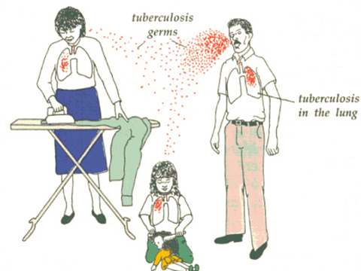
Stages of Tuberculosis
Exposure
to Contagious Adult with
Pulmonary Disease
Household
contacts
20-30%
Latent TB Infection
LTBI
Risk varies by age
5-50%
5-10%
Adult
Active TB Disease
Child
Active TB Disease

Slide 4
Risk of Progression to TB Disease if no Treatment by Age Infected or Medical Condition

Slide 5
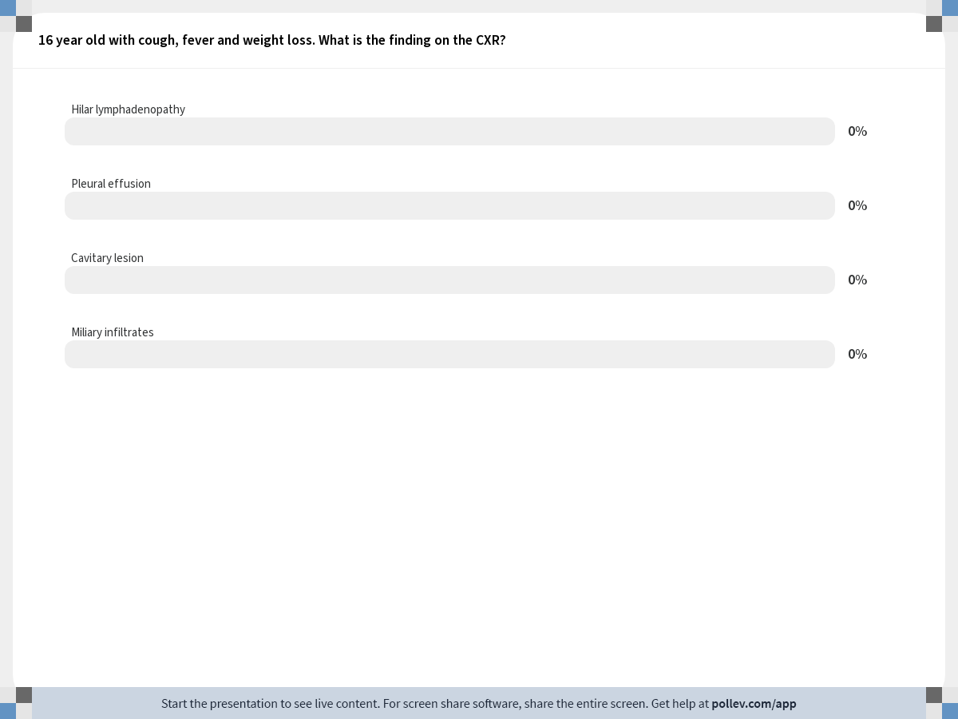
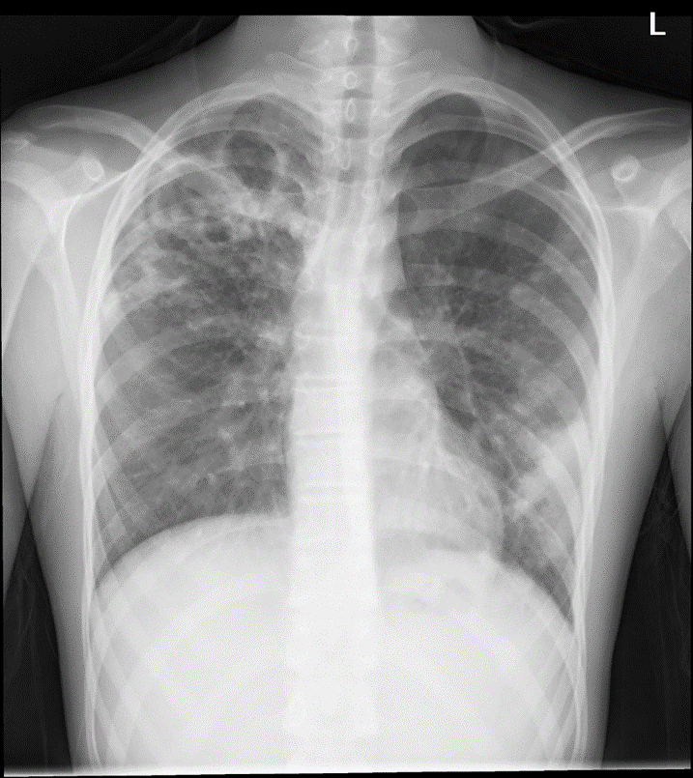
Notes:
Poll Title: 16 year old with cough, fever and weight loss. What is the finding on the CXR? https://www.polleverywhere.com/multiple_choice_polls/qigb4oifjN9jUh1

Slide 6
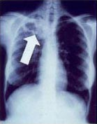

Reactivation Disease
Occurs years after primary infection
Typical of adult disease
Occasionally seen in teens
Often cavitary
High numbers of organisms (AFB +)
Usually symptomatic and contagious

Slide 7

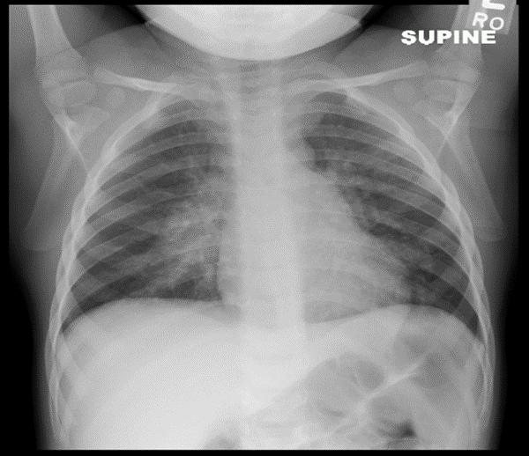

Primary TB Disease
Typical of childhood TB
Usually not cavitary
Classic x-ray:
Hilar lymphadenopathy
Infiltrates or
Miliary pattern
Low numbers of organisms
AFB smears negative (95%)
Cultures negative in 60%
Most children <10 yrs are not contagious
Often asymptomatic (50%)

Slide 8
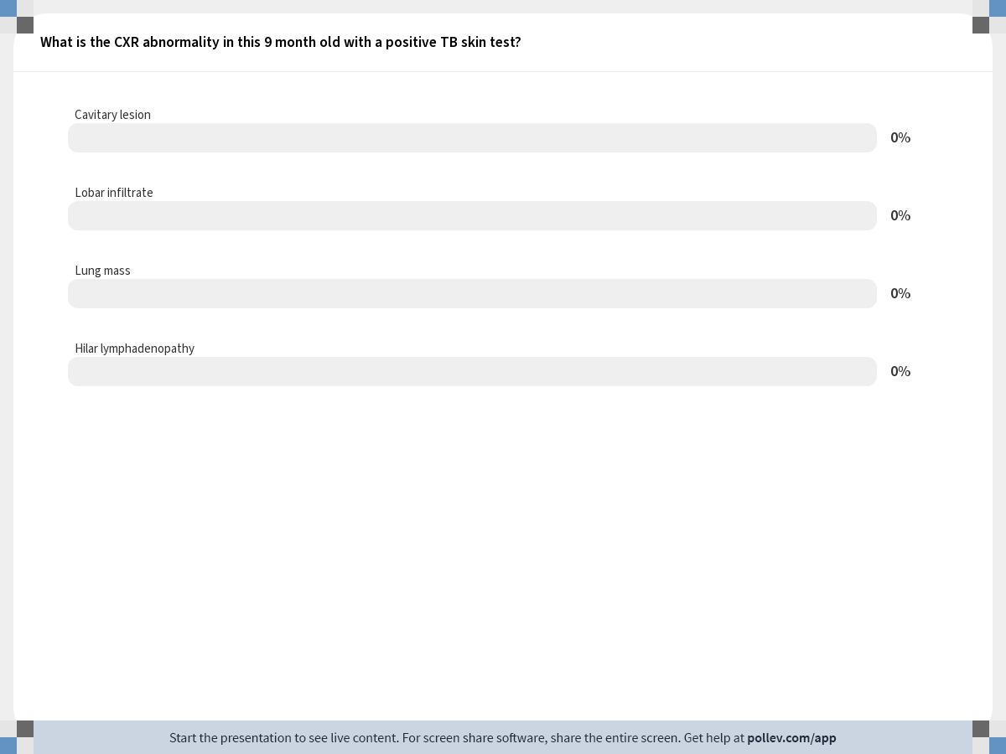
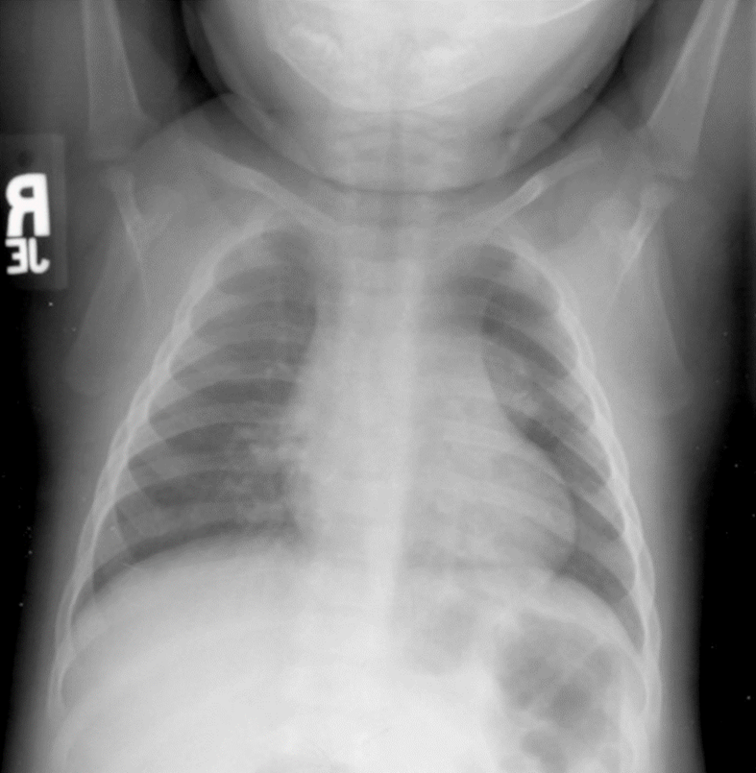
Notes:
Poll Title: What is the CXR abnormality in this 9 month old with a positive TB skin test? https://www.polleverywhere.com/multiple_choice_polls/ZkKS9aQdhsVYyrX

Slide 9
TB Disease
Adult TB Disease
Pediatric TB Disease
Source: U.S. Cases CDC

Slide 10
TB Extrapulmonary Disease
Adult Extrapulmonary Disease 15%
Pedi Extrapulmonary Disease 25%

Slide 11
Common symptoms of TB disease in children
Cough and/or other respiratory symptoms
Wheezing, crackles or decreased breath sounds on lung examination
Lymphadenopathy / lymphadenitis
Persistent fever (FUO)
Weight loss or failure to thrive
Signs and symptoms of meningitis
Headache, vomiting, irritability, lethargy or seizures
Unlike adults, half of children with TB disease have no symptoms

Slide 12
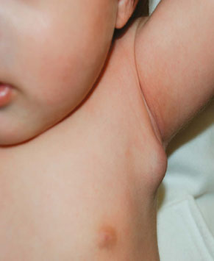
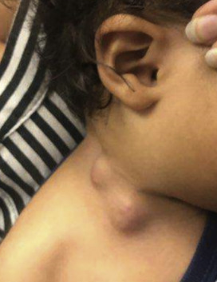
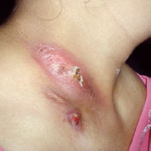
Peripheral Lymphadenopathy
Physical exam, carefully check for
Cervical, supraclavicular, axillary and inguinal nodes
TB diseased lymph nodes usually measure > 1 cm
Diagnosis: Fine needle aspirate or excisional biopsy for pathology and culture recommended
May progress to necrosis, caseation or chronic drainage
Nodes may become more inflamed with TB treatment

Slide 13
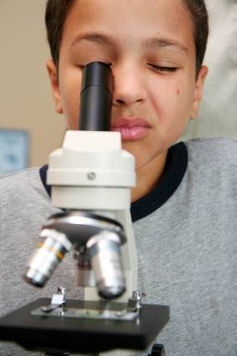
Diagnosis of TB in Children
Gold Standard –
Positive TB Culture, OR
Clinical Diagnosis (most common):
Abnormal CXR, laboratory or physical examination consistent with TB AND
1 or more of the following:
Positive tuberculin skin test or IGRA
Contagious adult contact identified
Clinical course consistent with TB disease
Improvement on TB therapy

Slide 14
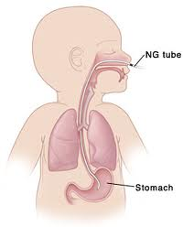
Consider Gastric Aspirates If no source identified
Usually inpatient but can be collected outpatient
Overnight fasting
Lavage with normal saline
Collected in morning x 3 days
AFB smear yield: minimal <5%
TB Culture yield: 40% average (20-50% range)
Protocol: Curry International TB Center
https://www.currytbcenter.ucsf.edu/product/guide/pediatric-tuberculosis-a-guide-to-the-gastric-aspirate-procedure

Slide 15
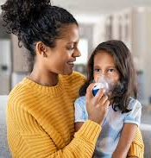
Induced Sputum
Outpatient procedure
2-3h fasting period
Pretreatment:
Nebulized bronchodilator and hypertonic saline
Chest physiotherapy (CPT)
Nasopharynx suctioned
One specimen sufficient
Culture yield 40%
May be successful in children 3 years and over
Lancet. 2005;365:130

Slide 16
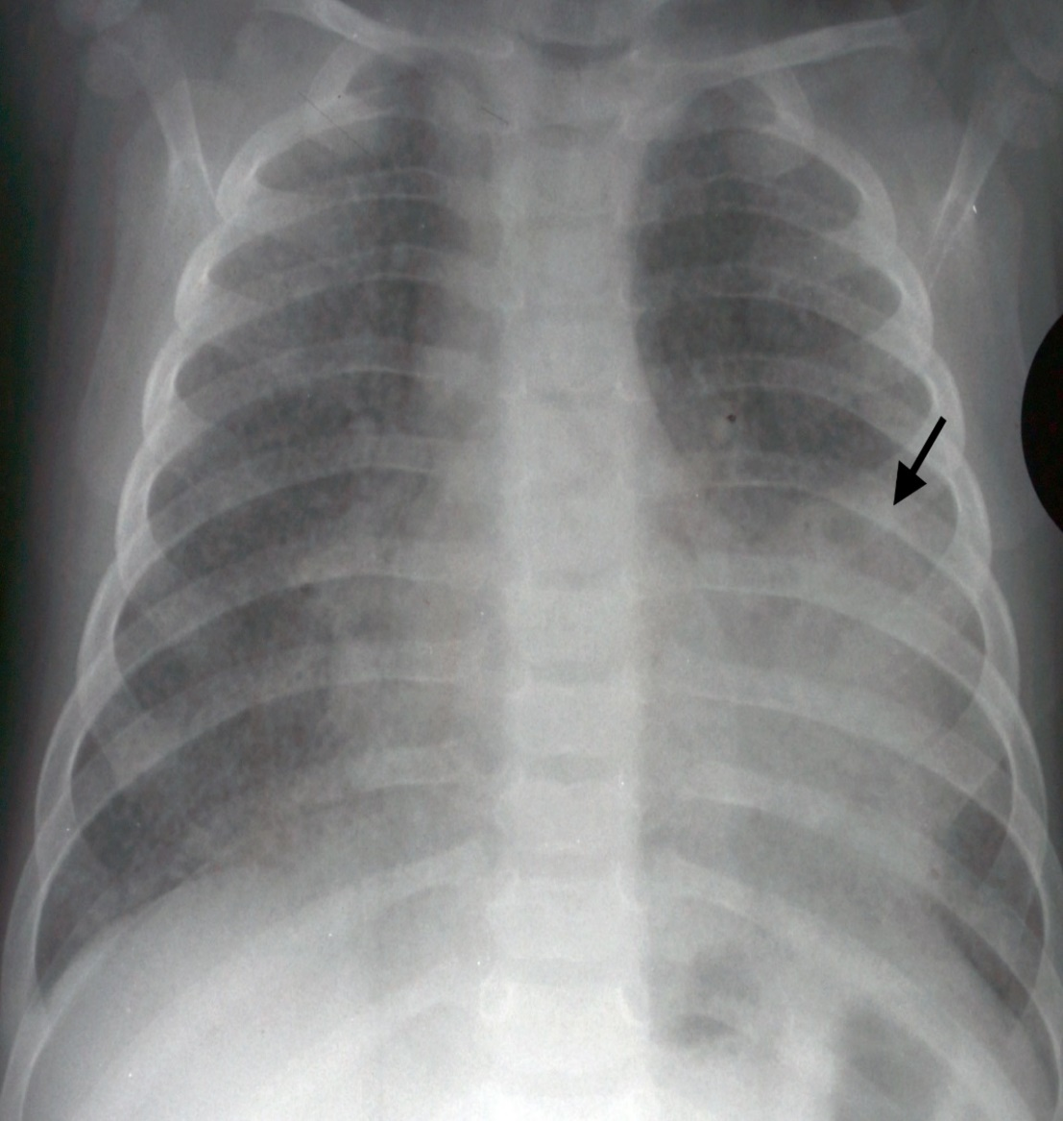
Pediatric Case
6-month-old
1–2-week history of fever, vomiting and sweating
Dx: viral illness at urgent care x 2
OSH with bilateral pneumonia on CXR
Developed respiratory failure, seizures, intubation
Altered mental status, abnormal neurologic exam
Diffuse Miliary Pattern with LLL consolidation

Slide 17
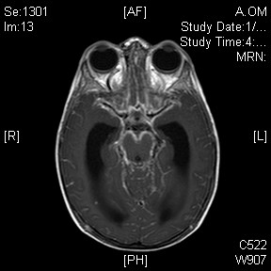
Hospital Course
Dx: meningitis & miliary TB
Family history
Father hospitalized 2 months prior with cavitary pneumonia
History of incarceration and mental illness
Father’s sputum AFB smear negative but culture grew TB at 4 weeks
Health Department unable to locate family for testing
Long term complications
Hydrocephalus and VP shunt
Developmental delay

Slide 18
Outcome
All family members tested positive for TB
Mother with abnormal CXR
Baby grew TB from tracheal aspirate and CSF
Baby treated with RIPE (rifampin, isoniazid, pyrazinamide, ethambutol) x12 months and steroids (2 months)
How could this have been prevented?

Slide 19
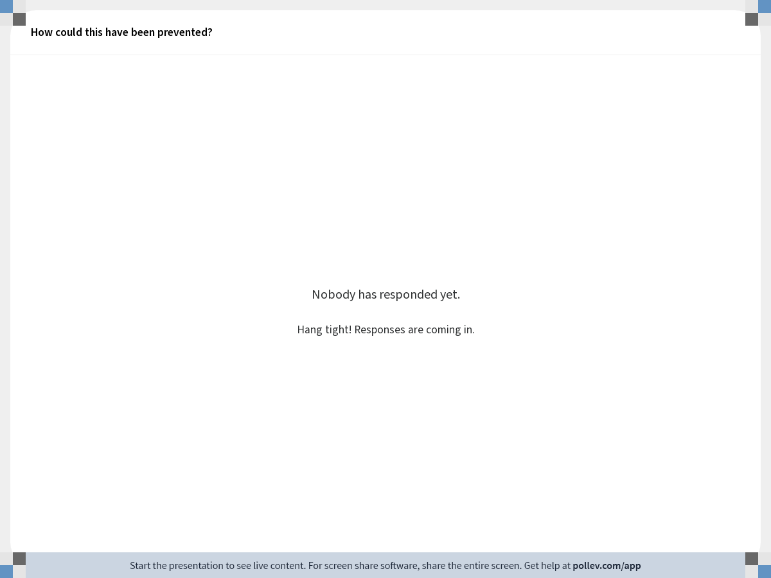
Notes:
Poll Title: How could this have been prevented? https://www.polleverywhere.com/free_text_polls/hEdpBhUqCak17mT

Slide 20


Treatment of TB in Children
Stages of TB | TST/IGRA | CXR/Lab Physical | Symptoms | Treatment
Exposure Child <4yrs (adult source) | Negative | Normal | None | Window CPX Rifampin or INH 8-10 wks Repeat TST 8-10 wks after last contact
LTBI Latent TB Infection | Positive | Normal | None | Rif x 4-6 mo or 3HP wkly x 12 wks, DOT (directly observed therapy) or INH x 9 mo
Disease | 90% Positive 50% false neg with miliary and TBM | Abnormal CXR, PE or labs | 50% of children have symptoms | RIPE x 4-12 months, duration depends on site

Slide 21
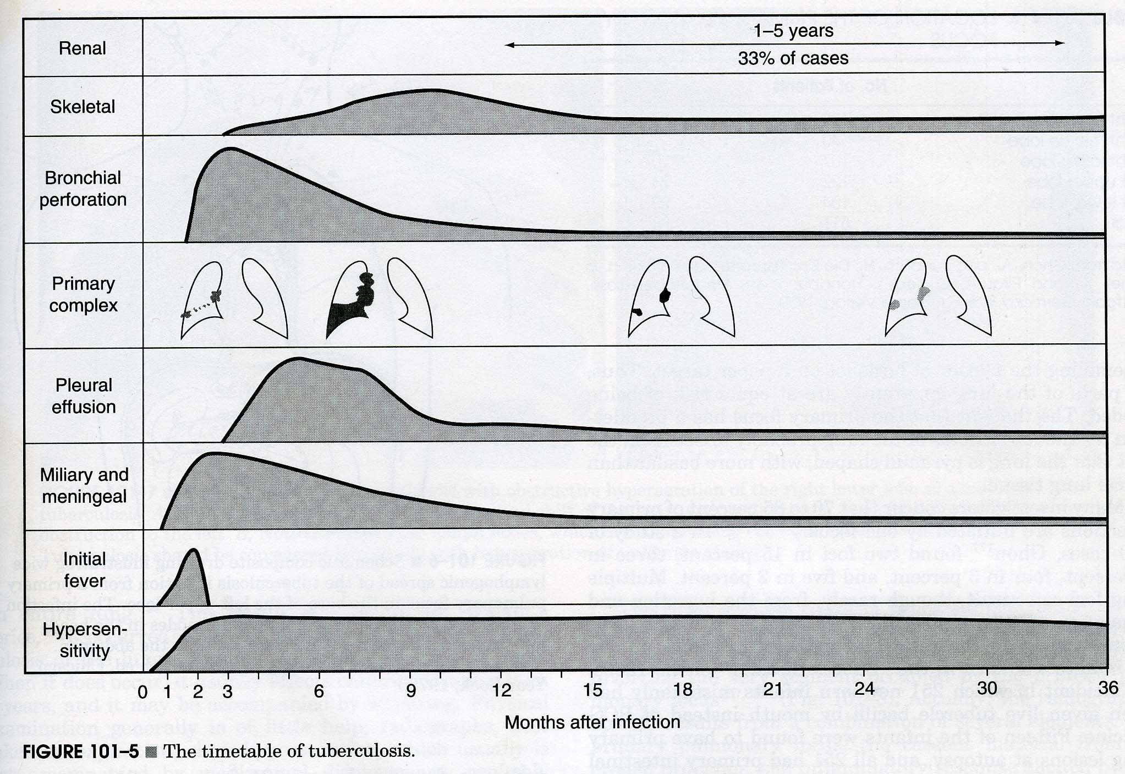

T
Timetable of Tuberculosis
*Feigin & Cherry, Text of Pedi ID

Slide 22

TB Testing in Foreign Born

Slide 23
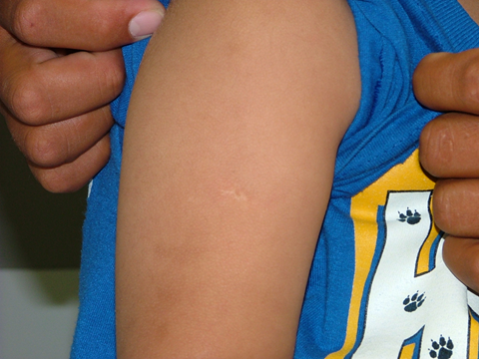
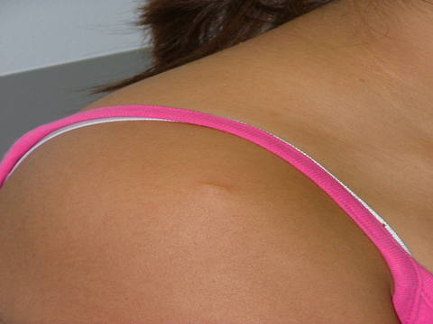
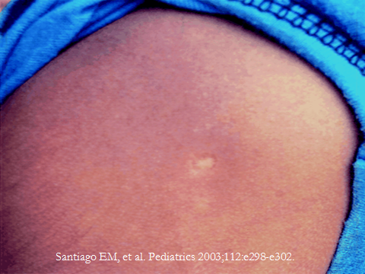
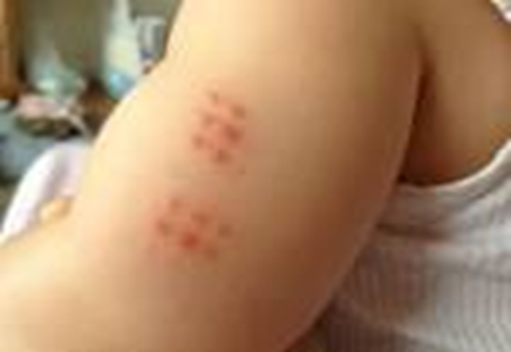
BCG Vaccination Scars

Slide 24


Algorithm for TB Testing in Children
TB Risk Questionnaire positive?
Screening Complete
No
Yes
BCG Vaccinated?
Yes
IGRA Preferred for all ages* due to higher specificity
No
Consider
Cost
Confidence in test
Ability to return
TST or IGRA Acceptable

Slide 25
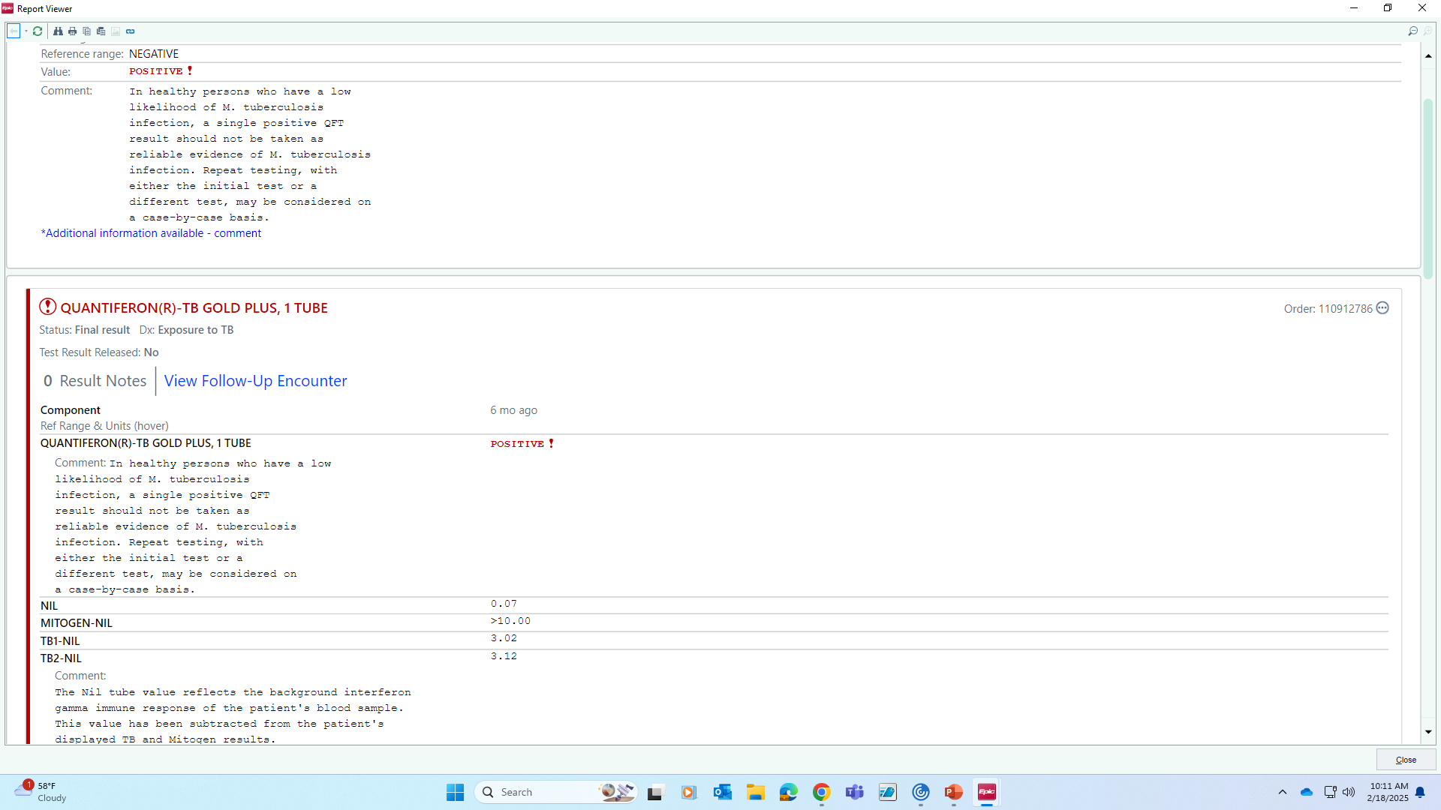
Positive QFT
Neg control
Positive control >0.5
Strongly positive >2

Slide 26

Treatment Options for LTBI
3HP - Health Department Only
INH & Rifapentine once weekly for 12 doses
High completion rates
Must be directly observed therapy (DOT)
Lots of pills to swallow may be issue for younger children
Approved for children > 2 years
Rifampin daily for 4 months
High completion rates
May be compounded to liquid or capsules sprinkled
Potential drug interactions (OCA’s, protease inhibitors)
Red/orange urine in most patients
More expensive
Old School
INH for 6-9 months
Inexpensive
Low completion rates (50%) for self administered treatment
INH indicated if contraindications to Rifampin
Rifampin resistant source case
Rifampin lowers efficacy of hormonal contraceptive agents
Incompatible with protease inhibitors
Allergy to rifampin

Slide 27

Comparing LTBI Treatment Options
Regimen | Isoniazid x 9 months | Rifampin x 4 months | INH/Rifapentine x 3 months (3HP)
Completion Rates | 62% (self admin) | 93% (self admin) | 90% (DOPT)
Administration | Daily self meds x 9 months | Daily self meds x 4-6 months | Once weekly x 12 weeks DOPT only
Adverse Events | 2-6% | 3% | 0.4-5%
Total Drug Cost | $40-100 | $400 | $120-350
Considerations | Long successful track record Poor completion rates | Possible drug interactions Expensive (insurance or Health Dept may cover) | Shortest regimen Age >2 yr Lots of pills once wkly

Slide 28

Monitoring Children on TB Treatment
Risk of drug toxicity very low
Monitor clinical signs
Regular clinical visits (4-6 wks)
Patient education
Routine blood work not necessary unless
Signs or symptoms of toxicity
Risk factors for toxicity (obesity, other hepatotoxic medications)
Follow up to monitor symptoms and reinforce adherence

Slide 29
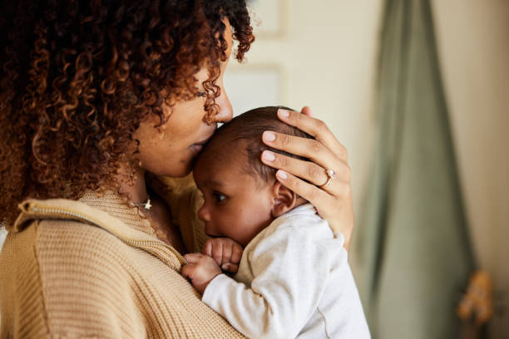

Baby Exposed to TB Disease
2-month-old infant
Mother with TB disease
How do you determine the risk to the baby?

Slide 30
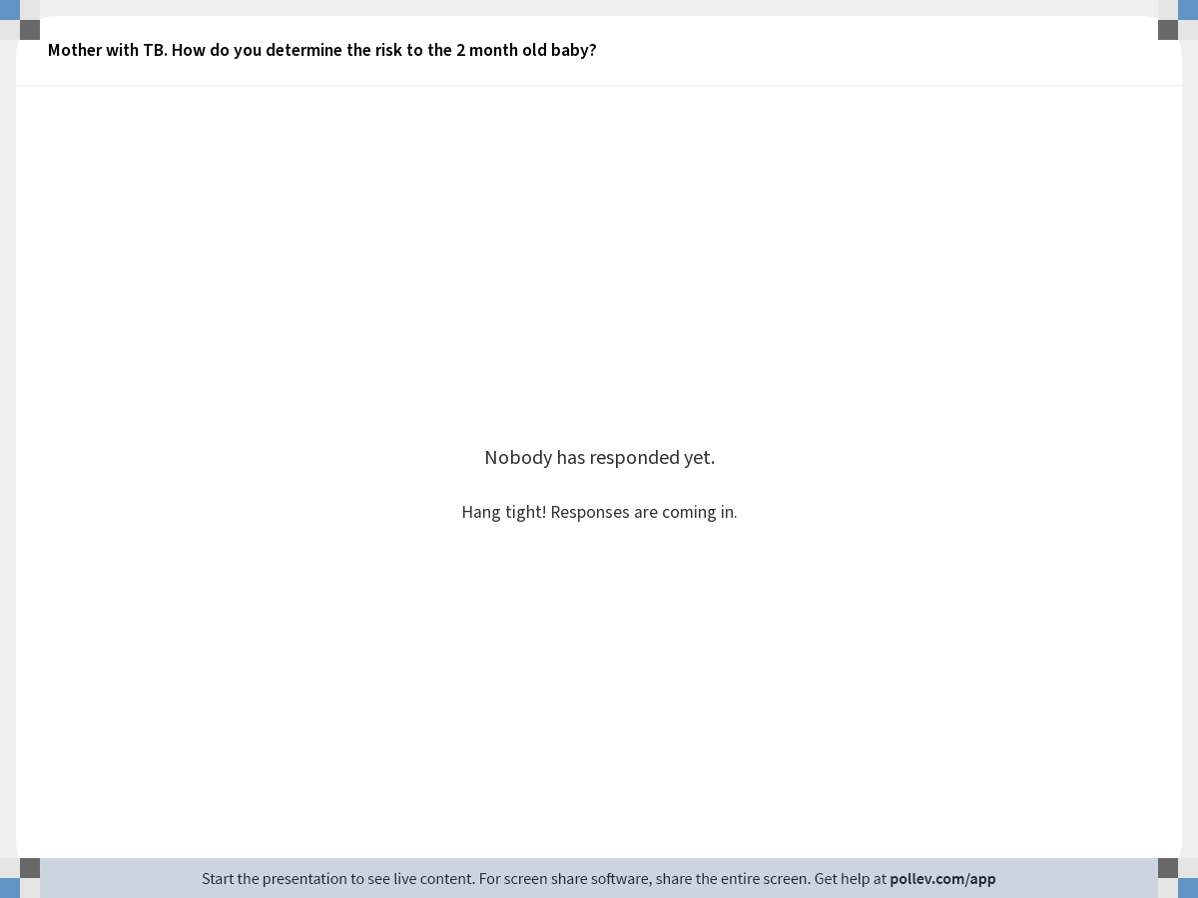
Notes:
Poll Title: Mother with TB. How do you determine the risk to the 2 month old baby? https://www.polleverywhere.com/free_text_polls/2JrpQyXKQxr1JK3

Slide 31
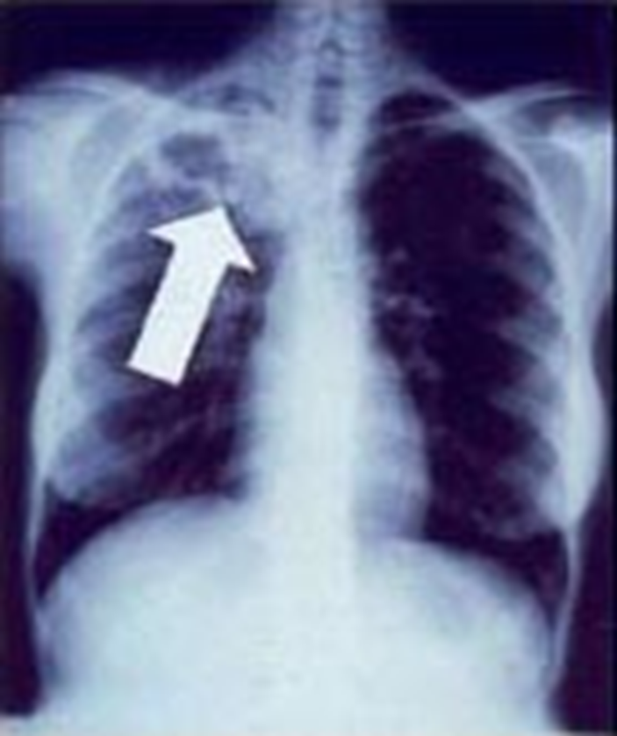
Baby Exposed to TB Disease
Mother AFB positive
Mom just starting treatment
Cavitary pneumonia
Is mother contagious?

Slide 32
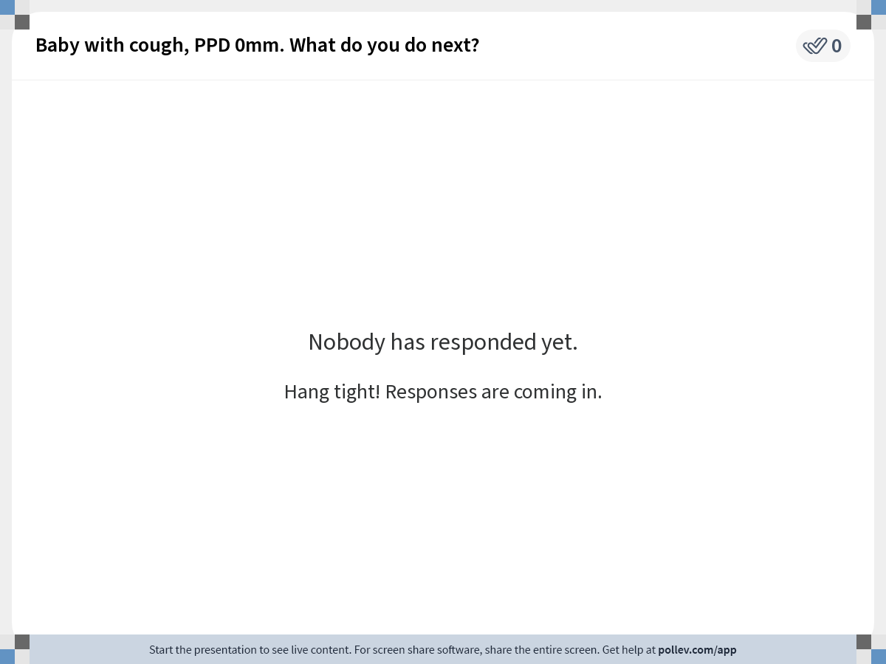
Notes:
Poll Title: Do not modify the notes in this section to avoid tampering with the Poll Everywhere activity. More info at polleverywhere.com/support Baby with cough, PPD 0mm. What do you do next? https://www.polleverywhere.com/free_text_polls/QsNSPYzsEnkqJ9XavExea

Slide 33
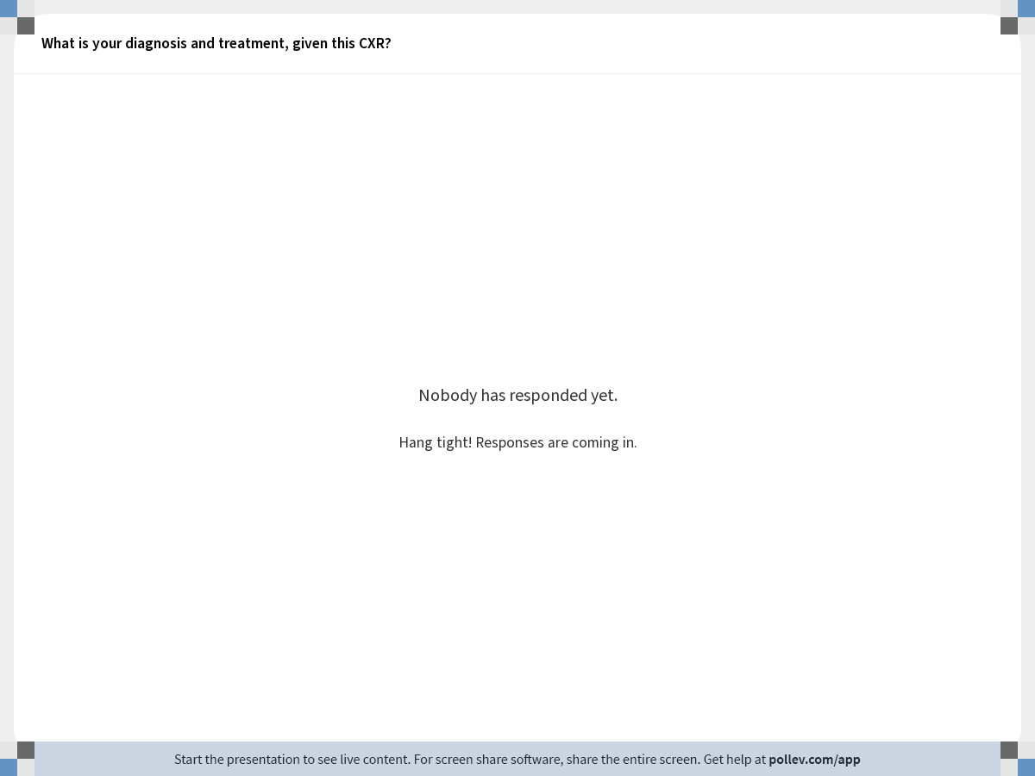
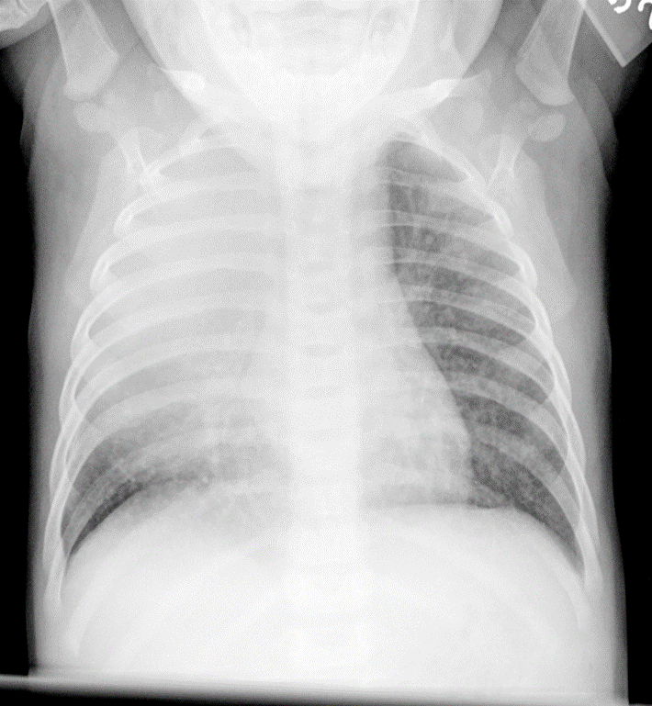
Notes:
Poll Title: What is your diagnosis and treatment, given this CXR? https://www.polleverywhere.com/free_text_polls/bjCKQJxxflHN7Dh

Slide 34
Outcome
Diagnosis:
Miliary TB
TB meningitis (CSF: 27 WBC 85% L, 120 protein)
Brain MRI: abnormal
Treatment:
RIPE therapy x 12 months
Prednisone x 2 months
Baby did well with normal exam and development after treatment

Slide 35
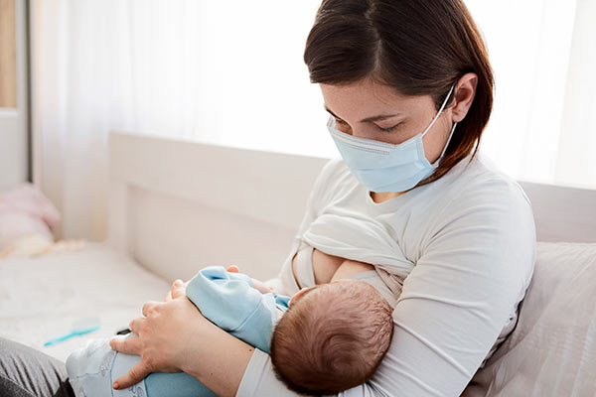
Newborn Exposed to Mother with TB Disease
Should mother/infant be separated?
Yes, if mother is suspected of having MDR-TB
If mother is infectious but not MDR disease:
Start baby on Rifampin or INH window prophylaxis
Minimize exposure
Mother can wear a mask while holding the baby
Sleep in separate rooms until mother is no longer infectious
Can mother breastfeed?
Yes
TB drugs cross the placenta and breast milk in low but safe levels

Slide 36
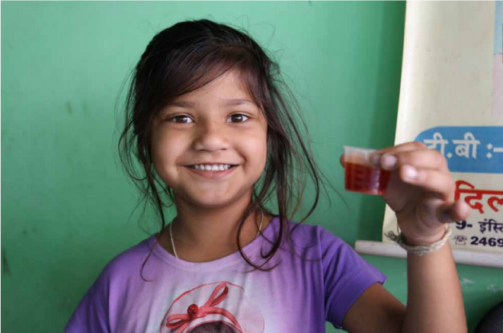
Treatment of TB in Children

Slide 37
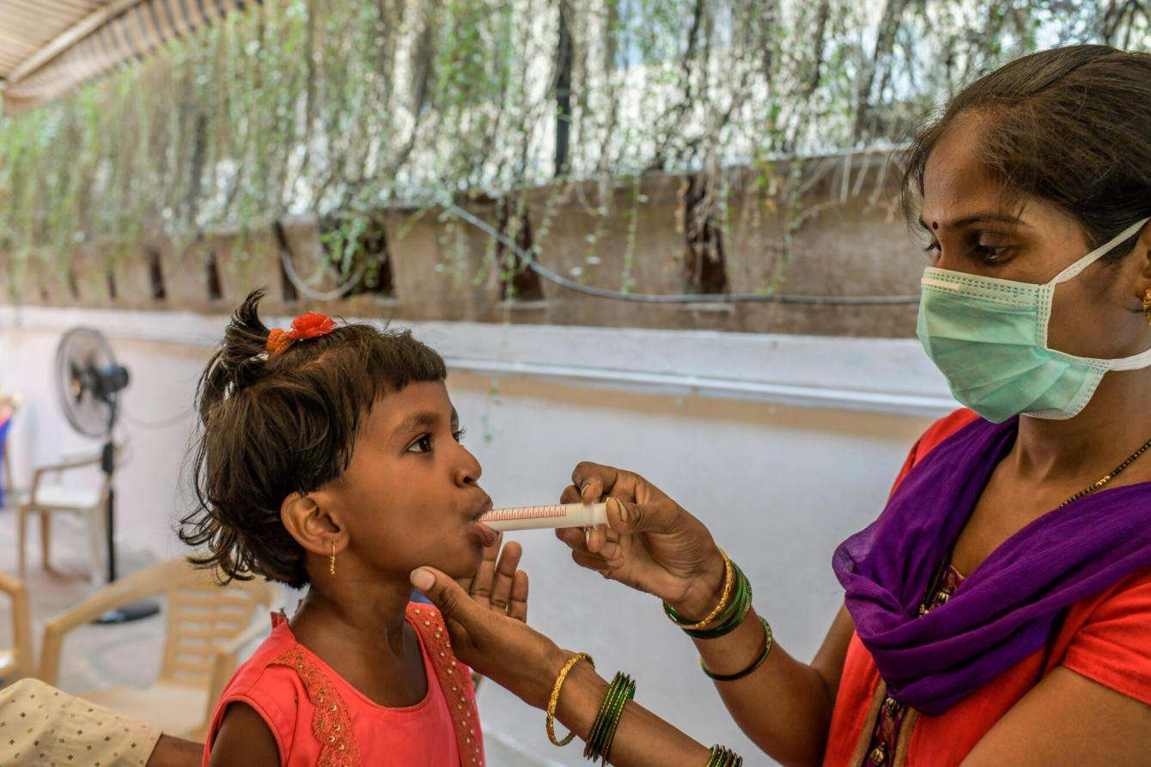

Treatment Options for Pediatric TB Disease
6-9-month-old standard RIPE therapy
NEWER
4-month RIP +/- E therapy for uncomplicated pediatric disease (SHINE study)
WHO endorsed
CDC expected to endorse
4-month Rifapentine, Moxifloxacin, INH and PZA
Adults and children > 12 yr of age
For uncomplicated, mostly pulmonary TB, including cavitary disease
CDC and WHO endorsed

Slide 38

Teen Case Study
15-year-old boy with 5-weeks of the following
Abdominal pain
Fever, 20 lb weight loss
No foreign travel or known TB exposure
No high-risk behaviors
Physical
220 lb, football player
3 cm cervical lymphadenopathy
Tender abdomen with no HSM or masses
Lungs clear
PPD negative, O mm
CXR normal

Slide 39
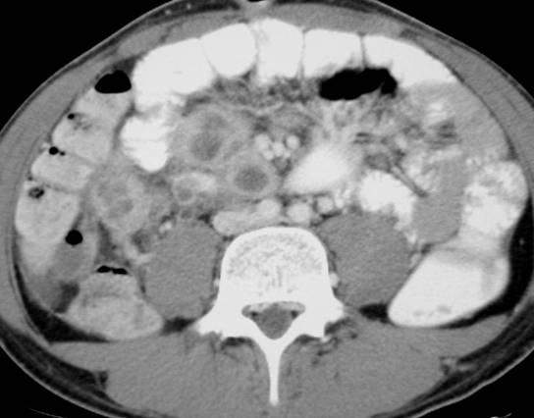
Abdominal CT shows multiple lymph nodes with low
attenuation centers and prominent rim enhancement (arrow).

Slide 40
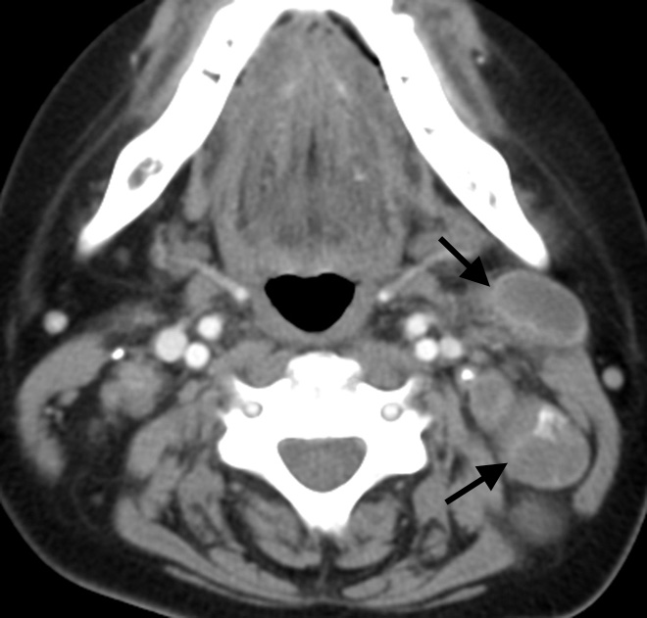
Neck CT
Lymphadenopathy

Slide 41
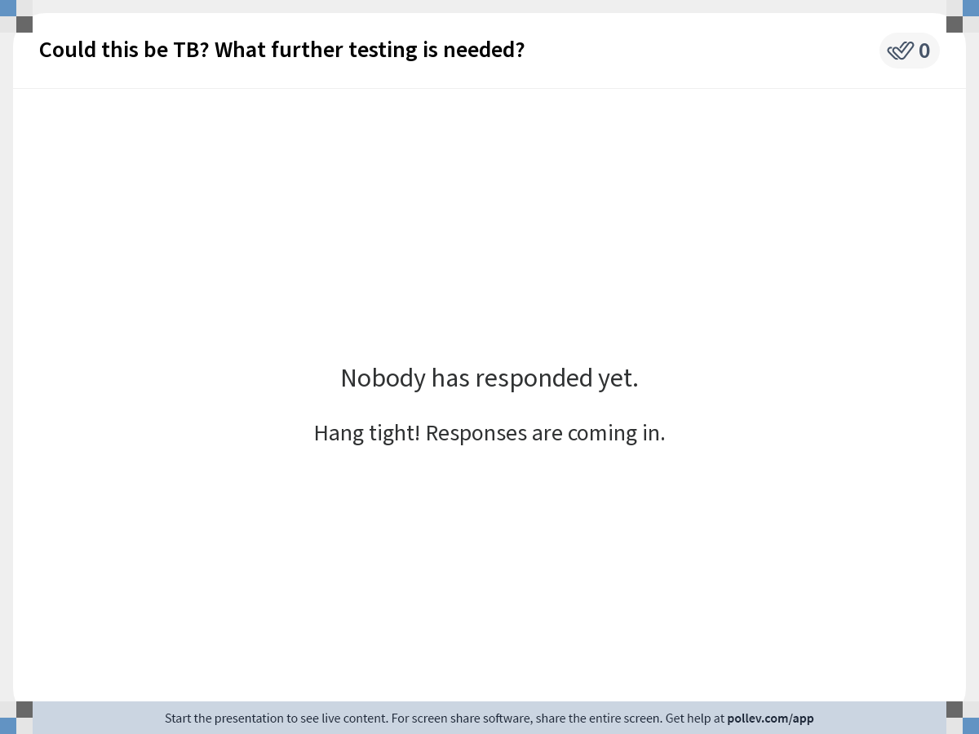
Notes:
Poll Title: Do not modify the notes in this section to avoid tampering with the Poll Everywhere activity. More info at polleverywhere.com/support Could this be TB? What further testing is needed? https://www.polleverywhere.com/free_text_polls/WEvhBxQncrjLcBMFUEyW8

Slide 42
Teen Case Study, continued
Differential diagnosis
Lymphoma, leukemia
HIV, EBV, cat scratch and other disseminated infections
Tuberculosis
Laboratory
CBC with peripheral smear - negative for cancer
HIV – negative
Quantiferon (IGRA) – positive at 5 days
Node biopsy:
Path negative for cancer
AFB smear negative, + granulomas on path
TB culture positive at 5 weeks for MTB
Susceptible to all drugs
Treatment RIPE, 9 months total for disseminated disease

Slide 43


Pediatric TB Disease Summary
Higher risk for
Progression to disease
Especially infants and children < 2 years
Extrapulmonary and disseminated disease including TB meningitis
Most common TB disease sites in children
Pulmonary and lymph nodes
Symptoms may be subtle or absent in children
Children < 10 years
Have low bacterial load (paucibacillary disease)
Usually are not contagious
Unless cavitary or AFB smear positive disease
AFB smears and TB cultures
Often negative in children
Clinical diagnosis most common

Slide 44
Prevention of TB in Children
Screen with TB Questionnaire
Order PPD or IGRA if TBQ positive
Window prophylaxis
For kids < 4 years with TB exposure
Treat latent TB infection
Shorter course therapies preferred due to higher completion rates

Slide 45


Slide 46
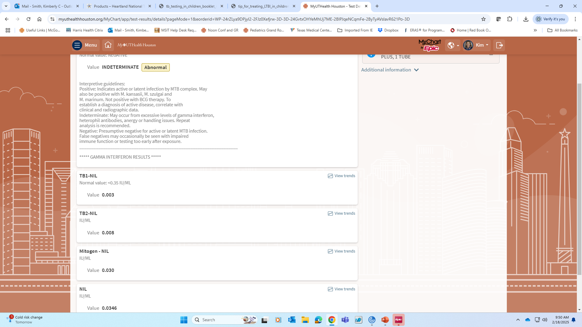
Indeterminate QFT = Control Failed
Patient response to TB1 & TB2 antigens
Positive control (Mitogen-NIL) failed if <0.5
NIL = Negative control or background should be low

Slide 47
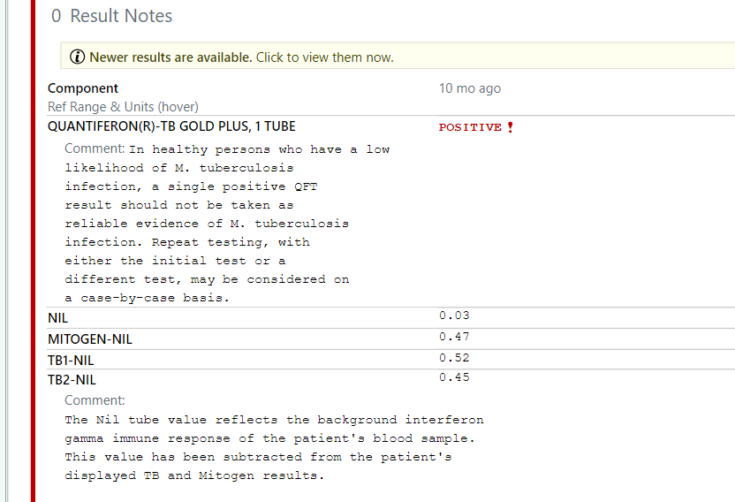

Low/Borderline Positive QFT
Good Mitogen should be > 0.5
Negative control (background)
Mitogen = positive control
>0.35 technically positive
Response 0.35-1.0 considered low or borderline by most experts. May consider repeating to confirm

Slide 48
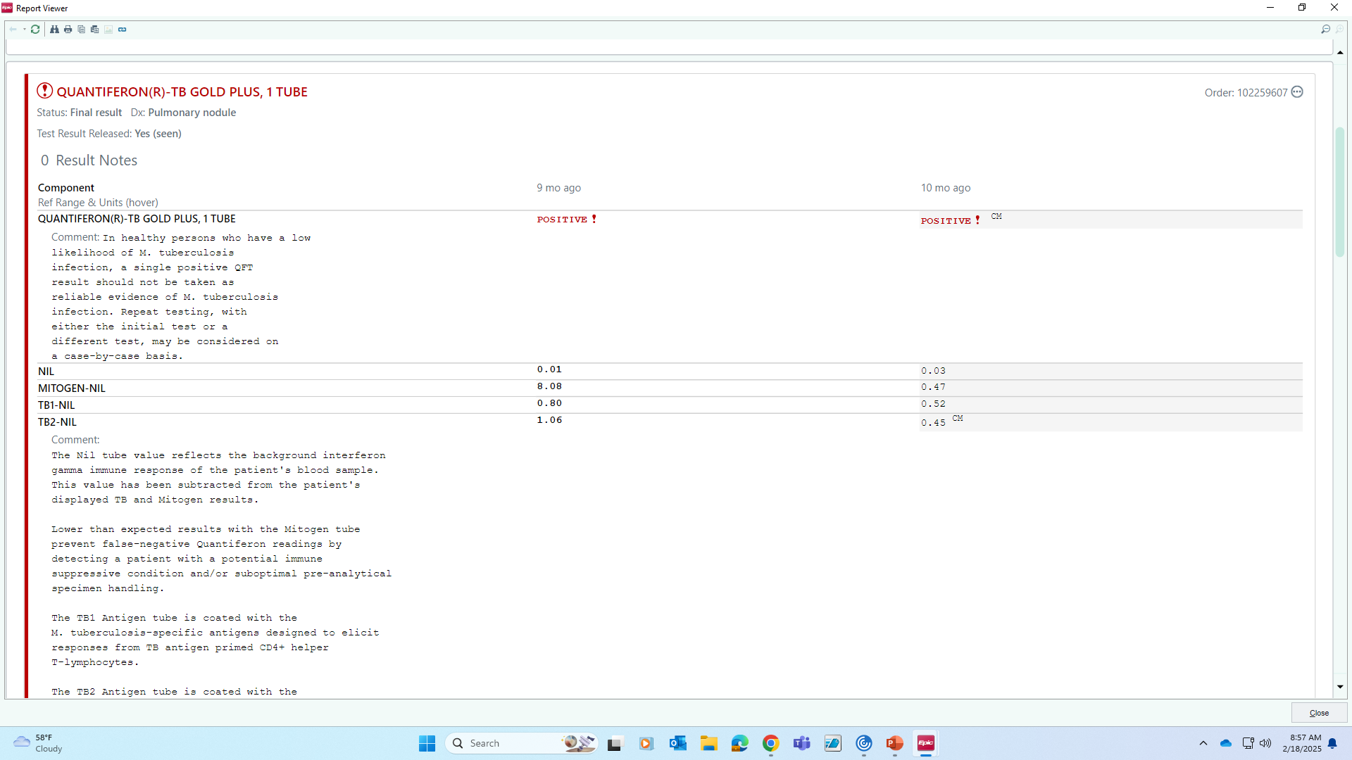

Borderline Positive Quantiferon
Good Mitogen should be > 0.5
Negative control
Mitogen = positive control

