Slide 1
TB and Health Disparities
Presented by: Mark Tisdel, MBA, BSN, RN
Chief Nurse
Houston Health Department - Bureau of Tuberculosis
Presentation Date: September 19, 2025

Slide 2
Definition
A health disparity is the occurrence of diseases at greater levels among certain population groups more than among others. Differences in rates of diseases, like TB, may occur by race or ethnicity, health conditions, and geographic location.
Social determinants of health are non-medical factors that influence overall health outcomes. These include the environments in which people are born, grow, live, work, and age, as well as the broader social, economic, and political systems that shape these conditions. Factors such as poverty, limited access to healthcare, inadequate education, stigma, and systemic racism contribute to health disparities. For instance, the stigma surrounding tuberculosis (TB) can discourage individuals from seeking medical attention or continuing with necessary follow-up care when ill.

Slide 3
Health Disparities and TB
In the United States, TB adversely affects groups that have historically experienced greater obstacles to health care.
Some population groups have higher rates of TB disease in their communities. These groups are at higher risk of being exposed to TB germs.
Additionally, a range of social, economic, and demographic factors affect a person’s risk for TB disease.

Slide 4
Conditions That Can Increase Risk
Some medications or health conditions can weaken your immune system, putting you at very high risk of developing active TB disease once infected with TB germs. These include:
  HIV infection
  Substance use (such as injection drug use)
  Mental Illness
  Specialized treatment for rheumatoid arthritis or Crohn's disease
  Organ transplants
  Severe kidney disease
  Head and neck cancer
  Diabetes

Slide 5
Conditions That Can Increase Risk (cont’d)
Low body weight
Children, especially those under age five, have a higher risk of developing TB disease once infected with TB germs due to having weak immune systems.
It is very important that these people receive treatment for inactive TB to prevent the development of active TB disease.

Slide 6
Racial and Ethnic Disparities
In 2023, 90.1% of the TB cases reported in the United States occurred among persons who identified as racial and ethnic minorities.
TB adversely affects groups that have historically experienced greater obstacles to health.
  Asian people
    In 2023, TB disease was reported among 2,887 non-Hispanic Asian persons in the United States. This accounts for 30.0% of all people reported with TB nationally. Asian people make up 7% of the US population.
  Black or African American people
    In 2023, TB disease was reported among 1,697 non-Hispanic Black or African American persons in the United States. This accounts for 17.6% of all people reported with TB nationally. African American people make up 14.4% of the US population.
  Hispanic or Latino people
    In 2023, TB disease was reported among 3,546 Hispanic or Latino persons in the United States. This accounts for 36.8% of all people reported with TB nationally. Hispanic people make up of 18.7% of the US population.

Slide 7
Places with Increased Risk of TB
You have a higher risk of being exposed to TB germs if you:
Were born in or frequently travel to countries where TB is common, including some countries in Asia, Africa, and Latin America
Live or used to live in large group settings where TB is more common, such as homeless shelters, prisons, or jails
Work in places where TB is more likely to spread, such as hospitals, homeless shelters, correctional facilities, and nursing homes

Slide 8
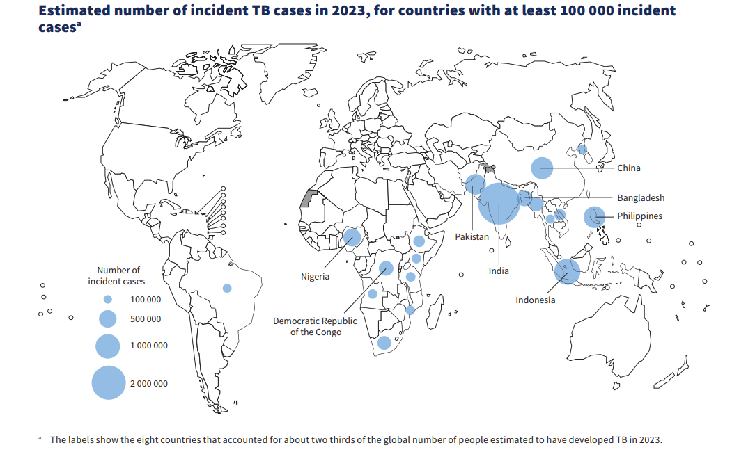
Places with Increased Risk of TB
(cont’d)
Note: In 2023, the United States reported 9,633 cases of TB disease

Slide 9
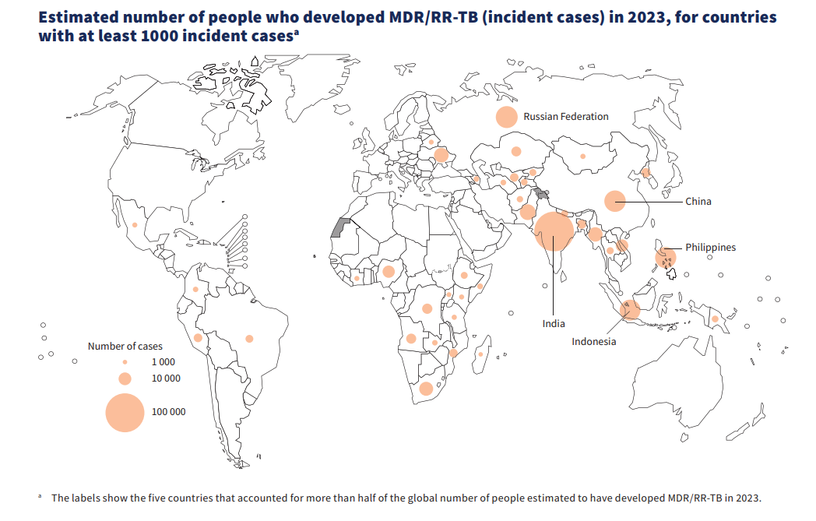
Places with Increased Risk of MDR/RR-TB
Note: In 2023, the United States reported 100 MDR cases.

Slide 10
Geographic Disparities in the US
TB disease rates vary across the United States. Consistent with previous years, in 2023, four states accounted for half of all reported U.S. TB cases:
  California
  Texas
  New York (including New York City)
  Florida

Slide 11
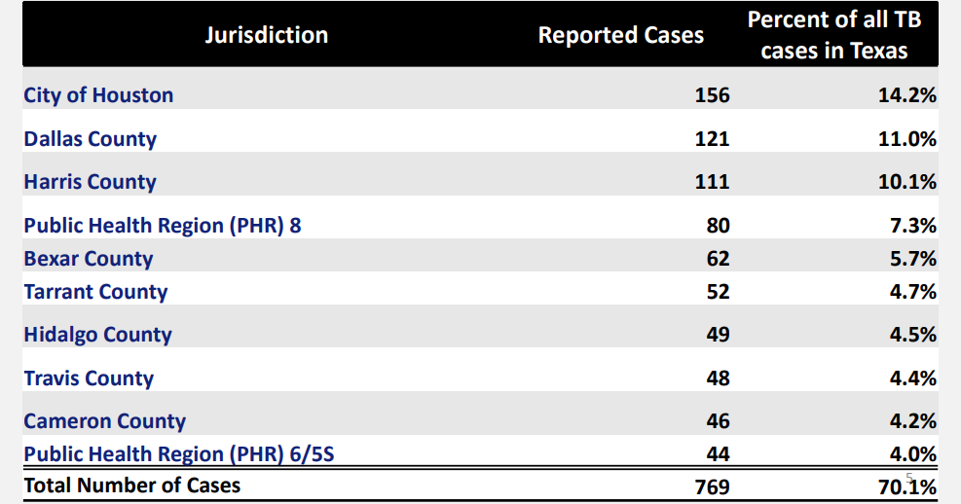
Texas Jurisdictions with the most reported TB Cases, 2022

Slide 12
What Prevents Health Equity
Socioeconomic factors can directly or indirectly increase a person's risk for TB disease and make treatment difficult. These factors include:
  Poverty
  Limited access to:
    Quality health care
    Employment opportunities
    Housing
    Transportation
    Adverse health outcomes

Slide 13
What Prevents Health Equity
(cont’d)
Language barriers and cultural factors may also place certain populations at higher risk for TB. These include factors such as:
  Health knowledge
  Stigma associated with the disease
  Values
  Beliefs
Health System Limitations
  Reduction in public health resources
  Loss of public health capacity has implications on:
    Access to care
    Maintaining clinical and public health expertise
    Diagnosing and Treating TB

Slide 14
What Houston Health Department is doing
Language Line translation services
Transportation to and from TB clinic appointments
TB Screening in the field (ex. home/work/under bridge)
In-person contact investigation (ex. environmental assessment, interview, TB101)
Video Directly Observed Therapy
Admit court-ordered patients to TCID to ensure completion of therapy.

Slide 15
What Houston Health Department is doing
Provide case management throughout the duration of treatment, working with local healthcare providers to ensure that recommended treatment protocols are followed
Engage health care providers with the latest TB diagnostics and treatment options available
Share resources and best practices among providers
Increase awareness and understanding of TB testing and treatment strategies
Develop partnerships to scale existing initiatives

Slide 16
What Houston Health Department is doing
(cont’d)
Provide assistance through Heartland National TB Center and TB Centers of Excellence for training, education, and medical consultation, which support TB control and prevention efforts in the United States
Highlight the personal stories of people who were diagnosed and treated for TB, as well as the work of TB control professionals on World TB Day
Lead community engagement and outreach to engage communities at risk to raise awareness of TB.

Slide 17
Conclusion
Some groups of people experience increased risk of developing TB.
Demographic, social, and economic factors affect a person’s risk of TB.
Loss of public health capacity necessitates creative methods to address identified gaps.
Engagement and collaboration with health care providers, local partners, and community members is needed to combat health disparities.
Reference: http://www.cdc.gov

Slide 18

Questions?

Slide 19
Thank You!
I hope you guys enjoyed it!

