Slide 1
Diagnosis and Treatment of TB Infection Lisa Armitige, MD, PhD
TB Nurse Case Management
September 17, 2025
Houston, Texas

Slide 2
Lisa Armitige, MD, PhD has the following disclosures to make:
• Consultant for Oak Therapeutics SBIR

Slide 3
What We Will Cover
Diagnosis of LTBI
Identifying those at risk of TB exposure
Determining Who to Treat
Identifying those at risk of progression to TB disease
LTBI Therapy – What Regimen is Best?

Slide 4
Latent TB Infection
Persons are infected with Mycobacterium tuberculosis but:
No Active TB Symptoms
Chest X-ray may be normal, or show granuloma, stable pleural or parenchymal scarring
Positive TST or IGRA
The TST, the T Spot and the QuantiFERON -
All miss > 10 % of those with active TB
The % of those with true LTBI with negative tests unknown

Slide 5
Latent TB Infection
Persons with LTBI are NOT infectious
90 +% chance of never getting Active TB Disease
But the TB organism is in your body!
Notes:
5

Slide 6
Latent TB Infection
We used to think the bacteria were in a resting state or dormant but
TB Bacteria are metabolically active and dividing, but infection is controlled by the immune system.
“…a state of persistent immune response to stimulation by Mycobacterium tuberculosis antigens without evidence of clinically manifested active TB”
WHO Guidelines on the management of Latent Tuberculosis Infection 2015

Slide 7
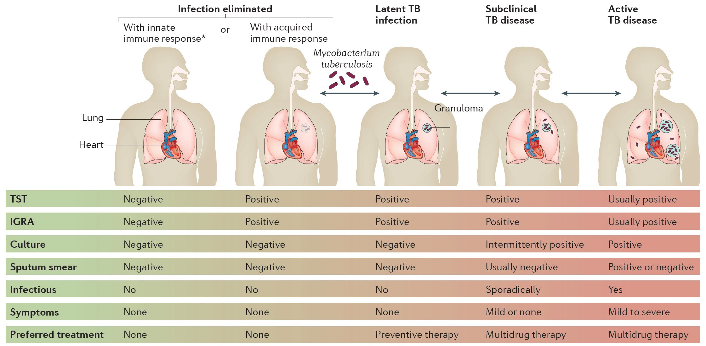
Tuberculosis Spectrum of Disease

Slide 8
Progression of LTBI to Active TB Disease Increased By
HIV infection
Chronic kidney disease
Silicosis
Recent exposure
Diabetes
Chest x-ray abnormality c/w previous inadequately treated TB (TB IV)
Intravenous drug use
Smoking – active and passive
Underweight by >10%
ATS-CDC. Am J Respir Crit Care Med 2000;161:S221

Slide 9
Progression of LTBI to Active TB Disease Increased By
Pregnancy and first three months post partum
Immunosuppression
Hematologic cancers and head and neck cancers
Medications
TNFα inhibitors
Prednisone >15 mg, > 4 weeks
Chemotherapy
Other immunosuppressive drugs

Slide 10
TB Infection Diagnostics
TB Skin Test (TST)
Interferon Gamma Release Assays (IGRA)
Notes:
10
Community health organizations=CHO Well defined populations at high risk that can be conveniently accessed and followed either in locations such as clinics or community health centers, prisons, or other congregate living sites or through mandatory registrations. Persons often have high risk of TB, Increased risk for disease if infected, significant consequences of spread of TB in congregate settings, easily identifiable, readily accessible probably able to access for significant time to complete therapy for LTBI

Slide 11
TB Skin Test (TST)
Pros:
Inexpensive
Simple to perform
(if you know what you are doing)
Cons:
Must return in 48-72 hrs
Interpretation is somewhat subjective
False Negatives:
Elderly
Immunosuppressed
False Positives:
Low risk populations
Non-tuberculous mycobacteria
BCG vaccination
Notes:
11
Community health organizations=CHO Well defined populations at high risk that can be conveniently accessed and followed either in locations such as clinics or community health centers, prisons, or other congregate living sites or through mandatory registrations. Persons often have high risk of TB, Increased risk for disease if infected, significant consequences of spread of TB in congregate settings, easily identifiable, readily accessible probably able to access for significant time to complete therapy for LTBI

Slide 12
Classifying the Tuberculin Reaction
You must know something about your patient!
≥ 5 mm is positive in ‘high risk people’
≥ 10 mm is positive in ‘people from high-risk environments”
≥ 15 mm is positive……period
Targeted skin testing programs should only be conducted among high-risk groups

Slide 13
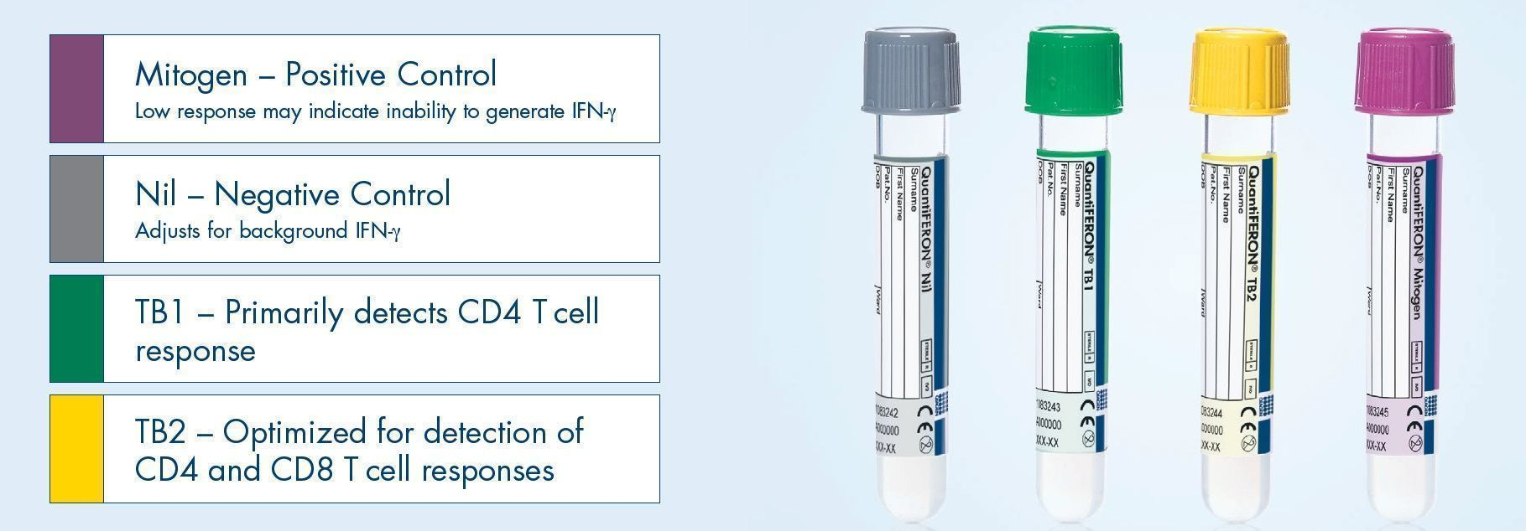
QuantiFERON®-TB Gold Plus
Essentially 2 tests in one blood draw
TB1 and TB2 should be close in value
Notes:
For the QuantiFERON-TB Gold In-Tube test, a single cocktail of overlapping peptides that represent ESAT-6, CFP-10, and part of a third Mtb protein called TB7.7, are included in a blood collection tube. Blood is collected into this tube and 2 similar tubes, one without the antigen and one with PHA. After mixing, the tubes are incubated for 16 to 24 hours. After incubation, the tubes are centrifuged to separate blood cells from plasma. Once centrifuged, the IFN-g is stable for several weeks if refrigerated or during shipping on ice. The test is considered positive if the amount of INF-G released by the TB antigens is 0.35 IU or greater, and at least 1.25 times the negative control.

Slide 14
Interpretation Criteria for the
QFT-Plus Test
Nil (IU/mL) | TB1 or TB2 Antigen minus Nil (IU/mL) | TB1 or TB2 (IU/mL) | Mitogen | Interpretation
≤ 8.0 | ≤ 0.35 or < 25% of Nil value | Negative | ≥ 5.0 | M. tuberculosis infection unlikely
≤ 8.0 | ≥ 0.35 and ≥ 25% of Nil value | Positive | ANY | M. tuberculosis infection likely
≥ 8.0 | ANY | Indeterminate | ANY | Indeterminate
≤ 8.0 | ≤ 0.35 and or < 25% of Nil value | Indeterminate | < 5.0 | Indeterminate

Slide 15
Interpretation Criteria for the T-Spot.TB
Result | Nil* | TB Response## | Mitogen++ | Interpretation+
Positive | ≤ 10 spots | ≥ 8 spots | Any | M.tuberculosis infection likely
Borderline | ≤ 10 spots | 5, 6, or 7 spots | Any | Uncertain likelihood of M. tuberculosis infection
Negative | ≤ 10spots | ≤ 4 spots |  | M Tb infection unlikely
Indeterminate | > 10 ≤ 10 | Any < 5 spots | Any < 20 spots | Uncertain likelihood of M. tuberculosis infection

Slide 16
Indeterminate and Borderline Results
Indeterminate
Negative control result is too high
High background production of IFN-γ
Positive control result is too low
Immunocompromised patients may not respond to mitogen
Borderline (T-Spot only)
Falls within borderline zone close to negative/positive cut point

Slide 17
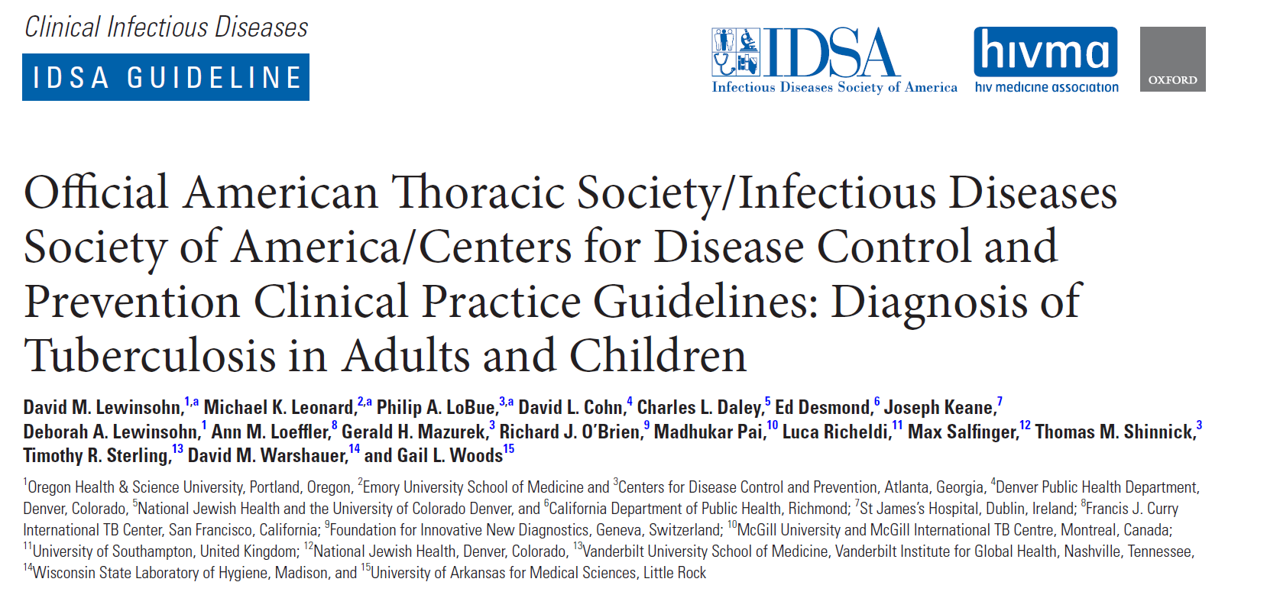
Lewinsohn et al. CID. 2016

Slide 18
ATS/IDSA/CDC Clinical Practice Guidelines: Diagnosis of TB in Adults and Children
Recommend IGRA rather than TST for persons ≥ 5
1) likely to be infected with MTB
2) low or intermediate risk of progression to disease
3) decided testing is warranted and
4) have either a history of BCG or are unlikely to return for reading
(Strong recommendation, moderate quality evidence)
TST acceptable if IGRA not available, too costly, too burdensome.
CID 2016

Slide 19
ATS/IDSA/CDC Clinical Practice Guidelines: Diagnosis of TB in Adults and Children
Suggest IGRA rather than TST for all other persons ≥ 5:
1) likely to be infected with MTB
2) low or intermediate risk of progression to disease
3) decided testing is warranted and
(Conditional recommendation, moderate quality evidence)
TST acceptable if IGRA not available, too costly, too burdensome.
CID 2016

Slide 20
ATS/IDSA/CDC Clinical Practice Guidelines: Diagnosis of TB in Adults and Children
Insufficient data to recommend a preference either a TST or IGRA for all other persons ≥ 5:
1) likely to be infected with MTB
2) have a high risk of progression to disease
3) decided testing is warranted
CID 2016

Slide 21
ATS/IDSA/CDC Clinical Practice Guidelines: Diagnosis of TB in Adults and Children
Guidelines recommend persons at low risk for MTB infection and disease progression NOT be tested.
If testing is performed in those unlikely to be infected despite guidelines to contrary:
We suggest performing an IGRA instead of a TST.
(conditional recommendation, very low-quality evidence)
We suggest a 2nd diagnostic test if initial test positive
Confirmatory test may be either IGRA or TST
Person considered infected only if both tests positive.
(conditional recommendation, very low-quality evidence)
CID 2016

Slide 22
ATS/IDSA/CDC Clinical Practice Guidelines: Diagnosis of TB in Adults and Children
We suggest performing a TST rather than an IGRA in healthy children under 5:
1) for whom it has been decided testing is warranted
(conditional recommendation, very low-quality evidence)
New 2024 version of Pediatric Red Book recommends IGRA at any age you use a TST
CID 2016

Slide 23
Active TB Disease or TB Infection? The Clinical Evaluation
The single most important thing prior to starting treatment for TB Infection is to exclude active TB disease.
If in doubt – wait!
Evaluate for TB disease
Consider consultation with TB expert

Slide 24
Evaluate to Exclude Active TB Disease
If the TST or IGRA is Positive –
OR
Patient has been exposed and is symptomatic
At least 10 % of persons with active TB disease are IGRA/TST negative
Child < 5 or immunocompromised person with recent exposure even if TST/IGRA negative –
Evaluation includes:
√ History
√ Physical examination
√ Chest X-Ray

Slide 25
Is There Evidence of Disease? Is Patient at Risk of Progression to Disease?
Symptoms*
Fever
Chills
Night Sweats
Weight Loss
Cough (dry/productive)
Hemoptysis
Fatigue
* only one may be present
Medical History:
HIV
Silicosis
Chronic Kidney Disease
Diabetes
Immunosuppression
Drug/alcohol/tobacco
TB exposure

Slide 26
Physical Exam
General assessment – does person look well?
Lung exam
Check for lymph nodes
Palpate liver
In children look at growth curve/weight/activity
Look for anything that will complicate therapy!

Slide 27
Radiologic Exam
CXR must be done before treatment of TB Infection
Must be read as normal
Or
IF abnormal:
Not consistent with Active TB
Stable abnormality confirmed over a 3 month period

Slide 28
Mycobacteriological Laboratory Exam
If you suspect TB disease due to an abnormal CXR and/or symptoms – collect sputum specimens:
Gene Xpert (1) AFB smear (3), and culture(3)
If Gene Xpert and AFB smears are negative, don’t start TB Infection treatment until cultures are negative – 6 weeks
Remember you suspected possible TB disease and you cannot exclude this without a negative culture
May be appropriate to start RIPE for disease

Slide 29
Management of Positive TST or IGRA When the CXR is Not Normal
Assess likelihood that the CXR abnormality is really TB
If Patient has NO signs or symptoms of Active TB, CXR possibly c/w TB but no classic findings:
Collect 3 sputum specimens for smears and culture
Evaluate for symptoms
If no symptoms and AFB smear/Xpert negative - Wait
Repeat CXR after 2 – 3months
If CXR stable at 2 – 3 months and cultures negative, treat for TB Infection

Slide 30
Management of Positive TST or IGRA When CXR is Abnormal c/w TB disease or If Patient Has Signs or Symptoms of Active TB Disease
The patient should be suspected of having TB disease
Collect 3 sputa for smear and culture
Strongly consider starting standard 4 drug (RIPE) treatment – if started report!
If positive smear and/or Gene Xpert
Report to public health and start 4 drug (RIPE) treatment
Never (ever!) start a treatment for TB infection in a patient with possible active TB

Slide 31
Deciding When to Treat LTBI Groups Who Should be Given High Priority for LTBI Treatment
People with a positive IGRA result or a TST reaction of ≥ 5 mm
HIV-infected persons
Recent contacts of a TB case
Persons with fibrotic changes on CXR c/w old TB
Organ transplant recipients
Persons immunosuppressed for other reasons
taking the equivalent of >15 mg/day of prednisone for ≥ 1 month,
taking TNF-α antagonists
receiving chemo/radiation therapy
People with a positive IGRA result or a TST reaction of ≥ 10 mm
Persons from high-prevalence countries
Injection drug users
Residents and employees of high-risk congregate settings (e.g., correctional facilities, nursing homes, homeless shelters, hospitals, and other health care facilities)
Mycobacteriology lab personnel
Children < 4 years of age,
Children and adolescents exposed to adults in high-risk categories

Slide 32
Children Who Should Be Treated Following Recent Exposure Once TB Disease Excluded:
Contacts < 5 y/o identified during an investigation surrounding an identified case
Treat even if initial TST or IGRA is negative
Those > 5 y/o who are TST or IGRA positive
Recent immigrants and refugee children with positive IGRA

Slide 33
Why Should Small Children Who Are Exposed to Active TB Disease Be Treated Even When TST or IGRA is Negative?
Very high rate of infection
Takes up to 3 months for the skin test to turn positive
Small children can very quickly become very sick
U.S. studies – 10% to 20% of childhood TB cases can be prevented if children exposed in a household are treated
WHO standards – children <5 years old exposed in a TB household should be treated
Notes:
33

Slide 34
Percent Risk of Disease by Age
Age at Infection | Risk of Active TB
Birth – 1 year* | 43%
1 – 5 years* | 24%
6 – 10 years* | 2%
11 – 15 years* | 16%
Healthy Adults | 5-10% lifetime risk
HIV Infected Adults⁺ | 30-50% lifetime
*Miller, Tuberculosis in Children Little Brown, Boston, 1963
⁺WHO, 2004

Slide 35
Risk of Progression to TB Disease by Age
Risk of Disease
TB Disease up to 50%
Pulmonary Disease 30-40%
Miliary or TB Meningitis 10-20%
Disease 20-25%
Pulmonary Disease 75%
Miliary or TB Meningitis 2-5%
Age @ primary infection
Birth - 12months
1-2 years
Marais BJ. Int J Tuberc Lung Dis 2004;8:392-402

Slide 36
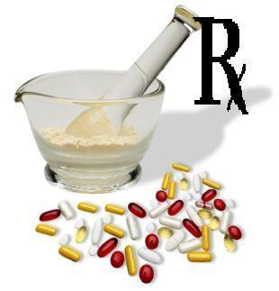
“Window Period” TB Prophylaxis After Exposure
Household contact with infectious person
Initial TST negative
Window period for TST/IGRA conversion (8-12 weeks)
CXR and physical exam normal
‘Window’ prophylaxis recommended:
For children <5 yrs of age
Immunosuppressed patients, especially HIV positive
Patients on tumor necrosis factor-alpha blockers or other biologics
May prevent progression to disease during window period
Repeat TST or IGRA 8-12 wks after exposure
May stop treatment if 2nd TST (<5mm) or IGRA is negative in immunocompetent patients
Consider completion of full course of treatment in HIV + and other immunosuppressed or children < 6 months

Slide 37
TB Infection Treatment Options
CDC Recommended Treatment regimens:
INH/Rifapentine x 3 months (3HP)
Once weekly DOT x 12 weeks
Average of 10 pills at once
Rifampin x 4 months
Daily (10 mg/kg: 600 mg max)
INH +rifampin x 3 months
INH daily (5 mg/kg: 300 mg max) + rifampin daily (10 mg/kg: 600 mg max)
INH x 6-9 months
Daily (5 mg/kg: 300 mg max) or BIW (15 mg/kg: 900 mg max)
ATS/IDSA/NTCA. November 2018.

Slide 38
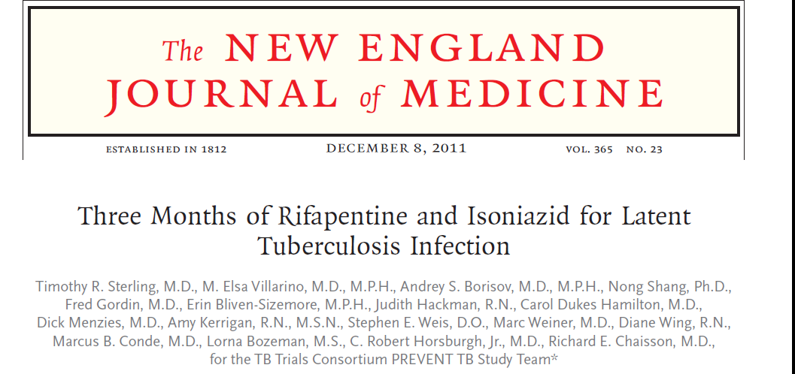
Active TB disease: 7/3986 in 3 HP arm; 15 of 3745 in 9H arm
Completion of treatment: 82.1% 3HP arm; 69% 9 H arm
Hepatotoxicity: 0.4% 3HP arm; 2.7% 9 H arm.
Conclusion: Use of 3 HP x 3 months was as effective as 9 months of INH and had a higher treatment completion rate.
Notes:
In MIIT TB in 7 of 3986 with 3 HP and 15 of 3745 with INH x 9 months Completion 82.1% 3 HP and 69 % INH x 9 Hepatotoxicity 0.4% and 2.7%

Slide 39
Dosing for 3HP
Children 2 – 12 years*
INH 25 mg/kg (round to nearest 50 or 100 mg tablet)
Rifapentine
10-14 kg: 300 mg
14.1-25 kg: 450 mg
25.1-32 kg: 600 mg
32.1-49.9 kg: 750 mg
≥ 50 kg: 900 mg
* Especially when short course is desirable; pill burden may be a problem
Adults and children > 50 kg
900 mg INH once weekly
900 mg Rifapentine once weekly
Vitamin B 6 50 mg once weekly
Completion - 11 to 12 doses in 16 weeks

Slide 40
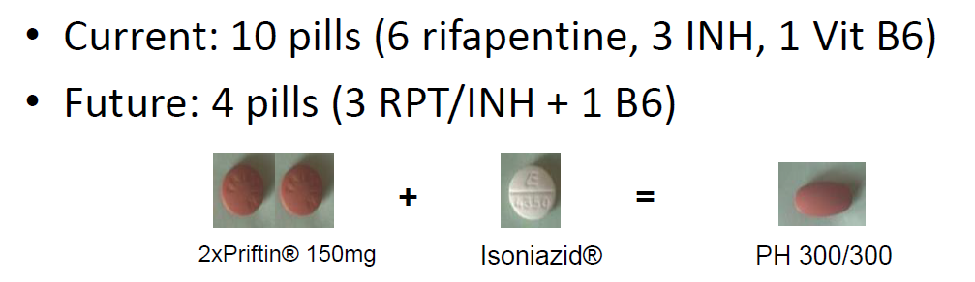
Pill Burden With 3HP is Currently a Problem for Some

Slide 41
INH + RPT (3HP) is NOT Recommended For:
Children under 2 y/o
HIV infected persons on Antiretroviral Therapy with drug drug interactions
Presumed INH or Rifampin Resistance in the source case
Pregnant women
Notes:
41

Slide 42
Four Months of Rifampin or Nine Months of Isoniazid for Latent Tuberculosis in Adults Menzies et al, N Engl J Med. 2018 Aug 2;379(5):440-453.
Open label trial in 9 countries comparing 4 months rifampin vs 9 months INH:
study endpoint: prevalence of TB 28 months after randomization
Rifampin: 3443 patients:
4 active TB, 4 clinical TB
INH: 3416 patients:
4 active TB, 5 clinical TB

Slide 43
Four Months of Rifampin or Nine Months of Isoniazid for Latent Tuberculosis in Adults Menzies et al, N Engl J Med. 2018 Aug 2;379(5):440-453.
Treatment completion:
Rifampin 79%,
INH 63% (p < 0.001)
Clinically significant (drug stopped) hepatotoxic events:
Rifampin 0.3%,
INH 1.7% (p < 0.001)
4 months of rifampin was not inferior to 9 months INH for preventing development of active TB but with significantly higher completion rates and greater safety than INH.

Slide 44
Rifampin Dosing for TB Infection
Adults
10 mg/kg daily
600 mg daily x 4 months
Children:
10 – 20 mg/kg daily x 4 months
Capsules 150mg/300 mg round up - use higher range
Higher rifampin doses well tolerated

Slide 45
Rifampin Treatment of TB Infection
Pros:
Higher Completion Rates
Equally effective
Fewer Side Effects
Less Hepatotoxicity
Cost effective
Rifampin resistance uncommon
Globally 3%
Cons:
Drug Interactions
Hormone Contraceptives
Warfarin
Prednisone
HIV Antiretroviral agents
And many more…must look up all drugs for interactions
Orange Body Fluids
Other Potential Side Effects (rare):
Rash
Thrombocytopenia
Anemia
Leukopenia
Allergic Interstitial Nephritis

Slide 46
INH TBI Therapy
The standard treatment regimen for TBI has been nine months of daily INH.
The regimen is effective and is the preferred regimen for HIV infected people taking antiretroviral therapy with drug-drug interactions that do not allow a rifamycin
Is the option when drug-drug interactions with rifamycins are significant and must be avoided
But less than 60% complete
Primarily due to long duration of treatment but also increased adverse effects

Slide 47
INH Hepatotoxicity
Asymptomatic elevation of aminotransferases: 20% of patients
Clinical hepatitis: 0.6% of patients
Fulminant hepatitis (hepatic failure)
Approximately 4/100,000 persons completing therapy (continued INH with symptoms of hepatitis, prior INH hepatotoxicity, malnutrition).

Slide 48
Severe INH Liver Injuries Among Persons Being Treated for LTBI, U.S., 2004-2008 MMWR 3/5/10/ 59(08); 224-229
“Medical providers should emphasize to patients that INH treatment should be stopped immediately upon the earliest onset of symptoms (e.g. excess fatigue, nausea, vomiting, abdominal pain, or jaundice), even before a clinical evaluation has been conducted, and that initial symptoms might be subtle and might not include jaundice.”

Slide 49
INH Side Effects
Hepatotoxicity
Migraine Headaches
Gastrointestinal
Nausea, Diarrhea, Constipation
Rash
Peripheral Neuropathy
Pyridoxine 50mg daily can help prevent this

Slide 50
Isoniazid (INH) Dosing
Adults: 300 mg single daily dose or 900 mg twice weekly*
Children: 10-15 mg/kg single daily dose (max dose 300 mg daily)
20-30 mg/kg twice weekly*
Duration of treatment for TB Infection: 6 - 9 months
9 month regimen more effective
9 month regimen is very difficult to complete
6 months is considered adequate therapy by ATS/IDSA/CDC guidelines
* twice weekly treatment must be given by directly observed therapy through health department

Slide 51
Treatment Options for LTBI
INH +RPT once weekly
Rifampin daily
INH 9 daily
INH 6 daily
12 weeks (12 doses)
4 months (120 doses)
9 months (270 doses)
6 months (180 doses)
The longer the duration/more doses, the less likely your patient is to complete treatment
Fewer than 60% complete 9 months of INH
Notes:
51

Slide 52
Should Pregnant Women Be Treated for TB Infection during Pregnancy?
A prior study showed increased risk of serious, even fatal hepatotoxicity with INH during pregnancy and the immediate post-partum period (3 months following delivery)
No study has shown increased risk of hepatotoxicity with daily rifampin
In pregnant persons who have reason for treatment of LTBI, consider daily rifampin
Monitoring should be close
Blood work for any symptoms and hold medication
Monitor liver enzymes and patient at every monthly visit.

Slide 53
Monitoring for Toxicity and Progression to Active Disease
Baseline liver enzymes - all with risk of liver toxicity
Those with underlying liver disease due to Hepatitis B or C or alcohol
Those taking other potentially hepatotoxic medications
Those with a medical co-morbidity
Pregnant women and those in immediate post-partum (3 months) period
Elderly
Generally not needed for children; healthy young adults
Monitor monthly “in person” for toxicity and for evidence of progression to TB disease
Monthly liver enzymes if baseline LFTs abnormal or above risks

Slide 54
Pearls of Wisdom for Treating TBI
Consider the shortest regimen possible to increase the odds of completion
Be vigilant
Be supportive…..and forgiving

Slide 55
Thank you for being here. Thank you for all that you do every single day. You make a difference. Questions? Lisa.Armitige@dshs.texas.gov 1-800-TEX-LUNG

