Slide 1
Importance of Weight in the Treatment Outcomes of a Patient with TB
TB Nurse Case Management
Houston, Texas
September 18, 2025
Catalina B. Navarro BSN, RN
Nurse Consultant/Educator
Notes:
Thank you Debbie! And Hi again everyone
It’s my turn to talk about the importance of weight on the treatment outcome of a patient with TB

Slide 2
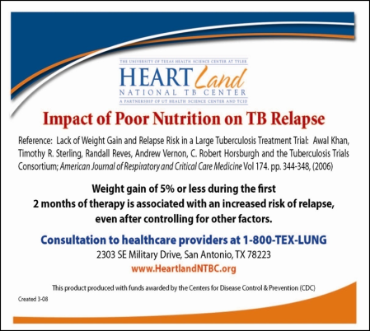
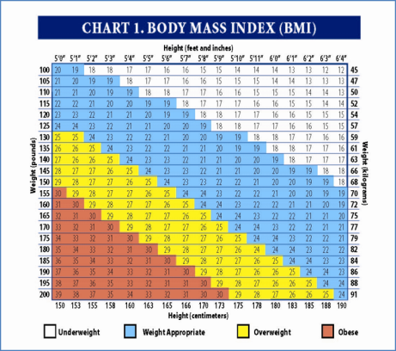
Objectives
Discuss the Importance of weight gain on TB treatment outcomes
Demonstrate the use of the BMI chart with case studies
Notes:
Let’s start with the objectives, I’ll be discussing the importance of weight gain on TB treatment outcomes, and I’ll demonstrate the use of this pocket guide that includes a BMI chart with case studies.
This pocket guide is one of our products at heartland it was developed more than 10 years ago to aid the nurses with the clinical assessment in monitoring the patient’s weight and nutritional status.

Slide 3

Malnutrition
Malnutrition refers to deficiencies, excesses, or imbalances in a person’s intake of energy and/or nutrients.
Undernutrition
Micronutrient-related malnutrition
Overweight and obesity
Notes:
First I would like to clarify some terms. Malnutrition and undernutrition are terms that we often use loosely to refer to a condition where a person is not getting a balanced diet. However, malnutrition refers not only to deficiencies but also to excesses or imbalances
This is the definition of Malnutrition by the WHO.
The term malnutrition addresses conditions:
For the purposes of this presentation, I’ll be talking about undernutrition and the relationship with TB

Slide 4
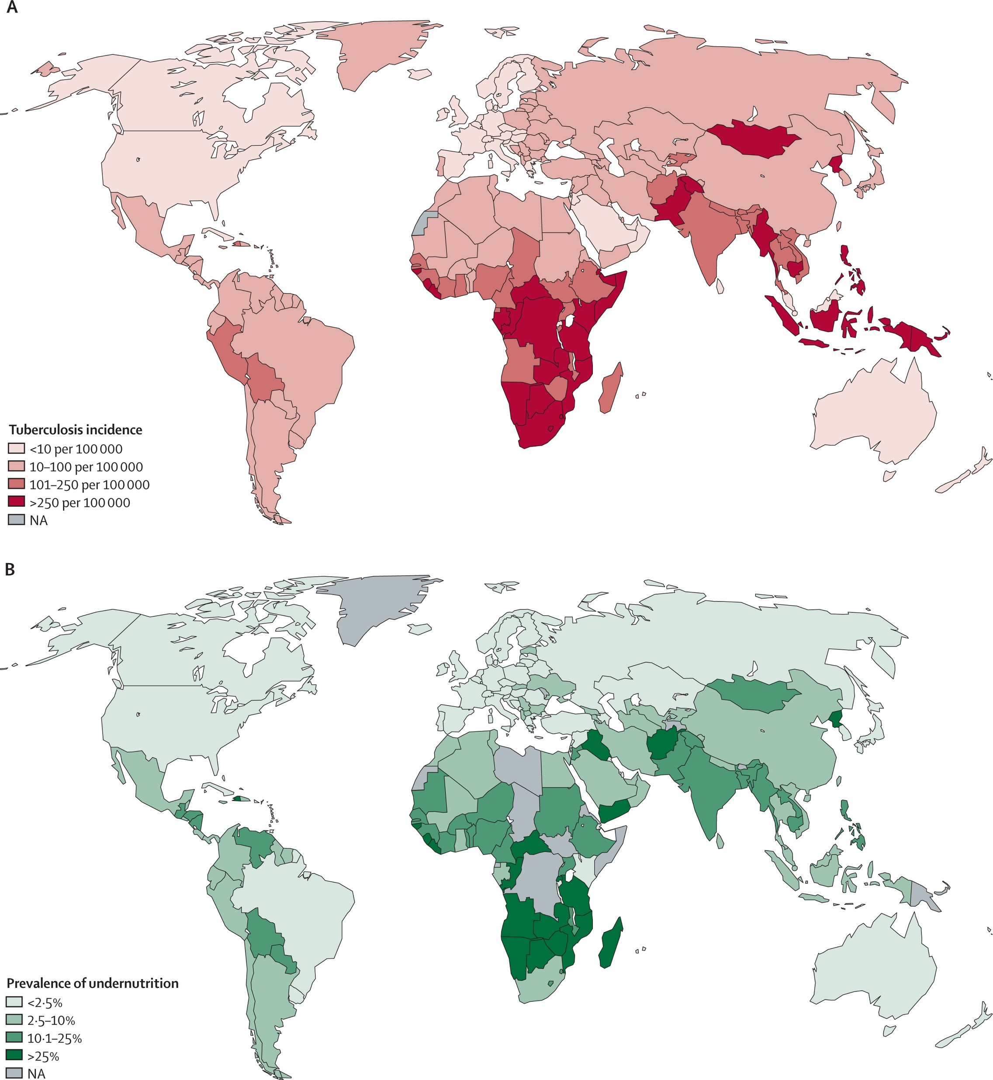
Geographic Overlap between TB and Undernutrition Worldwide 2018
Notes:
Undernutrition and TB affect the poorest and most marginalized countries.
Worldwide geographically, there is an link between TB and undernutrition.
The top map, the dark red represents the countries with high incident of Tuberculosis
bellow is the map with highest prevalence of undernutrition, its in dark green.

Slide 5
Geographic Overlap between TB and Undernutrition Worldwide 2018
Notes:
You see here the overlap
TB incidence and high undernutrition prevalence x2
The correlation is pretty obvious
It becomes clear that TB and undernutrition are not separate issues.

Slide 6
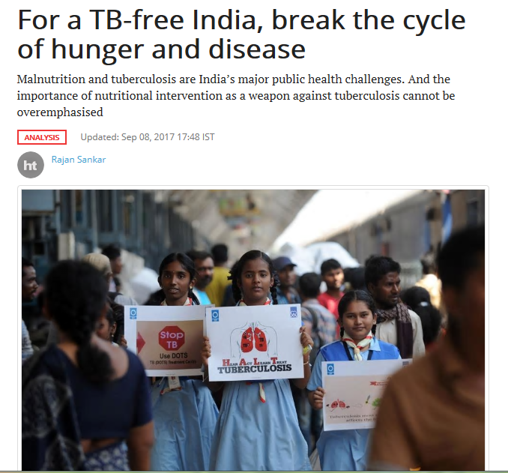
Undernutrition and TB in India
People suffering from undernutrition are predisposed to contracting TB
Undernutrition contributes to a staggering 55% of the annual TB incidence in India
Notes:
Undernutrition and tuberculosis (TB) are the major public health challenges in India
India is the country with the highest burden of TB in the world.
55% of the annual TB incidence is related to undernutrition. this is an overwhelming number of persons diagnosed with TB that country.
.

Slide 7
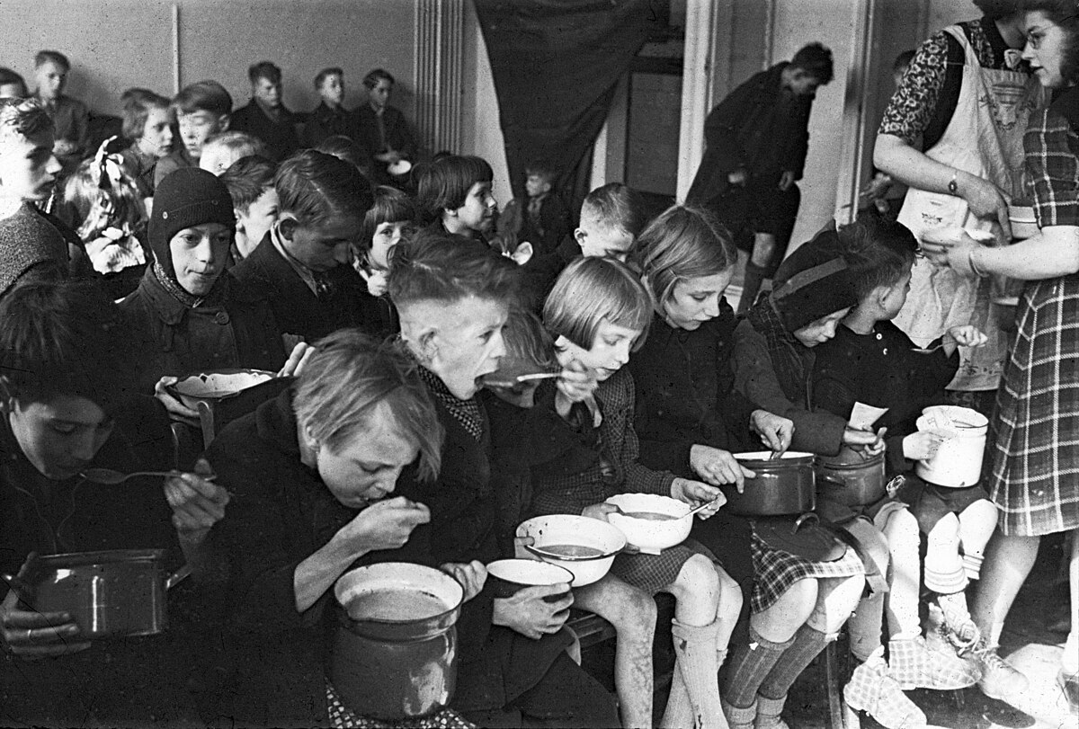
Impact of Diet on Tuberculosis Mortality: Historical Insights
“Rise in tuberculosis mortality was recorded in 1914-1916, and in those years the consumption of bread and flour rose, whereas that of meat decreased. ."--
“High TB mortality in Europe during and since WWII, coincided with great reduction of intake of protein food, such as, meat, fish and eggs”
Sandler MD (Diet Prevents Polio)
Notes:
For more than a century studies have suggested an association between undernutrition and TB.
There was a rise in TB mortality between 1914-1916, this was correlated to the decrease in the consumption of meat.
Then There was a similar rise in TB mortality in practically all countries in Europe due to in the World War II and for exactly similar reasons,, a great reduction in the consumption of protein foods, such as, meat, fish, and eggs,."--Sandler MD (Diet Prevents Polio)

Slide 8
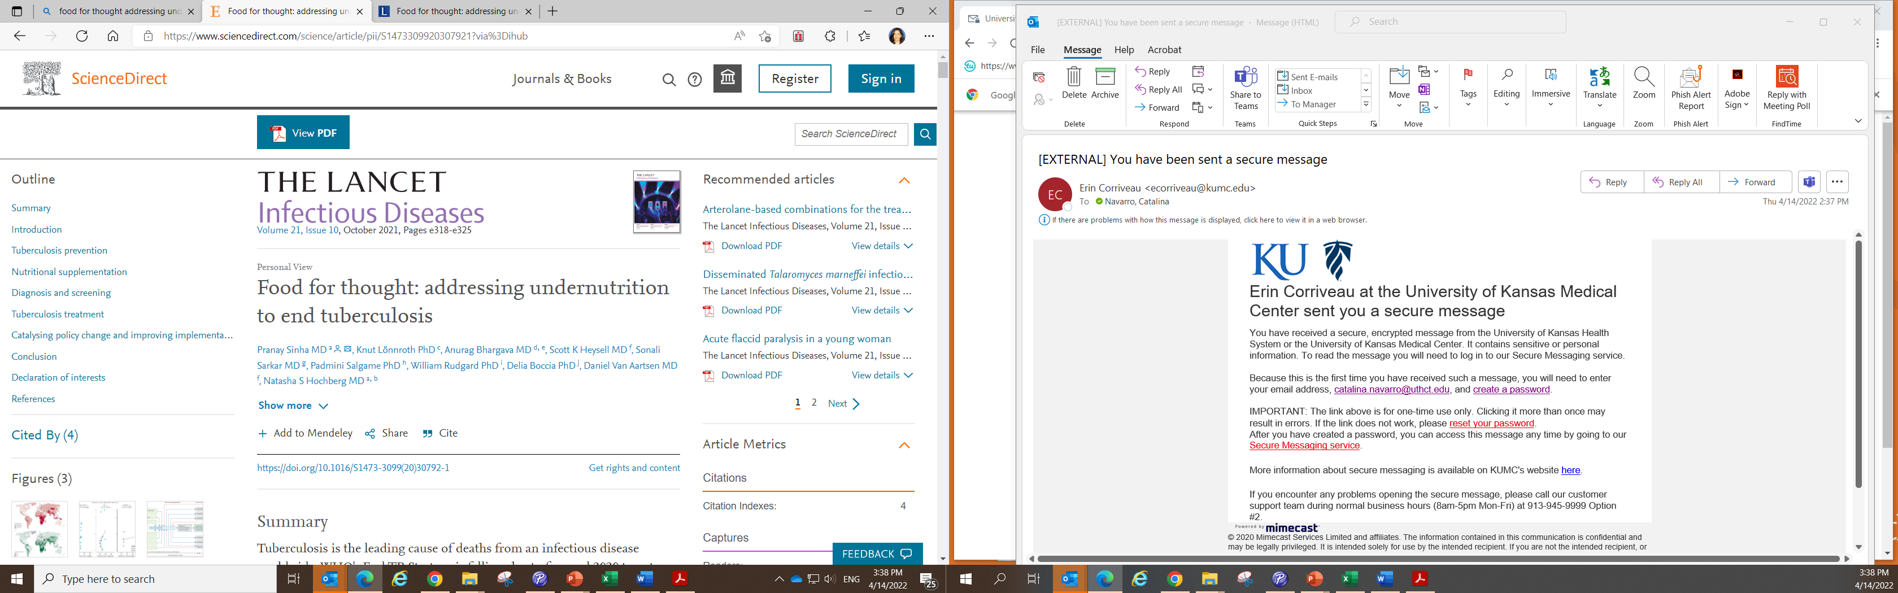
Recent Studies 2021
Undernutrition is the leading population-level risk factor for tuberculosis.
Studies have consistently found that undernutrition is associated
Increased tuberculosis incidence
Increased severity
Worse treatment outcomes
Increased mortality
Food for thought: addressing undernutrition to end tuberculosis - The Lancet Infectious Diseases
Notes:
In the last 10 years there have been a rise in studies regarding TB and undernutrition.
In this most recent study published in the Lancet ID journal the authors discussed that undernutrition is associated with
increased tuberculosis incidence,
increased severity,
worse treatment outcomes, and
increased mortality.

Slide 9
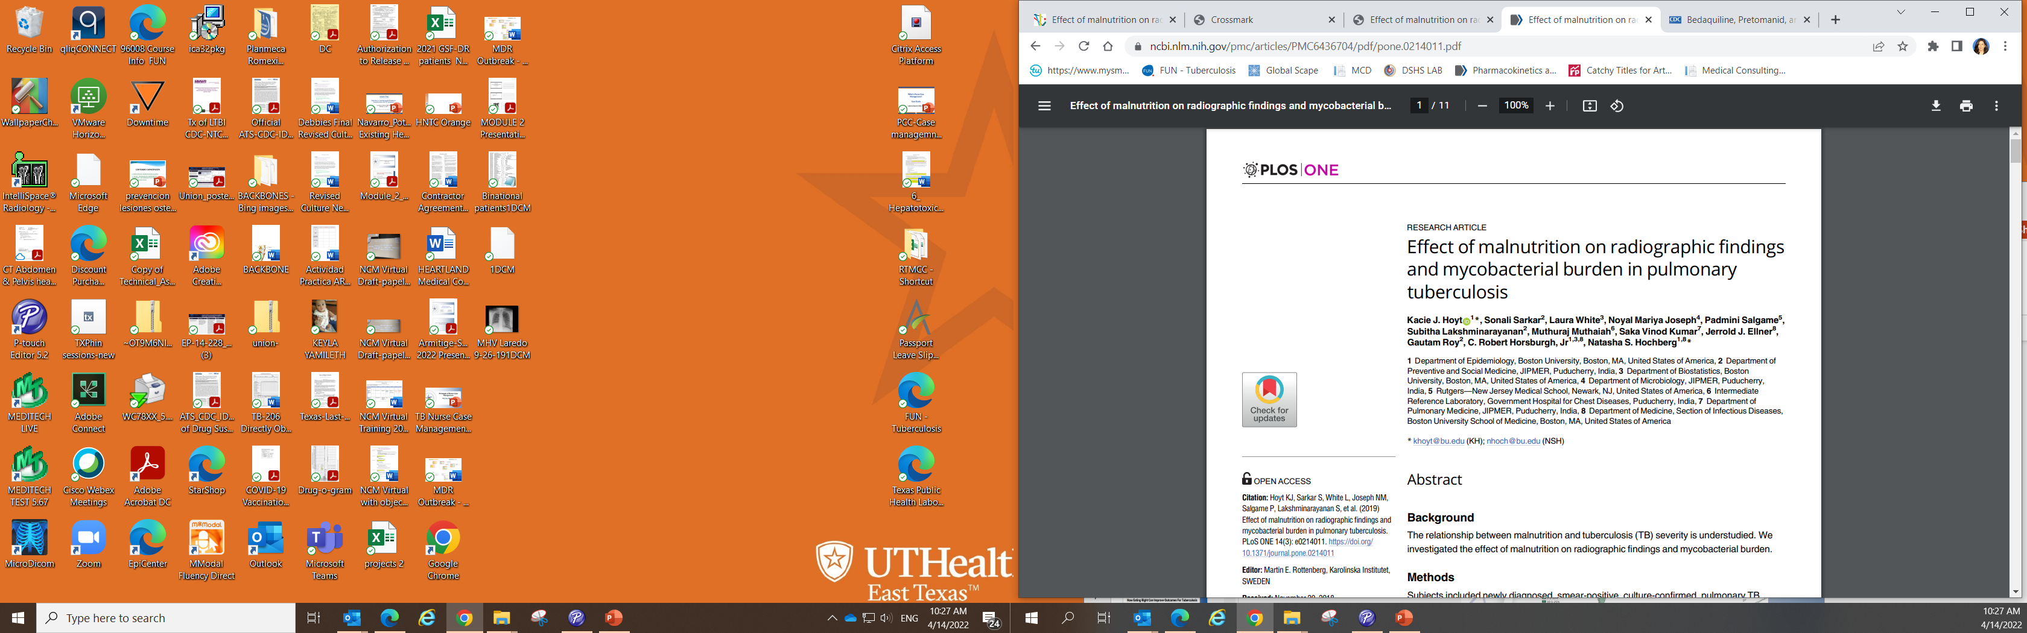
Conclusion:
Malnutrition was associated with increased extent of disease and cavitation on CXR
https://journals.plos.org/plosone/article?id=10.1371/journal.pone.0214011
Notes:
This is another study that was done by Boston University, they investigated the effect of malnutrition on radiographic findings and mycobacterial burden.
They concluded that malnutrition was associated with increase on severity of disease and cavitations on CXRs.

Slide 10
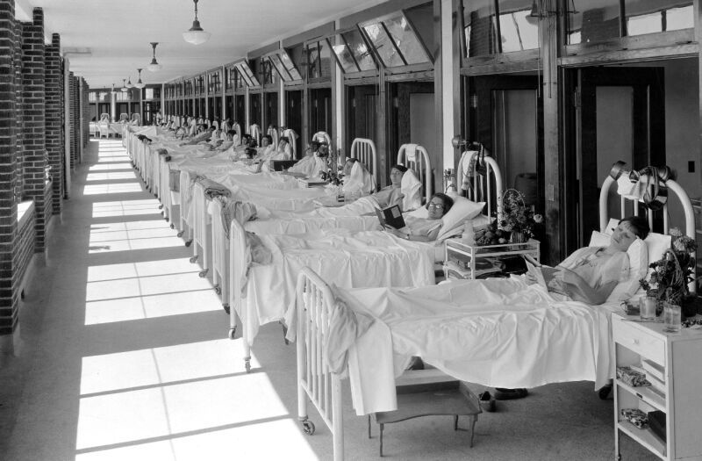
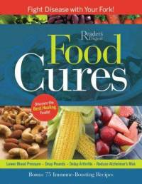
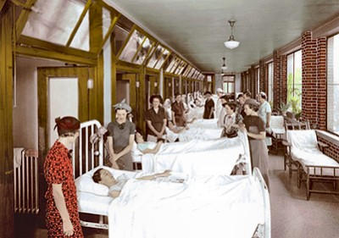
Nutritious Food Rest Sunshine Fresh Air
How Was TB Treated Prior to 1950?
Notes:
10
As Marybel discussed in her presentation last week, before 1950, before TB medications were introduced, For many people a diagnosis of TB was a slow death sentence. People with TB in the US were sent to sanatoriums where they followed a daily routine that included :
lots of rest, nutritious food, plenty of sunshine and fresh air. Most of the sanatoriums emphasized a well-balanced diet rich in vitamins and minerals,,"
Many of the patients that were sent to Sanatoriums were able to recover and went back home to cure without taking meds.

Slide 11

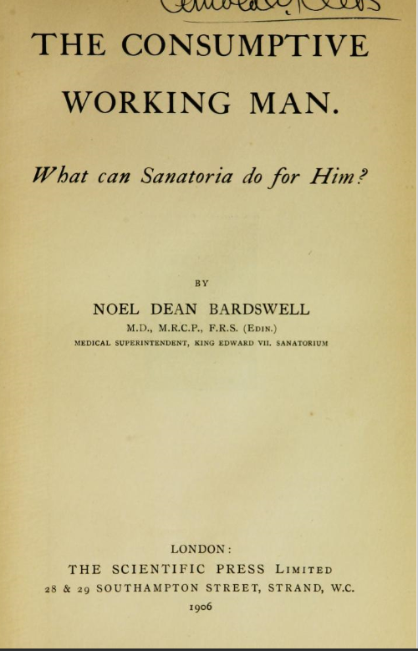
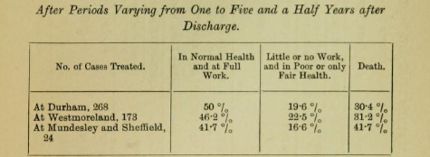
TB Outcomes in a Sanatorium: Insights from 'The Consumptive Working Man'"
.
1906
"Every patient should take an adequate diet as one of the essentials for the successful treatment of consumption."
Daily diet: 196.5g protein, 126.4g fat, 522.6g carbohydrates, totaling 4,040 kcal
Notes:
I found this book… from 1906 ..the title “The consumptive working man” (TB was called consumption)
What can sanatoria do for him?
The book studied patients being treated for TB in 3 different sanatoriums in England.
This book explains the diet provided to successfully treat TB, the follow those who survive and were D/C - up to 5 years after d/c and remarkably 45-50% of the patients were in normal health and at full work , we can conclude that even without TB medications , patients were able to recovered ….So food cures.

Slide 12
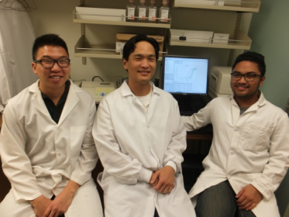
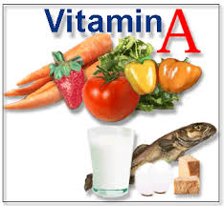
Vitamin A and Tuberculosis
UCLA study (Journal of Immunology, March 1) shows vitamin A may play a key role in helping the immune system fight tuberculosis
UCLA Researchers
UCLA's Elliott Kim, Philip Liu and Avelino De Leon
February 25, 2014
Notes:
These are recent stuydies about Vitamins and TB
This is a study done at UCLA

Slide 13
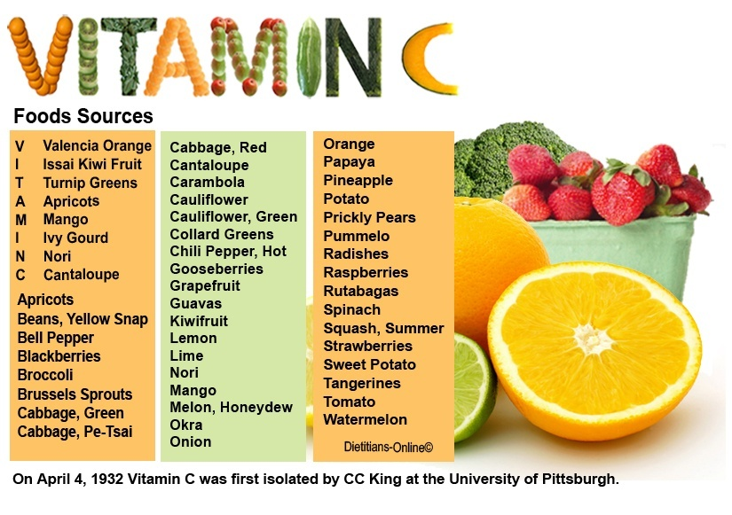

MTB is Sensitive to Killing by a vitamin C-induced Fenton Reaction
https://pmc.ncbi.nlm.nih.gov/articles/PMC3698613/pdf/nihms468905.pdf

Slide 14
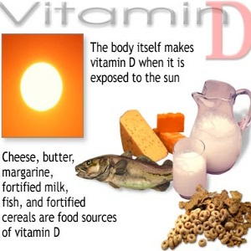

Vitamin D Powerful Weapon Against TB
Research shows that adequate levels of vitamin D can trigger the body's immune system to naturally respond to tuberculosis
Journal Science Translational Medicine October 2011

Slide 15
Most Recent Systematic Review
Effects of Vitamin D Supplementation on the Outcomes of Patients With Pulmonary Tuberculosis
A Systematic Review and Meta-Analysis
Hong-xia Wu; Xiao-feng Xiong; Min Zhu; Jia Wei; Kai-quan Zhuo; De-yun Cheng Disclosures BMC Pulm Med. 2018;18(108)
CONCLUSIONS:
Vitamin D supplementation can be considered as a combination therapy in patients with PTB.

Slide 16
Undernutrition and TB
Weight loss
Loss of appetite
Undernutrition
Tuberculosis
Increase risk from LTBI to TB disease
Weakens inmune system
Increase susceptibility to infection
Notes:
Undernutrition and TB have a bidirectional relationship…
Undernutrition predisposes to TB, how? Because weakens the immune system,
Increase the susceptibility to infection, TB, weight loss
It is essential that this vicious cycle of undernutrition It should be broken
.

Slide 17
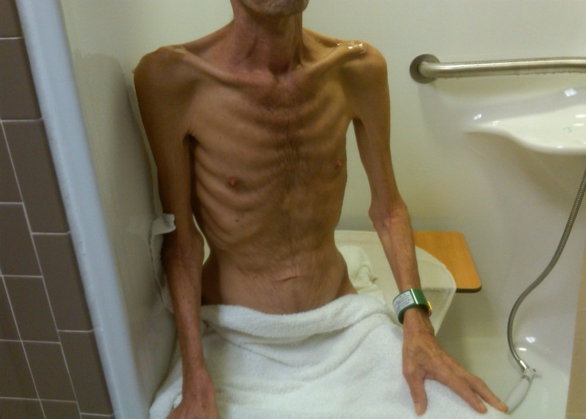
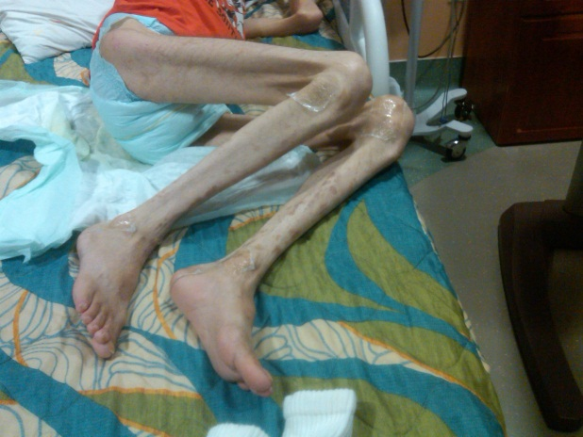
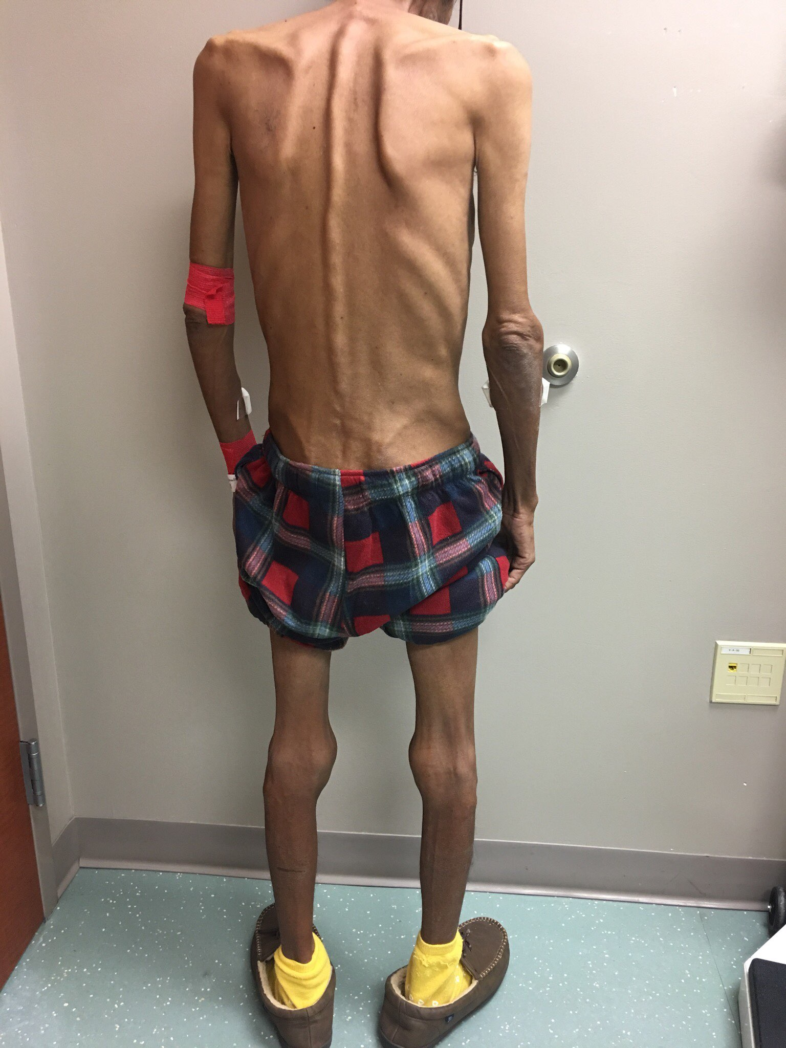
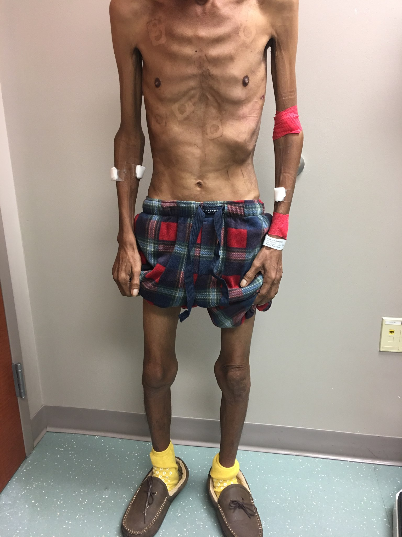
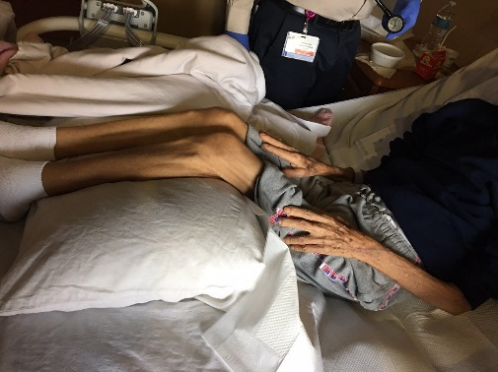
Why is Nutrition Important in a Person with TB?
Notes:
These are some pictures of patients that have been admitted to the Texas Center for Infectious diseases the only TB hospital in the nation. These are real patients:
This is a 42 y/o male admitted in this condition, with a diagnosed of disseminated TB and 60 lb weight loss.
This is a 82 y/o lady also admitted severe undernutrition, generalized weakness and unable to walk due to weakness
This is a third patient 45 y/o male his weight was 81 lb. at admission.
a country with plenty of food…

Slide 18
Importance of Nutrition in TB Treatment Response
Lack of Weight Gain & Relapse Risk in a Large Tuberculosis Treatment Trial
A. Khan, T. Sterling, R. Reeves, A. Vernon and the TB Trials consortium American Journal of respiratory and Critical Care Medicine. Vol. 174
Notes:
Now I’m going to talk about the most important study that is going to teach us a Good lesson 2006
The impact of lack of gain weight and the risk of Relapse
The important of paying attention to the weight of the patient, to evaluate nutritional status, to follow up weigth, the BMI, to encourage patients to work in gaining weight because the risk of relapse
Relapse this is a new term for many…

Slide 19
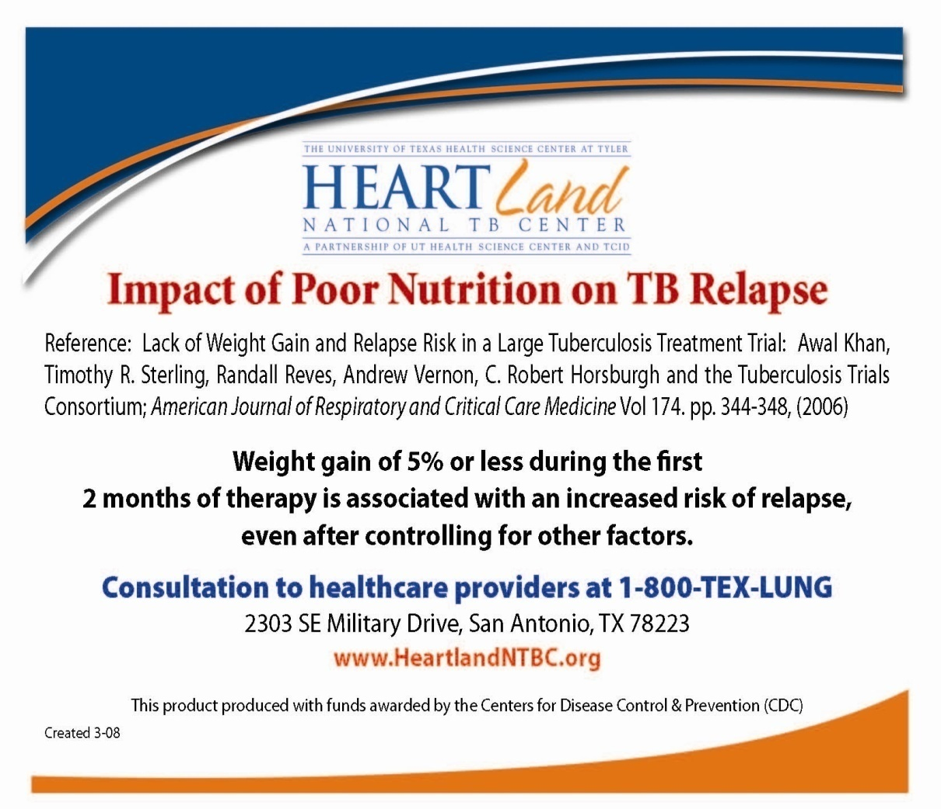
Importance of Nutrition in TB Treatment Response
Khan Am J Resp Crit Care Med 2006
Notes:
We took this study done in 2006 to developed this tool
The impact of poor nutrition on TB relapse.
You can order this producto in our web page.

Slide 20
Importance of Nutrition in TB Treatment Response
The relationship between nutritional status and poor outcomes for patients with TB.
The association of weight gain between diagnosis and the end of 2-month Initial Phase therapy and risk of relapse

Slide 21
Definition of TB Relapse
Patients remain culture negative during treatment , but after completion of therapy, they become culture positive again or show clinical or radiographic deterioration consistent with active TB

Slide 22
Lack of Weight Gain and Relapse Risk
857 subjects were enrolled.
Monitored for two (2) years.
Body weight (kg) was measured at:
Diagnosis
Enrollment in study
Monthly during treatment
And every 3-6 months during follow-up
Height
BMI (Body Mass Index)
IBW (Ideal Body Weight)
Lack of Weight gain & Relapse Risk in a Large Tuberculosis Treatment Trial : A. Khan, T. Sterling, R. Reeves, A.
Vernon and the TB Trials consortium . American Journal of respiratory and Critical Care Medicine. Vol. 174

Slide 23
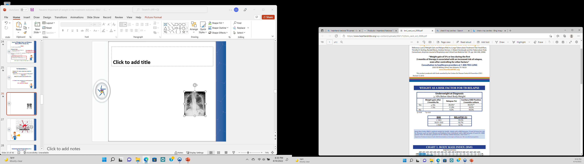
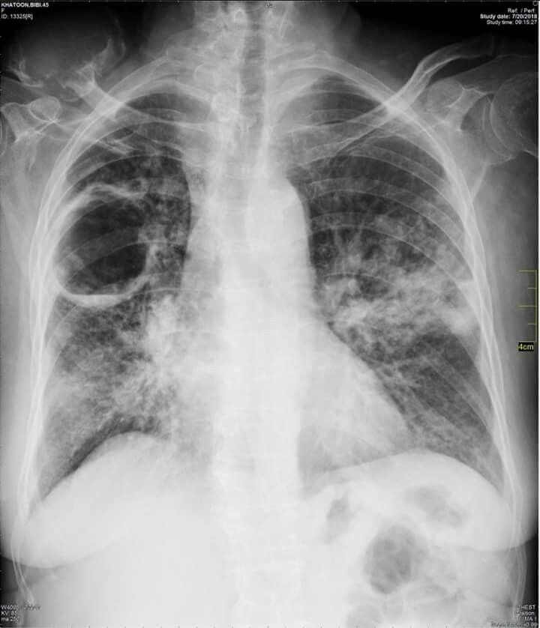

Slide 24



Lack of Weight Gain and Relapse Risk
Results
61 patients relapsed (7.1%)
Khan. 2006 Am J Resp & Crit Care Med;174:344-48

Slide 25
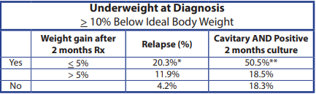
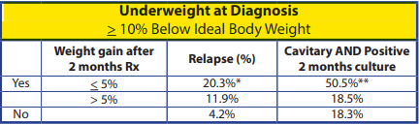
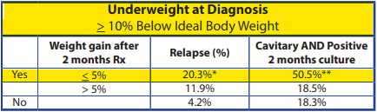
Lack of Weight Gain and Relapse Risk
Notes:
From those who relapse
Those who were undernourished or underweight (BMI <18.5) Risk of relapse 20%
Under weight Patients in the study who also had cavitary disease, positive sputum at 2-months but had a > 5% weight gain during the Initial Phase had a 18.5% relapse rate
Under weight Patients in the study who had cavitary disease, positive sputum at 2-months and a < 5% weight gain during the Initial Phase of therapy had a 50.5% relapse rate
If only weight change between diagnosis and end of 2-month initial phase of therapy was assessed, the relapse risk was 11.9% among patients gaining more than 5% body weight versus 20.3% in patients gaining less than 5% body weight

Slide 26


Remember....
Patients with 10% below ideal body weight at diagnosis that don’t regain at least 5% weight by end of two months of Rx
At 2 months sputum culture (+)
50% chance of relapse
Notes:
The risk of relapse can be attributed to lack of weight gain between diagnosis and the end of the initial phase of therapy

Slide 27



Slide 28

Assessing Nutritional Status in a Person with TB

Slide 29
Laboratories (Normal Values)
Albumin: 3.8 – 5.2 g/dl
(Major protein. Low levels in poor diets, ↓ iron intake)
Total Protein: 6.0-8.5 g/dl (Low levels indicate poor nutrition)
Hemoglobin: 11.5 – 16 g/dl 13.2 – 17.1 g/dl
Hematocrit: 36.0 – 45.0 % 38.5 – 50.5 %
Glucose: 65 – 110 mg/dl
WBC: 3.8 – 10.8
Lymph: 18-48 % (decreases with progressive malnutrition)

Slide 30
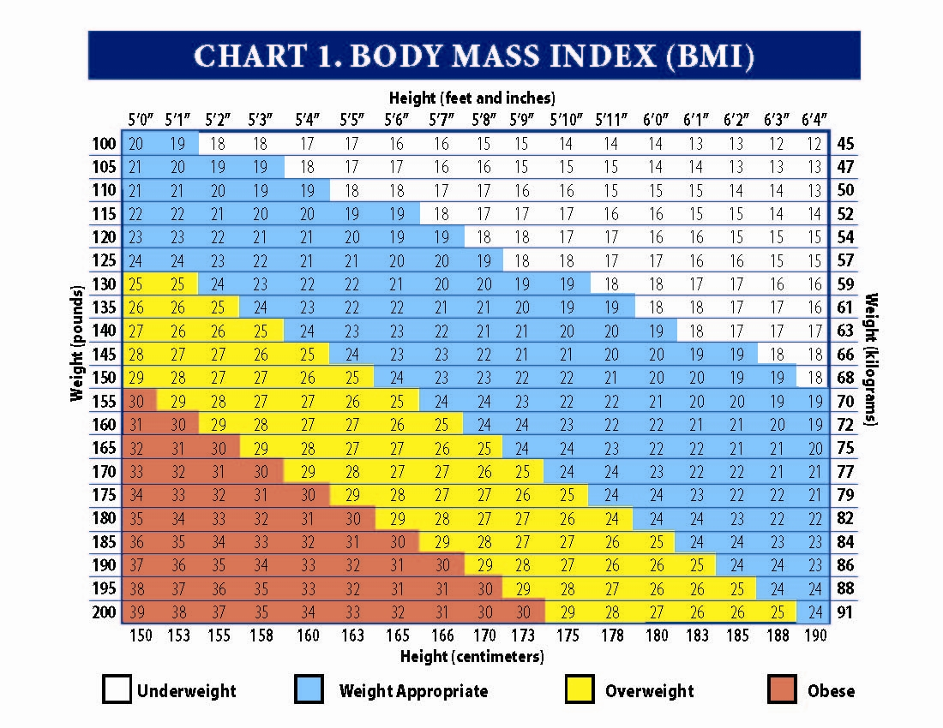
Body Mass Index (BMI)
Notes:
BMI is a table, is a method to measure the condition of nutrition
calculates as the weight in kilograms divided by the height in meters squared
Categories are
severely underweight <16
Underweight 16-18.5
Normal weight 18.5-24.9
Overweight 25-29
Obese >30

Slide 31
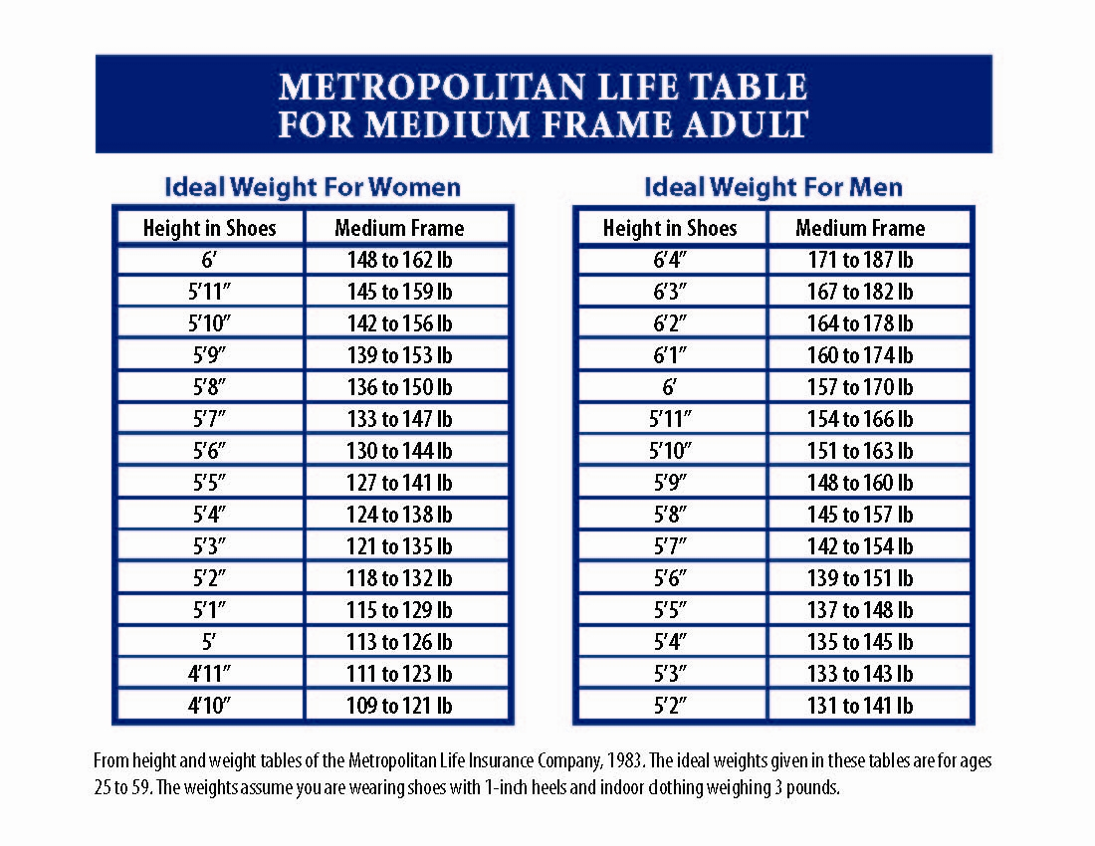
Ideal Body Weight Table

Slide 32
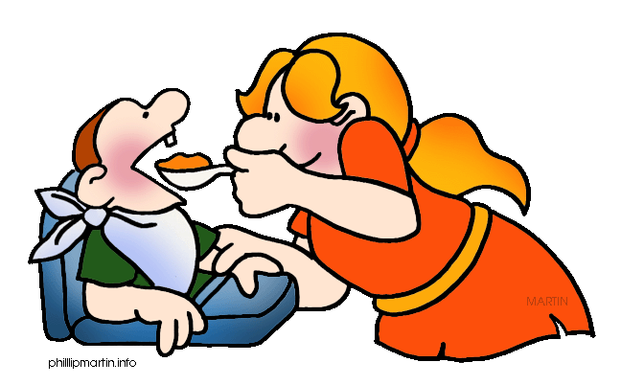
Nutritional Teaching TIPS!
Considerer Prolonging therapy for patients >10% underweight.
Calculate BMI and IBW %
Monitor weight weekly in underweight patients.
Once stable, monitor monthly
Ideally patients should gain1lb/week
Provide food resources
Recommend iron-rich food intake if client is anemic
Recommend intake of food sources of vit A, C, Vit D (fish, butter, milk etc)
Encourage the patient to monitor his/her weight.

Slide 33

How to calculate the % IBW?
% IBW =
Current Body Weight
X 100
Ideal Body Weight
Hi, I am Mr. B!
Mr. B Height: 5’4” Weight: 109lb
IBW: (see chart) 140lb
% IBW =
109lb
140 lb.
= (100% - 77.8%) =
22.2%
X100
= 77.8%
Below of the IBW

Slide 34
Weight Classification Based on IBW Percentage
Weight Classification | Percentage of IBW
Minimal Survival | 48 – 55%
Severely Underweight | < 75%
Underweight | 75 – 84%
Normal Weight | 85 – 119%
Overweight | 120 – 129%
Obese | 130 – 140%
Morbidly Obese | > 140 %

Slide 35
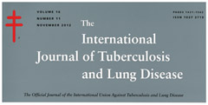
More Studies!
Int J Tuberc. Lung Dis. 2014 May;18(5):564-70. doi: 10.5588/ijtld.13.0602.
Body mass index predictive of sputum culture conversion among MDR-TB patients in Indonesia.
Compared to patients with normal weight (BMI ≥18.5), severely underweight patients (BMI <16 ) had longer time to initial conversion and a lower probability of sputum culture conversion within 4 months.
Conclusion:
Severe underweight was associated with longer time to initial sputum culture conversion among MDR-TB patients.

Slide 36
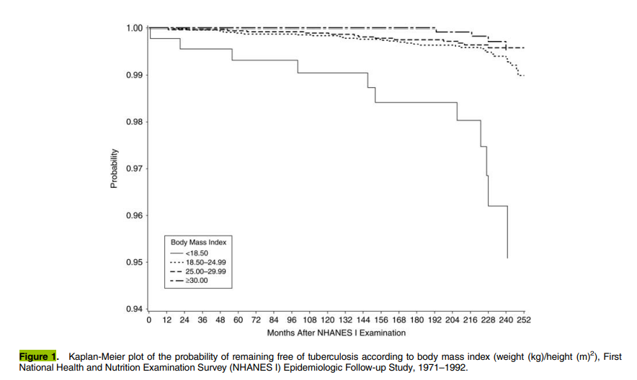
TB Incidence Related to BMI
1971-1992
Notes:
"This chart illustrates the probability of contracting TB and its correlation with BMI percentage over time. In this chart, the continuous line represents individuals with low BMI, while the dotted line shows those with high BMI.
For those unfamiliar with BMI, it is a measurement based on your height and weight. Generally, a higher BMI indicates a higher body fat percentage, while a lower BMI suggests undernutrition.
This data is from a study conducted by the National Health and Nutrition Examination Survey (NHANES) in the USA between 1971 and 1992, covering a 20-year period. Almost 15,000 individuals were studied.
The study found that individuals with a BMI less than 18.5 had a higher risk of contracting TB compared to those with a normal BMI."
The X-Axis (horizontal) represents time (in months)
The Y-Axis represents probability of remaining free of TB (1 (or 100%) means that all people on that group are free of TB in that point of time,
As time progresses, this probability may decrease as some people develop TB.
Conclusion: Undernourished participants (Low BMI) developed TB significantly more quickly than those with normal nutritional status or higher BMI

Slide 37
Case Study # 1

Slide 38
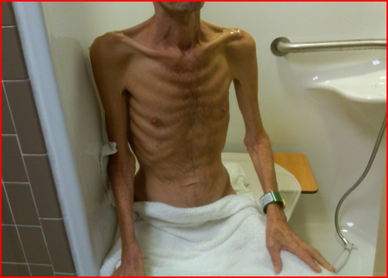
Case Study # 1
42-year-old Hispanic male admitted to Texas Center for Infectious Disease (TCID)
Chronic diarrhea, severe undernutrition, difficulty walking, generalized weakness
60Lb weight loss
Disseminated TB involving lungs and bowel

Slide 39
Nutritional Assessment Case study # 1
MC, 42 y/o Hispanic male
Admitted to the TB hospital
Diagnosis: Disseminated TB (lungs and bowel), DM, Chronic diarrhea, severe malnutrition
Age:
Sex:
Ht:
Wt:
Usual Body Weight:
42
M
5’7”
77.8
142 Lb
Frame Size:
Ideal Body Weight:
% IBW:
BMI:
Classification
Medium
142 Lb
54.7
12.2
Severely underweight
Labs:
ALB: 2.0
Hgb: 9.7
Hct: 26.3
GLUC: 161
WBC: 4.2
Hgb A1C 13.4%
Risk Factors:
>20% underweight
Disseminated TB
GI TB
Poorly control diabetes
Smoker
Lack of family support
Notes:
Pt with a mass in throat that prevents PO. Pt needed a PEG tube to be fed.

Slide 40
Nutritional Assessment Follow Up Case # 1
Diet advance slowly, pt. refuses to eat meals on regular basis, several episodes of hypoglycemia. Severe metabolic acidosis. Discharged after 1 year of treatment
Age:
Sex:
Ht:
Wt:
Usual Body Weight:
42
M
5’7”
114 Lb
142 Lb
Frame Size:
Ideal Body Weight:
% IBW:
BMI:
Classification
Medium
142 Lb
80 %
18
underweight
Labs: Adm. d/c
ALB: 2.0 3.2
Hgb: 9.7 12.1
Hct: 26.3 35.2
GLUC: 161
WBC: 4.2 4.8
Hgb. A1C 13.4%
Chronic pancreatitis/pancreatitis insufficiency
Chronic condition, not reversible medication lifelong
High risk of relapse
Notes:
Percutaneous Endoscopic Gatrostomy Tube, mass in his throat
40

Slide 41
Case Study # 2

Slide 42

Case Study # 2
Ms. RM: 82-year-old Hispanic female
Admitted to hospital with septic shock and multifocal pneumonia
Generalized weakness; non-ambulatory for the past 2-3 months
Transferred to ICU for intensive care

Slide 43
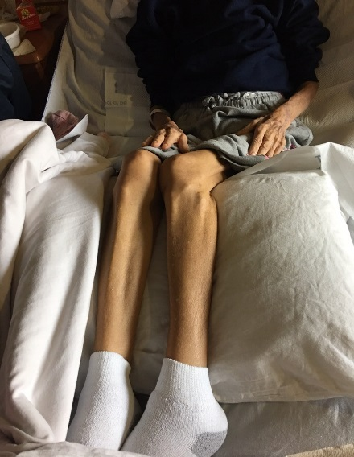
Case Study # 2
Declining health with severe malnutrition and cachexia
Significant dental issues (poor dentition)
20 Lb weight loss
Incontinence of urine and stool for the past 2 weeks
Pulmonary tuberculosis with cavitary lesions on chest X-ray
Poor prognosis

Slide 44
Case study # 2
RM 82 y/o female Diagnosis: Pulmonary cavitary TB
Admitted to TCID Malnutrition
Age:
Sex:
Ht:
Wt:
Usual Body Weight:
82
F
4’8’’
65.7 Lb
Frame Size:
Ideal Body Weight:
% IBW:
BMI:
Classification
Small
97lb
67.7lb
14.1
Underweight/
Severely underweight
Labs:
ALB: 1.1
Hgb: 7.7
Hto: 24.2
GLUC:
WBC: 5.4
Risk Factors: ->20% underweight
-Infectious disease
- Poor dentition

Slide 45
Nutritional Assessment Follow Up Case # 2
Marked improvement during TB treatment. Soft diet with ensure. Good response to treatment and eating better after dental work
Age:
Sex:
Ht:
Wt:
Usual Body Weight:
45
M
4’8”
98lb
Frame Size:
Ideal Body Weight:
% IBW:
BMI:
Classification
Small
97 Lb
100%
22
Appropriate weight
Labs:
ALB: 3.2
HGB: 12.9
HTO: 39.4
GLUC: 97
WBC: 3.8
Notes:
45

Slide 46


Case Study # 2
Pictures Updated
November 2017
April 2018

Slide 47
"Giving people medicine for TB and not giving them food is like washing your hands and drying them in the dirt”
Quote by a Haitian public health worker
Book: Mountains Beyond Mountains
47
Notes:
Thank you for your time
47

Slide 48
THANK YOU!

