Slide 1
OVERVIEW OF
TB CONTACT INVESTIGATION
Presented by: Patrick Ndibe, MA
Bureau Chief
Houston Health Department - Bureau of Tuberculosis
Presentation Date: September 19, 2025

Slide 2
TB 101 Questionnaire
TB is a virus T F
TB is not treatable T F
TB is spread through the air T F
TB infection is not contagious T F
TB can spread to other parts of the body T F
If you are coughing, you have TB T F
I will definitely have TB if I share airspace T F
with someone who has contagious TB

Slide 3
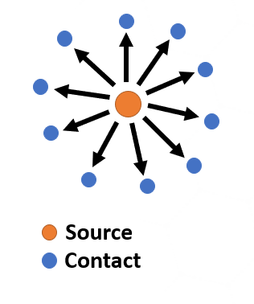
Why Conduct Contact Investigation?
Stop transmission of TB
Identify the source case
Identify contacts
Prevent future cases of TB
Evaluate and treat recently exposed person
Nationally, on average:
  20-30% of household contacts have TB infection and 1% of contacts have TB disease¹
1. US Department of Health and Human Services, Centers for Disease Control and Prevention (2014). Contact Investigations for Tuberculosis, Module 8, p. 4

Slide 4
Example of What Can Go Wrong…
21 y.o. female was exposed to patient with TB disease but was not identified during contact investigation.
One year later (22 y.o.), patient is diagnosed with TB
  Patient had 1 y.o. child at home requiring window prophylaxis
  Patient babysat a 3 y.o. who also required window prophylaxis
  Patient was enrolled in school at the time, requiring testing of school contacts
  Patient had occasional side effects to treatment and became pregnant while on treatment.

Slide 5
What is Contact Investigation?
It is a TB control strategy used to:
Identify, locate, and evaluate individuals who may have been exposed to infectious TB patients
Provide appropriate treatment, as needed
Ensure completion of treatment
Note: Contact investigation is NOT TB education!

Slide 6
What is Contact Investigation? (Cont)
It is second in priority to the treatment of individuals with TB disease.
Contacts who are NOT quickly identified, evaluated or treated constitute the reservoir of future TB cases.
Effective and efficient contact investigation is critically important to eliminate TB in the United States.

Slide 7
Objectives
Interviewing of the patient with TB disease for contacts
Prioritizing contacts
Data management and community communication
Confidentiality
Special settings and source-case investigations

Slide 8
What is Contact Identification
A systematic process to:
  Identify persons (contacts) exposed to someone with infectious TB disease
    Household members
    Friends
    Co-workers
    Others
  Assess contacts for infection with M. tuberculosis
  Provide appropriate treatment for contact with latent TB or TB disease

Slide 9

Decision to Begin
General issues
  Competing demands
    Limited resources
    Limited staff
  Prioritization of cases
    Which cases are the most and least likely to transmit TB germs?
    Which cases have highest priority contacts?
    Which cases are the highest profile?

Slide 10

Decision to Begin (Cont)
TB transmission factors
  Anatomical site of disease
  Sputum bacteriology
  Radiographic findings
  Behaviors that increase aerosolization of
  respiratory secretions
  Age
  HIV status
  Administration of effective treatment

Slide 11
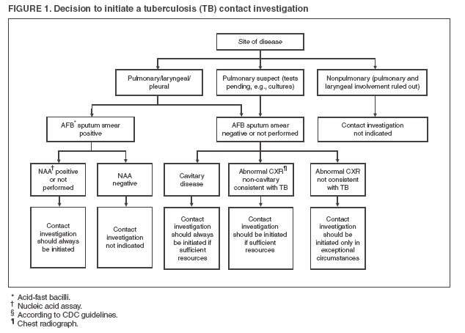
Decision to Initiate a Tuberculosis (TB) Contact Investigation

Slide 12
Interviewing Patients
Pre-interview considerations:
  Preferred language of patient
  Living situation
  Substance abuse, mental illness or other illnesses
  Need for respirator
  Calendar of events
In-person interview should be performed within one business day for symptomatic patients and within 3 business days for others

Slide 13
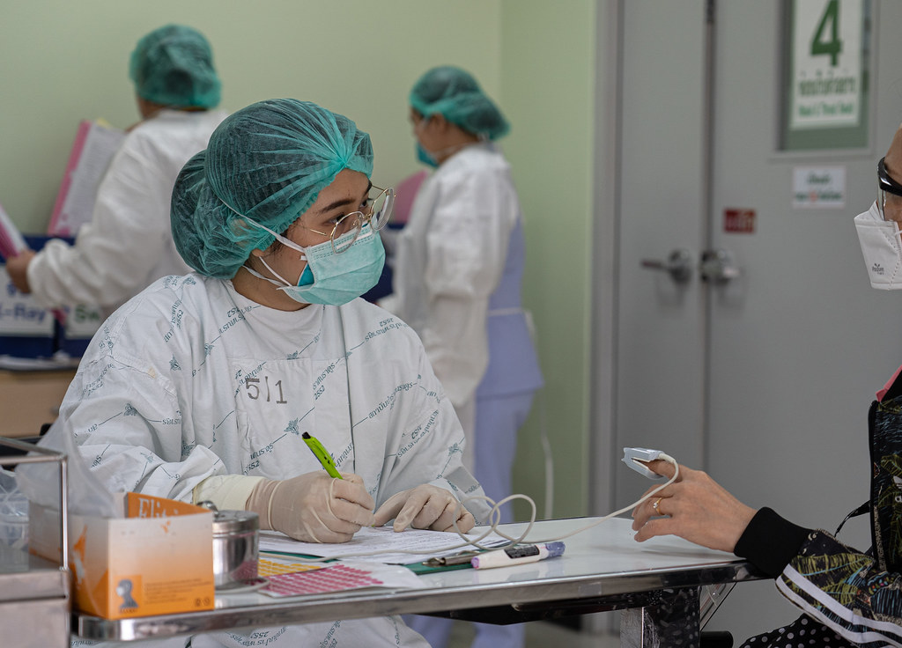
Interviewing Patients (Cont)
Establish trust and consistent rapport with patient
Interviews should be in primary language of patient
  Or use of translation service, if applicable
Utilize standard documents or forms
for data collection

Slide 14
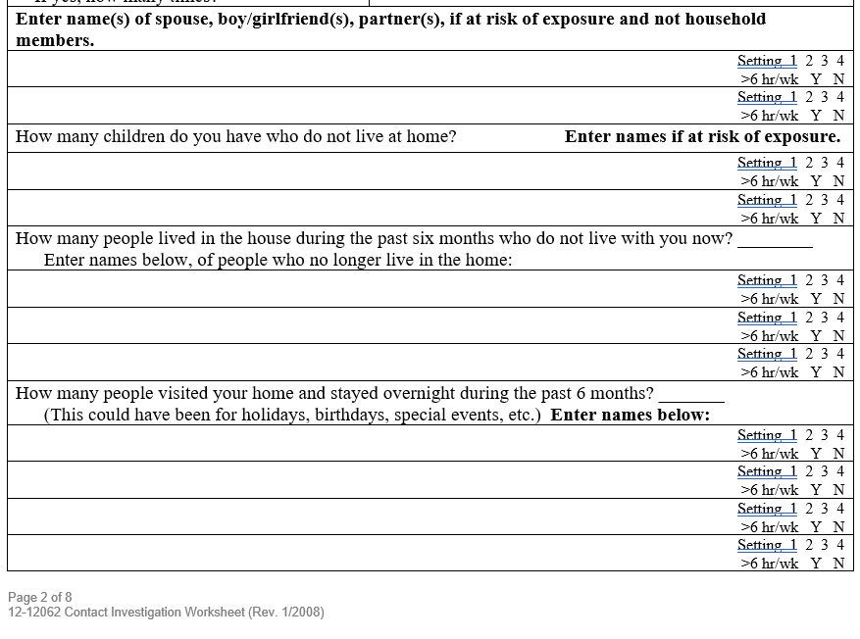
Excerpt from Contact Identification Worksheet
https://www.dshs.texas.gov/tuberculosis-tb/texas-dshs-tb-program-tb-forms-resources

Slide 15
Infectious Period
Establish infectious period at first visit and modify as appropriate
  Recommended to be 3 months before the earliest indication of disease
  Infectious period closes when:
    At least 3 consecutive sputum smears are negative for acid-fast bacilli (AFB)
    Patient has received 2 weeks of adequate treatment for TB if sputum smears are AFB+ OR has received at least 1 week of adequate treatment for TB if sputum smears are all AFB- from beginning
    Patient has clinical improvement of signs and symptoms of TB
  Closure of infectious period important for release from isolation and 2nd round testing of household contacts

Slide 16
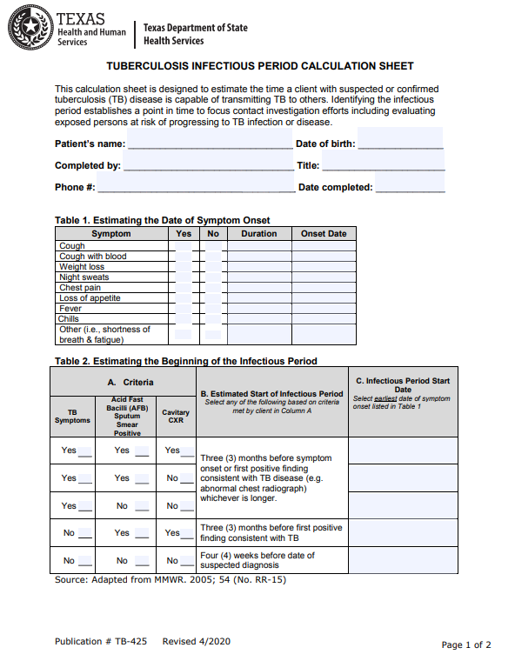
Example of an Infectious Period Worksheet
https://www.dshs.texas.gov/sites/default/files/IDCU/disease/tb/forms/PDFS/TB-425.pdf

Slide 17

So, what are you going to do with all these contacts?

Slide 18
Prioritizing Contacts
Establish a break-in-contact for each contact
  Break-in-contact is when the contact is no longer being exposed to the TB germ
Likelihood of infection depends upon:
  Intensity (how many germs to which contact exposed)
  Frequency (how often exposure occurred)
  Duration (how long was exposure at each time period)
  Risk factors (does the patient have age or medical-related risk factors that make them greater risk for disease)

Slide 19

Age and Medical Risk Factors
These risk factors increase a contact’s possibility of rapidly developing TB disease if infected with TB germ
  Age <5 years old; <2 years old even more at risk
    Incubation period is shorter
  Medical and medication usage issues
    HIV positive (disease will progress more rapidly)
    Long-term corticosteroid use (>15 mg daily for >4 weeks)
      Inhaled corticosteroids don’t count
    Anti-rejection medications for organ transplants
    Cancer chemotherapy agents
    Tumor necrosis factor alpha antagonists

Slide 20
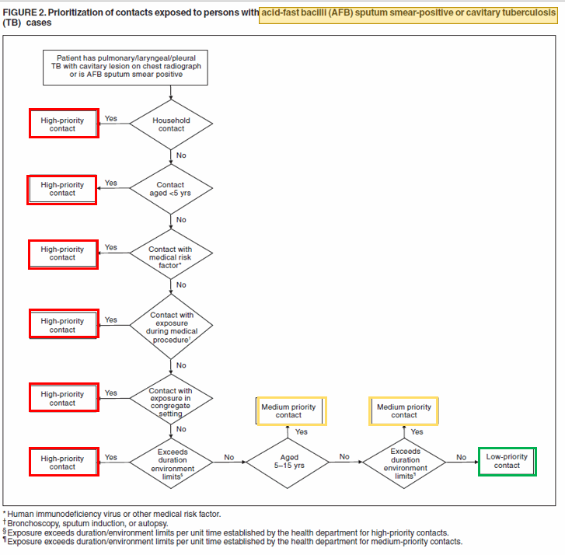
Prioritization of Contacts
Algorithm for contacts to patients with smear+ or cavitary TB.
Note the following:
Number of high-priority contacts
Health Department sets the environmental limits.

Slide 21
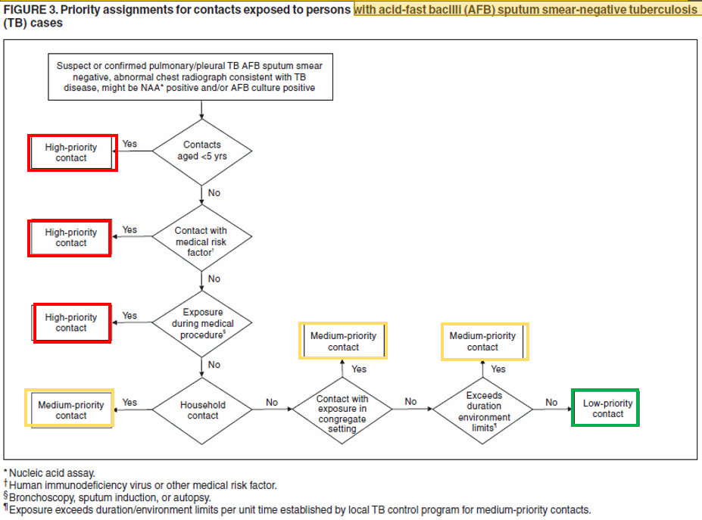
Prioritization of Contacts
Algorithm for contacts to patients with smear- TB.
Note the following:
Decreasing number of high-priority contacts
Health Department continues to set the environmental limits.

Slide 22
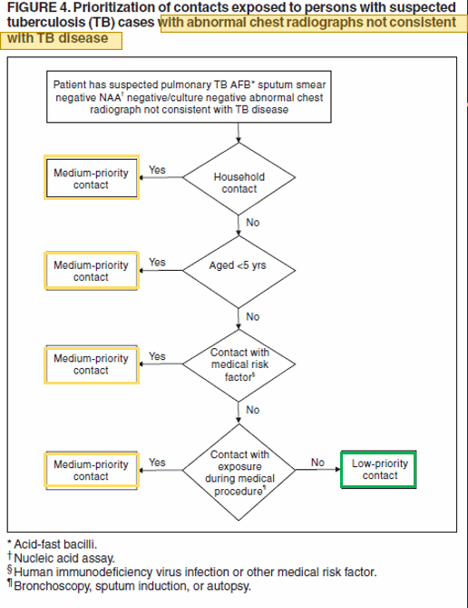
Prioritization of Contacts
Algorithm for contacts to patients with possible TB with chest X-ray not consistent with TB disease.
Note the following:
No high-priority contacts
No environmental limits set.
You may be performing a very limited contact identification with these patients.

Slide 23

A Note About Window Prophylaxis
Window prophylaxis is treating a patient without evidence of TB infection like they have TB infection
We do this for those with high risk for conversion to TB disease and a short incubation period that include:
  Children <5 years old
  Patients who are HIV+
  Patients on immunosuppressive medications (discussed earlier)
Patient will receive medications until 2nd round testing performed 8-10 weeks after last exposure to TB *.
* HIV infected contacts who are placed on windows prophylaxis should complete the full course of LTBI treatment regardless of their post-incubation testing result

Slide 24

So, how do you manage your data and communicate with the community?

Slide 25

Communications
Internal
  When new patient needs contact identification, meet with team to establish plan
  Establish communication methods with the team
    Secure e-mail
    Shared drive with data collection
    Case manager point of contact
  Create line-list of each contact and break-in-contact (last day of TB exposure)
  Identify triggers to expand communication
    Day care contacts
    Medical facility contacts
    Congregate setting contacts
    High profile contacts

Slide 26

Communications
External
  Have a plan established for communicating a TB contact identification is happening in a designated area
    Local elected officials
    Local response groups (if applicable)
    Local medical facilities
  Determine who needs to be involved with external communication outside these groups
  Develop a template for communication
  Ensure all the team is aware of external communication before it occurs

Slide 27

Communications
Large-scale Media
  Get your Public Information Officer (PIO) involved immediately
  Meet with team to establish the facts about the case and the contacts that are currently being identified and tested
  Use press statements that do not give the following to the
  public:
    Gender
    Age
    Employment
    Country of origin
  Guide inquiries back to the health
  department and have team established
  to field calls

Slide 28
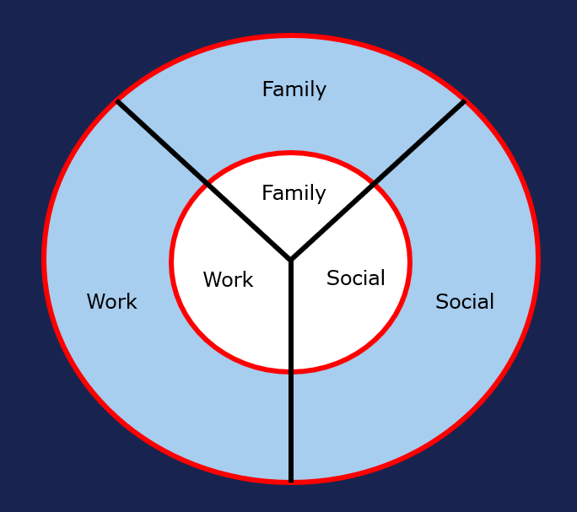
Data Management
Keep things organized
  Excel or Access database
  Secured documents
  Standardized forms for data collection
    Saves you from reinterviewing contacts
  Address/Interjurisdictional Notifications
Analyze data to determine if expansion of contact identification is needed
  If so, where? (Social, Household, Work)
  Keep data for required length of time per your records retention department

Slide 29

So, you want to know about confidentiality? I’d tell you about it, but it’s a secret.
Confidentiality vs Secret
Confientiality VS Secret

Slide 30

Confidentiality
All private health information (PHI) collected must be kept safe
Keep information about patient with TB from others
Keep information about others from others
  Even if people ask about index case, you mustn’t confirm
Determine HIPAA documents required to sign
Notes:
People are not stupid. They may be able to figure out who the index case is. We have very rural areas where people don’t want their information known in a small town.

Slide 31

You may remember me from such movies as: “Source Case Identification: The Only Way Forward is Backwards”

Slide 32
Source-Case Identification
Trying to figure out who gave someone TB
Used for the following:
  A child 5 years or younger who has been diagnosed with TB disease
  An infant 2 years or younger who has been diagnosed with TB infection
  A healthcare setting where TB testing indicates recent infection in a healthcare worker
  In correctional facilities where TB testing indicates increased TB infection among inmates or staff

Slide 33

Source-Case Identification
Interview those around the patient with TB disease about symptomatic people in the following locations:
  Home or extended family visits
  School
  Daycare
  Carpools and buses
  Play groups
  Recreational activities
  Places of recent travel
Notes:
Example of baby whose father was the source case.
Remember, the source case may feel badly about getting someone else sick.

Slide 34
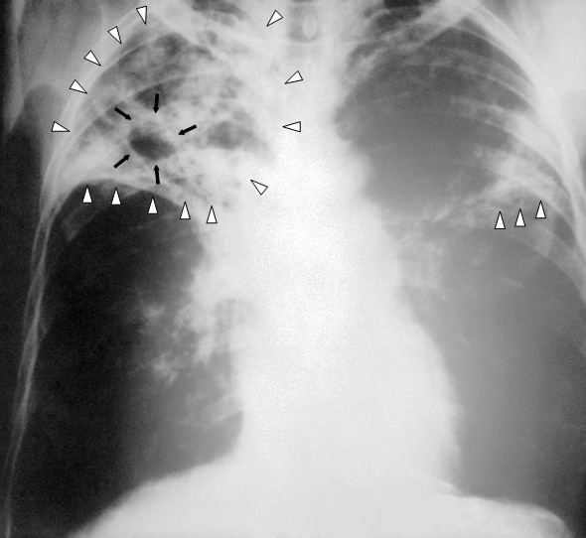
Source-Case Identification
Focus is on those who are symptomatic
  Obtain chest X-ray
  Obtain sputum specimens
  Obtain IGRA/TST
Determine if specimens from current case
and possible source case can be genotyped and matched
Consider using susceptibilities of known source cases to guide treatment of current case
Notes:
Example of baby whose father was the source case.

Slide 35
Special Settings Challenges
Schools
Children/minors involved
Get school officials involved
Anticipate parental concerns and information sessions
Evaluate the student/teacher/staff member movements throughout the day
Gather parental consents and attempt onsite testing
Anticipate work to find contacts if 2nd round is during the summer
Homeless Shelters
Population may have more underlying issues to include mental health, drug, or alcohol issues
Population may be very mobile and not available for 2nd round testing
Check for HIV
Check for history of incarceration that increases risk for TB exposure
Work with facility administration
Correctional Facilities
Expect a large number of contacts
Work with facility to determine the patient’s movement within the facility and amongst other correctional facilities
Obtain results from TB testing upon intake
Consider many of the contacts to be high priority due to poor ventilation and crowded space
Anticipate patients moving when on treatment

Slide 36
Cases Identified Through Contact Investigation (City of Houston)
 | 2022 | 2023 | 2024
Number of Cases | 156 | 166 | 186
Number of Contacts | 878 | 653 | 431
Number of Cases Found as a Result of Contact Investigation | 22 (2.5%) | 37 (5.7%) | 9 (2%)

Slide 37
Acknowledgements
Matthew D. Whitson, DNP, APRN-CNP, FNP-BC
Department of State Health Services, Region 8
Steven Dang, Senior Staff Analyst, HHD Bureau of Tuberculosis
Dawn Clifton, Management Analyst, HHD Bureau of Tuberculosis
Carlota Arriozola, Public Health Investigator Manager, HHD Bureau of Tuberculosis

Slide 38

Questions?

Slide 39
Thank You!
I hope you guys enjoyed it!

