Slide 1
Diagnosis and Management of TB Disease in Adults
Yates Lee MD
Harris County TB Elimination

Slide 2
Objectives
Describe the clinical presentation and diagnostic methods for TB disease.
Differentiate latent TB infection (LTBI) from active TB disease.
Identify first-line TB treatment regimens.

Slide 3
Pretest
1. Does a negative IGRA rule out TBD?
2. What is the minimum duration of treatment for drug-susceptible TBD?
3. True or False: A normal chest X-ray rules out active TB disease.
4. Which famous Beatle had TB?

Slide 4
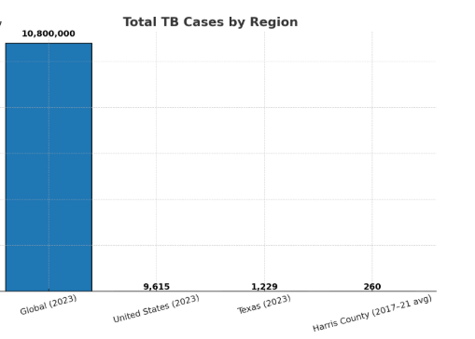
Global and Local Burden

Slide 5
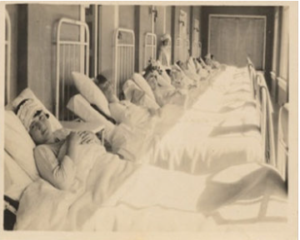
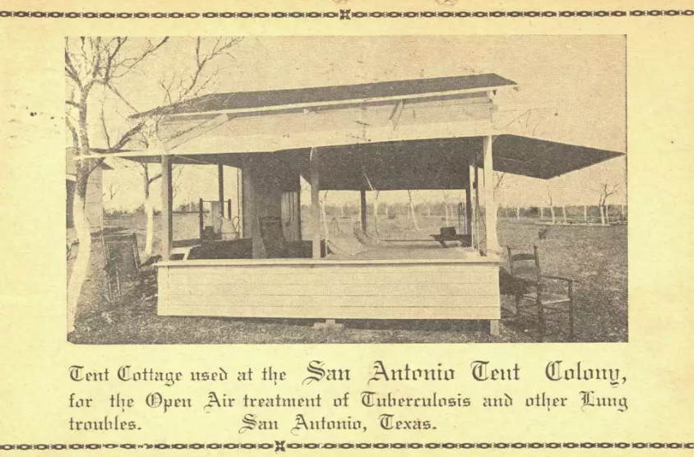
Sanitoriums

Slide 6
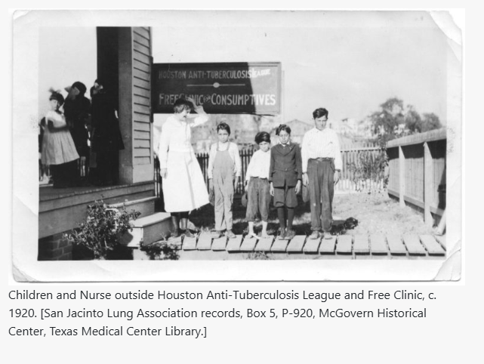
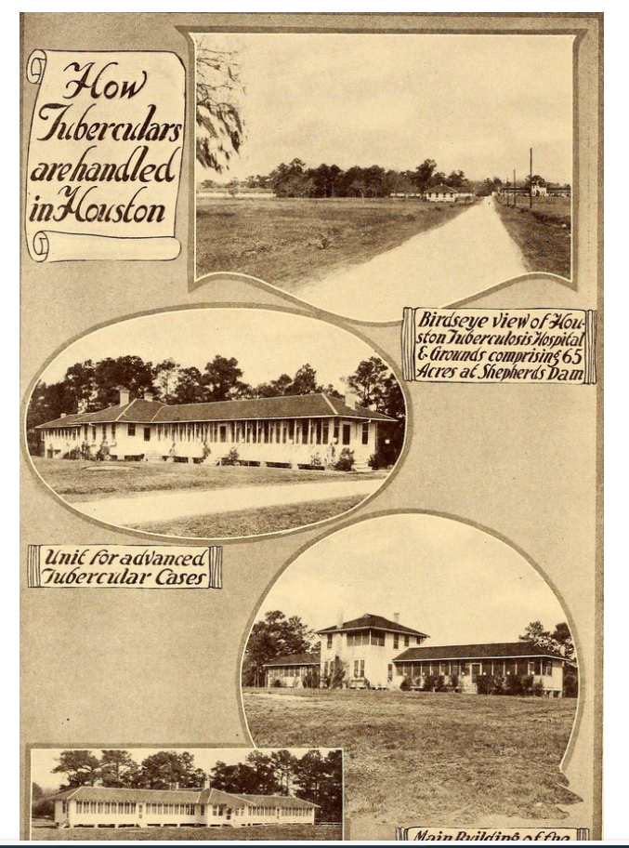
Houston TB

Slide 7
Clinical Presentation
Pulmonary TB:
Persistent cough (≥2–3 weeks)
Hemoptysis, weight loss, night sweats, fever
Is Pleural TB considered pulmonary?
Extrapulmonary TB:
Lymph nodes, CNS (TB meningitis), bones/joints, pleura
Note: Symptoms may be subtle in immunocompromised patients

Slide 8
Primary Tuberculosis
TB is divided into primary and post-primary (or reactivation)
Most primary TB resolves spontaneously, but reactivation may occur without treatment

Slide 9
Reactivation TB
Post Primary TB is progressive
Upper lobes predilection, cavitation and absence of lymphadenopathy
Fibrosis and calcification are seen after healing

Slide 10
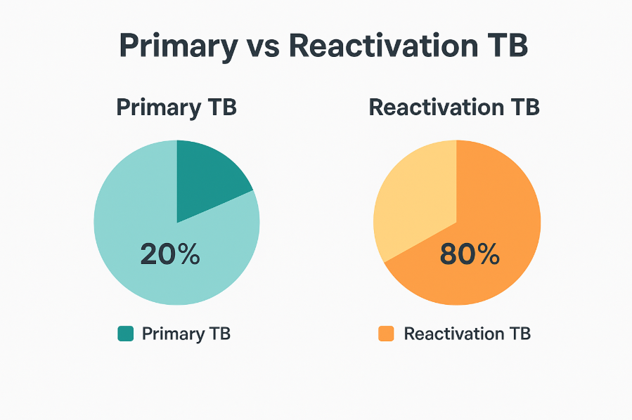

Slide 11
TB Diagnosis
Patient History
  Symptoms
  History, co morbidities, demographics, family history
  Hospital Discharge Information
Physical examination
Laboratory testing
  Tuberculin Skin Test or Interferon Gamma Release Assays
    QTF Gold In Tube, TSpot TB
    How often are IGRA’s False negative? False positive?
  CBC, LFTs, sputum smears/cultures, Tissue histology
Radiologic evaluation
  CXR, (CT, MRI)

Slide 12
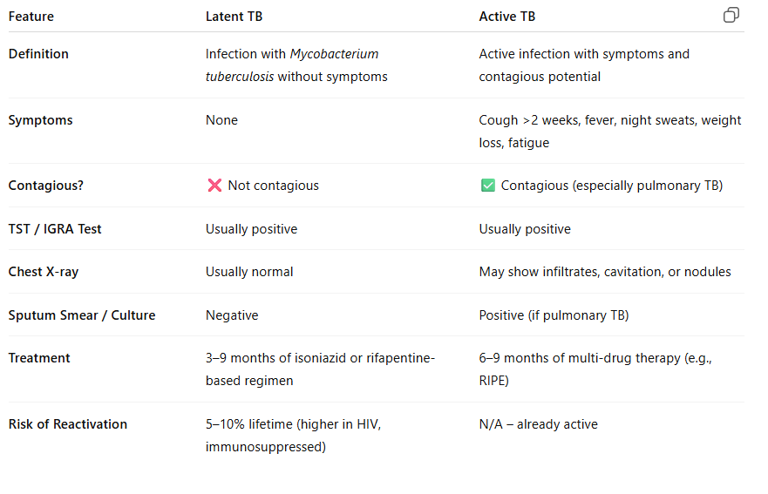
Latent vs Active TB

Slide 13
CXR
Obtain a CXR in
  Every person with a newly positive TST or IGRA
  Any person at risk of TB who has symptoms and no other obvious diagnosis
  May be indicated in some asymptomatic, TST/IGRA negative contacts at increased risk
    Children 4 years and younger
    HIV infected
    Immunosuppressed

Slide 14
Why Use A NAAT ?
Confirms AFB + patient as M TB
If AFB + patient is NAAT negative on 2 specimens
  Less likely to have M TB
    Suspend Contact investigation and
    Hold TB treatment unless TB is a strong consideration
    Can I get 2 NAATs from the state?
If patient is not strongly considered to have MTB and is NAAT negative x 2,
  Remove from isolation.

Slide 15
Mycobacterial Cultures
Three initial sputum cultures within 24 hours or 3 days in a row
  At least one first morning
  At least one observed
Cultures should be obtained monthly until negative on two consecutive months
  Determine length of therapy
  Identify delayed response (+ at 3 months)
  Identify treatment failure ( + at 4 months)

Slide 16
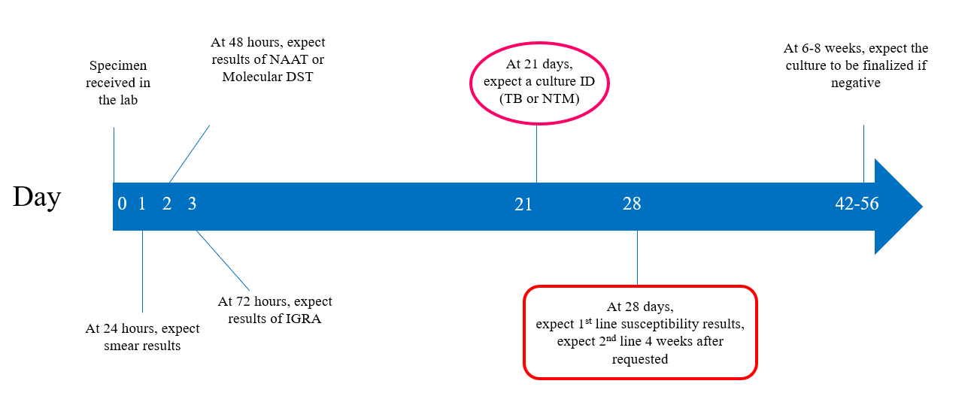
When should I consider my specimen delayed?

Slide 17
Management of QFT (+) Persons With an Abnormal CXR and AFB Smear(-)
Isolated CXR with nodules and/or fibrotic lesions:
If no symptoms - wait
  Collect sputum culture
  Evaluate for symptoms
  Repeat CXR
If CXR stable at 2 – 3 months and cultures are negative,
treat as LTBI
Isolated CXR with nodules and/or fibrotic lesions:
  If patient has any signs or symptoms of TB disease: This person may have tuberculosis
    Start 4 drugs
  Never start a single drug in a patient with possible active TB

Slide 18
TB Management (Drug-Susceptible)
First-line (RIPE regimen):
Rifampin (R)
Isoniazid (I)
Pyrazinamide (P)
Ethambutol (E)
Typical course:
Intensive phase: 2 months (RIPE)
Continuation phase: 4 months (R + I)
Total duration: 6-9 months
What about the 4 month treatment?

Slide 19
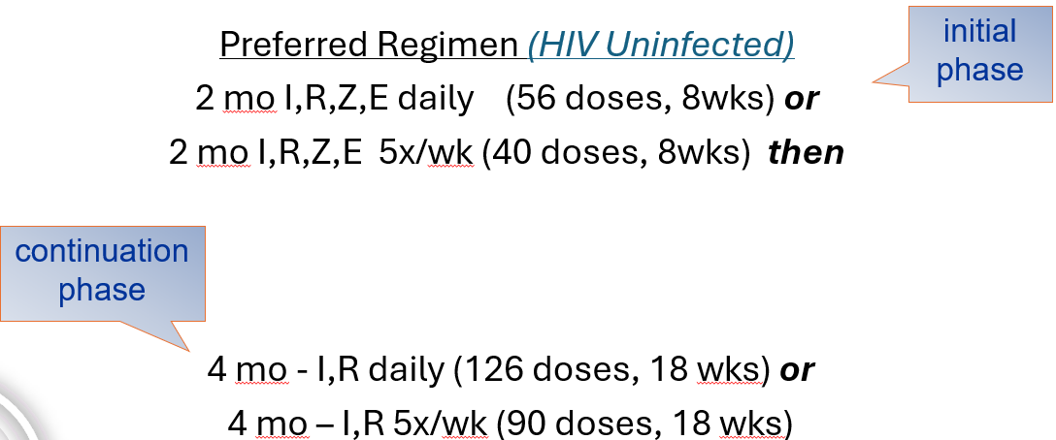
Treatment of Culture-Positive Drug Susceptible Pulmonary TB

Slide 20
When to extend more than 6 months
Prolong continuation phase when:
  Positive 2 month culture with cavitary disease
  Extrapulmonary disease
    Meningitis, bone and joint
  HIV TB in adults not receiving HAART during TB treatment

Slide 21
Why Give Ethambutol?
A four drug regimen is recommended until susceptibility tests are reported
Ethambutol can be stopped as soon as the lab reports an isolate susceptible to INH & rifampin.
If treatment is being initiated after drug susceptibility tests are known and the organisms are susceptible, ethambutol is not necessary if the patient is given both INH and rifampin
What if it’s a clinical case?

Slide 22
Nursing Considerations: Medication
Rifampin: orange secretions, hepatotoxicity, drug interactions
Isoniazid: hepatotoxicity, peripheral neuropathy (give Vit B6)
Pyrazinamide: hepatotoxicity, hyperuricemia (gout)
Ethambutol: optic neuritis → vision monitoring
Nurses must: monitor side effects, reinforce adherence

Slide 23
Relapse
Circumstance in which a patient becomes and remains culture-negative while receiving antituberculosis drugs but at some point, after completion of therapy, either becomes culture-positive again or experiences clinical and radiographic deterioration consistent with active tuberculosis
How often does relapse occur?

Slide 24
Medical Factors Associated With
Relapse
Cavitary TB
Extensive disease on CXR; bilateral infiltrates
Positive 2 month culture
Associated medical conditions
  Diabetes
  HIV
  Malabsorption of TB drugs
Tuberculous lymphadenitis
Underweight at diagnosis and failure to gain
Drug resistant disease
Prior treatment for tuberculosis

Slide 25
What about Culture Negative TB
A person who could have TB with positive TST or IGRA
  Risk factors for TB
  Abnormal CXR
  Usually – clinical symptoms
All cultures are negative
Classify based on clinical and/or radiograph response to treatment at 2 months
  Clinical or CXR improvement – Culture Negative TB
  Treat for 4 months (children and HIV + 6 months)
  RIPE for 2 months, then RIE +/- PZA dependent on INH resistance

Slide 26
Management of Treatment Interruptions
Initial phase of therapy
  <14 days –complete standard # of doses
  >14 days – restart from the beginning
Continuation phase
  >80% doses by DOT – if initial smear–, may stop but if initial smear +, complete treatment
  < 80% doses by DOT and lapse >3 months – reevaluate and restart therapy from beginning

Slide 27
Post Test
1. Does a negative IGRA rule out TBD?
2. What is the minimum duration for drug-susceptible TBD?
3. True or False: A normal chest X-ray rules out active TB disease.
4. Which famous Beatle had TB?

Slide 28
Summary
Summary
TB remains a major global health issue
Diagnosis = clinical + lab + imaging
RIPE regimen = first-line treatment
Nurses play a central role in adherence, safety, and infection control

