Slide 1
TB Nurse Case Studies

Slide 2


Slide 3

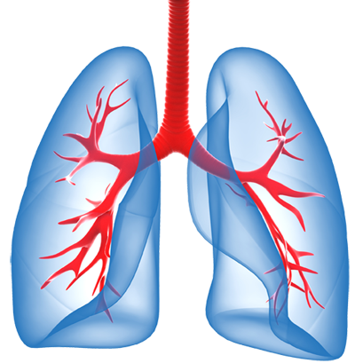
TB Case Studies: Choose Your Ending!

Slide 4
Chapter 1: Mrs. X

Slide 5
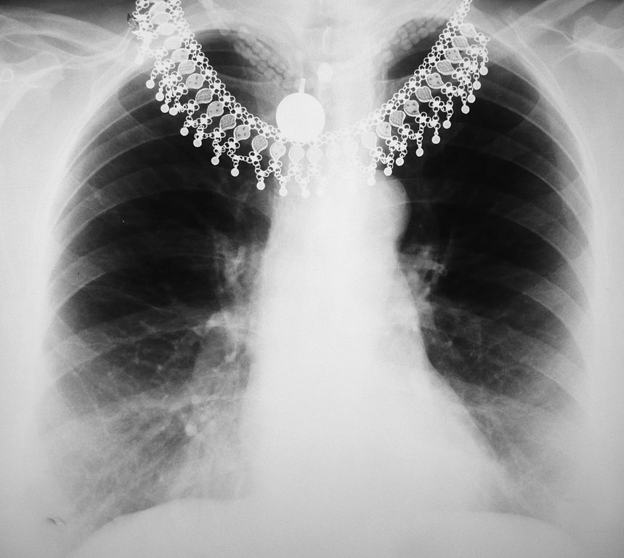
Chapter 1: Mrs. X
62-year-old female
Born in Vietnam
Emigrated to U.S. in 2018
Currently unemployed
Past medical history: hypertension, type 2 diabetes

Slide 6
Mrs. X’s TB Work-Up
Hospitalized for respiratory symptoms in late July (cough, SOB, night sweats).
Ultimately diagnosed as suspected TB on July 30, 2025.
Initial diagnostics:
  AFB sputum smear positive >1/field, negative, 1+
  NAA positive, no rifampin resistance
  Abnormal CXR, cavitary lesion in LUL with volume loss
  IGRA negative
  HIV negative
  LFTs WNL
  Glucose 228 fasting
Discharged home a few days later and started RIPE on August 4, 2025 (per your MD orders).

Slide 7
Current TB status
About 1.5 weeks later:
Mrs. X has taken 12 DOT doses (M-F) with self-admin on the weekends.
She has three negative AFB sputum smears collected earlier in the week.
She is anxious to be released from isolation to attend her best friend’s daughter’s wedding Saturday.
Patient informs DOT worker she has been nauseous since last week, worse today and didn’t say anything until now. DOT worker holds the dose after calling you.
You arrange to visit patient tomorrow at her home.

Slide 8
The Next Day
The next day, you do an assessment. Patient tells you she is still nauseated and has had fatigue since last week which started first.
She says she is not vomiting, and she usually gets nauseated when takes any medication – this is nothing new.
She says she missed yesterday’s DOT and wants to take today’s dose and Fridays so she can go to the wedding.

Slide 9
Option A
You hold the DOT dose
Option B
You allow her to take today’s DOT dose – the nausea is not new
You draw LFTs
You instruct the patient to take small meals
You instruct the patient to remain in home-based isolation
You inform your physician
You draw LFTs
You let her know you will ask about the weekend wedding
You instruct her to take small meals
Go to slide 10
Go to slide 15

Slide 10
Option A
You do not dose her that day (Thursday) but draw her LFTs.
You tell her she will need to remain in isolation and that you are holding her medications.
Notes:
You call her, she picks up, and you ask if she is returning tomorrow as scheduled.
She informs you that her aunt became ill and therefore she will be staying an additional week. She is apologetic but says she cannot return home.
She asks you how she will receive more medications.

Slide 11
Option A
Your physician has recommended zofran and write a prescription for the patient to obtain.
You visit the patient Friday the prescription and check in; she’s still tired but denies nausea.
Patient states she will have her husband pick up the zofran.
You inform her she cannot go to the wedding.
Notes:
You have a busy Friday catching up on emails from DSHS, following up with persons reported to you, clinic visits, and patient phone calls.
On Monday when you come into the office, you find out her DSTs have resulted: She is pan susceptible. The treating physician discontinues the ethambutol.

Slide 12
Option A
The weekend passes.
Monday, you get results of her LFTs:
    AST: 120
    ALT: 132
You contact the physician who tells you to keep medications on hold and re-draw labs in one week.
You call the patient and let her know, including the news about remaining in isolation. She is disappointed.
Notes:
You call her, she picks up, and you ask if she is returning tomorrow as scheduled.
She informs you that her aunt became ill and therefore she will be staying an additional week. She is apologetic but says she cannot return home.
She asks you how she will receive more medications.

Slide 13
Option A
It’s been just under two weeks (12 days) later and you re-drawn her LFTs; they are normalizing (now less than 1.5 x UNL).
The physician reviews and recommends a drug challenge.
You initiate the challenge and PZA is the culprit.
The patient is now ordered treatment without PZA.
The patient is subsequently released from TB isolation after she resumed INH and RIF.

Slide 14
Check in: Was this the right option?
Can you resume her initial phase dose counting?

Slide 15
Option B
You dose her during that home visit but still decide to draw her LFTs just in case. It’s Friday, so you give her Saturday/Sunday doses but instruct her not to take them if she’s not feeling well.
You confirm with your physician who agrees to release her 1 day early from isolation.
On Saturday she takes her morning dose of RIPE.
She goes to the wedding, and she has a few glasses of wine.

Slide 16
Option B
On Monday morning, she wakes up vomiting and goes to the ER; they admit her for jaundice and concerns for hepatotoxicity.
Monday you see the results of her LFTs:
    AST: 272
    ALT: 246
You call the patient but find out she is hospitalized.
You go to the hospital and speak with her nurse.
The patient will be admitted and monitored for several days; ID is consulted.
You inform your physician.

Slide 17
Check in: Was this the right option?
What do you expect in her plan of care when discharged?

Slide 18
Chapter 2: Mr. P

Slide 19

Chapter 2: Patient Mr. P
Mr. P. is a 42-year-old man who works in construction and demolition.
He is originally from Mexico.
He was diagnosed with TB based on a positive NAA and abnormal CXR on August 1, 2025.
He is your patient.

Slide 20
Mr. P’s Current Status
It has been eight weeks since patient started RIPE.
He missed 7 DOT doses during the initial phase, but otherwise no interruptions.
His DSTs have now resulted:
  INH susceptible 1.0mcg/ml; RESISTANT at 0.2mcg/ml
  RIF susceptible
  PZA susceptible
  EMB susceptible
  OFX RESISTANT

Slide 21
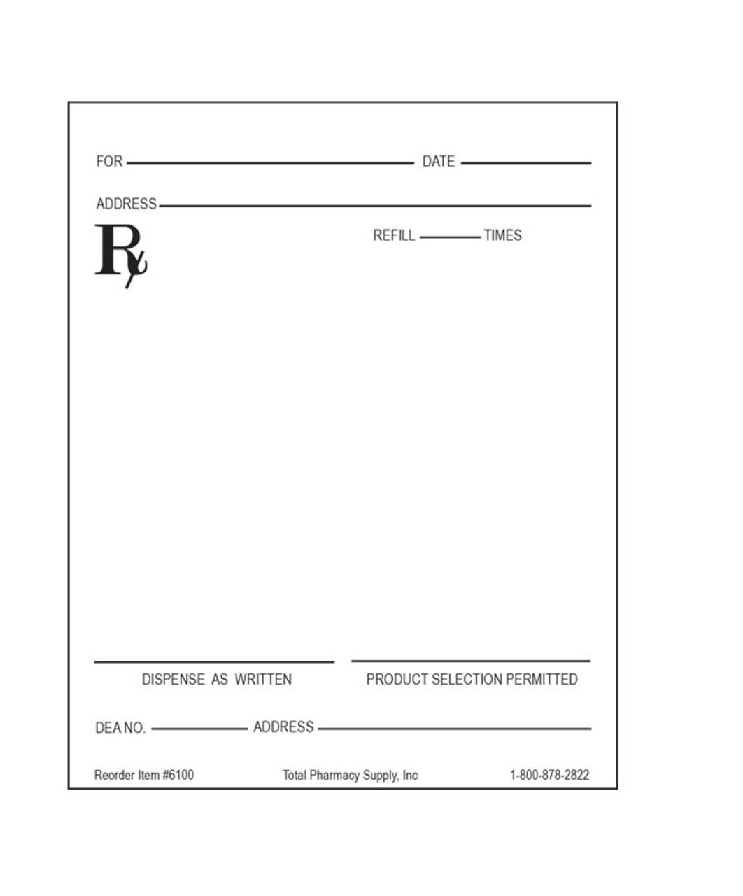
Treatment Orders
The treating physician is a pulmonologist in town.
He writes the following order ---
You contact him to discuss this plan, because it is not the same as what is listed in the DSHS SDOs.
Discontinue pyrazinamide and ethambutol.
Keep patient on rifampin.
Increase isoniazid to 20mg/kg (low-level resistance).

Slide 22
Option A
You document discussion with the physician in the patient’s medical record.
Option B
You respectfully inform the physician you cannot complete the order.
You place a PIOS order for more INH at the higher dose.
The physician assures you of this order.
Go to slide 23
Go to slide 26

Slide 23
Option A
It’s been nearly six months. EMB and PZA were discontinued after the initial phase, and the patient has had 87 DOT doses of high-dose INH, RIF and needs 43 more doses to complete therapy.
You contact DSHS TB Unit for an unrelated question and mention this patient.
The nurse inquires more and reminds you that INH resistance, event low level, no longer uses high-dose INH. A consult is suggested.
Notes:
You have a busy Friday catching up on emails from DSHS, following up with persons reported to you, clinic visits, and patient phone calls.
On Monday when you come into the office, you find out her DSTs have resulted: She is pan susceptible. The treating physician discontinues the ethambutol.

Slide 24
Re-Start Therapy From the Beginning
HNTC recommends the following:
    Basically, any doses after you stopped EMB and PZA are not adequate. I would recommend:
    Repeat a CXR now to establish a new baseline
    Collect sputum x 3 to ensure he has not developed additional resistance
    For his weight of 88 kg, treat with:
      Rifampin 900 mg daily (I would increase the dose just in case)
      EMB 1600 mg daily
      PZA 2000 mg daily
      Linezolid 600 mg daily x 2 months
    Repeat CXR at 2 months of treatment (at the end of linezolid doses) to assess response to treatment
  You must start TB therapy from the beginning.
  The patient is beyond upset.
Notes:
You have a busy Friday catching up on emails from DSHS, following up with persons reported to you, clinic visits, and patient phone calls.
On Monday when you come into the office, you find out her DSTs have resulted: She is pan susceptible. The treating physician discontinues the ethambutol.

Slide 25
Check in: Was this the right option?

Slide 26
Option B
You inform the physician that you cannot move forward with the regimen, showing the SDOs indicating how to address low-level INH resistance.
The physician is annoyed but tells you that you may submit a consult.
HNTC recommends a regimen consistent with INH and OFX resistance:
  RIF, EMB, PZA, Linezolid
Notes:
You call her, she picks up, and you ask if she is returning tomorrow as scheduled.
She informs you that her aunt became ill and therefore she will be staying an additional week. She is apologetic but says she cannot return home.
She also tells you to nurse from Oklahoma called her in the morning to see if she was okay, and she told the nurse her plans.
She said the nurse was planning on seeing her tomorrow morning.

Slide 27
Option B
You share results with the physician who orders the new regimen.
You are thankful the patient had remained on PZA and EMB so that you could continue dose counting until treatment completion.
Notes:
You call her, she picks up, and you ask if she is returning tomorrow as scheduled.
She informs you that her aunt became ill and therefore she will be staying an additional week. She is apologetic but says she cannot return home.
She also tells you to nurse from Oklahoma called her in the morning to see if she was okay, and she told the nurse her plans.
She said the nurse was planning on seeing her tomorrow morning.

Slide 28

Option B
Notes:
You check your VM and sure enough there is a message from the NCM from Oklahoma. She says she is very busy with other patients but since you had given her the head’s up of the trip, She’s all over it- she included this person in her schedule and can get the patient what is needed.
You agree to share updated DSTs and recommended medication orders.
The Nurse says he will be DOTing the person since his state does not do VDOT yet. He will inform you when the patient is able to return to Texas.

Slide 29
Check in: Was this the right option?

Slide 30
TB Case Study: Respiratory Isolation
Heartland National TB Center

Slide 31


Slide 32
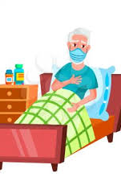
Initial Presentation
A 71-year-old Caucasian male presented to the Emergency Department (ED) after experiencing gross hemoptysis.
He had a 2-month history of cough, a 25-pound weight loss, night sweats, and fatigue.
A CXR revealed bilateral cavitary infiltrates.
The initial sputum was smear positive 4+ and was submitted for a NAA, culture, and sensitivity.
The patient has a history of heavy alcohol and drug use. He is HIV negative, Hepatitis B and C positive, has a long history of cigarette use, and a chronic smoker’s cough.
The patient resides with his wife and three grand- children (ages 9, 7, and 2 years old).

Slide 33
Questions
The patient was admitted to the hospital, should he be placed in an Airborne Infection Isolation (AII) room?
No, TB has not been confirmed yet.
No, he should be admitted to a private room because he probably has lung cancer and isolation would be too distressing.
No, he can be admitted into a shared room.
Yes, he should be placed in an AII room.
Notes:
Answer: D. Yes, he should be placed in an AII room. Rationale: The patient is AFB smear positive 4+, which suggests that he is probably very infectious and should be isolated in a room with proper environmental controls for airborne precautions.

Slide 34
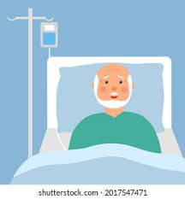
TB Therapy Begins
The patient’s NAAT was positive for M. tuberculosis.
He was immediately started on a standard four drug regimen and tolerated the medications well.
After four days of hospitalization the physician called the local health department to report the person with TB disease and his intention to discharge the patient with a prescription for INH, RIF, PZA, EMB, and vitamin B6.

Slide 35
Questions
2) What is the appropriate response for the request to discharge?
Document the patient information, fill the prescription as ordered and proceed with discharge plans.
Document the patient information and inform the physician that the patient cannot be discharged until the prescription is filled by the local health department.
Document the patient information and inform the physician that the patient does not meet the standard criteria for discharge.
Document the patient information and discharge the patient with a follow-up appointment to the local health department.
Notes:
C. Document the patient information and inform the physician that the patient does not meet the standard criteria for discharge (see Appendix C). Rationale: The patient does not meet the criteria for discharge from hospitalization to the home with high-risk individuals. He has not had three consecutive negative smears, has not received medications for a minimum of 10 days, and documentation of clinical improvement has not been noted.7

Slide 36
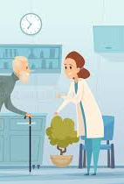
In the Hospital
The patient was fairly cooperative during the first week of hospitalization, however, the nursing staff reported the patient had been out in the hallway without his mask.
The hospital staff was becoming anxious, so the physician called the local health department to coordinate the discharge.
The patient was visited in the hospital by a nurse from the local health department to coordinate his discharge.
Based on recommendations from the local health department, the mother made arrangements to have the children stay next door.

Slide 37
Questions
3) What is the appropriate response to the physician’s request for discharge?
Agree to coordinate discharge as long as the patient is on DOT.
Advise the physician to delay discharge until 3 consecutive negative smears are received, patient has received a minimum of 10 days of treatment, and is clinically improving; or home arrangements have been made.
Agree to coordinate the discharge since the patient is a nuisance in the hospital and keeping him there is doing more harm than good.
Deny discharge until susceptibilities are known.
Notes:
Answer: B. Advise the physician to delay discharge until 3 consecutive negative smears are received, patient has received a minimum of 10 days of treatment, and is clinically improving; or home arrangements have been made. Rationale: Local health departments are pressured to agree to discharge patients for various reasons. Pediatric patients exposed to TB are at high risk of developing severe forms of TB disease once infected; advocating for their protection is a critical role for public health.7

Slide 38
Questions
4) Regarding respiratory isolation precautions, what is an important task of this hospital visit?
Educate the patient on TB infection control (home isolation precautions) in the home.
To avoid a missed dose, have TB medications ready for the patient.
Confirm that the patient completely understands the pathophysiology and transmission of TB.
Establish a referral for smoking cessation classes.
Notes:
A. Educate the patient on TB infection control (home isolation precautions) in the home (see Appendix C). Rationale: It is important to educate the patient on steps to take to prevent the further spread of TB while in home isolation. Education should include instructions on cough etiquette, isolating self to a room, and/or not allowing visitors into their home until they are no longer infectious.4

Slide 39

When Home…
The patient was discharged home and was adherent to home isolation precautions during the first week.
Sputa were obtained by the local health department during his first week home, the results were still positive (1+ AFB smear, 0 AFB smear, 1+ AFB smear) and home isolation continued.
At the next visit the patient was not home.
The wife shared that “he got stir crazy,” went drinking with his friends Friday night, and has not been back since.

Slide 40
Questions
5) What should the local health department do at this point?
Ask the wife’s assistance in locating the patient and leave contact information with instructions to call the local health department when the patient returns.
Leave TB medications with the wife for the patient to self-administer.
Report patient to police.
No action needed.
Notes:
A. Ask the wife’s assistance in locating the patient and leave contact information with instructions to call the local health department when the patient returns. Rationale: It is important to reinstitute home isolation because the patient has documented signs of TB disease and remains infectious despite treatment.4

Slide 41
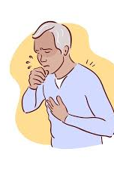
Two Weeks Later…
Two weeks later, the patient was found at a relative’s house.
After re-educating the patient, he was adherent to the respiratory isolation precautions.
During this time, three consecutive sputa results were reported as negative, his symptoms improved, and he remained on an appropriate TB treatment regimen for two weeks.
At that point, the local health department discontinued respiratory isolation precautions.

Slide 42
Reflection
In this scenario, the patient presented to the ED with symptoms consistent with TB and was evaluated appropriately by the ED physician.
Due to his positive AFB smears and his potential to infect others, the patient was immediately placed in an AII room.
Because TB is a communicable disease additional criteria is required prior to discharge.
The local health department should encourage the hospital to refrain from discharging the patient until three consecutive sputa results are received.
However, there may be situations that the local health department will need to work with the patient in making alternative living arrangements in the event that he/she is discharged prior to receiving negative results.
Further, if the patient is released prior to negative results, the patient is considered contagious, and it is the responsibility of the local health department to locate the patient and place him back on respiratory isolation precautions.

Slide 43
Questions?

