Slide 1
Who is at Risk of TB?
Annie Kizilbash, MD, MPH
September 25, 2025
Screening and Treating Tuberculosis (TB) Infection
Heartland National TB Center,
El Paso, Texas

Slide 2
Disclosures

Slide 3
Objectives
Describe the current epidemiology of TB in Texas, the United States and globally
List the groups of people who are more likely to be exposed to or infected with Mycobacterium tuberculosis
List risk factors for progression to TB disease if infected with M. tuberculosis
Notes:
3

Slide 4
What is the Current Epidemiology of TB in the US and along the US/Mexico Border?

Slide 5
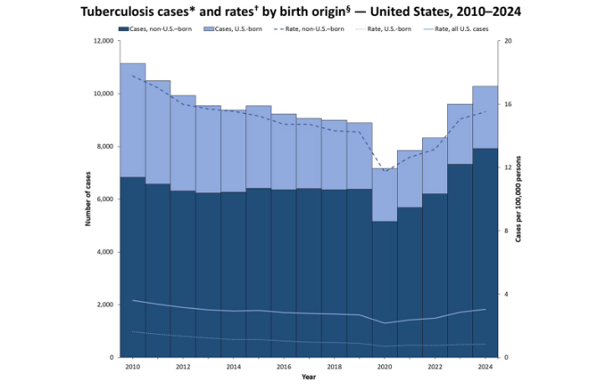
In 2024, 10,347 TB cases were provisionally reported with a corresponding rate of 3.0 cases per 100,000 population. This is the highest number of cases reported since 2013 (9,556).
Notes:
During COVID there was a decline in the number of reported cases in 2020 and as expected the number of reported cases and the incidence rate slightly increased over the last couple of years. In 2022 there were…

Slide 6
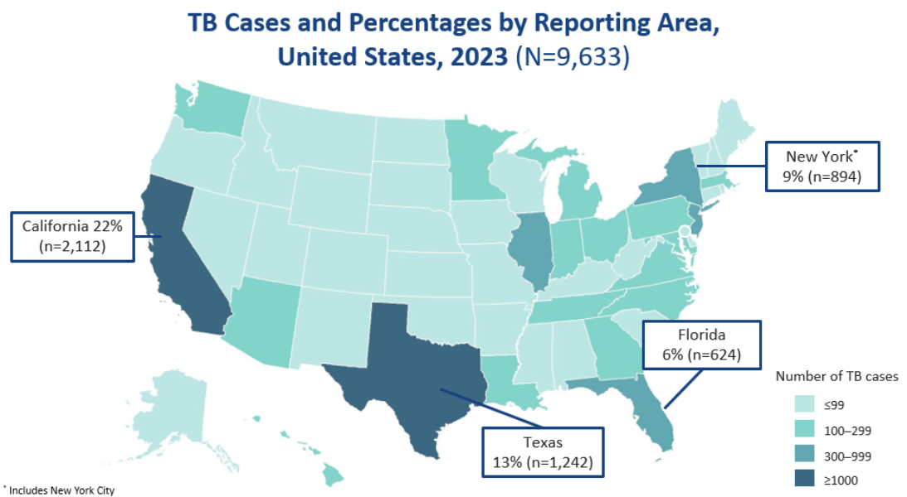
Notes:
These 4 states make up about half of all TB cases in the US

Slide 7
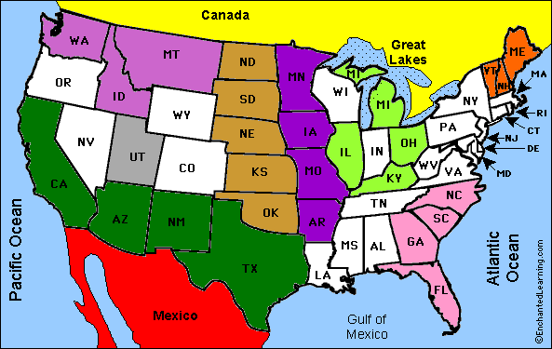
US/Mexico Border States

Slide 8
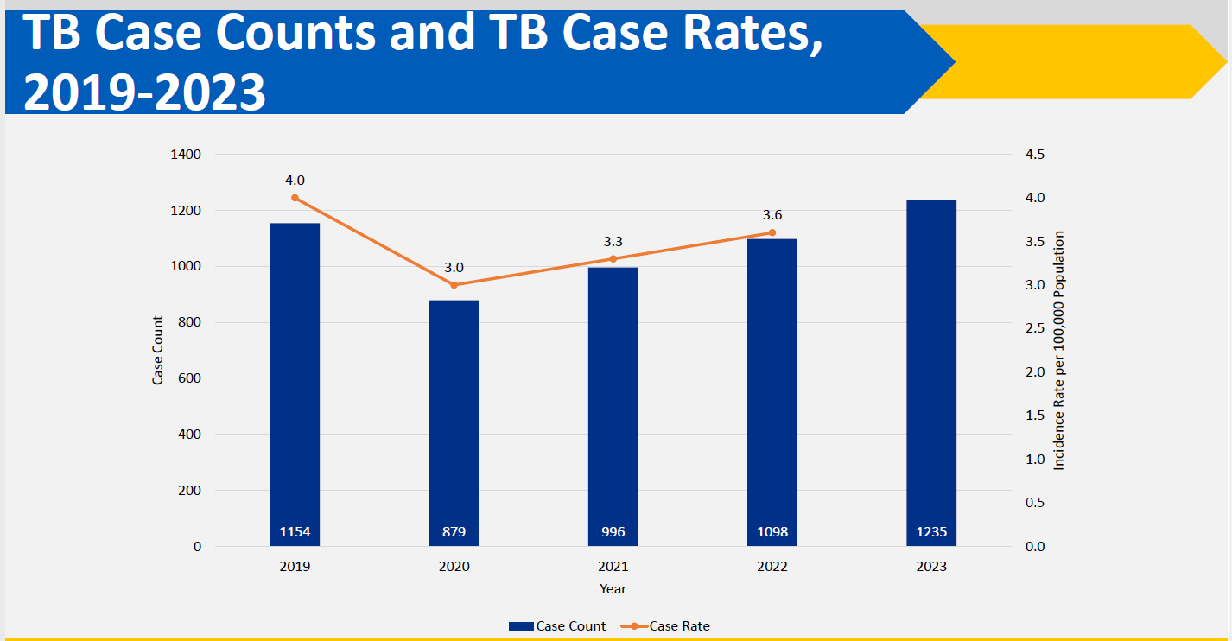
Texas
*2023 data are provisional and subject to change

Slide 9
Geographic Distribution of TB in
Texas Communities, 2023*

Slide 10
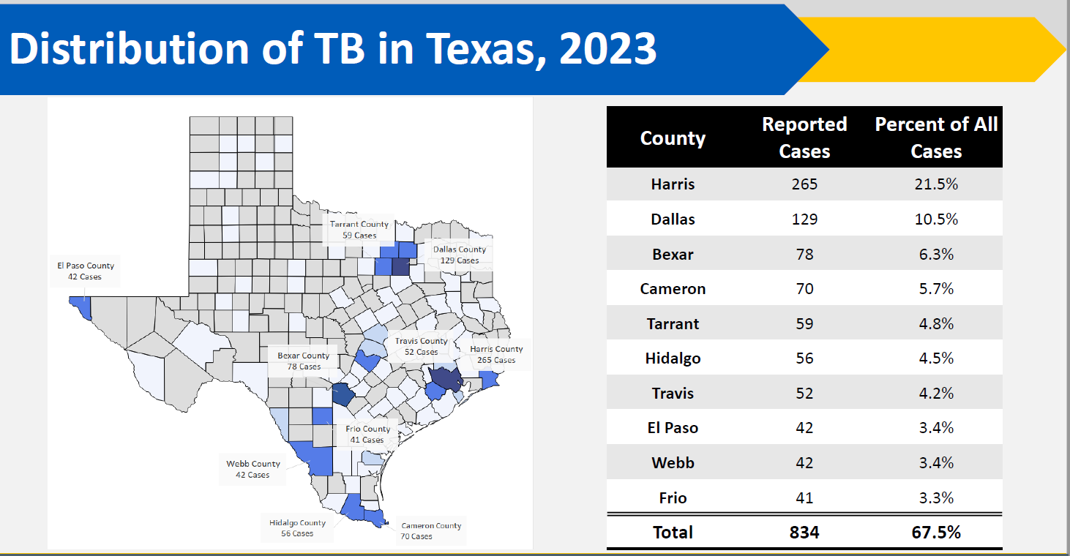
Notes:
Tyler is in Smith County

Slide 11
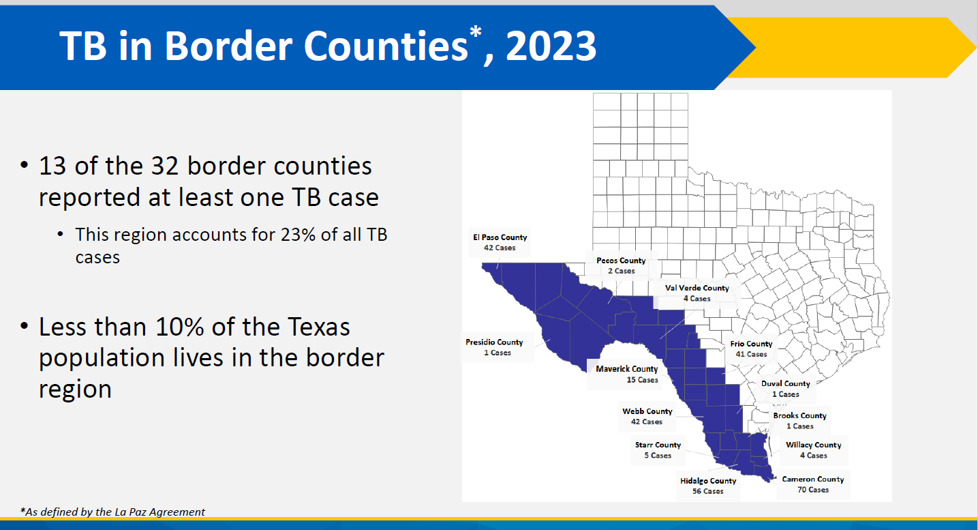
Notes:
A border county is any county within 100 miles of the US Mexico border. There are 32 border counties in Texas and these accounted for 23% of all TB cases in Texas even though less than 10% of the Texas population lives in these counties.

Slide 12
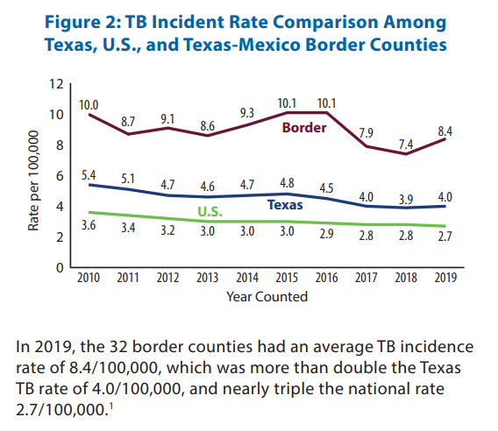

Slide 13
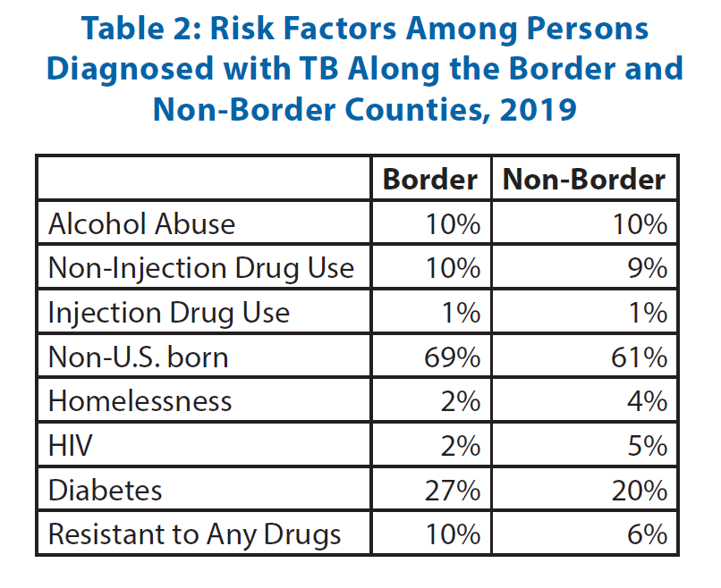

Slide 14
Who is more likely to be exposed or infected with Mycobacterium tuberculosis ?

Slide 15
Pathogenesis of Tuberculosis
Exposure to TB bacilli
No infection (70-90%)
Infection (10-30%)
Latent TB (90%)
-will never develop active TB
-not infectious
Active TB(10%)
-5% develop TB within 2 years
-5% develop TB years later
Notes:
In order to disucss this we need to understand a little about the pathogenesis of tuberculosis..one has to be exposed to TB bacilli. In 7-90% of cases infection does not occur at all in spite of the exposure. 10-30% will develop infection with TB in whom 90% will remain with latent or dormant TB without devt of signs of symptoms and are not infectious to others. 10% of immune competent hosts will develop active TB, half or 5% within the first 2 years of infection and 5% any time in the remainder of their lifetimes.

Slide 16
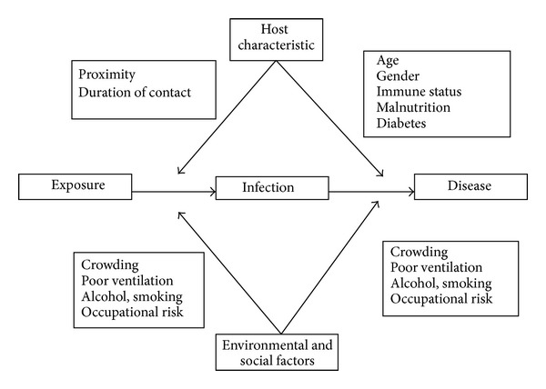
Risk Factors for Tuberculosis
Notes:
In summary there is a complex interplay of various risk factors which affect exposure to TB bacilli, the development of TB infectious and the development and manifestations of TB disease!

Slide 17
Who is more likely to be exposed to
M. tuberculosis?
Foreign born persons from countries with a high incidence of TB disease
Residents and employees of high-risk congregate settings (e.g. correctional facilities, long term care facilities)
Healthcare workers
Contacts to persons with infectious TB disease
Persons who spend time in shelters
Persons who use illicit drugs

Slide 18
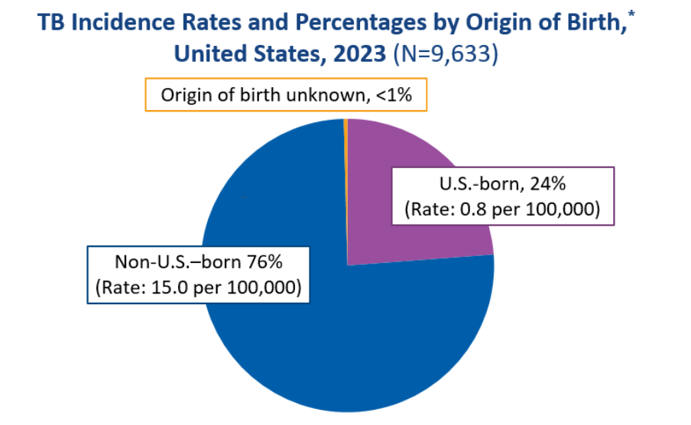
Incidence of TB Global vs. USA
Globally: In 2022
  10.6 million estimated cases of TB disease
  133 per 100,000 population
USA: In 2022
  8,300 TB disease cases reported
  2.5 cases per 100,000 population
Global Tuberculosis Report WHO Report 2023
MMWR March 2023
Notes:
Numbers of TB cases and disease incidence were highest in the WHO South-East Asia and Africa regions, and 9% of cases occurred among persons with HIV infection. Rifampicin-resistant (RR) or multidrug-resistant (MDR) (resistance to at least both isoniazid and rifampicin) TB occurred among 3.6% and 18% of new and previously treated TB cases, respectively (5.6% among all cases).
In order to understand why foreign born in the US have an increased risk for TB, we have to know a little about TB epidemiology. Globally in 2013 there were estimated to be 9 million cases of TB which is a case rate of 3 per 100k population. In the US in 2013 in contrast there were 9588 cases in 2013 which is a case rate of 3 per 100k. The incidence of TB is therefore much higher in many countries compared to the US.

Slide 19
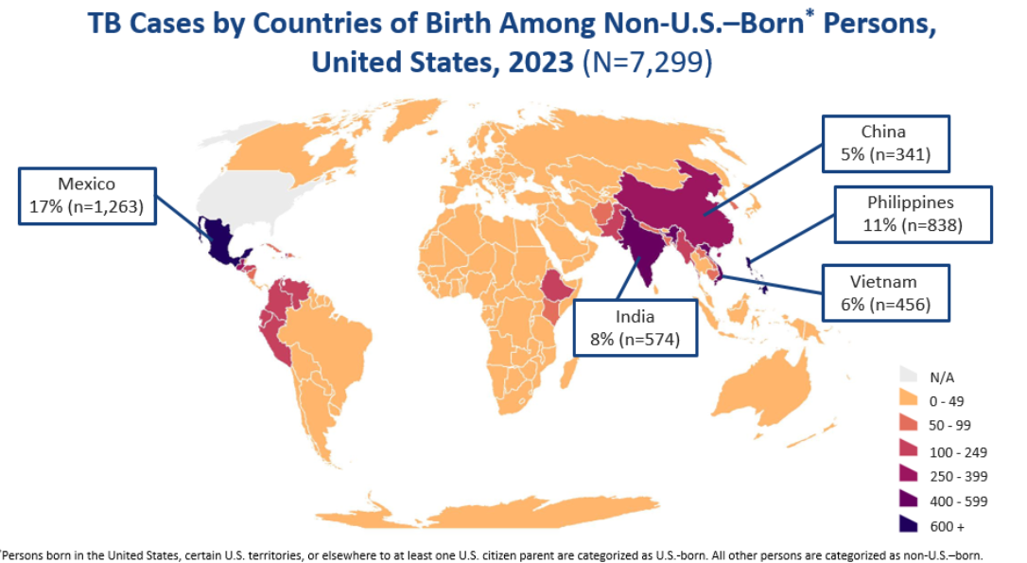

Slide 20
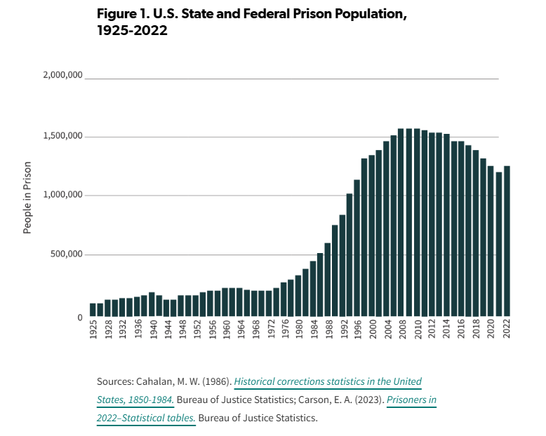
Correctional Facilities and Risk for TB
Notes:
Congregate living situations are also a risk factors for TB in the US of which correctional facilities play an important role.
You can see that the number of americans incarcerated has gone up exponentially over the last several decades for three reasons primarily : 1)Harsher sentences for drug crimes – mandatory criminal sentence 2)Mental institutions were closed down 3)Increasing in flux of undocumented persons in the US.

Slide 21
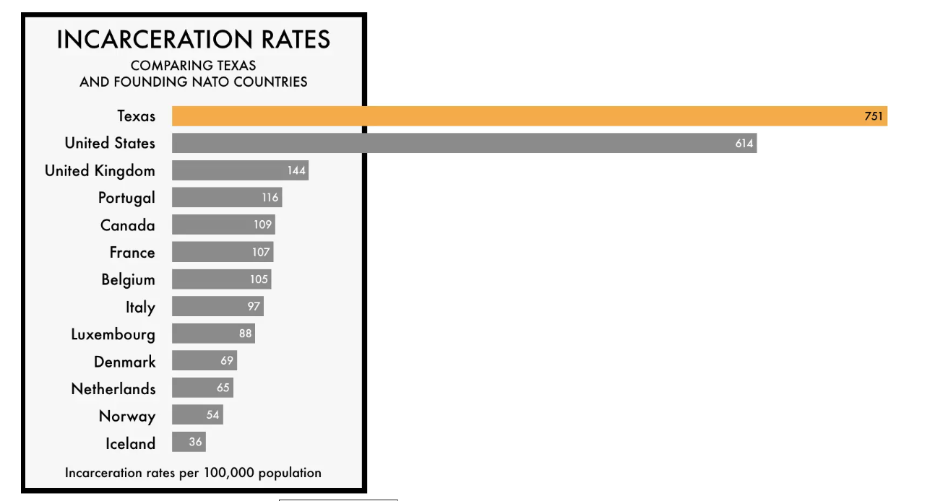

Notes:
The US leads the world in terms of the rate of incarceration of its citizens.
The Organisation for Economic Co-operation and Development (OECD) is an international organisation that works to build better policies for better lives.

Slide 22
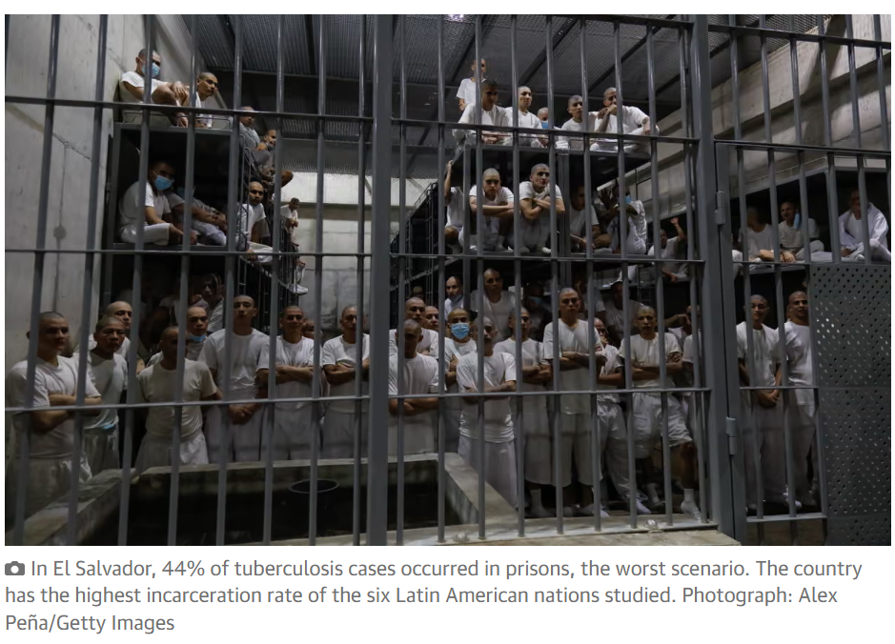
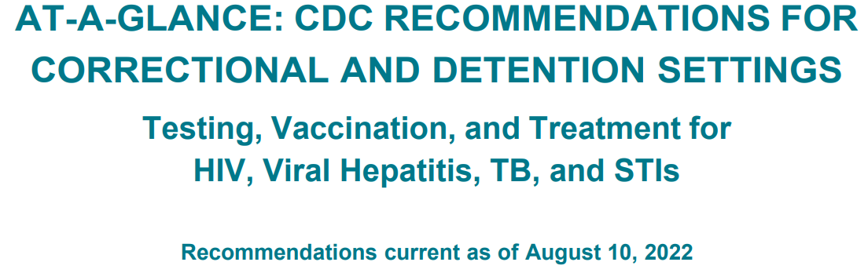
Correctional facilities and Risk for TB
  Prevalence of LTBI among inmates high
    49 correctional facilities in 12 states, 198102 inmates , 17% TST positive
      Treatment for latent TB in correctional facilities: a challenge for TB elimination; Loboto MN; Am J Prev Med. 2003; 24:249-53
  Correlation between length of incarceration and positive TST
    8% LTBI newly incarcerated, 5% increase with each year
      Active and latent tuberculosis in Brazilian correctional facilities: cross sectional study; Carbone; BMC Infectious Diseases 2015
  Substantially higher TB disease cases rates in correctional populations
    E.g. New Jersey (1994) - 91.2 cases per 100,000 (11 cases per 100,000 among all residents)
Notes:
In terms of risk of TB. A study was conducted looking a 49 correctional facilities in 12 states and 198102 has TST. Of these 17% were read as positive.
A cross sectional study in Brazil published this year found that 8% of the newly incacerated population had LTBI and there was an increase in the prevalence of LTBI by each 1 year of incaceration.
It is also known that the rate of active TB is significantly higher than in the general population and I gave an example here the rate of TB in New Jersey 91.2 per 100k compared to 11 per 100k among general population
In 2013, the% of TB cases which were diagnosed in a correctional facility was 3.9%.
Active and latent tuberculosis in Brazilian correctional facilities (cross sectional study)
8% LTBI in newly incarcerated inmates
LTBI progressively increased by 5% with each year of incarceration

Slide 23

Why ?
At least three factors:
  Those incarcerated are at higher risk for TB
  Physical structure of the facility – inadequate ventilation, overcrowding, close living quarters
  Movement of inmates into and out of facilities
In 2023, 324 (3.6%) persons 15 years of age or older with TB disease were residents of a correctional facility at the time of TB diagnosis.
Notes:
At least three factors contribute to the high rate of TB in correctional and detention facilities. First, disparate numbers of incarcerated persons are at high risk for TB (e.g., users of illicit substances [e.g., injection drugs], persons of low socioeconomic status, and persons with human immunodeficiency
virus [HIV] infection). These persons often have not received standard public health interventions or nonemergency medical care before incarceration. Second, the physical structure of the facilities contributes to disease transmission, as facilities often provide close living quarters (including triple bunks are commonly used to increase capacity in low security facilities), might have inadequate ventilation, and can be overcrowded (9,17–19). Third, movement of inmates into and out of overcrowded and inadequately ventilated facilities, coupled with existing TB-related risk factors
of the inmates, combine to make correctional and detention facilities a high-risk environment for the transmission of
M. tuberculosis and make implementation of TB-control measures particularly difficult

Slide 24
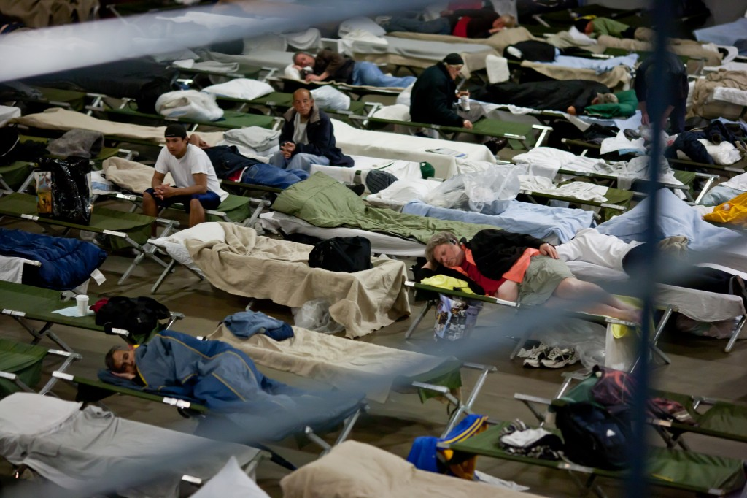
Tuberculosis among the Homeless
TB outbreaks frequently originate in homeless shelters – high risk of recurrence
Homeless – person without a fixed, regular adequate nighttime residence within 12 months preceding the diagnosis of TB
Notes:
– Preventing Another Outbreak through Community Action
There are three main ways in which shelters
can reduce the chances that TB will spread:
• Administrative and work practice control measures
• Ventilation, fi lters, and UVGI
• Staff use of respiratory protection

Slide 25
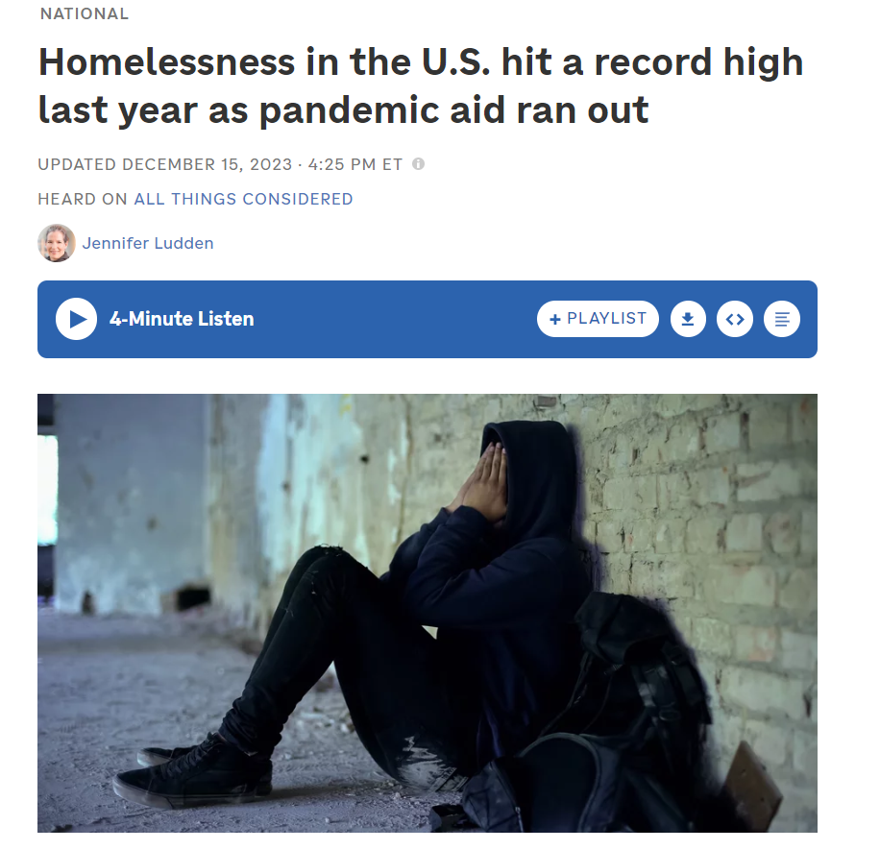
In 2023, among persons 15 years of age or older with TB disease:
695 (8.3%) persons reported ever experiencing homelessness during their lifetime, and
536 (5.9%) persons reported experiencing homelessness within 12 months prior to TB diagnosis.
Notes:
Homelessness in America spiked last year in 2024 by 18% higher than the previous year and reached a record high. This is due to lack of affordable housing, stagnating wages and rising costs, inadequate social safety net systems and other factors.

Slide 26
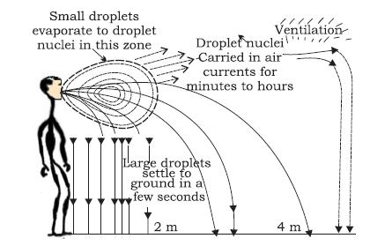
What are environmental factors which increase likelihood of TB transmission?
Poorly ventilated settings
Crowding
Notes:
A person with pulmonary TB can introduce thousands of droplet nuclei into a room space but coughing, sneezing, or talking some of which will contain MTB bacilli. The larger droplets will fall to the ground within seconds but the droplets that are 1-5 um in diameter can remained suspended in the air for hours and when these droplets containing MTB are inhaled it can result in TB infection. It is therefore not surprising that TB transmission occurs often in spaces that are poorly ventilated and overcrowded such as prisons and shelters.

Slide 27

Crowding and Risk of TB Transmission
‘Persons per room’ is widely used an indicator of crowding
  Definition is problematic, varies between countries and temporally
Increases the likelihood of contact between an infectious TB case and a susceptible person and increases intimacy of exposure
  PPD conversion in children living in houses of TB cases is associated with the number of cubic ft/person in house
    Chapman JS. Social and other factors in intrafamilial transmission of tuberculosis. Am Rev Respir Dis 1964
  The number of new TB cases was highly correlated with overcrowding.
    Stein L. Glasgow tuberculosis and housing. Tubercle 1954:35; 195-203
Notes:
In New Zealand, criteria for crowding based on people-to-room ratios have ranged from one to two people per room (Statistics New Zealand 1998). The fall in the persons per room ratio in New Zealand
has been due in part to a decline in household size and in part to an increase in the average size of houses (Morrison 1994). In the 1940s in the United States the definition of crowding was more than two people per room. This was lowered to 1.5 people by 1950 and to one person by 1960, with standards becoming more rigorous as the phenomenon of crowding declined (Myers et al 1996). A ratio of one person per room is in line with the standard prevailing in most European countries. As in New Zealand, current European and North American densities are relatively low by world standards. The persons per room ratio in New Zealand in 1991 was 0.41 (Morrison 1994). In North America it is currently 0.5, “hardly what most people would consider very crowded conditions”. The level of household crowding is somewhat higher in Europe, hovering in the range of 0.6 to 0.8, depending on the specific country, with particularly high levels in Greece, Italy and Portugal (Edwardset al 1994).

Slide 28
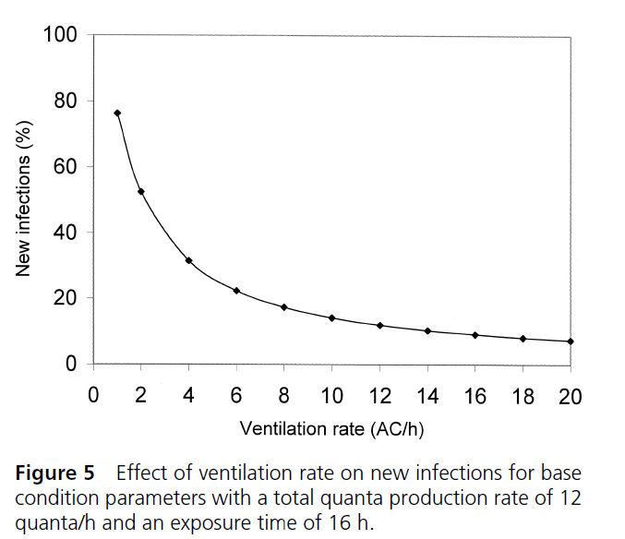
Poor Ventilation and Risk of TB Transmission
Simplistic parametric model
Depends on other factors such as room volume, occupancy density, infectious dose and susceptibility of host
The transmission of tuberculosis in confined spaces: an analytical review of alternative epidemiological models,
Beggs C.B., Int J Tuberc Ling Dis 7(11): 1015-1026, 2003
Notes:
It can be seen in Figure 5 that as the relative ventilation rate is increased, the number of new infection cases drops dramatically for the same exposure conditions. An inspection of equations 13 and 17 reveals that these increased ventilation rates are of benefit because they reduce the quanta concentration in the room air. However, while the greatest benefits are gained through ventilation rate increases in poorly ventilated spaces, the benefits derived by very high ventilation rates are marginal.

Slide 29
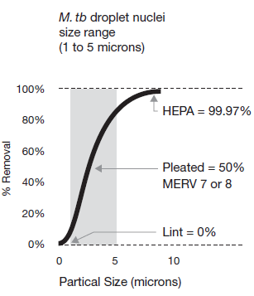
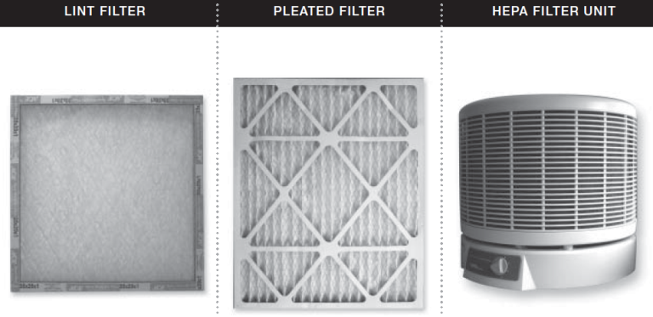
Guidelines for Preventing the Transmission of M.tuberculosis in Health-Care Settings 2005; CDC
Airborne infection isolation room
  Minimum ventilation rate of 12 air changes per hour
  Negative pressure rooms created by exhausting air
  HEPA filters recommended ± UV germicidal irradiation
Notes:
Multiple TB outbreaks occurred in healthcare facilities in the late 1980s and early 1990s. In response, guidelines and regulations were developed and implemented to help ensure safe TB control practices. Investigations of these outbreaks found lapses in administrative,
environmental, and respiratory protection control measures
63% of the droplets are removed with one air exchange, and then with the next air exchange 63% of the remaining particles are removed.
Negative pressure is created by exhausting more air from a room than is supplied to the room so infectious particles are contained within a room by a continuous air current being pulled into the room under the door. Therefore, when the negative pressure room is usedas designed, airborne particles generated in the room cannot escape to the corridor. This creates a ventilation imbalance, called an offset. The room makes up the offset by continually drawing in air from outside the room.

Slide 30

Why are Healthcare Workers Sick of TB?
In low- and middle-income countries annual risk of TB infection in HCWs 3.9% to 14.3% (between 2.6% and 11.3% attributable to occupational exposure).
Joshi R, Reingold AL, Menzies D, Pai M. Tuberculosis among health-care workers in low- and middle-income countries: a systematic review. PLoS Med 2006;3(12):e494.
Annual risk of developing TB disease was three times higher (95% CI:2.43–3.51) for HCWs compared to the general population.
Baussano I, Nunn P, Williams B, Pivetta E, Bugiani M, Scano F. Tuberculosis among health care workers. Emerg Infect Dis 2011;17(3):488–94.
Four occupational drug-resistant TB survivors unite behind ZERO TB and ZERO STIGMA on South African National Women’s Day.
Notes:
Another important group at risk for exposure and infection with TB are healthcare workers.
It a systematic review published in 2006 it was found that the annual risk was….
In another study published in Emerging Inf Diseases in 2011 the annual risk was 3 times higher.

Slide 31
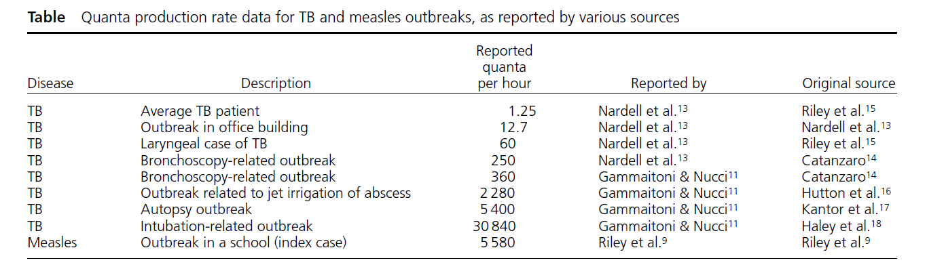
Healthcare Associated Outbreaks
Extraordinarily high rate of production of droplet nuclei containing M. tuberculosis in ‘artificial’ clinically-induced outbreaks compared to ‘normal’ pulmonary TB patients
The transmission of tuberculosis in confined spaces: an analytical review of alternative epidemiological models,
Beggs C.B., Int J Tuberc Ling Dis 7(11): 1015-1026
Notes:
There are many different ways in an healthcare associated TB transmission may potentially occur although we classically think of TB transmission occurring from one person coughing on another. I found this study interesting. In 1955 William Firth Wells at Harvard University definted a quanta as the number of infectious droplet nuclei required to cause an infection in a susceptible person. You can see that 1.25 quanta per hour were produced by an average TB patient which is how we would think most cases of TB are transmitted; whereas in the case of a bronchoscopy related outbreak 250 to 360 quanta were produced per hours, irrigation of an abscess, autopsies, and intubations were all much higher risk because of a greater number of quanta or aerosilization of TB bacilli.

Slide 32
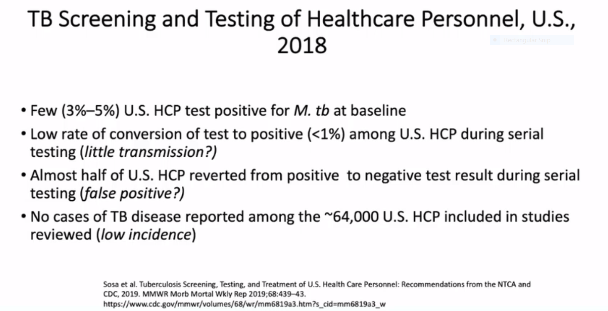

Slide 33
Contacts to persons with infectious TB disease
Factors include:
  Infectiousness of TB patient
  Susceptibility of contact
  Duration of contact
    No safe exposure time has been established
  Proximity of contact
    Difficult to determine
Contact Investigation for Tuberculosis: a systematic review and meta-analysis; Fox G, Eur Respir J. 2013
Notes:
Another group at risk of exposure and infection with TB are those who are contacts to persons with infectious TB disease.
Studies have confirmed the contribution of certain factors to the likelihood of transmission for an index patient to a contact and these form the basis for performing a contact investigation when there a new case of tuberculosis. These factors include the extent of disease in the index patient, the susceptiblity of the contact. Other factors include the duration that the source and the contact are together and their proximity. No safe exposure time to airborne M.tuberculosis has been established. Even a single bacterium can cause disease experimentally in guinea pigs. This may difficult to determine and can only be approximated at best.

Slide 34
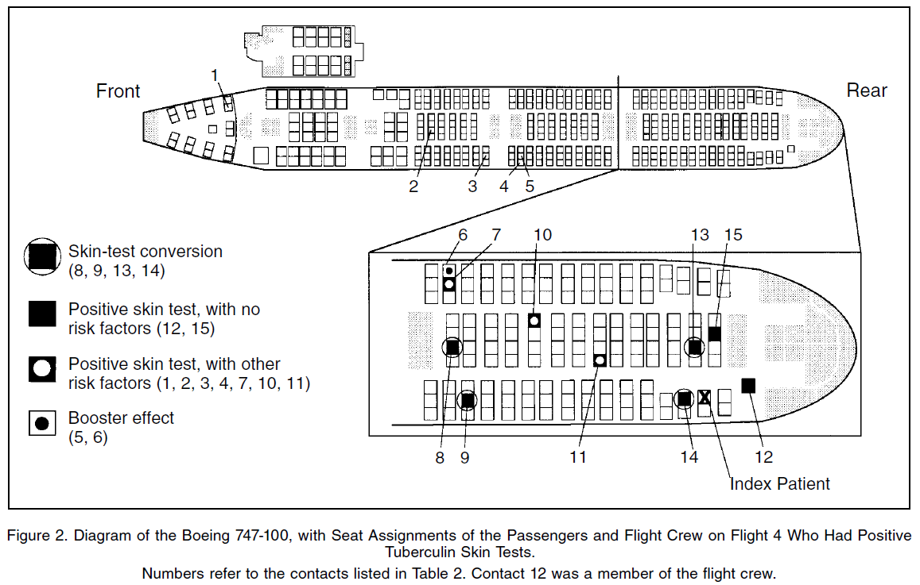
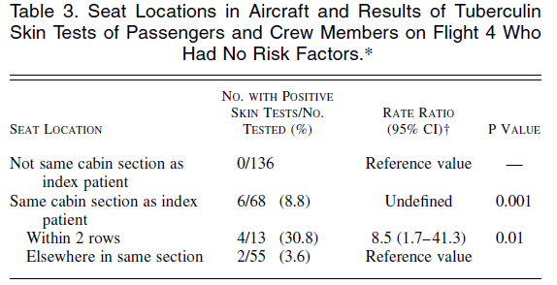
Proximity and Duration of MTB Exposure
32 years old Korean lady MDR pulmonary TB
Flight from Chicago to Honolulu
Flight duration 8.75 hours
15 positive TST
  6 without TB risk factors
Transmission of Multidrug Resistant Mycobacterium tuberculosis during a long airplane flight, NEJM 4/11/96
Notes:
Although we cannot exactly determine what duration and proximity of contact is considered safe there was an investigation published in NEJM almost 20 years ago which tried to assess this investigated how many passessngers aboard a flight with an active multidrug resistant pulmonary TB patient from Korea developed latent TB. They found that there were 15 patients who had a positive PDD and 6 of these patients had no other known risk factors for latent TB. They found that patients who were sitting within 2 rows of the passenger had 8.5 times the risk of developing latent TB than the passengers sitting anywhere else in the same cabin.

Slide 35
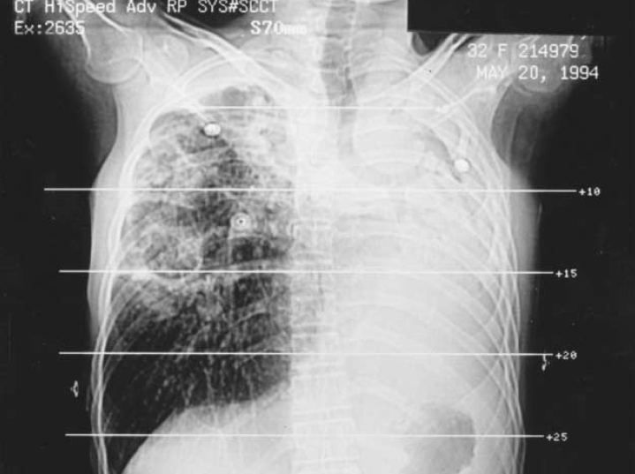
Chest X-ray of Index Patient 8 days after Flight

Slide 36
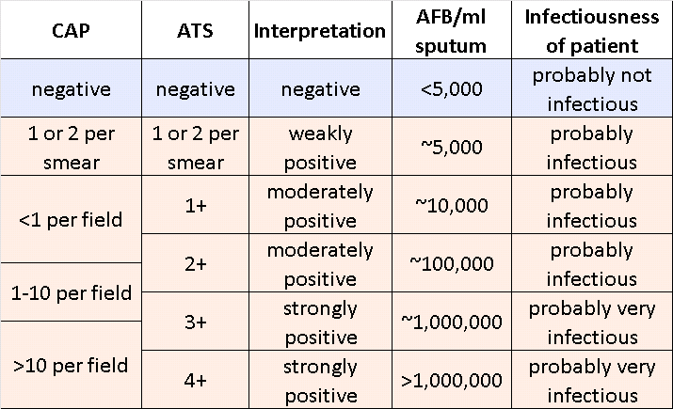
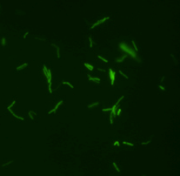
Sputum Bacteriology – AFB smear positive
one microscopic field
Notes:
AFB smear positive sputum is also a risk factors for transmission of TB. You can see in this table that if someone has smear positive sputa there is at least 5000 AFB per ml of sputa. Although AFB smear negative and culture positive patients still have a risk for transmission of TB the risk is relatively lower.

Slide 37

Illicit Drug Use and TB
IDU often share risk factors which confer additional risk for exposure
During 2023, reported types of substance use among persons 15 years of age or older with TB disease were:
  Excess alcohol use (7.9%)
  Noninjecting drug use (7.8%)
  Injecting drug use (1.1%)
‘Shotgunning’ – inhaling and exhaling smoke into another’s mouth – Kansas TB outbreak
Tuberculosis and Illicit Drug Use: Review and Update; Deiss R.G.; CID 2009: 48 Jan 1
A network informed approach to investigating
a tuberculosis outbreak: implications for
enhancing contact investigations. McElroy RD;
Int J Tuberc Lung Dis 2003; 7 S486-93
Notes:
Last but not least a risk factor which all TB providers in the US have to deal with is illict drug use.
The physiological effects of drug use, along with the environment and risk behaviors of drug users, may all contribute to the high prevalence of TB among drug users. A number of in vitro studies have demonstrated deleterious effects of drug use on the immune system [37], with biologic evidence supporting direct impairment by opiates of the cell-mediated immune response [38]. Although the clinical implications of this evidence remain unclear [39], drug use is frequently associated with a number of epidemiological factors, including tobacco use, homelessness, alcohol abuse, and incarceration, and mental health issues that confer additional risk of TB [40–45]. Together, these physiological and epidemiological factors may contribute to observed outcomes—namely, that drug users are more likely to be infectious
[8, 46, 47], to take longer to achieve negative culture [47, 48], and to be at increased risk of mortality [49, 50]. The high prevalence of LTBI and longer periods of infectivity
may further contribute to increased rates of TB transmission among drug users. Evidence from contact investigations [51, 52] and molecular epidemiological studies [6, 53–59] demonstrates that a disproportionate incidence of TB disease among drug users results from TB transmission, and the presence of identical DNA patterns (“clusters”) in TB isolates implies recent transmission [60]. Cluster analysis has been used to identify outbreaks of drug-resistant TB among drug users in England [8] and multidrug-resistant TB in Thailand [2], Argentina [61],
Latvia [62], and Portugal [63]. In the United States, a TB outbreak
occurred at a methadone-treatment facility [64], and 1
patient subsequently became the source case for a hospital outbreak
of multidrug-resistant TB [65]. TB outbreaks among
non-IDUs have also been attributed to sharing drug equipment
or to cramped conditions and poor ventilation [66–70].
“Shotgunning,” a practice of inhaling and then exhaling smoke (e.g., crack cocaine or hashish) directly into another’s mouth, hasbeen reported among 17% [71] and 62% [72] of drug users and was implicated in a South Dakota TB outbreak [73]
4 (44%) of the nine female cases (four of the six who used
crack) reported ‘shotgunning,’ a drug sharing and conserving
practice whereby inhaled smoke (from crack or
marijuana) is exhaled or blown directly from one user’s
mouth into the mouth of another
Doing a shotgun: a drug use practice and its relationship to sexual behaviors and infection risk.
Perlman DC¹, Henman AR, Kochems L, Paone D, Salomon N, Des Jarlais DC.
Author information
¹Beth Israel Medical Center, New York, NY 10003, USA. perlman@aecom.yu.edu
Abstract
There has been a rise in the frequency with which inhalational routes such as smoking are used for illicit drug use. A growing population of new inhalational drug users augments the pool of individuals at risk for transition to injection drug use. Further, illicit drug smoking has been implicated in the transmission of a variety of pathogens by the respiratory route, and crack smoking has been associated with an increased risk of HIV infection, particularly through the exchange of high-risk sex for drugs. Shotguns are an illicit drug smoking practice in which smoked drugs are exhaled or blown by one user into the mouth of another user. We conducted a series of ethnographic observations to attempt to characterize more fully the practice of shotgunning, the range of associated behaviors, and the settings and contexts in which this practice occurs. Shotguns may be seen as a form of drug use which has close ties to sexual behaviors, and which has both pragmatic and interpersonal motivations, combining in a single phenomenon the potential direct and indirect risk of disease transmission by sexual, blood borne and respiratory routes. These data support the need to develop and evaluate comprehensive risk reduction interventions, which take into consideration the relationships between interpersonal and sexual behaviors and specific forms of drug use
The association between alcohol use and tuberculosis has long been known, although there have been inconclusive findings related to various confounding factors, because it is still not known whether the increased risk of tuberculosis is due to the use of alcohol per se or because of the sequelae of AUD, such as liver damage and nutritional deficiency, or social factors, such as crowding, malnutrition, homelessness, and imprisonment, independently of the alcohol consumption. However, in vivo and in vitro studies have demonstrated that alcohol use significantly disrupts the immune response, increasing susceptibility to respiratory diseases such as tuberculosis. ⁴¹

Slide 38
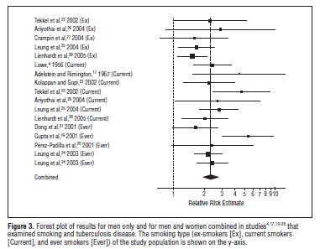

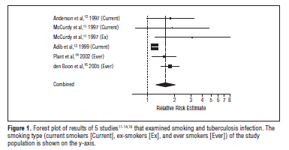
The Effects of Smoking
Smoking associated with RR 1.7 for TB Infection and RR 2.3-2.7 for TB disease
Estimated RR for development. of TB disease in a TB infected population of 1.4-1.6
Risk of Tuberculosis From Exposure to Tobacco Smoke;
Bates M.N.; Arch. Int. Med, Feb 2007
Notes:
A metaanalysis was done by Bates et al in 2007 in order to quantify the relationship between active tobacco smoking and TB infection and TB disease. All relevant articles published between 1953 and 2005. Study Selection: Included were epidemiologic studies that provided a relative risk (RR) estimate for the association between TB (infection, pulmonary disease, or mortality) and active tobacco smoking stratified by (or adjusted for) at least age and sex and a corresponding 95% confidence interval (CI) (or data for calculation). Excluded were reports of extrapulmonary TB, studies conducted in populations prone to high levels of smoking or high rates of TB, and case-control studies in which controls were not representative of the population that generated the cases, as well as case series, case reports, abstracts, editorials, and literature reviews. Data Extraction: Twenty-four studies were included in the meta-analysis. Extracted data included study design, population and diagnostic details, smoking type, and TB outcomes. Data Synthesis: A random-effects model was used to pool data across studies. Separate analyses were performed for TB infection (6 studies), TB disease (13 studies), and TB mortality (5 studies). For TB infection, the summary RR estimate was 1.73 (95% CI, 1.46-2.04); for TB disease, estimates ranged from 2.33 (95% CI, 1.97-
2.75) to 2.66 (95% CI, 2.15-3.28). This suggests an RR of 1.4 to 1.6 for development of disease in an infected population. The TB mortality RRs were mostly below the TB disease RRs, suggesting no additional mortality risk from smoking in those with active TB. Conclusions: The meta-analysis produced evidence that smoking is a risk factor for TB infection and TB disease. However, it is not clear that smoking causes additional mortality risk in persons who already have active TB. Tuberculosis control policies should in the future incorporate tobacco control as a preventive intervention

Slide 39
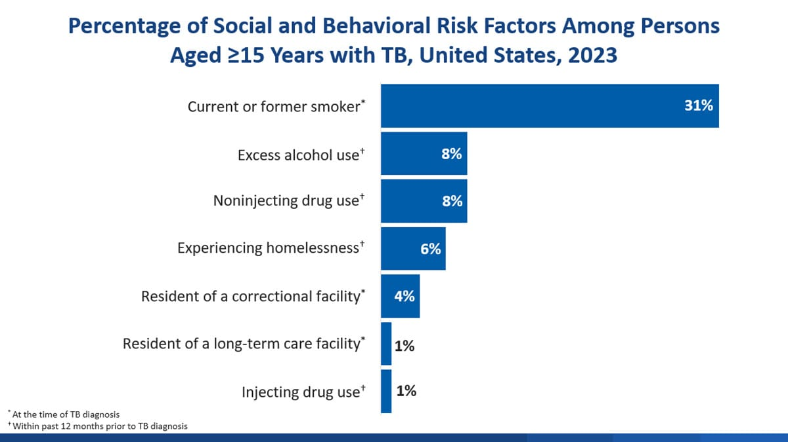
Smoking
Smoking is associated with increased risk of TB disease. In the 2020 RVCT, the definition of "smoking" is consuming tobacco (or nicotine) through:
Combustible tobacco products (e.g., cigarettes)
Electronic nicotine delivery systems (e.g., vapes, e-cigarettes)
In 2023, 2,834 (31.2%) persons 15 years of age or older with TB disease reported being a current or former smoker.

Slide 40
Who is likely to progress to TB disease after infection with M. tuberculosis?
Notes:
So we are moving onto our second objective which was to discuss who is likely to progress to TB disease after infection with MTB occurs.

Slide 41
Risk Factors for Progression to TB disease after infection with M.tuberculosis
Infants and children aged ≤5 years
Notes:
So the first group who are likely to progress after infection are infants and children who are less than 5 years old….more likely to have disseminated disease and TB meningitis as well.

Slide 42
Percent Risk of Disease by Age
Age at Infection | Risk of Active TB
Birth – 1 year* | 43%
1 – 5 years* | 24%
6 – 10 years* | 2%
11 – 15 years* | 16%
Healthy Adults | 5-10% lifetime risk
HIV Infected Adults⁺ | 30-50% lifetime
*Miller, Tuberculosis in Children Little Brown, Boston, 1963
⁺WHO, 2004

Slide 43
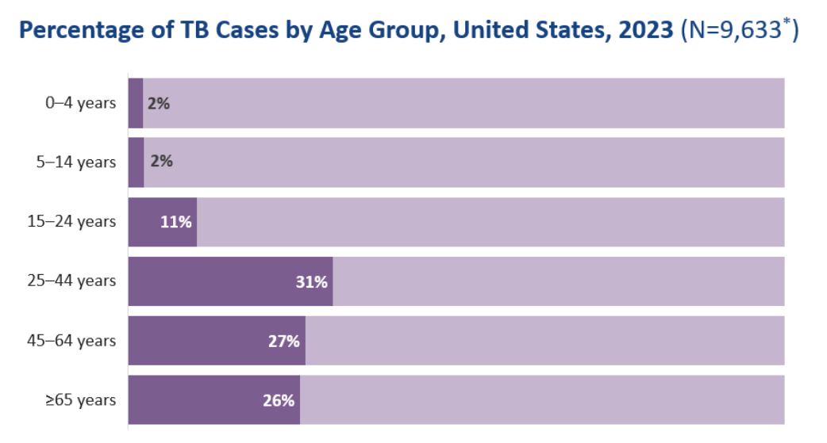
Notes:
17% of US population is 65 and older.

Slide 44
Risk Factors for Progression to TB disease after infection with M.tuberculosis
Infants and children aged ≤5 years
Infected with M. tuberculosis within the prior 2 years
Notes:
The second group are those who are exposed/infected within the 2 years prior since if you remember the slide in the beginning 5 % of patients develop TB within the first two years and 5% during the remainder of their lifetime. The third group which is HIV infection and other medical risk factors

Slide 45
Pathogenesis of Tuberculosis
Exposure to TB bacilli
No infection (70-90%)
Infection (10-30%)
Latent TB (90%)
-will never
develop active TB
-not infectious
Active TB(10%)
-5% develop TB within 2 years
-5% develop TB years later
Notes:
In order to disucss this we need to understand a little about the pathogenesis of tuberculosis..one has to be exposed to TB bacilli. In 7-90% of cases infection does not occur at all in spite of the exposure. 10-30% will develop infection with TB in whom 90% will remain with latent or dormant TB without devt of signs of symptoms and are not infectious to others. 10% of immune competent hosts will develop active TB, half or 5% within the first 2 years of infection and 5% any time in the remainder of their lifetimes.

Slide 46
Risk Factors for Progression to TB disease after infection with M.tuberculosis
Infants and children aged ≤ 5 years
Infected with M.tuberculosis within the prior 2 years
HIV infection and other medical risk factors
Notes:
So the first two groups who are likely to progress after infection are infants and children who are less than 4 years old….more likely to have disseminated disease and TB meningitis as well. The second group are those who are exposed/infected within the 2 years prior since if you remember the slide in the beginning 5 % of patients develop TB within the first two years and 5% during the remainder of their lifetime. The third group which is HIV infection and other medical risk factors

Slide 47
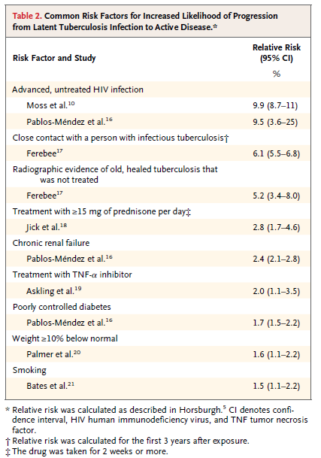
Latent Tuberculosis Infection in the United States, Horsburgh R., NEJM, 4/14/2011
Notes:
So referring back to the same article on latent TB in the US from NEJM. You can see here the common risk factors for progression from latent TB to active disease in this table. This list includes HIV, close contact with a person with infectious TB, prednisone, chronic renal failure, TNF a inhibitors, diabetes, weight >=10% below normal and smoking.

Slide 48
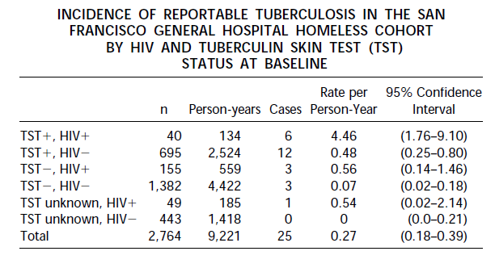
Effect of HIV on Progression from
Latent to TB Disease
Tuberculosis in the Homeless; A Prospective Study
Moss, A.; J Respir Crit Care Med Vol 162. pp 460–464, 2000
HIV infected had about a 10 times higher risk of reactivation than those HIV uninfected
Notes:
So HIV is a risk factor for progression from TB infection to disease. In this study a cohort of 2,774 homeless individuals in San Francisco. There were 25 incident cases during the period of folloup. Ten cases were persons with seropositive HIV. They found that the rate of active TB in for those TST HIV negative patients the case rate was 0.48 per person years whereas for those TST positive at baseline was 4.46 per person year which is about 10 times higher.
.

Slide 49
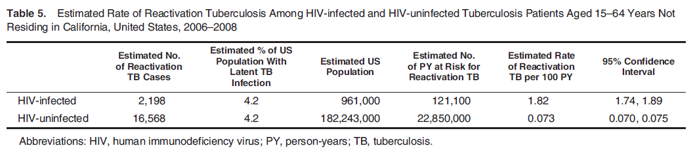
Effect of HIV on Latent TB Reactivation
*HIV infected with 25 times the rate of reactivation of latent TB compared to HIV uninfected
Estimated rate of reactivation of latent tuberculosis infection in the United States, overall and by population
subgroup; Shea KM, Am J Epidemiol. 2014 Jan 15; 179(2):216-25
5.3% of TB patients with known HIV status in 2018 were coinfected with HIV, including 8.6% among persons aged 25–44 years. MMWR 2019
Notes:
In another study it was found that the risk of reactivation of TB per 100person years was 1.82 for those HIV infected whereas it was 0.073 for those who were HIV uninfected. Is this study the risk was 25 times higher.

Slide 50
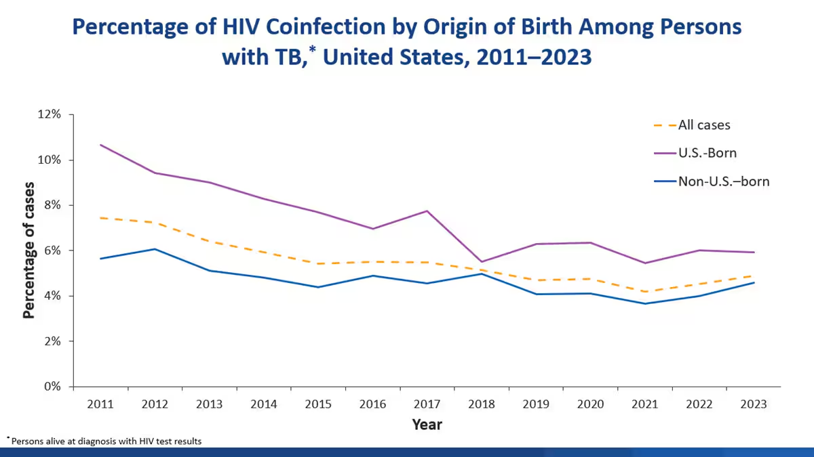
Among persons with TB disease during 2023 who were alive at TB diagnosis and had a known HIV status, 4.9% had HIV coinfection. The percentage of HIV coinfection among persons with TB disease in the United States has been relatively stable since 2018.

Slide 51
Pathogenesis of Tuberculosis
Exposure to TB bacilli
No infection (70-90%)
Infection (10-30%)
Latent TB (90%)
-will never
develop active TB
-not infectious
Active TB(10%)
-5% develop TB within 2 years
-5% develop TB years later
HIV infected – 10% reactivation per year of latent TB
Notes:
In order to disucss this we need to understand a little about the pathogenesis of tuberculosis..one has to be exposed to TB bacilli. In 7-90% of cases infection does not occur at all in spite of the exposure. 10-30% will develop infection with TB in whom 90% will remain with latent or dormant TB without devt of signs of symptoms and are not infectious to others. 10% of immune competent hosts will develop active TB, half or 5% within the first 2 years of infection and 5% any time in the remainder of their lifetimes.

Slide 52

Diabetes and TB
A link between diabetes and TB has been recognized for centuries
Diabetics have increased risk of progression to disease, failure of therapy, relapse and mortality from TB
Tuberculosis and diabetes mellitus: convergence of two epidemics; Dooley K; Lancet Infect Dis. 2009 December; 9(12): 737–746.
Notes:
That a link exists between diabetes and TB has been recognized for centuries. Richard Morton had written a treatise( Phthisiologia) on consumption in 1694 had stated that an association between diabetes had been suggested even in Roman times. Since then multiple studies have been conducted which have demonstrated increased risk of progression, failure of therapy, increased risk of relapse and increased mortality from TB

Slide 53
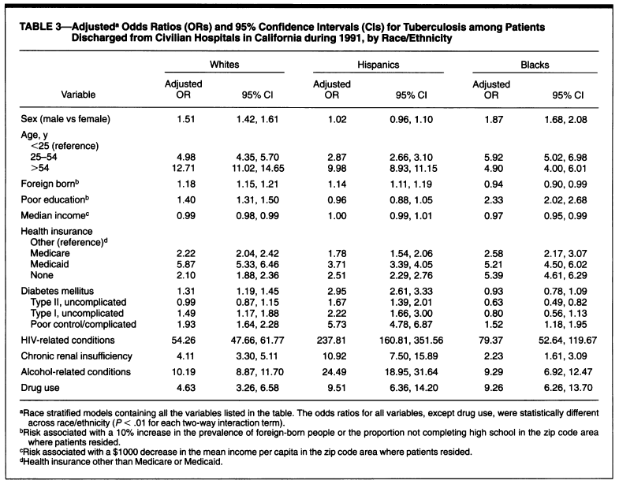
The role of diabetes mellitus in the higher prevalence of tuberculosis among Hispanics;
Pablos M.A.; Am J Public Health 1997; 87:574-9
Notes:
Just to give an example in the study by Pablos from 1997; they found in their case control study that the odd of tuberculosis among diabetics, particularly poor control/complicated diabetes was increased compared to the controls regardless of the race although the effect was pronounced in Hispanics.

Slide 54


Age-adjusted Prevalence of Obesity and Diabetes
Obesity (BMI ≥30 kg/m²)
1994
2000
2013
No Data <14.0% 14.0%–17.9% 18.0%–21.9% 22.0%–25.9% > 26.0%
Diabetes
1994
2000
2013
No Data <4.5% 4.5%–5.9% 6.0%–7.4% 7.5%–8.9% >9.0%
CDC’s Division of Diabetes Translation. National Diabetes Surveillance System available at http://www.cdc.gov/diabetes/statistics
Notes:
Over the last few decades the prevalence of obesity in the US is increasing and with it is the prevalence of diabetes. The hospital where I work we are starting to see patients which no longer are thin and emaciated but are seeing more patients who are overweight. The International Diabetes Federation has estimated that the number of people living with diabetes mellitus (DM) worldwide has been increasing and will rise to 592 million by 2035. This is changing the population over time in whom we see tuberculosis because although HIV has a very high risk of progression to active TB the number of HIV infected patients is relatively low at 35 million and in US 1 million in 2021 whereas the number of diabetics in the US is 38.4 million in 2021 though the risk of progression is less this can result in a larger number of overall cases of TB.

Slide 55
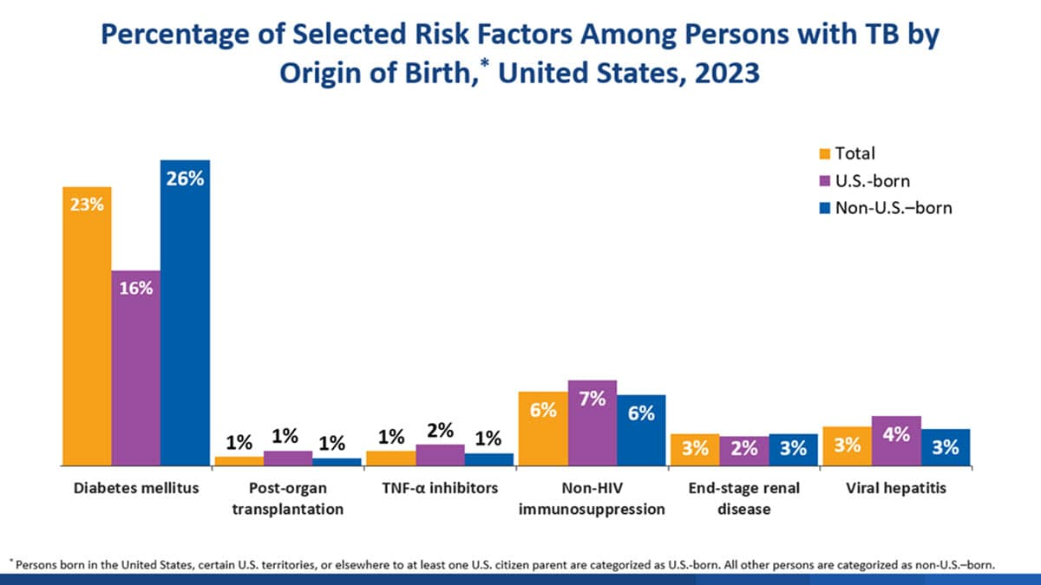
In 2023, 2,251 (23.4%) of persons with TB disease reported also having diabetes mellitus. A higher percentage of non-U.S.–born persons (25.6%) reported having diabetes mellitus compared with U.S.-born persons (16.3%).

Slide 56
Chronic Kidney Disease and TB
The role of diabetes mellitus in the higher prevalence of tuberculosis among Hispanics;
Pablos M.A.; Am J Public Health 1997; 87:574-9
Notes:
Chronic kidney disease is also a medical risk factor for progression of TB and in the same study by Pablos et al. you can see that for development of TB the adjusted OR was significant for those with CKD among all races and the likely reason for this is the effect CKD and ESRD has on immune suppression.

Slide 57
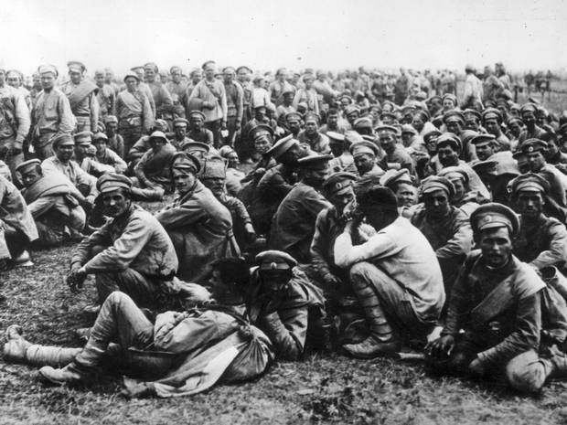

Malnutrition and Progression from Latent to Active TB
Ecologic Study
  Prisoners of War
    British soldiers given food supplements – TB incidence 1.2%
    Russian soliders not given food supplements – TB incidence 15-19%
      Leyton G B. Effects of slow starvation. Lancet 1946; 2: 253–255
Notes:
An important contribution to the early literature on the effects of malnutrition on TB was an ecologic study conducted by Leyton among British and Russian prisoners of war held in German prisoner of war camps during the Second World War. The prisoners shared the same prison diet, but the British received Red Cross food supplements amounting to 30 g protein and 1000 Kcal per day. In a subsequent radiographic survey, the tuberculosis rate among the British was only 1.2% and their plasma proteins were higher than in the Russians, who had a tuberculosis rate of 15–19%. Both groups shared the same living and working conditions and chance for infection. In the malnourished prisoners, tuberculosis was more severe, the onset was more rapid, and patients died rapidly with large pulmonary cavities and massive tissue breakdown. Granuloma formation was poor in the malnourished prisoners, supporting the idea that there was a deficit of CMI in this group.

Slide 58
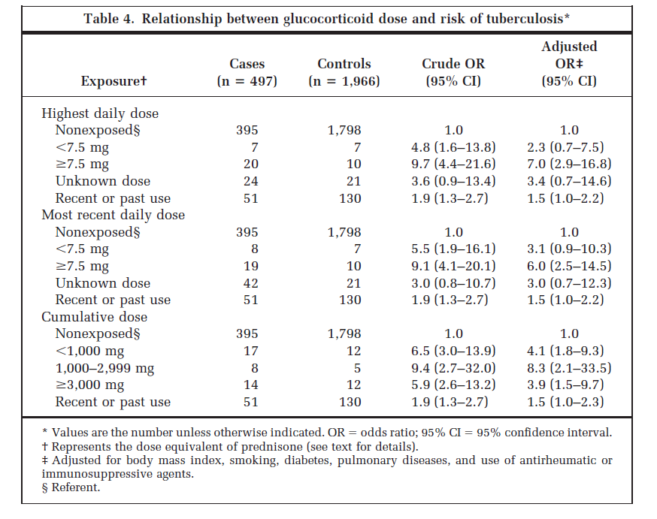
Steroids and TB
CDC guidelines – Prednisone 15mg/day (or its equivalent) administered for 1 month is a risk factor for tuberculosis, primarily because this dosage has been shown to suppress tuberculin reactivity.
However, speciﬁc thresholds of dose and duration that could increase the risk for tuberculosis were unknown
Glucocorticoid Use, Other Associated Factors, and the Risk of Tuberculosis; Jick S; Arthritis & Rheumatism, Vol. 55, No. 1, February 15, 2006, pp 19–26
Notes:
So the prior risk factors are patient driver but what about the use of provider driven risks for progression to active TB? Jicks et all conducted a case control study using a database looking at TB cases in the UK from 1990 to 2001 in order to evaluate the association of glucocorticoids and other purported risk factors with the development of tuberculosis. Cases were patients with a first time diagnosis of tuberculosis accompanied by at least 6 months of treatment with at least 3 different tuberculosis medications. Up to 4 controls were matched to each case on age, sex, the practice attended by the case, index date, and amount of prior computerized records. Results. The study encompassed 497 new cases of tuberculosis and 1,966 controls derived from 16,629,041 person-years at risk (n 2,757,084 persons). The adjusted odds ratio (OR) of tuberculosis for current use of a glucocorticoid compared with no use was 4.9 (95% confidence interval [95% CI] 2.9–8.3). The adjusted ORs for use of <15 mg and >15 mg of prednisone or its equivalent daily dose were 2.8 (95% CI 1.0 –7.9) and 7.7 (95% CI 2.8 –21.4), respectively. Conclusion. These results indicate that patients treated with glucocorticoids have an increased risk of developing tuberculosis, independent of other risk factors.

Slide 59
TNF alpha Antagonists
TNF alpha activity is required for granuloma formation and control of
MTB infection
Used for rheumatoid arthritis, Crohn’s disease, psoriasis and a variety of other immune mediated diseases
Remicaid (inflixamab)
Embril (entanercept)
Humira (adalimubab)
Cimzia (certolizumab)
Notes:
Similar to the effect of steroids. TNF alpha antagonists are another provider induced methods of immune suppression. TNF alpha activity is required for granuloma formation and control of MTB infection . TNF alpha antagonists are used to RA, CD, psor and a variety of other immune mediated disease.

Slide 60
Warning: Risk Of Infections
Infliximab
Tuberculosis (frequently disseminated or extrapulmonary at clinical presentation), …and other opportunistic infections have been observed in patients receiving Remicade some of these infections have been fatal.
Patients should be evaluated for LTBI with a TST.
Treatment of LTBI should be initiated prior to therapy with Remicade.
SEE WARNINGS
        PDR 2004
Notes:
Within a few years after the first TNF alpha antagonist infliximab was approved by the FDA the PDR had a warning which stated that TB ad been observed in patients receiving Remicade. The risk of progression of TB is different for different TNF alpha antoagnists but for all it is recommended to evaluate patients to LFTBI with a TST or QFT prior to their use.

Slide 61
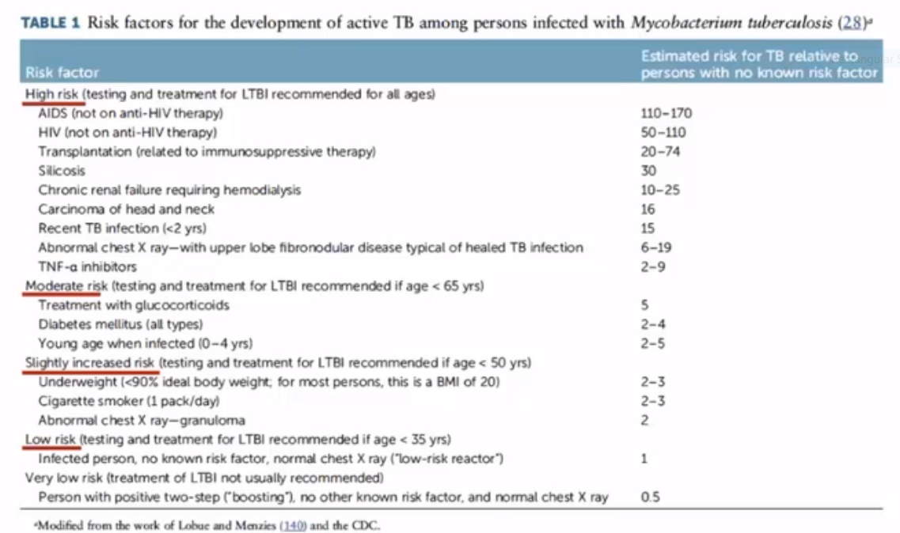
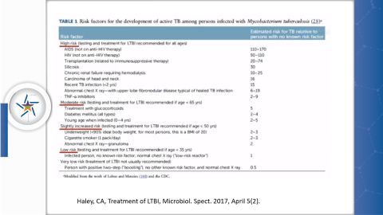
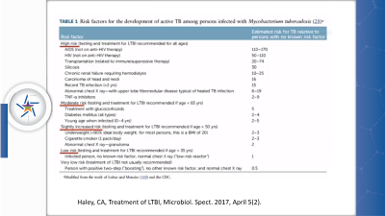
Haley, CA, Treatment of LTBI, Microbiol. Spect. 2017, April 5(2).

Slide 62
Risk Factors for Tuberculosis
Notes:
In summary there is a complex interplay of various risk factors which affect exposure to TB bacilli, the development of TB infectious and the development and manifestations of TB disease!

Slide 63

Thank you!

