Slide 1

TB Infection Diagnosis Recommendations
Lisa Armitige, MD, PhD
Co-Medical Director Heartland National TB Center
Professor of Medicine and Pediatrics University of Texas at Tyler Health Science Center
Screening & Treating TBI El Paso TX
September 25, 2025

Slide 2
Lisa Armitige, MD, PhD has the following disclosures to make:
• Consultant for Oak Therapeutics NIH SBIR

Slide 3

Available Tools

Slide 4
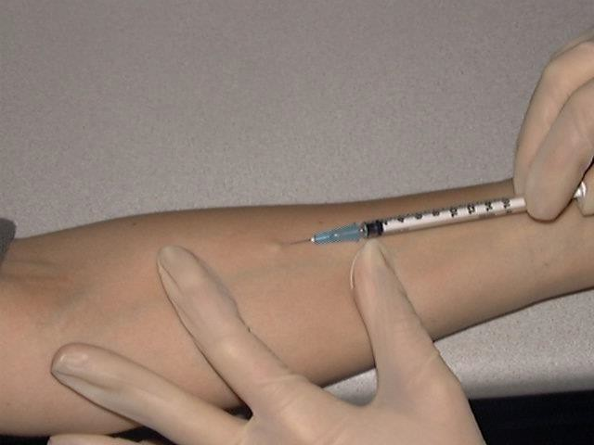
The Tuberculin Skin Test (TST)
0.1 ml of 5 TU PPD tuberculin
injected intradermally
Induration in millimeters read 48-72 hours after injection

Slide 5
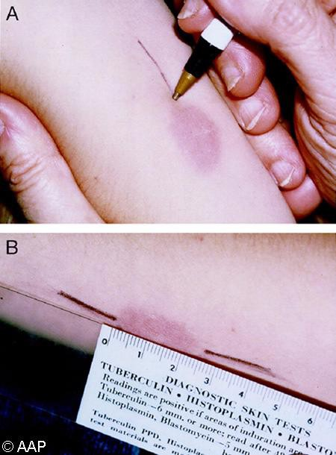
Reading the TB Skin Test
Measure induration, not erythema!!!

Slide 6
TB Skin Test (TST)
Pros:
  Inexpensive
  Simple to perform
(if you know what you are doing)
Cons:
  Must return in 48-72 hrs
  Interpretation is somewhat subjective
  False Negatives:
    Elderly
    Immunosuppressed
  False Positives:
    Low risk populations
    Non-tuberculous mycobacteria
    BCG vaccination

Slide 7
Classifying the Tuberculin Reaction
Requires that you know something about the patient
5 mm is classified as positive in High-Risk Individuals
  HIV/Immune suppressed
  Recent contact with a person with infectious TB
  Persons with evidence of old disease
10 mm is positive in Persons in High-Risk Settings
  Immigrants from countries with high rates of TB (> 20/100K)
  Residents/Employees of congregate settings
15 mm is positive…..period

Slide 8
Antigens for Newer Generation IGRAs
Negative control or nil (e.g., saline, heparin)
Positive control or mitogen:
  non-specific immune response stimulator (e.g., phytohemagglutinin)
M. tuberculosis-specific antigens
  Unlike PPD used in TST, do not cross-react with BCG or NTM (some exceptions)
  ESAT-6, CFP-10 (actually simulated using overlapping peptides)

Slide 9
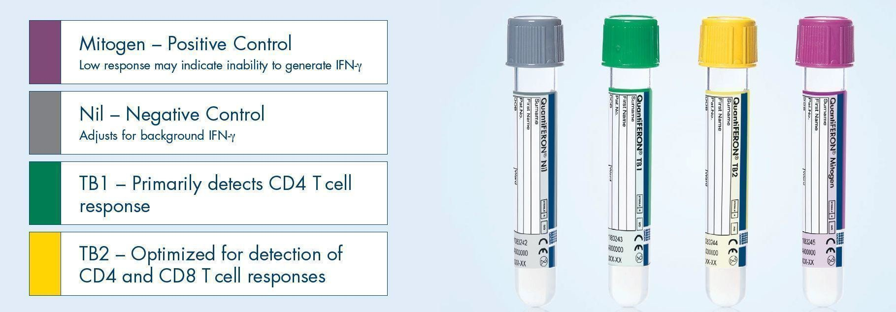
QuantiFERON®-TB Gold Plus
Essentially 2 tests in one blood draw
TB1 and TB2 should be close in value

Slide 10
Interpretation Criteria for the QFT-Plus Test
Nil (IU/mL) | TB1 or TB2 Antigen minus Nil (IU/mL) | TB1 or TB2 (IU/mL) | Mitogen | Interpretation
≤ 8.0 | ≤ 0.35 or < 25% of Nil value | Negative | ≥ 5.0 | M. tuberculosis infection unlikely
≤ 8.0 | ≥ 0.35 and ≥ 25% of Nil value | Positive | ANY | M. tuberculosis infection likely
≥ 8.0 | ANY | Indeterminate | ANY | Indeterminate
≤ 8.0 | ≤ 0.35 and or < 25% of Nil value | Indeterminate | < 5.0 | Indeterminate

Slide 11
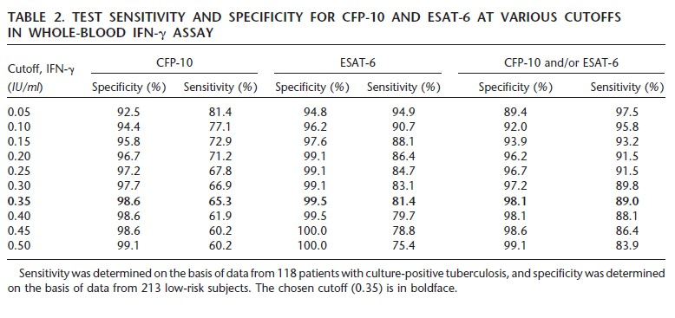
QuantiFERON-TB Gold
Mori et al 2004 Am J Respir Crit Care Med ,170: 59–64

Slide 12
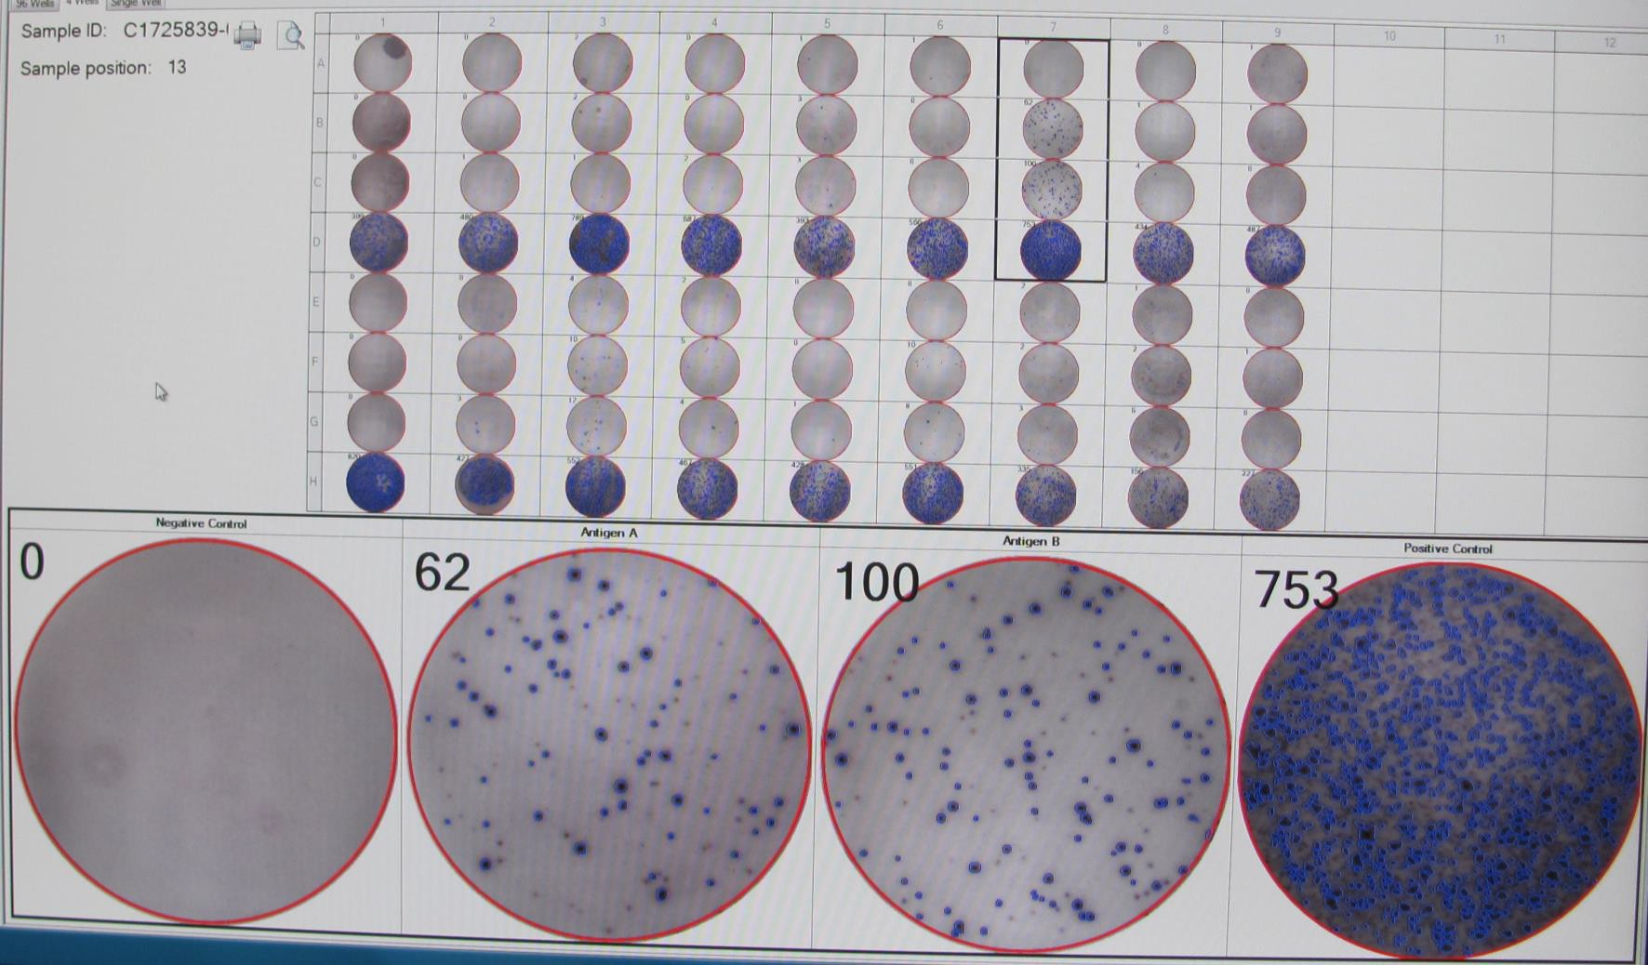
T-Spot.TB

Slide 13
Interpretation Criteria for the T-Spot.TB
Result | Nil* | TB Response## | Mitogen++ | Interpretation+
Positive | ≤ 10 spots | ≥ 8 spots | Any | M.tuberculosis infection likely
Borderline | ≤ 10 spots | 5, 6, or 7 spots | Any | Uncertain likelihood of M. tuberculosis infection
Negative | ≤ 10spots | ≤ 4 spots |  | M Tb infection unlikely
Indeterminate | > 10 ≤ 10 | Any < 5 spots | Any < 20 spots | Uncertain likelihood of M. tuberculosis infection

Slide 14
Pediatric Considerations for TB Screening
Young immune systems, like young bodies, are growing
By the time you have 5 candles on your birthday cake, your immune
system behaves like an adult’s
There is grey area in children < 6 months of age (any test….every test),
treat any positive and some negatives
We overtreat and we are not sorry

Slide 15
TB Test Take Homes
TST expertise is fading fast
  When can I still use it?
    If you trust the person placing/reading it knows what they are doing
    US born
    No history of BCG
    To add sensitivity
    Repeatedly indeterminate or borderline IGRAs
IGRAs are fast becoming the preferred screening tests for TB
  Single visit
  Objective result (positive or negative…..ish)
TB screening tests are tools that add to the answer
  They are not the answer themselves
  They do not distinguish between TB infection (LTBI) and TB disease

Slide 16
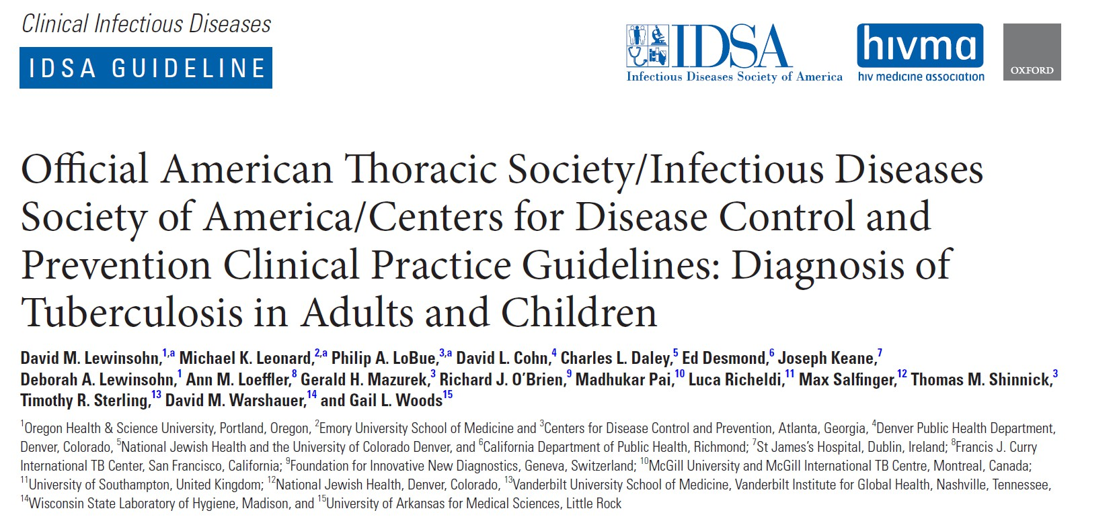
Lewinsohn et al. CID. 2016

Slide 17
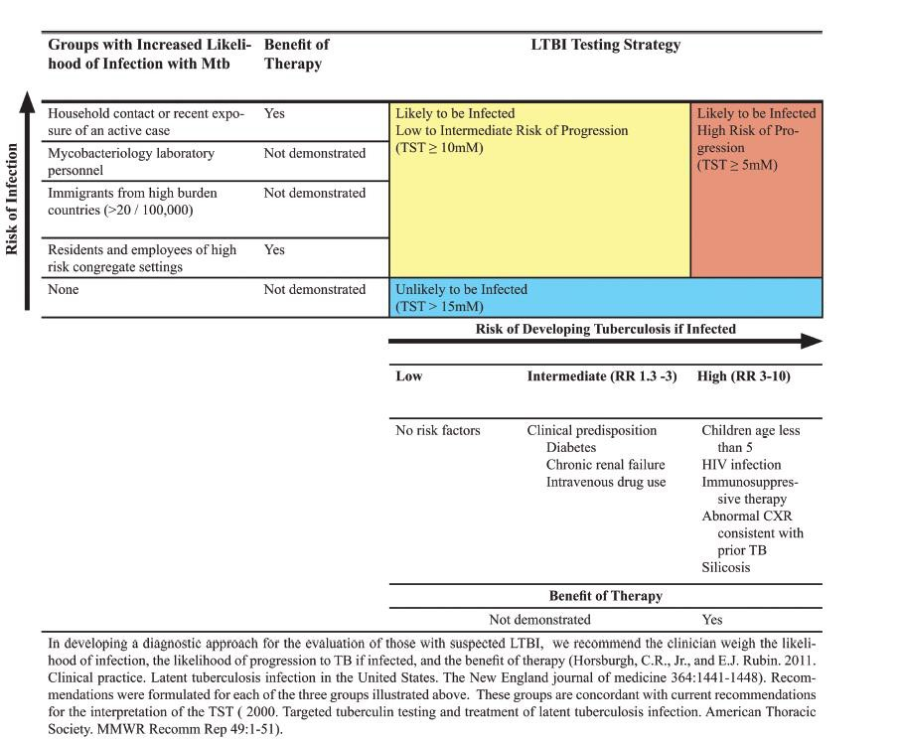
Lewinsohn et al. CID. 2016

Slide 18
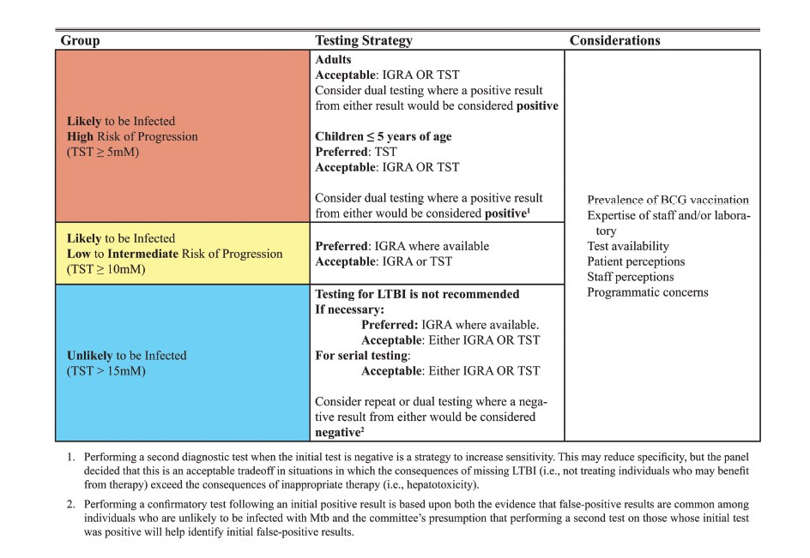

Slide 19
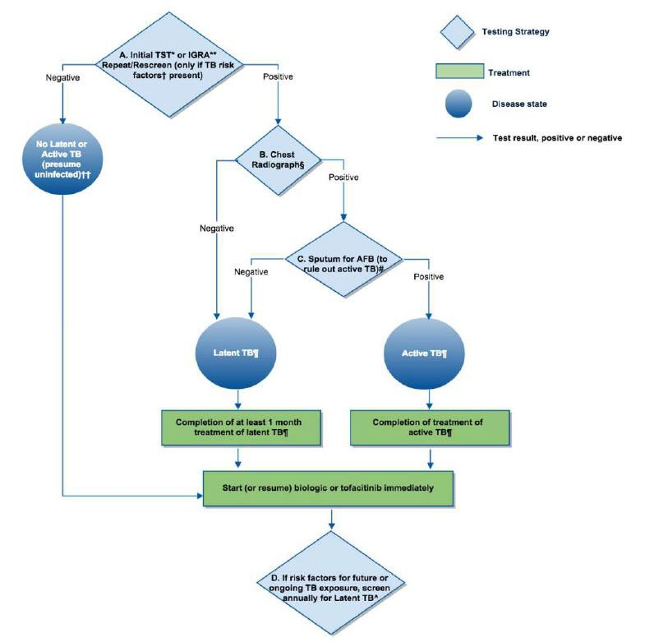
Why, Rheumatology, Why?
ACR RA Treatment Recommendations, 2015

Slide 20
World Traveler with RA
56 y/o WF about to be started on Humira for rheumatoid arthritis
  She has traveled extensively, in the Peace Corp in her 20’s and on humanitarian
visits to Haiti, Sudan and Guatemala in the past 15 years
  Her TST returns positive
Do you:
  Treat for TB infection (LTBI)?
  Retest with an IGRA?

Slide 21
Recommendations
Should an IGRA or a TST be performed in individuals 5 years or older who are likely to be infected with Mtb, who have a high risk of progression to disease, and in whom it has been decided that testing for LTBI is warranted?
Recommendation 2:
There are insufficient data to recommend a preference for either a TST or an IGRA as the first- line diagnostic test in individuals 5 years or older who are likely to be infected with Mtb, who have a high risk of progression to disease, and in whom it has been determined that diagnostic testing for LTBI is warranted.

Slide 22
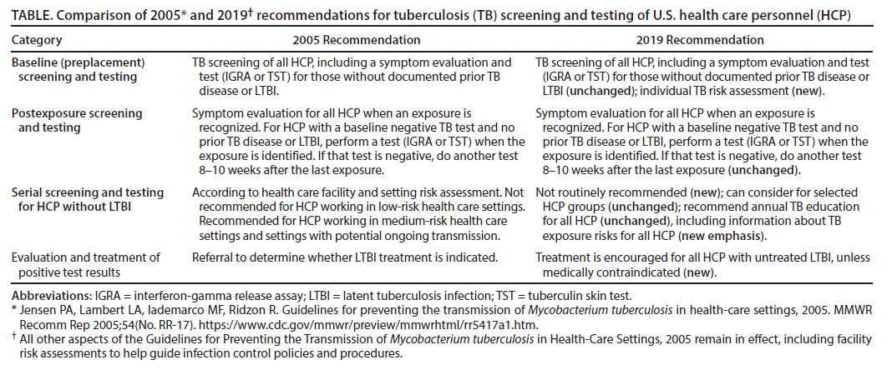
Screening HCW for TB
MMWR / May 17, 2019 / Vol. 68 / No. 19

Slide 23
Suddenly Positive
35-year-old US-born man takes a job at new hospital in the accounting department. He has been tested annually at his old hospital job and has been TST negative for the past 10 years.
He has a positive IGRA (nil 0, TB1-nil 0.42, TB2-nil 0.27). He has no recent travel nor known contact to anyone with TB disease.
What should you do with him?

Slide 24
Recommendations
Should an IGRA or a TST be performed in individuals 5 years or older who are unlikely to be infected with Mtb, but in whom it has been decided that testing for LTBI is warranted?
Recommendation 3a:
We suggest performing an IGRA instead of a TST
(conditional recommendation, low-quality evidence).
Recommendation 3b:
We suggest a second diagnostic test if the initial test is positive
(conditional recommendation, very low-quality evidence).
Remarks: The confirmatory test may be either an IGRA or a TST. When such testing is performed, the person is considered infected only if both tests are positive.

Slide 25
Evaluate for Tuberculosis Disease

Slide 26
Initiating Treatment for LTBI
Before initiating treatment for LTBI
Rule out TB disease
  i.e. wait for culture results if specimen obtained
Determine prior history of treatment for LTBI or TB disease
Assess risks and benefits of treatment
Determine current and previous drug therapy

Slide 27
Evaluate to Exclude Active TB Disease
If the TST or IGRA is Positive
OR
Child < 5 or immunocompromised person with recent exposure even if TST/IGRA negative
  History
  Physical examination
  Chest X-Ray

Slide 28
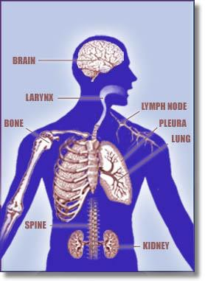
Sites of TB Disease
Lungs
Extrapulmonary:
Larynx
Pleural effusion
Kidneys
Lymphatics
Bones & joints
Miliary (disseminated)

Slide 29
Evaluation for TB
Medical history
Physical examination
Testing for TB infection
Chest radiograph
Bacteriologic or histologic exam

Slide 30
Is There Evidence of Disease?
Is Patient at Risk of Progression to
Disease?
Symptoms*
  Fever
  Chills
  Night Sweats
  Weight Loss
  Cough (dry/productive)
  Hemoptysis
  Fatigue
* only one may be present
Medical History:
  HIV
  Silicosis
  Chronic Kidney Disease
  Diabetes
  Immunosuppression
  Drug/alcohol/tobacco
  TB exposure

Slide 31
Physical Exam
General assessment – does person look well?
Lung exam
Check for lymph nodes
Palpate liver
In children look at growth curve/weight/activity
Look for anything that will complicate therapy!

Slide 32
Radiologic Exam
CXR must be done before treatment of TB Infection
  Must be read as normal
Or
  IF abnormal:
    Not consistent with Active TB
    Stable abnormality confirmed over a 3 month period

Slide 33
No CXR study shows findings specific for TB
Cavitary processes suggest TB
Common mimics of TB
Non-tuberculous mycobacteria (NTM)
fungal infection
bacterial abscesses
necrotic neoplasm (especially lung neoplasm)

Slide 34
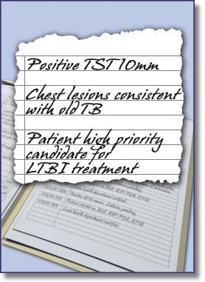
CXR – old healed TB
Nodules & fibrotic lesions may contain slowly multiplying bacilli = potential for progression
CXR consistent with old TB and + TST/IGRA
= high priority for LTBI treatment
Calcified nodular lesions (calcified granuloma) pose a very low risk for future progression

Slide 35
CXR - special situations
Pregnant women who are suspected of having or who are being evaluated for active TB disease should undergo a CXR without delay, even during the first trimester
Patients suspected of extrapulmonary TB should have a CXR to R/O pulmonary TB

Slide 36
Management of Positive TST or IGRA When the CXR is Abnormal
If Patient has NO signs or symptoms of Active TB:
  Collect 3 sputum specimens for smears and culture
  Evaluate for symptoms
    If no symptoms - Wait
  Repeat CXR after 2 – 3months
If CXR stable at 2 – 3 months and cultures negative, treat for TB Infection

Slide 37
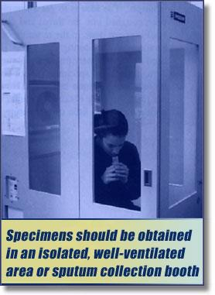
Bacteriologic and Histologic Examinations
When lung or larynx is site of disease:
3 sputum specimens for AFB smear and culture
Collected 8-24 hours apart
with at least 1 early morning specimen

Slide 38
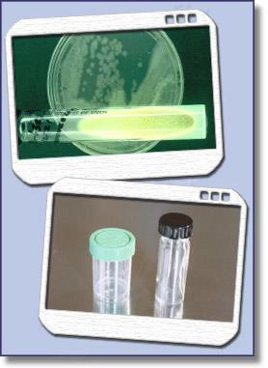
Bacteriologic and Histologic Examinations
Extrapulmonary Specimens
Urine
Cerebrospinal fluid 
Pleural fluid 
Pus
Biopsy specimens
Do NOT collect specimens in Formalin
recovery poor

Slide 39
Laboratory Examination
AFB smear
AFB culture
Nucleic acid amplification test (NAAT)
  GeneXpert
  Molecular Detection of Drug Resistance (MDDR)

Slide 40
I Think This is TB…….
38-year-old man referred for persistent cough, abnormal CXR. Cough has been going on for 2 months, intermittently productive.
CXR with fibronodular disease and small cavities in the RUL. IGRA positive, fungal serologies negative.
He feels fine. No fevers, chills, no symptoms. Some weight loss (recent
increase in work stress), night sweats (air condition has been acting up)
Sputum x 3 is AFB smear negative (2 specimens NAAT negative)
You still think this is TB….what do you do with him?

Slide 41
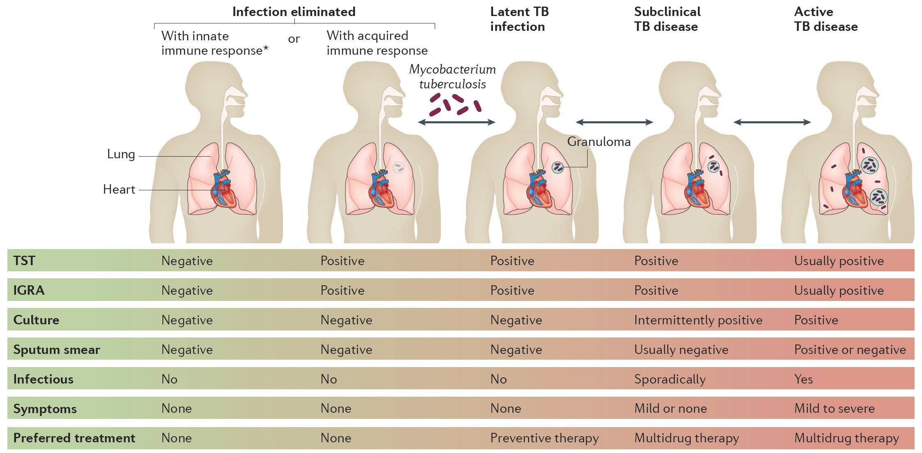
Tuberculosis Spectrum of Disease

Slide 42
Management of Positive TST or IGRA When CXR is Abnormal
and the Patient Has ANY Signs or Symptoms of TB
The patient should be suspected of having TB disease
Collect 3 sputa for smear and culture
Consider starting standard 4 drug (RIPE) treatment
If positive smear and/or Gene Xpert
  Report to public health and start 4 drug (RIPE) treatment
Never (ever!) start a treatment for TB infection in a patient with possible active TB

Slide 43
Pediatric TB
The contact investigation is the life-changing event for children exposed to TB
Every child contact under 5 y/o gets a physical exam, a CXR and a screening test
Children mostly have paucibacillary disease, 10% smear positivity, 10- 40% culture positivity
50% of children have no symptoms at all

Slide 44
TB Testing in Pregnant Persons
Test in every instance you would test if they were not pregnant
  HIV
  Contact to an active case
  Immigrant from a high-risk country
The immune system may not react as expected
Yes, you can/should get a CXR

Slide 45
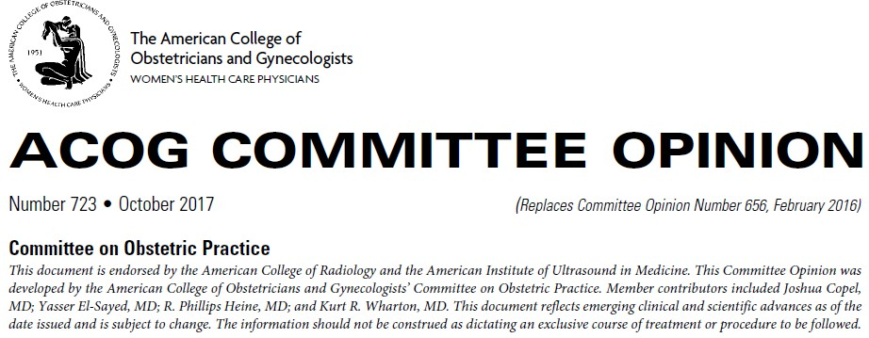
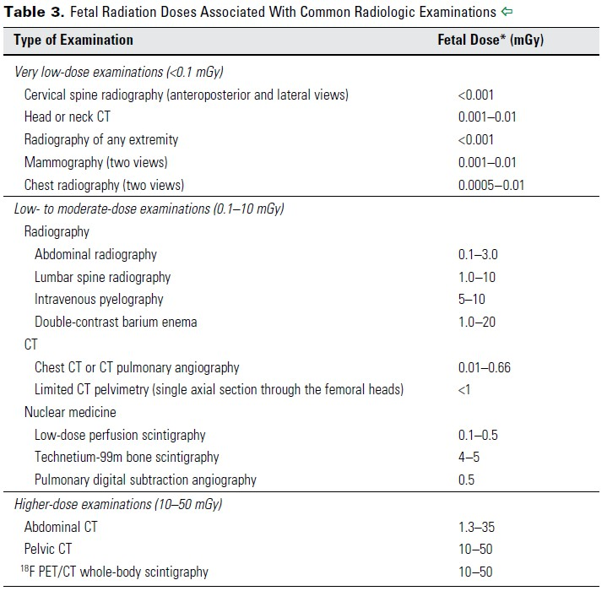
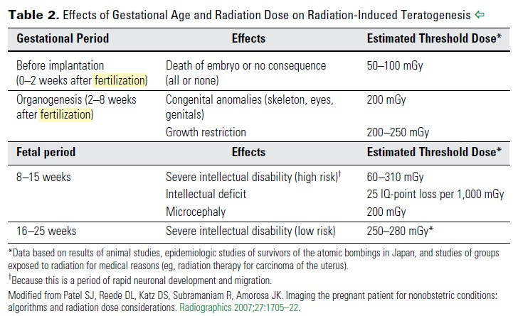
Yes! You can X-ray a pregnant patient!

Slide 46
Conclusions
IGRAs are becoming the TB test of choice, though the TST still has some utility
Screening for TB should be considered in non-US born individuals who have not been previously screened or who spend significant time in higher risk countries.
HCW screening is focused less on annual screening of low risk individuals and more on treatment of workers who test positive.
Current TB screening tests are tools, not an answer

Slide 47

Questions?
Lisa.Armitige@dshs.texas.gov 1-800-TEX-LUNG

