Slide 1
Who Should Be Treated & How Should We Treat Them?
Lisa Armitige, MD, PhD
Co-Medical Director
Heartland National TB Center
Professor of Medicine and Pediatrics
University of Texas at Tyler Health Science Center
Screening and Treating
El Paso, TX
September 25, 2025

Slide 2
‘Latent’ TB Infection
Persons are infected with Mycobacterium tuberculosis but:
No Active TB Symptoms
Chest X-ray may be normal, or show granuloma, stable pleural or parenchymal scarring
Positive TST or IGRA

Slide 3
‘Latent’ TB Infection
Persons with LTBI are NOT infectious
90+ % chance of never getting Active TB Disease
TB Bacteria are metabolically active and dividing, but infection is controlled by the immune system.
But the TB organism is in your body!
“…a state of persistent immune response to stimulation by Mycobacterium tuberculosis antigens without evidence of clinically manifested active TB”
WHO Guidelines on the Management of Latent Tuberculosis Infection, 2015

Slide 4
Progression of LTBI to Active TB Disease Increased By
HIV infection
Chronic kidney disease
Silicosis
Recent exposure
Diabetes
Chest x-ray abnormality c/w previous inadequately treated TB
Intravenous drug use
Smoking – active and passive
Underweight by >10% (Maybe)
ATS-CDC. Am J Respir Crit Care Med 2000;161:S221

Slide 5
Progression of LTBI to Active TB Disease Increased By
Immunosuppression
Pregnancy and first three months post partum
Hematologic cancers and head and neck cancers
Medications
TNFα inhibitors
Prednisone >15 mg, > 4 weeks
Chemotherapy
Other immunosuppressive drugs

Slide 6
Latent tuberculosis infection: the final frontier of tuberculosis elimination in the USA LoBue PA¹, Mermin JH². Lancet Infect Dis. Epub 2017
After substantial progress during the past two decades, the rate of tuberculosis cases in the USA each year has now levelled off and remains well above the elimination threshold.
Both epidemiological data and modelling underline the necessity of addressing latent tuberculosis infection if further progress is to be made in eliminating the disease.
A major new effort is required and should consist of
a surveillance system or registry to monitor progress,
scale-up of targeted testing for latent tuberculosis infection in at-risk populations,
scale-up of short-course treatment regimens
increased public health staffing for implementation and oversight.

Slide 7
Who Should be Tested for TB Infection? Targeted Testing for TB Infection
The simplified version:
Persons who are at increased risk for M. tuberculosis infection
Persons at increased risk for progression to active disease if infected with M. tuberculosis (even if not at increased exposure risk)
And those who tend to be tested in addition:
Persons tested for administrative reasons (e.g., mandatory employment testing)
Persons with symptoms of active TB disease (fever, night sweats, cough, and weight loss)

Slide 8
Initiating Treatment for LTBI
Before initiating treatment for LTBI
Rule out TB disease
i.e. wait for culture results if specimen obtained
Determine prior history of treatment for LTBI or TB disease
Assess risks and benefits of treatment
Determine current and previous drug therapy

Slide 9
Contacts of Active TB Case
Among close contacts approximately 30% have LTBI and 1-3% have active TB disease
Without treatment, approximately 5% of contacts with newly acquired LTBI progress to TB disease within 2 years
Examination of contacts is one of the most important activities for identifying persons with disease and with LTBI

Slide 10
Been a Long Time…..
50-year-old man from Honduras, immigrated to the US 20 years ago. He recently changed jobs and they require an IGRA for employment. He tests positive.
He had a positive TST in the past that he attributed to being BCG vaccinated. He is currently without symptoms and has a negative CXR.
What is your messaging to this man regarding LTBI treatment?

Slide 11
Percentage of TB Cases Among Non-U.S.–born Persons by Year Since Initial Arrival in the United States at Diagnosis, 2020 (N=5,127)
Percentage of cases
~1/3 of cases occurred 20+ years after U.S. arrival
Years* in the United States
* Years since arrival was missing/unknown for 585 cases (11.4%).
Notes:
This slide is similar to the previous slide but breaks down the time in the United States by year. The highest percentage of TB cases among non-U.S.-born persons occurs in those who were diagnosed with TB disease within 1 year of arrival in the United States. The percentage of TB cases by years since initial arrival in the United States gradually decreases. Even though the percentage of TB cases decreases as years since U.S. arrival increases, approximately 1/3 of TB cases among non-U.S.–born persons occurred at least 20 years after arrival in the United States. Notable peaks at 10-year intervals are evident, potentially attributable to “round number bias” in patient self-reports, where patients are more likely to indicate how long they have lived in the United States rounded to the nearest 10th year rather than reporting the exact number of years.

Slide 12
Percentage of TB Cases Among Non-U.S.–Born* Persons by Years Since Arrival in the United States Prior to Diagnosis, 2023 (N=7,299)
*Persons born in the United States, certain U.S. territories, or elsewhere to at least one U.S. citizen parent are categorized as U.S.-born. All other persons are categorized as non-U.S.–born.
Notes:
This slide shows the percentage of TB cases among non-U.S.–born persons by number of years since initial arrival in the United States prior to diagnosis. In 2023, 37.4% of non-U.S.–born persons with TB were diagnosed within 5 years of arrival in the United States, with more than half of those occurring within the first year after arrival. Nearly one-third (30.4%) were diagnosed after being in the United States for at least 20 years.

Slide 13
TB Cases Among Non-U.S.–Born* Persons by Age Group, United States, 1994–2023
* Persons born in the United States, certain U.S. territories, or elsewhere to at least one U.S. citizen parent are categorized as U.S.-born. All other persons are categorized as non-U.S.–born.
Notes:
During 1994 to 2023, the number of TB cases among non-U.S.–born persons for each age group under 45 years of age decreased, while the number of TB cases for those 45 years of age and above increased. The total number of TB cases by age group among non-U.S.–born persons increased from 2022 to 2023.
In 2023, people aged 25–44 years had the highest number (n=2,439) of TB cases, followed by those aged ≥65 years and those aged 45–64 years (n=1,990 and n=1,974, respectively). Children 0–4 years of age had the lowest number (n=30) of TB cases.

Slide 14
Percentage of TB Cases Among Non-U.S.–Born* Persons by Years in the United States Prior to Diagnosis, 2010–2023
*Persons born in the United States, certain U.S. territories, or elsewhere to at least one U.S. citizen parent are categorized as U.S.-born. All other persons are categorized as non-U.S.–born.
Notes:
Since 2010, persons who have lived in the United States for at least 20 years prior to TB diagnosis have comprised the greatest percentage of cases among non-U.S.–born persons, compared to those who have lived in the United States for less than 1 year, 1–4 years, 5–9 years, and 10–19 years. The percentages of persons who were diagnosed 1–4 years, 5–9 years, or 10–19 years after arrival remained relatively consistent during 2010–2023, with the percentages fluctuating within 5%. However, the percentage of cases that occurred among persons who were diagnosed within 1 year of arrival dropped from 13.5% in 2019 to 9.8% in 2020 and then increased to 16.9% in 2022 and 22.4% in 2023.

Slide 15
Testing is good and necessary!
But is it funded…..?

Slide 16
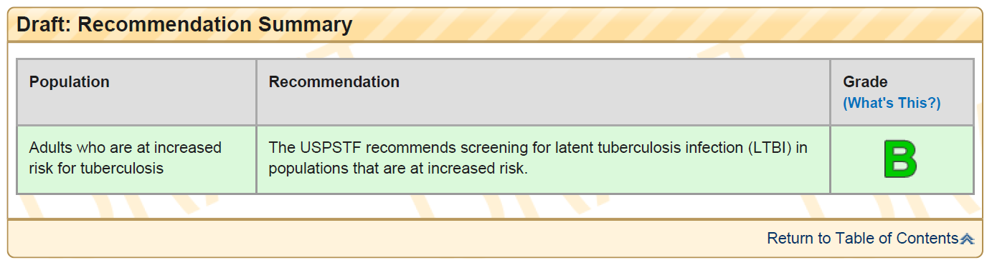
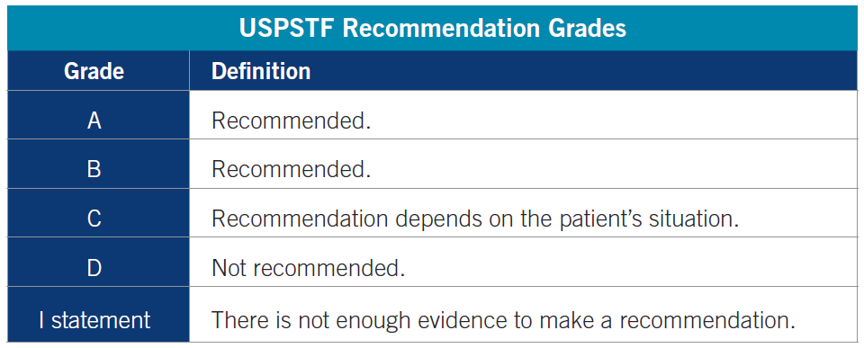
US Preventative Services Task Force (USPSTF) Recommendations for LTBI

Slide 17
Examples of USPSTF ‘A’ and ‘B’ ratings
Topic | Grade | Release Date
Bacteriuria screening: pregnant women | A | July 2008
Blood pressure screening in adults | A | October 2015
Cervical cancer screening | A | March 2012
Cholesterol abnormalities screening: men 35 and older | A | June 2008
Cholesterol abnormalities screening: women younger than 45 | A | June 2008
Abdominal aortic aneurysm screening: men | B | June 2014
Alcohol misuse: screening and counseling | B | May 2013
Aspirin preventive medication: Adults aged 50 to 59 years with a ≥10% 10-year cardiovascular risk | B | April 2016
BRCA risk assessment and genetic counseling/testing | B | December 2013
http://www.uspreventiveservicestaskforce.org/Page/Name/uspstf-a-and-b-recommendations/

Slide 18
USPSTF and the Affordable Care Act (Coverage of Preventive Services)
Public Health Service (PHS) Act section 2713 and the interim final regulations relating to coverage of preventive services require non-grandfathered group health plans and health insurance coverage offered in the individual or group market to provide benefits for, and prohibit the imposition of cost-sharing requirements with respect to, the following:
Evidenced-based items or services that have in effect a rating of "A" or "B" in the current recommendations of the United States Preventive Services Task Force (USPSTF) with respect to the individual involved, except for the recommendations of the USPSTF regarding breast cancer screening, mammography, and prevention issued on or around November 2009, which are not considered current
CMS.gov: https://www.cms.gov/CCIIO/Resources/Fact-Sheets-and-FAQs/aca_implementation_faqs18.html

Slide 20
Initiating Treatment for LTBI
Before initiating treatment for LTBI
Rule out TB disease
i.e. wait for culture results if specimen obtained
Determine prior history of treatment for LTBI or TB disease
Assess risks and benefits of treatment
Determine current and previous drug therapy

Slide 21
So….How to Treat?
You discuss risk with the patient and he agrees to treatment.
What do you treat with?

Slide 22
TB Infection Treatment Options
CDC Recommended Treatment regimens:
INH/Rifapentine x 3 months (3HP)
Once weekly DOT x 12 weeks
Average of 10 pills at once
Rifampin x 4 months
Daily (10 mg/kg: 600 mg max)
INH +rifampin x 3 months
INH daily (5 mg/kg: 300 mg max) + rifampin daily (10 mg/kg: 600 mg max)
INH x 6-9 months
Daily (5 mg/kg: 300 mg max) or BIW (15 mg/kg: 900 mg max)
ATS/IDSA/NTCA. November 2018.

Slide 23
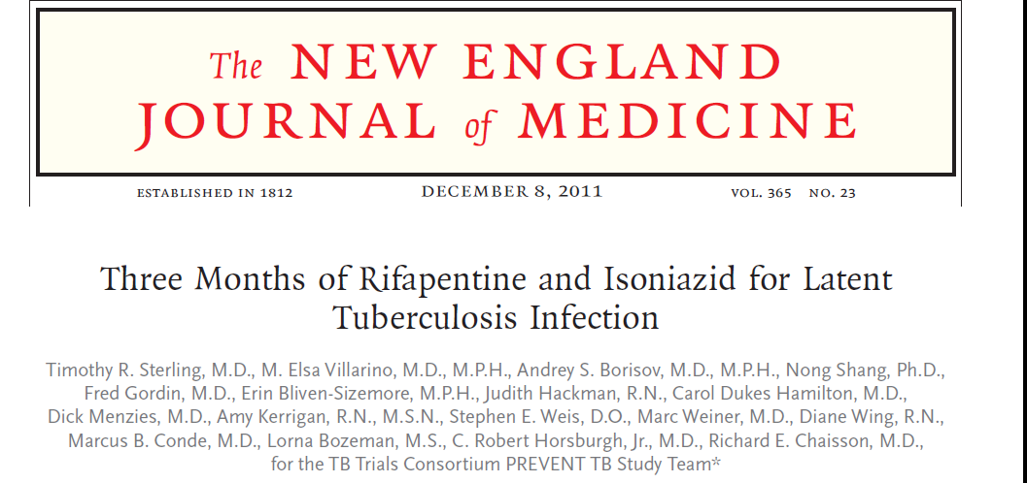
Active TB disease: 7/3986 in 3 HP arm; 15 of 3745 in 9H arm
Completion of treatment: 82.1% 3HP arm; 69% 9 H arm
Hepatotoxicity: 0.4% 3HP arm; 2.7% 9 H arm.
Conclusion: Use of 3 HP x 3 months was as effective as 9 months of INH and had a higher treatment completion rate.
Notes:
In MIIT TB in 7 of 3986 with 3 HP and 15 of 3745 with INH x 9 months Completion 82.1% 3 HP and 69 % INH x 9 Hepatotoxicity 0.4% and 2.7%

Slide 24
Dosing for 3 HP Rifapentine is available only as a 150 mg tablet for oral administration. It can be crushed for pediatric dosing
Adults and adolesents (>12 y/o)
INH 15 mg/kg once weekly
(max 900 mg)
Rifapentine (max 900 mg) once weekly
Vitamin B6 50 mg once weekly
Completion - 11 to 12 doses in 16 weeks
Children 2 – 12 years*
INH 25 mg/kg (round to nearest 50 or 100 mg tablet)
Rifapentine
10-14 kg: 300 mg
14.1-25 kg: 450 mg
25.1-32 kg: 600 mg
32.1-49.9 kg: 750 mg
≥ 50 kg: 900 mg
* Especially when short course is desirable; pill burden may be a problem

Slide 25
INH + RPT (3HP) is NOT Recommended For:
Children under 2 y/o (but more to come)
HIV infected persons on Antiretroviral Therapy with drug drug interactions
Any individuals with drug-drug interactions
Presumed INH or Rifampin Resistance in the source case
Pregnant women

Slide 26
Four Months of Rifampin or Nine Months of Isoniazid for Latent Tuberculosis in Adults. Menzies et al, N Engl J Med. 2018 Aug 2;379(5):440-453.
Open label trial in 9 countries comparing 4 months rifampin vs 9 months INH:
study endpoint: prevalence of TB 28 months after randomization
Rifampin: 3443 patients:
4 active TB, 4 clinical TB
INH: 3416 patients:
4 active TB, 5 clinical TB

Slide 27
Four Months of Rifampin or Nine Months of Isoniazid for Latent Tuberculosis in Adults. Menzies et al, N Engl J Med. 2018 Aug 2;379(5):440-453.
Treatment completion:
Rifampin 79%,
INH 63% (p < 0.001)
Clinically significant (drug stopped) hepatotoxic events:
Rifampin 0.3%,
INH 1.7% (p < 0.001)
4 months of rifampin was not inferior to 9 months INH for preventing development of active TB but with significantly higher completion rates and greater safety than INH.

Slide 28
Rifampin Dosing for TB Infection
Adults
600 mg daily x 4 months
Children:
10 – 20 mg/kg daily x 4 months
0-2 y/o: 20 – 30 mg/kg daily x 4 months
Capsules 150mg/300 mg round up - use higher range
Higher rifampin doses well tolerated

Slide 29
Rifampin (rifamycin) Toxicity
Cutaneous Reactions: 6%, generally self- limited
Orange discoloration of body fluids
Gastrointestinal symptoms: nausea, anorexia, abdominal pain
Flulike symptoms: < 1% of patients on intermittent therapy.
Severe immunologic reactions: thrombocytopenia, hemolytic anemia, acute renal failure and thrombotic thrombocytopenic purpura (each < 0.1% of patients)
Severe Hepatotoxicity: nearly 0% as monotherapy, may appear cholestatic

Slide 30
Common Rifampin (Rifamycin) Drug Interactions
HMG-CoA reductase inhibitors
Oral anticoagulants
Oral contraceptives
Cyclosporine/Tacrolimus
Digoxin
Glucocorticoids
Itraconazole/ketoconazole
Methadone
Phenytoin
Theophylline
Verapamil/diltiazem
Amiodarone
Midazolam
Thyroid hormone

Slide 31
Rifampin (rifamycin) Drug Interactions
Interactions due to induction of hepatic microsomal enzymes (cytochrome P-450, CYP, enzyme system) that accelerate metabolism of multiple drugs
Major concern is reduction in serum concentrations of common drugs (OCP’s, warfarin, etc.) to ineffective levels
Bidirectional interactions between rifamycins, INH and antiretroviral agents

Slide 32
INH LTBI Therapy
The standard treatment regimen for LTBI has been nine months of daily INH.
New guidelines suggest 6 months to be adequate
The regimen is very effective and is the preferred regimen for HIV infected people taking antiretroviral therapy with drug-drug interactions that do not allow a rifamycin
Is the option when drug-drug interactions are significant and must be avoided
But less than 60% complete
Primarily due to long duration of treatment but also increased adverse effects

Slide 33
INH Hepatotoxicity
Asymptomatic elevation of aminotransferases: 20% of patients
Clinical hepatitis: 0.6% of patients
Fulminant hepatitis (hepatic failure)
Approximately 4/100,000 persons completing therapy (continued INH with symptoms of hepatitis, prior INH hepatotoxicity, malnutrition).

Slide 34
Severe INH Liver Injuries Among Persons Being Treated for LTBI, U.S., 2004-2008 MMWR 3/5/10/ 59(08); 224-229
10 patients with CDC on-site investigation
All patients had:
indications for LTBI treatment,
were prescribed INH within recommended dosage range,
took the medication as prescribed
Prescribers followed guidelines for monthly clinical monitoring
Symptoms 1-7 months after INH started
2 patients INH discontinued within 3 days of symptoms, 8 stopped at least one week after symptom onset

Slide 35
Severe INH Liver Injuries Among Persons Being Treated for LTBI, U.S., 2004-2008 MMWR 3/5/10/ 59(08); 224-229
“Medical providers should emphasize to patients that INH treatment should be stopped immediately upon the earliest onset of symptoms (e.g. excess fatigue, nausea, vomiting, abdominal pain, or jaundice), even before a clinical evaluation has been conducted, and that initial symptoms might be subtle and might not include jaundice.”

Slide 36
INH Side Effects
Hepatotoxicity
Migraine Headaches
Gastrointestinal
Nausea, Diarrhea, Constipation
Rash
Peripheral Neuropathy
Pyridoxine 50mg daily can help prevent this

Slide 37
Isoniazid (INH) Dosing
Adults: 300 mg single daily dose or 900 mg twice weekly*
Children: 10-15 mg/kg single daily dose (max dose 300 mg daily)
20-30 mg/kg twice weekly*
Duration of treatment for TB Infection: 6 - 9 months
9 month regimen more effective
9 month regimen is very difficult to complete
6 months is considered adequate therapy by ATS/IDSA/CDC guidelines
* twice weekly treatment must be given by directly observed therapy through health department

Slide 38
Duration of Therapy
INH
Rifampin
INH + Rifampin
INH +RPT
9 months (270 doses)
4 months (120 doses)
3 months (90 doses)
12 weeks (12 doses)
The longer the duration/more doses, the less likely your patient is to complete Rx!
Fewer than 60% complete 9 months of INH!

Slide 39
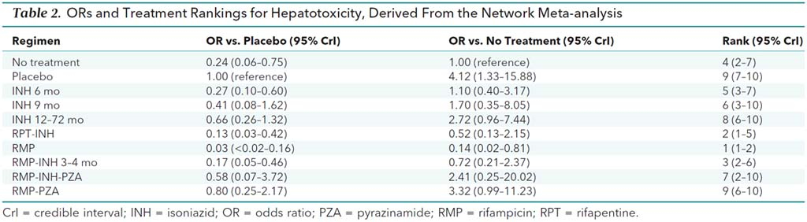
Treatment of Latent Tuberculosis Infection: An Updated Network Meta-analysis of 8 new and 53 previously included studies. Zenner D et al. AIM;167:248-255

Slide 40

TB Prevention After Exposure
Household contact with contagious person
Teen or adult with pulmonary TB disease
Usually > 4 hours of contact
Initial TST negative
Window period for TST conversion
(8-10 weeks)
CXR and physical exam normal
Window prophylaxis recommended:
For children <5 yrs of age
Immunosuppressed patients
Patients on tumor necrosis factor-alpha blockers
May prevent progression to disease during window period
Repeat TST 8-10 wks after exposure
May stop INH if 2nd TST negative <5mm in immunocompetent patients
Slide shamelessly stolen from
Dr. Kim Smith

Slide 41
Should Pregnant Women Be Treated for TB Infection during Pregnancy?
Treatment usually only given to those with recent contact to a person with active TB disease, HIV positive women or those with other immunosuppressive conditions. This is being reconsidered
A pregnant woman with tuberculosis can transmit to her unborn child which can have devastating consequences.
Active disease during delivery can expose medical staff to additional risk
Multiple medications required for treatment of active TB disease adds additional risk to the pregnancy

Slide 42
Should Pregnant Women Be Treated for TB Infection during Pregnancy?
A prior study showed increased risk of serious, even fatal hepatotoxicity with INH during pregnancy and the immediate post-partum period (3 months following delivery)
No study has shown increased risk of hepatotoxicity with daily rifampin
In pregnant women who have reason for treatment of LTBI, consider daily rifampin
Monitoring should be close
Blood work for any symptoms and hold medication
Monitor liver enzymes and patient at every monthly visit.

Slide 43
Treatment for LTBI in contacts of MDR-TB patients, Federated States ofMicronesia, 2009-2012. Bamrah S. Int J Tuberc Lung Dis. 2014;18:912.
119 contacts of MDR-TB patients
12 mos daily FQ-based treatment of MDR TBI by DOT.
Moxi (45%), Levo (4%), Moxi + EMB, Levo + EMB, Levo + ETH
119 infected contacts, 104 began treatment, 15 refused
Of the 104 who initiated treatment:
93 (89%) completed treatment, 4 discontinued due to AE’s.
None of the 104 contacts who undertook MDR LTBI treatment of any duration developed MDR-TB disease;
3 of 15 contacts who refused and 15 unidentified contacts developed MDR-TB disease.

Slide 44
Conclusions
The most important step to treating LTBI is to rule out active disease first
Treatment for LTBI can be done safely in most populations
Shorter, rifamycin-based regimens are preferred

Slide 45
Thank you for being here. Thank you for all that you do every single day. You make a difference. Questions?

