Slide 1
Ethical Access to care in TB
Hector I. Ocaranza, MD, MPH, FAAP
Local Health Authority
City-County of El Paso, TX
September 25, 2025

Slide 2
Objectives
Discuss tuberculosis as a disease with global impact.
Recognize stigma associated with TB.
Discuss tuberculosis access to care and funding.
Identify ethical issues in tuberculosis prevention, care and control.

Slide 3
Disclosures
No conflict of interests
No relevant financial relationships with any commercial companies pertaining to this educational activity (or any other activity)

Slide 4

ETHICS
AND
MORALS

Slide 5
Ethics and Morals
A set of principles or a code of conduct that guides behavior within a profession, organization, or society.
An individual's own sense of right and wrong, shaping their personal beliefs and values about how to act.
Notes:
Differences:
Source:
Ethics often comes from a group or external standard, while morals are personal beliefs.
Scope:
Ethics can be considered a framework for applying moral principles, while morals are the foundational principles themselves.
Context:
Ethics is often applied to specific fields or dilemmas, whereas morals are a broader guide for a person's overall life and conduct.

Slide 6

ETHICS AND MORALS
ARE ETHICS AND MORALS THE SAME?

Slide 7
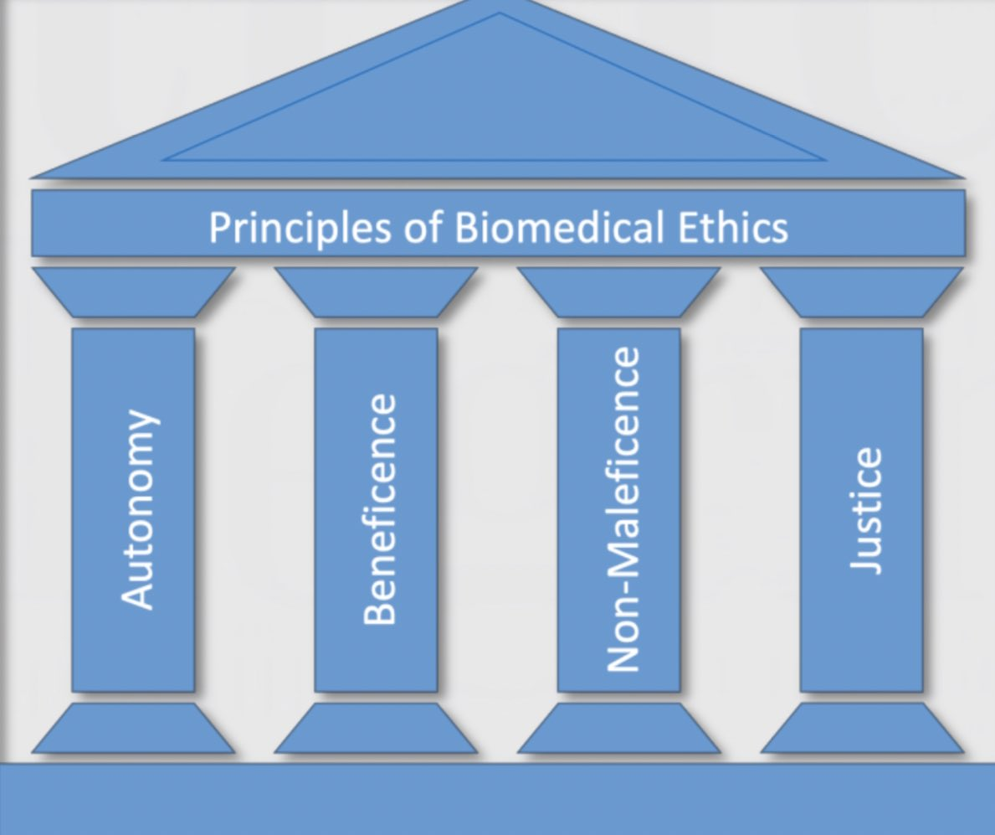
Medical Ethics
Philosophers Tom Beauchamp (1939-) and James Childress (1940-) introduced a transitional approach to medical ethics, providing simple heuristics emphasizing 4 principles based on a culmination of philosophies throughout time
BENEFICENCE
NON-MALEFICENCE
AUTONOMY
JUSTICE
(Beauchamp T, Childress J. Principles of Medical Ethics. Oxford University Press; 1979)

Slide 8
The medical profession has long subscribed to a body of ethical statements developed primarily for the benefit of the patient. As a member of this profession, a physician must recognize responsibility to patients first and foremost, as well as to society, to other health professionals, and to self. The following Principles adopted by the American Medical Association are not laws, but standards of conduct that define the essentials of honorable behavior for the physician
https://code-medical-ethics.ama-assn.org/principles

Slide 9
Medical Ethics & Dilemas
What is the moral &/or ethical responsibility of a government to provide healthcare for its population?
How are the limits determined?
Who gets counted as part of the population?
Does that change by the nature of the disease, such as an infectious vs non-infectious disease?

Slide 10

AMA Principles of Medical Ethics
Be dedicated to providing competent medical care, with compassion and respect for human dignity and rights.
Uphold the standards of professionalism, be honest in all professional interactions, and strive to report physicians deficient in character or competence, or engaging in fraud or deception, to appropriate entities.
Respect the law and also recognize a responsibility to seek changes in those requirements which are contrary to the best interests of the patient.
respect the rights of patients, colleagues, and other health professionals, and shall safeguard patient confidences and privacy within the constraints of the law.
Continue to study, apply, and advance scientific knowledge, maintain a commitment to medical education, make relevant information available to patients, colleagues, and the public, obtain consultation, and use the talents of other health professionals when indicated.
In the provision of appropriate patient care, except in emergencies, be free to choose whom to serve, with whom to associate, and the environment in which to provide medical care.
Recognize a responsibility to participate in activities contributing to the improvement of the community and the betterment of public health.
While caring for a patient, regard responsibility to the patient as paramount.
Support access to medical care for all people.
https://code-medical-ethics.ama-assn.org/principles

Slide 11

American Nurses Association (ANA): 2025 Code of Ethics (Provisions 1-5)
The nurse practices with compassion and respect for the inherent dignity, worth, and unique attributes of every person
A nurse’s primary commitment is to the recipient(s) of nursing care, whether an individual, family, group, community, or population
The nurse establishes a trusting relationship and advocates for the rights, health, and safety of recipient(s) of nursing care
Nurses have authority over nursing practice and are responsible and accountable for their practice consistent with their obligations to promote health, prevent illness, and provide optimal care
The nurse has moral duties to self as a person of inherent dignity and worth including an expectation of a safe place to work that fosters flourishing, authenticity of self at work, and self-respect through integrity and professional competence
https://codeofethics.ana.org/provisions

Slide 12
American Nurses Association (ANA): 2025 Code of Ethics (Provisions 6-9)
Nurses, through individual and collective effort, establish, maintain, and improve the ethical environment of the work setting that affects nursing care and the well-being of nurses.
Nurses advance the profession through multiple approaches to knowledge development, professional standards, and the generation of policies for nursing, health, and social concerns
Nurses build collaborative relationships and networks with nurses, other healthcare and non-healthcare disciplines, and the public to achieve greater ends
Nurses and their professional organizations work to enact and resource practices, policies, and legislation to promote social justice, eliminate health inequities, and facilitate human flourishing
https://codeofethics.ana.org/provisions
Notes:
Revised from 2015 codes and a 10th provision was added specifically to address global issues of ethical nursing
Language is a living entity that changes over time ― terminology evolves, and the meaning of specific words may change based on context. For example, the once firm and clearly understood distinctions between may and can; will and shall; and ought, should, and must have faded in everyday language and have come to be used interchangeably in both speech and writing, except in rare instances in which the nuance is essential to an argument. However, the meaning of terms in everyday language may differ from their use in ethics. For example, the term ought in everyday language denotes a permissiveness and choice. In ethics the foundational term ought calls for autonomous moral discernment and judgment and implies a moral imperative. In this revision of the Code, ought was deliberately used to signify autonomous moral agency when necessary and important. Should was carefully chosen to express obligations or expediencies that do not necessarily carry a moral imperative. Must was employed to denote obligations, duties, or necessities that may not be intrinsically moral and reflect the expectations of nurses in practice. Each term was intentionally woven into the fabric of the Code. In another example, the term good in ethics is juxtaposed by evil, not by bad. A good nurse in the moral sense is the nurse who is evaluated by the moral norms, values, virtues and ideals of the community and traditions of nursing, and is contrasted with the evil nurse, not the bad nurse. This Code understands the good nurse in its moral meaning.
Applied ethics wrestles with questions of right, wrong, good, and evil in a specific, socially defined realm of human action, such as nursing, business, or law. All of these aspects of ethics are found in the nursing literature. However, the fundamental concern of a code of ethics for nursing is to provide normative moral guidance for nurses in terms of what they ought to do, be, seek and embody in everyday nursing.
The values of nursing arise from the community, tradition, and practices of nursing and are the basis of nursing moral norms and evaluation. These values are the ends and goods (things that are good in themselves or instrumental goods necessary to realize a desired end) that nursing seeks. That is to say, the community of nursing regards their absence (that is, failure to seek them) in practice to be wrong, inadequate, and morally blame-worthy. The values of nursing are part of what makes good nursing and must be enacted in every nurse’s practice and exemplified by the whole profession. There is no specific list of values that nursing seeks; they are the innumerable values of the nursing community, and include values such as justice, equity, inclusiveness, integrity, dignity, cultural humility, care, comfort, compassion, trust, commitment, and health ― all that is good to seek. The values of nursing also underpin nursing’s need to articulate and advance the notions of good and health within a society. A good society balances justice and compassion, while supporting the opportunity for its members to coexist and strive to flourish individually and collectively.

Slide 13
ANA 2025 Code of Ethics: more about the 3 parts of Provision 9
9.1 Professional nursing organizations ought to exemplify the values of nursing and respect the inherent dignity, worth, unique attributes, and human rights of all individuals. The need for and right to health is universal, transcending all individual differences.
It is the shared responsibility of professional nursing organizations to speak for nurses collectively in shaping healthcare and to promulgate change for the improvement of health and healthcare rooted in humanistic and social justice principles.

Slide 14
ANA 2025 Code of Ethics: more about the 3 parts of Provision 9
CONTINUED……
Nurses and professional nursing organizations condemn dehumanization in all its forms while simultaneously affirming the intrinsic dignity of all people through advocacy and allyship.
Nurses recognize this as an ethical duty, enacted through intentional interventions and support to eliminate harmful acts, words, and deeds. Nurses create spaces that amplify voices not traditionally heard, recognized, or welcomed, in order to create a culture that respects all persons.
Nursing values instill a sense of duty beyond individual careers, emphasizing the collective impact the profession can have on societal well-being. Professional organizations acting in solidarity is a formidable force and strengthens the ability of the profession to influence social justice and global health.

Slide 15
ANA 2025 Code of Ethics: more about the 3 parts of Provision 9
9.2 (in part) states:
Nursing curricula and formation, research and healthcare policy education, and professional development should prepare nurses to address unjust systems.
The nursing profession upholds the public’s trust, in part, by its deliberate and intentional education in advocacy and allyship to create just systems.

Slide 16
ANA 2025 Code of Ethics: more about the 3 parts of Provision 9
9.3 (in part) states:
Advancing the vision of a good and healthy society can occur through professional organizations that support nurses to influence and transform social and structural determinants of health and policy that impact communities and society.
More specific examples include addressing: …the increasing complexity of healthcare; the failure to employ less costly community health models of care; that healthcare is driven more by profit than by ethics; the realities of food insecurity;… disinformation and misinformation; discrimination in all forms...
Notes:
This is so rational and well thought out. We see these problems and issues every day caring for our patients with TB.
Ok, there is one last provision in Nursing Ethics to take a look at now

Slide 17
ANA 2025 Code of Ethics: Provision 10
Nursing, through organizations and associations, participates in the global nursing and health community to promote human and environmental health, well-being, and flourishing.
Notes:
As mentioned, these were Revised for 2025 from 2015 codes and there’s a new provision on the block: a 10th provision was added specifically to address global issues of ethical nursing. Let’s take a closer look
Language is a living entity that changes over time ― terminology evolves, and the meaning of specific words may change based on context. For example, the once firm and clearly understood distinctions between may and can; will and shall; and ought, should, and must have faded in everyday language and have come to be used interchangeably in both speech and writing, except in rare instances in which the nuance is essential to an argument. However, the meaning of terms in everyday language may differ from their use in ethics. For example, the term ought in everyday language denotes a permissiveness and choice. In ethics the foundational term ought calls for autonomous moral discernment and judgment and implies a moral imperative. In this revision of the Code, ought was deliberately used to signify autonomous moral agency when necessary and important. Should was carefully chosen to express obligations or expediencies that do not necessarily carry a moral imperative. Must was employed to denote obligations, duties, or necessities that may not be intrinsically moral and reflect the expectations of nurses in practice. Each term was intentionally woven into the fabric of the Code. In another example, the term good in ethics is juxtaposed by evil, not by bad. A good nurse in the moral sense is the nurse who is evaluated by the moral norms, values, virtues and ideals of the community and traditions of nursing, and is contrasted with the evil nurse, not the bad nurse. This Code understands the good nurse in its moral meaning.
Applied ethics wrestles with questions of right, wrong, good, and evil in a specific, socially defined realm of human action, such as nursing, business, or law. All of these aspects of ethics are found in the nursing literature. However, the fundamental concern of a code of ethics for nursing is to provide normative moral guidance for nurses in terms of what they ought to do, be, seek and embody in everyday nursing.
The values of nursing arise from the community, tradition, and practices of nursing and are the basis of nursing moral norms and evaluation. These values are the ends and goods (things that are good in themselves or instrumental goods necessary to realize a desired end) that nursing seeks. That is to say, the community of nursing regards their absence (that is, failure to seek them) in practice to be wrong, inadequate, and morally blame-worthy. The values of nursing are part of what makes good nursing and must be enacted in every nurse’s practice and exemplified by the whole profession. There is no specific list of values that nursing seeks; they are the innumerable values of the nursing community, and include values such as justice, equity, inclusiveness, integrity, dignity, cultural humility, care, comfort, compassion, trust, commitment, and health ― all that is good to seek. The values of nursing also underpin nursing’s need to articulate and advance the notions of good and health within a society. A good society balances justice and compassion, while supporting the opportunity for its members to coexist and strive to flourish individually and collectively.

Slide 18
ANA 2025 Code of Ethics: more about parts of Provision 10
10.3 …
Nurses and nursing organizations work toward the realization of the Sustainable Development Goals (SDGs) of the United Nations (UN) and other global-based benchmarks as they affect health and well-being. The United Nations SDGs include:
The eradication of poverty, hunger, and malnutrition, and the diseases they foster; a positive agenda toward the realization of health and well-being including the reduction of maternal and child morbidity and mortality; universal literacy and education; and universal gender equality.
Nursing and nurses also work to bring about access to clean water, safe food and milk supplies, sanitation, affordable clean energy; healthy cities and communities; ecological protection through responsible consumption, production, and shared natural resources; climate-related advocacy; conservation of oceanic and terrestrial life, waters, and lands; peace, justice, human rights, and strong institutions; and global partnerships to further these goals.
Notes:
There are 5 parts; let’s look at 2 of them:
I am going to need another shirt.
How can any of us be in the profession of helping others, of healing, of caring and compassion and NOT work towards all of these things? Can any person be truly healthy without these things?
Language is a living entity that changes over time ― terminology evolves, and the meaning of specific words may change based on context. For example, the once firm and clearly understood distinctions between may and can; will and shall; and ought, should, and must have faded in everyday language and have come to be used interchangeably in both speech and writing, except in rare instances in which the nuance is essential to an argument. However, the meaning of terms in everyday language may differ from their use in ethics. For example, the term ought in everyday language denotes a permissiveness and choice. In ethics the foundational term ought calls for autonomous moral discernment and judgment and implies a moral imperative. In this revision of the Code, ought was deliberately used to signify autonomous moral agency when necessary and important. Should was carefully chosen to express obligations or expediencies that do not necessarily carry a moral imperative. Must was employed to denote obligations, duties, or necessities that may not be intrinsically moral and reflect the expectations of nurses in practice. Each term was intentionally woven into the fabric of the Code. In another example, the term good in ethics is juxtaposed by evil, not by bad. A good nurse in the moral sense is the nurse who is evaluated by the moral norms, values, virtues and ideals of the community and traditions of nursing, and is contrasted with the evil nurse, not the bad nurse. This Code understands the good nurse in its moral meaning.
Applied ethics wrestles with questions of right, wrong, good, and evil in a specific, socially defined realm of human action, such as nursing, business, or law. All of these aspects of ethics are found in the nursing literature. However, the fundamental concern of a code of ethics for nursing is to provide normative moral guidance for nurses in terms of what they ought to do, be, seek and embody in everyday nursing.
The values of nursing arise from the community, tradition, and practices of nursing and are the basis of nursing moral norms and evaluation. These values are the ends and goods (things that are good in themselves or instrumental goods necessary to realize a desired end) that nursing seeks. That is to say, the community of nursing regards their absence (that is, failure to seek them) in practice to be wrong, inadequate, and morally blame-worthy. The values of nursing are part of what makes good nursing and must be enacted in every nurse’s practice and exemplified by the whole profession. There is no specific list of values that nursing seeks; they are the innumerable values of the nursing community, and include values such as justice, equity, inclusiveness, integrity, dignity, cultural humility, care, comfort, compassion, trust, commitment, and health ― all that is good to seek. The values of nursing also underpin nursing’s need to articulate and advance the notions of good and health within a society. A good society balances justice and compassion, while supporting the opportunity for its members to coexist and strive to flourish individually and collectively.

Slide 19
ANA 2025 Code of Ethics: more about parts of Provision 10
10.5…
Local concerns are now global concerns. Global security is perpetually jeopardized by pandemics, terrorism, natural disasters, and human exploitation including trafficking.
Beyond security, health is a major element in economic welfare, human rights, social justice, foreign policy, and geopolitical decisions.
Health can no longer be subservient to other values, specifically profit. Successful health outcomes are achieved when foreign policy is aligned with identified health needs.
Notes:
And this is the last bit; this is part of part 5 of the 10th ethical provision.
Language is a living entity that changes over time ― terminology evolves, and the meaning of specific words may change based on context. For example, the once firm and clearly understood distinctions between may and can; will and shall; and ought, should, and must have faded in everyday language and have come to be used interchangeably in both speech and writing, except in rare instances in which the nuance is essential to an argument. However, the meaning of terms in everyday language may differ from their use in ethics. For example, the term ought in everyday language denotes a permissiveness and choice. In ethics the foundational term ought calls for autonomous moral discernment and judgment and implies a moral imperative. In this revision of the Code, ought was deliberately used to signify autonomous moral agency when necessary and important. Should was carefully chosen to express obligations or expediencies that do not necessarily carry a moral imperative. Must was employed to denote obligations, duties, or necessities that may not be intrinsically moral and reflect the expectations of nurses in practice. Each term was intentionally woven into the fabric of the Code. In another example, the term good in ethics is juxtaposed by evil, not by bad. A good nurse in the moral sense is the nurse who is evaluated by the moral norms, values, virtues and ideals of the community and traditions of nursing, and is contrasted with the evil nurse, not the bad nurse. This Code understands the good nurse in its moral meaning.
Applied ethics wrestles with questions of right, wrong, good, and evil in a specific, socially defined realm of human action, such as nursing, business, or law. All of these aspects of ethics are found in the nursing literature. However, the fundamental concern of a code of ethics for nursing is to provide normative moral guidance for nurses in terms of what they ought to do, be, seek and embody in everyday nursing.
The values of nursing arise from the community, tradition, and practices of nursing and are the basis of nursing moral norms and evaluation. These values are the ends and goods (things that are good in themselves or instrumental goods necessary to realize a desired end) that nursing seeks. That is to say, the community of nursing regards their absence (that is, failure to seek them) in practice to be wrong, inadequate, and morally blame-worthy. The values of nursing are part of what makes good nursing and must be enacted in every nurse’s practice and exemplified by the whole profession. There is no specific list of values that nursing seeks; they are the innumerable values of the nursing community, and include values such as justice, equity, inclusiveness, integrity, dignity, cultural humility, care, comfort, compassion, trust, commitment, and health ― all that is good to seek. The values of nursing also underpin nursing’s need to articulate and advance the notions of good and health within a society. A good society balances justice and compassion, while supporting the opportunity for its members to coexist and strive to flourish individually and collectively.

Slide 20
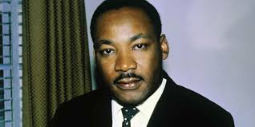
“Of all the forms of inequality, injustice in health is the most shocking and inhuman.”
Dr. Martin Luther King, Jr., Chicago, IL, March 25, 1966 Statement to the second convention of the Medical Committee for Human Rights

Slide 21

The Burden of TB in the US & Globally
Global:
2 billion TBI
10 million TB disease
1.25 MILLION DEATHS
USA:
13 million TBI
8300 to 9600 TB disease
600 DEATHS
Notes:
The WHO also has the goals globally, to eliminate TB and they emphasize treating TBI as the way to do this. This has not always been the case and most countries have not promoted this for various reasons, so it’s an uphill battle. But we are making progress in getting doctors and the population at large educated about TBI.
Recently in the US about 8300-9600 people got TB disease each year and about 600 died from TB yearly.
The numbers add up
10% might not add up to a lot if you are talking about a discount
But in medicine, it’s a huge number
Attacking TBI has a huge benefit down the road

Slide 22

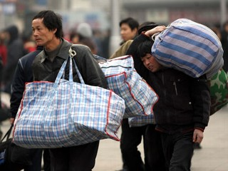
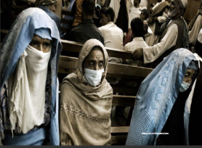
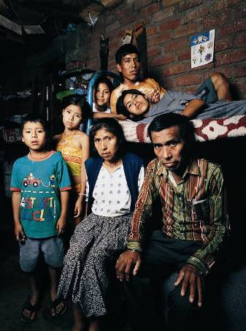
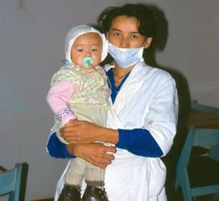
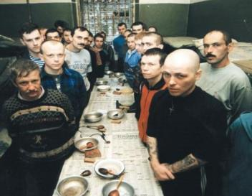
Who carries the burden of tuberculosis?
…the most vulnerable
TB spreads in poor, crowded & poorly ventilated settings
1.25 million people died from TB in 2023
161,000 PLWHIV died of TB
Migrants, prisoners, minorities, refugees face risks, discrimination & barriers to care
TB linked to HIV infection, malnutrition, alcohol, drug and tobacco use, diabetes
Notes:
The people most affected by TB are often the very ones that faces discrimination, have little access to resources and have more barriers to care. Let’s look at some numbers, latest are from 2023
Globally reported # of people newly dx with TB reached a new high in 2023 10.8 million dx, up from 10.7 in 2022
TB deaths continued a downward trend in 2023 to 1.25m from 1.31 in 2022 and 1.42 in 2021. Deaths were up as reported cases were down during the pandemic. It appears that TB reclaimed it’s pre-pandemic title as the #1 ID killer in the world. Covid had officially reported deaths of 300k in 2023. Now, let’s take a closer look at some of the things that can affect TB care: (next slide)

Slide 23

Social Justice
Social justice is a fundamental principle of public health,
focuses on protecting and improving the health of populations.
Social determinants of health, significantly impact health outcomes.
Therefore, addressing social injustices is crucial for achieving optimal public health.
Gostin LO, Powers M. What does social justice require for the public’s health? Public Health Ethics and Policy Imperatives. Health Aff (Millwood) 2006; 25(4):1053–60.
Slide from presentation given by Erin Corriveau, MD, MPH in July 2024 at a TB Intensive, A Discussion of Ethics in TB Care

Slide 24

SOCIAL JUSTICE
Concerned with inequalities and with the fair distribution of advantages and burdens among people
Social inequalities drive TB, and TB drives many people deeper into poverty.
Ending TB and addressing social determinants of health are interdependent.
https://journalofethics.ama-assn.org/article/call-service-social-justice-public-health-issue/2014-09

Slide 25
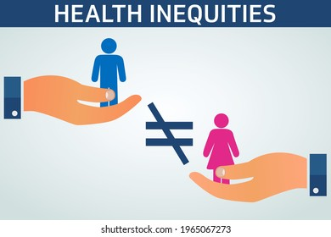
Role of Social Justice in Public Health
Identifying and addressing health inequities:
Recognizing and challenging systemic inequalities that disproportionately affect marginalized communities.

Slide 26

Role of Social Justice in Public Health
Promoting health equity:
Ensuring that all people have equal access to healthcare, resources, and opportunities to improve their health.

Slide 27

Role of Social Justice in Public Health
Advocating for policy changes:
Influencing policies and regulations that support social justice and improve health outcomes for vulnerable populations.

Slide 28

Role of Social Justice in Public Health
Empowering communities:
Collaborating with communities to develop culturally appropriate and community-driven interventions that address their health needs.

Slide 29
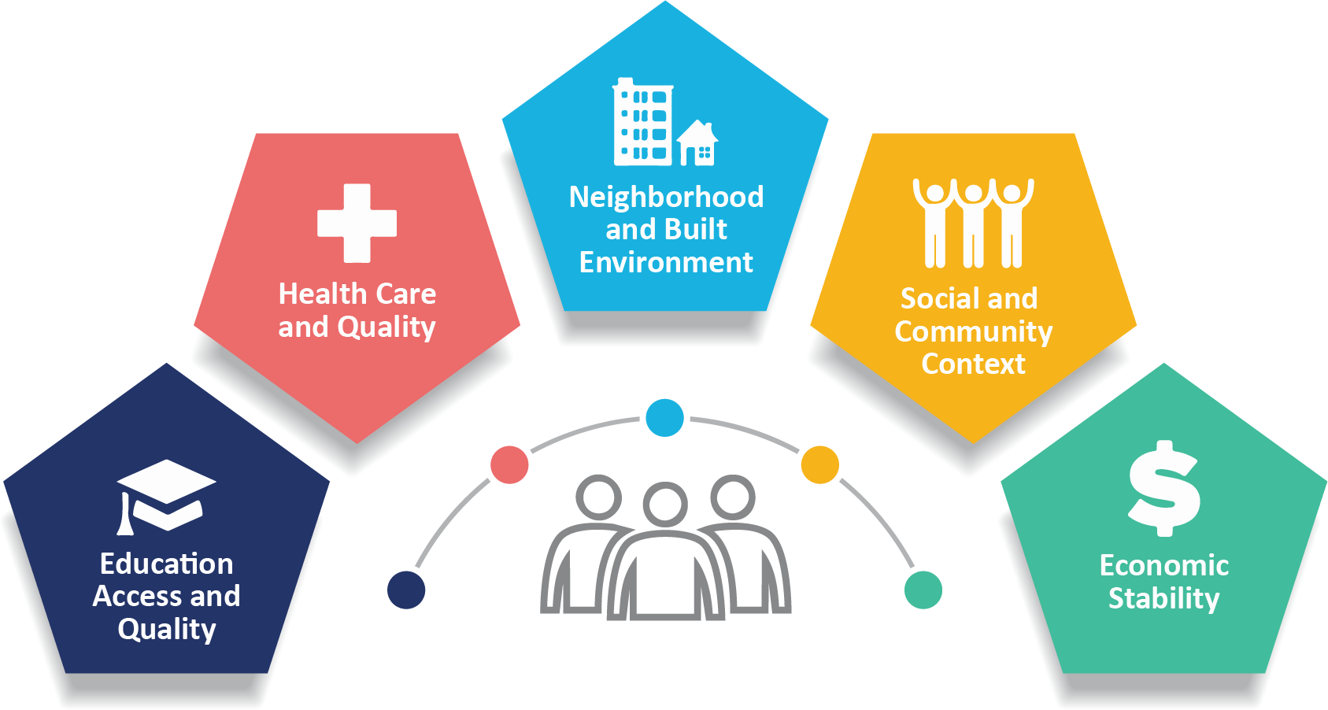
Role of Social Justice in Public Health
Educating the public:
Raising awareness about social determinants of health and the importance of social justice for public health.

Slide 30
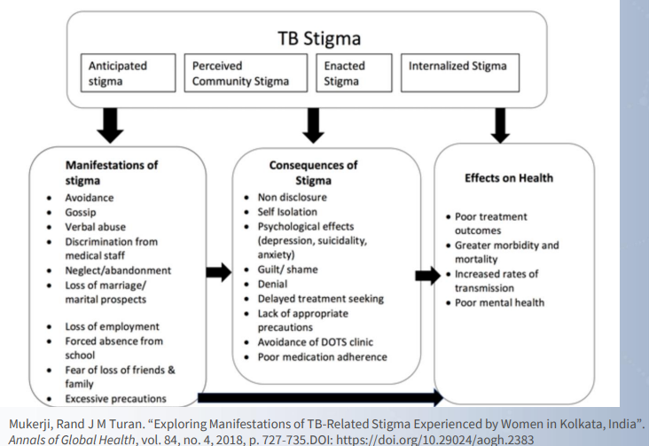
TB STIGMA
Negative or discriminatory attitudes;
Negative and unfair beliefs
Notes:
Stigma. And stigma definitely affects health, in a number of ways. This slide shows a study from India which looks at the stigma surrounding TB. We treated a pt a couple of years ago that dealt with some of this, and we see the effects of stigma on a regular basis. There are some cultural aspects to this, but we see it across all cultures, across income levels, across all the lines. One of my pts, born and raised right here in Austin repeatedly denied that she had TB. (next slide)

Slide 31
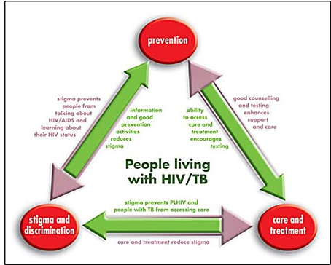
STIGMA
Prevents people with HIV and TB from:
accessing care
talking and learning about HIV and TB status
Good counseling enhances support
Access to care and treatment encourages testing
Education and prevention activities reduces stigma
Notes:
I think we are getting a bit better about accepting that HIV is a chronic dz that can generally be controlled, though certainly there is still plenty of stigma about it; and many other countries have not gotten to where we are yet (and again, we are still evolving too!) But stigma harms those who need health care wherever they are if it keeps them from accessing that care. Some people won’t even get tested because getting tested could lead to a diagnosis which could bring them more stigma, which could lead to social isolation, depression, withdrawal. But education and talking about the topic actually helps, and reduces stigma.

Slide 32

STIGMA and TB Care
Reduction of stigma is essential to End TB
Stigma needs to be addressed to achieve zero TB suffering
Stigma interferes with care seeking, contact investigation, treatment initiation, adherence and quality of care
Judgmental terms and negative connotation of words place blame for the disease and responsibility for adverse treatment outcomes on the patient.

Slide 33
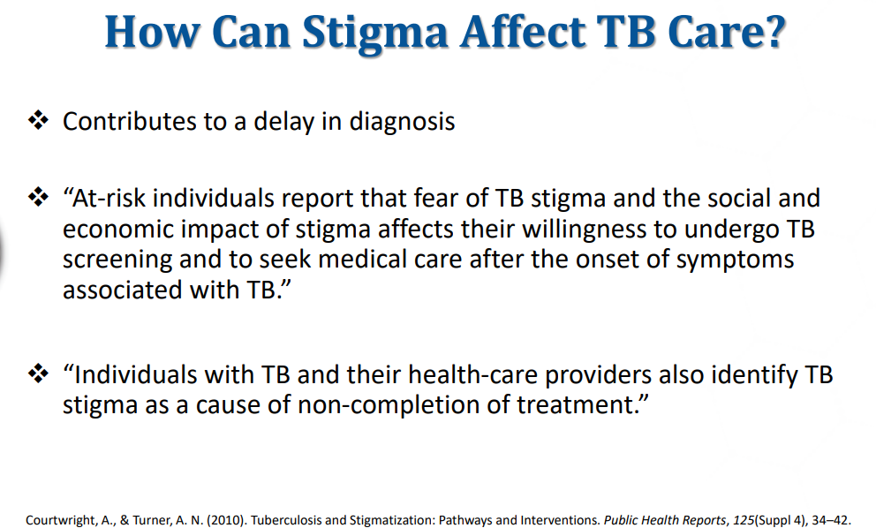
Ways STIGMA affect TB Care
Contributes to delayed diagnosis
At-risk individuals report that fear of TB stigma and the social and economic impact of stigma affects their willingness to undergo TB screening and to seek medical care after the onset of symptoms associated to TB
Individuals with TB and their healthcare providers also identify TB stigma as a cause of non-completions of treatment.

Slide 34
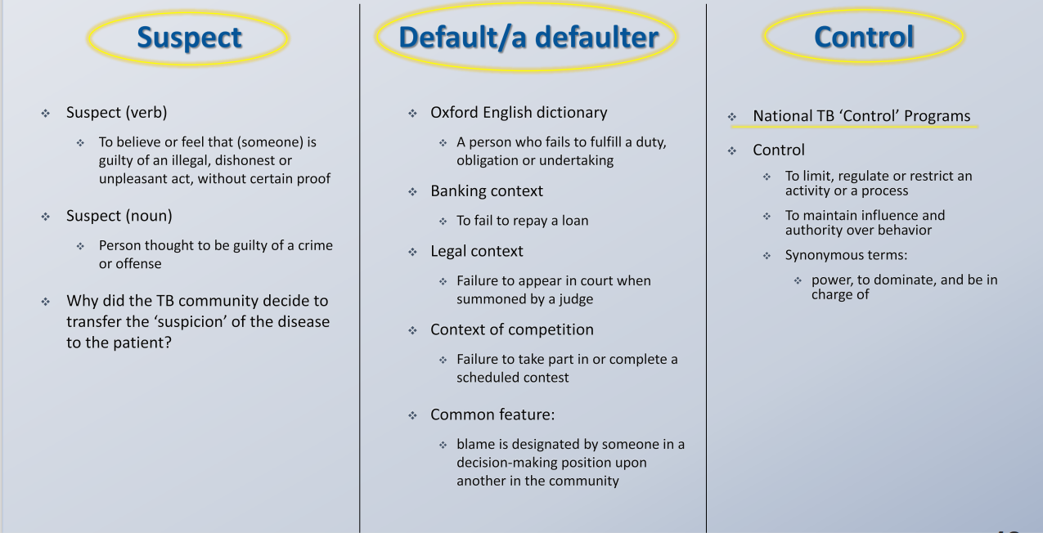

Slide 35

ISOLATION
Feeling lonely, confined, abandoned
Shame of needing to wear a mask
Feeling dirty “like a leper”
Isolation from family
Chang B.Quality of life in TB: A review of English literature

Slide 36

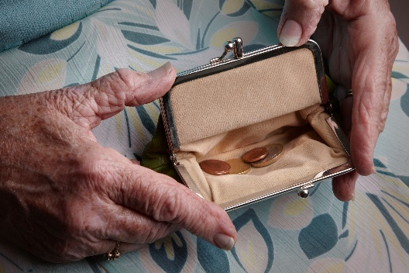
Financial Aspects of TB Disease
TB Financially affects families and communities
Cost of care for TB is high due to medications, follow up and ancillary services.
Adverse financial and health outcomes are associated to racial and ethnic disparities in TB care with an estimated economic cost of $914M over 2023-2035 period
JAMA Netw Open; Published Online: September 10, 2024
2024;7;(9):e2431988. doi:10.1001/jamanetworkopen.2024.31988
Notes:
We see the financial hardship TB causes. The very moment we diagnose someone with TB, we also take away some of their individual rights and freedoms. We put them in isolation and tell them that because of the infectiousness of their condition & the seriousness of the illness itself, we are obligated to protect the public. Most people rely on their income to pay for life’s necessities; if they are the only one working in the home and they don’t have savings or insurance that covers loss of income, then such an order can be devastating. The lower you go down the income/assets scale the less likely you are to have savings to cover this loss of income.

Slide 37
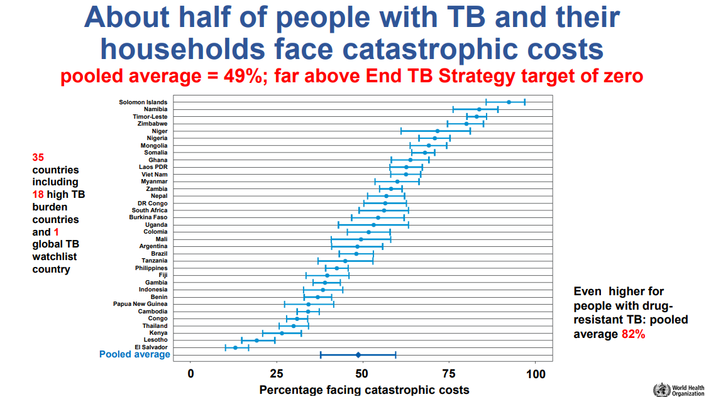

Slide 38
Financial Aspects of TB Disease
Adhere to isolation orders
Stay at home
Do not work, for an undetermined time
Eat
Pay rent or mortgage
Buy medicines
Increase financial security
OR
Notes:
We see the financial hardship TB causes. The very moment we diagnose someone with TB, we also take away some of their individual rights and freedoms. We put them in isolation and tell them that because of the infectiousness of their condition & the seriousness of the illness itself, we are obligated to protect the public. Most people rely on their income to pay for life’s necessities; if they are the only one working in the home and they don’t have savings or insurance that covers loss of income, then such an order can be devastating. The lower you go down the income/assets scale the less likely you are to have savings to cover this loss of income.

Slide 39
Financial Issues & / or Stigma
31-50% of patients have financial difficulties
11% of children with TB affected parents abandoned schooling and 8% took up work
Can lead to delayed care
Sicker at diagnosis
More costly to treat
May be more difficult to cure
Patients sometimes chose immediate needs (working/making money) over continuing treatment
Chang B.Quality of life in TB: A review of English literature

Slide 40
Financial Aspects of TB Disease
Often leading to catastrophic costs, income loss, and asset depletion. These impacts can perpetuate a cycle of poverty and worsen health outcomes.
Catastrophic Costs and Income Loss: TB-affected households frequently face catastrophic costs, defined as expenses exceeding 20% of their annual income. In Tanzania, 44.9% of TB-affected households experienced catastrophic costs, driven by income loss and medical expenses. Similarly, in the Philippines, 42.4% of households faced catastrophic costs, with a higher burden among drug-resistant TB patients.
Asset Depletion: Many households resort to dissaving practices, such as borrowing money or selling assets, to cope with TB-related expenses. In the Philippines, over 40% of households engaged in such practices. In Tanzania, 53% of households borrowed money or sold assets to finance TB treatment.
Notes:
We see the financial hardship TB causes. The very moment we diagnose someone with TB, we also take away some of their individual rights and freedoms. We put them in isolation and tell them that because of the infectiousness of their condition & the seriousness of the illness itself, we are obligated to protect the public. Most people rely on their income to pay for life’s necessities; if they are the only one working in the home and they don’t have savings or insurance that covers loss of income, then such an order can be devastating. The lower you go down the income/assets scale the less likely you are to have savings to cover this loss of income.

Slide 41

Financial Aspects of TB Disease
What can we do?
Release pts from isolation as soon as possible
Make them aware of community services potentially available (ideally, assign a SW)
Notes:
In my clinic this is how we address it
But even these things have barriers
-Management of TB must follow minimum state standards, which can result in extended isolation periods
-Budget cuts are the norm, and there is, I think, the sense that more loom large; everyone I think its nervous about the immediate future Will this service even be around?
I guess that’s one way to ease the financial burden of TB… if we don’t have a PHD to tx them, then they don’t have to stay out of work… But I will argue that is not the best way of handling TB.

Slide 42
Financial Aspects of TB Disease
Easing the financial burden of TB requires a multifaceted approach:
targeted cash transfers,
socioeconomic support,
nutritional programs,
active case finding, and
strong intersectoral collaboration.
Notes:
In my clinic this is how we address it
But even these things have barriers
-Management of TB must follow minimum state standards, which can result in extended isolation periods
-Budget cuts are the norm, and there is, I think, the sense that more loom large; everyone I think its nervous about the immediate future Will this service even be around?
I guess that’s one way to ease the financial burden of TB… if we don’t have a PHD to tx them, then they don’t have to stay out of work… But I will argue that is not the best way of handling TB.

Slide 43
Easing the Financial Burden: Effective Approaches
Implementation of cash transfer programs.
These can be either TB-specific, targeting households with a confirmed TB diagnosis, or TB-sensitive, aimed at increasing the income of households at high risk of TB to enhance their economic resilience. A study comparing these strategies in low- and middle-income countries found that TB-specific cash transfers were more effective and affordable in preventing catastrophic costs than TB-sensitive approaches.
Provision of socioeconomic support.
In Peru, a TB-specific socioeconomic intervention, which included cash transfers conditional upon TB screening and treatment adherence, significantly reduced the likelihood of households incurring catastrophic costs. This intervention highlights the importance of integrating economic support with health interventions to mitigate financial burdens.
Nutritional support programs
can also play a crucial role. An example is the Indian government's 'Nikshay Poshan Yojana' scheme provides nutritional support to TB patients, which has been shown to help reduce catastrophic costs.
Notes:
The financial burden caused by tuberculosis (TB) can be eased through several strategies, primarily focusing on social protection measures and economic support.

Slide 44
Easing the Financial Burden: Effective Approaches
Active case finding and community-based treatment
can reduce pre-diagnosis costs and overall financial burden. In Cambodia, active case finding significantly lowered the costs incurred before treatment compared to passive case finding.
Intersectoral collaboration
between health and social support sectors is essential. Policymakers in Mozambique emphasized the need for shared goals, trust, and resource allocation to design and implement effective social support programs for TB patients.

Slide 45
Funding TB Care
Ending the TB epidemic by 2030 is among the health targets of the United Nations Sustainable Development Goals
$ 22 billion USD is needed annually for TB prevention, diagnosis, treatment and care to achieve the global target by 2027 agreed at the 2023 UN high level-meeting on TB.
Notes:
Another side to finances is funding of TB prevention & treatment
A bit more in a moment about the UN Sustainable Goals

Slide 46
$Money $Money$ Money$
As in the past decade, 80% of the spending on TB services in 2023 was from domestic sources.
In low- and middle-income countries, international donor funding remains crucial.
From 2019 to 2023, there was a decline (of US$ 1.2 billion) in available funding from domestic sources and a very slight increase (of US$ 0.1 billion) in funding provided by international donors.
Notes:
These BRICS countries are definitely NOT where we need to decrease funding!! these are high-MDR. We don’t want TB to get out of control, and I would add a few “reallys… as in really really really to MDR getting to be a worse problem, which already starts at “dire”

Slide 47
$Money $Money$ Money$
Most of the reduction in domestic funding is largely explained by reductions in domestic funding trends in Brazil, the Russian Federation, India, China and South Africa (BRICS).
Financing for TB research and innovation at US$ 1.0 billion in 2022 also continues to fall far short of the global target of US$ 5 billion per year, constrained by the overall level of investment.
Notes:
These BRICS countries are definitely NOT where we need to decrease funding!! these are high-MDR. We don’t want TB to get out of control, and I would add a few “reallys… as in really really really to MDR getting to be a worse problem, which already starts at “dire”

Slide 48

Why to Invest In Missed TB Patients
TB is Curable with a $30 USD six-month treatment course
TB Respects No Borders
For every dollar invested in TB the return is $43 dollars
1 Person with TB can infect up to 10 people a year
Notes:
TB is the largest killer among communicable diseases in the 15 to 49 age group, when humans are most productive. TB accounts for the highest DALYs or workdays lost each year among the communicable diseases. TB is the leading cause of death among people with HIV. A well ventilated room that allows sunlight reduces risk of TB transmission. Treating a drug-resistant TB case can cost as much as US$ 5000. A dollar invested in TB gives a return of $43

Slide 49

Why Are TB Patients Missed
No Access:
Distance to care, poverty, stigma, limited
facilities, financial barriers, conflict
No Diagnosis:
Lack of molecular testing, culture, susceptibility
No Documentation:
Weak reporting, lack of notification
No Treatment:
Lack of meds and poor links between services
Notes:
All of these things contribute, especially in resource-poor countries. But what about here, in our rich country?

Slide 50
Other Needs to Address
Failure to Address Psychosocial Needs Leads to:
Decrease adherence to treatment
Ongoing transmission
Higher mortality rates
Addressing psychosocial factors and mental health needs is necessary to ensure positive treatment outcomes
Notes:
Do we have an ethical or moral duty to provide these services? To help out financially? To address all the problems?

Slide 51

TB in the Global Context
Margaret Chan Director General World Health Organization:
“Everyone with TB should have access to the innovative tools and services they need for rapid diagnosis, treatment and care. This is a matter of social justice, fundamental to our goal of universal health coverage. Given the prevalence of drug-resistant tuberculosis, ensuring high quality and complete care will also benefit global health security. I call for intensified global solidarity and action to ensure the success of this transformative End TB Strategy.

Slide 52
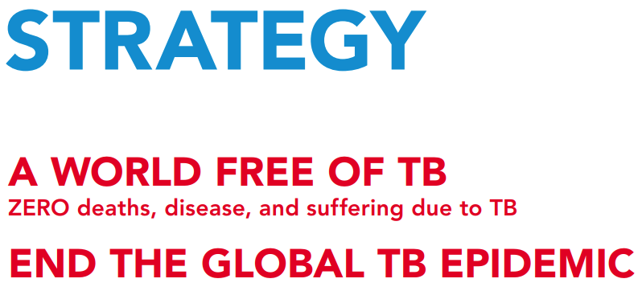
END TB Strategy
Vision: A world free of TB. Zero deaths, disease and suffering due to TB.
Goal:
End the global tuberculosis epidemic.
Indicators:
95% reduction by 2035 in number of TB deaths compared with 2015.
90% reduction by 2035 in TB incidence rate compared with 2015.
Zero TB-affected families facing catastrophic costs due to TB by 2035.

Slide 53
END TB Strategy
Principles
Government stewardship and accountability, with monitoring and evaluation.
Strong coalition with civil society organizations and communities.
Protection and promotion of human rights, ethics and equity.
Adaptation of the strategy and targets at country level, with global collaboration.

Slide 54
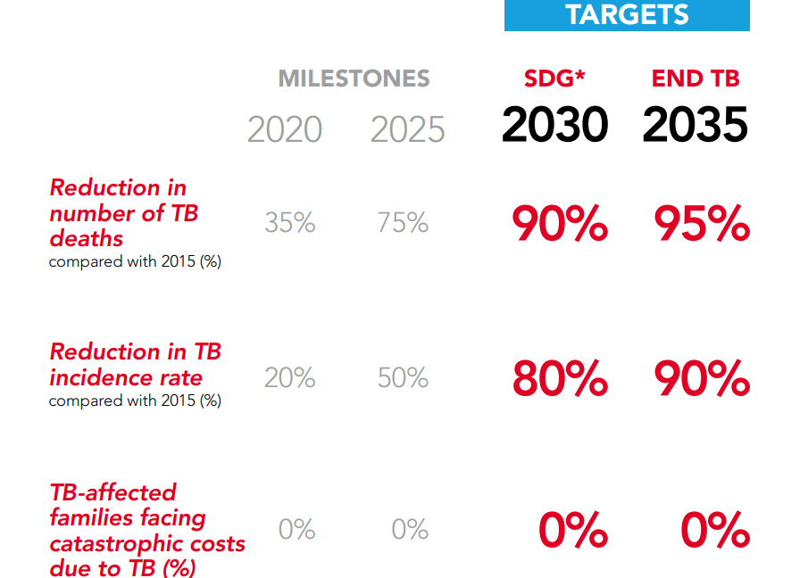

END TB Strategy
*SDG: Sustainable Development Goals

Slide 55
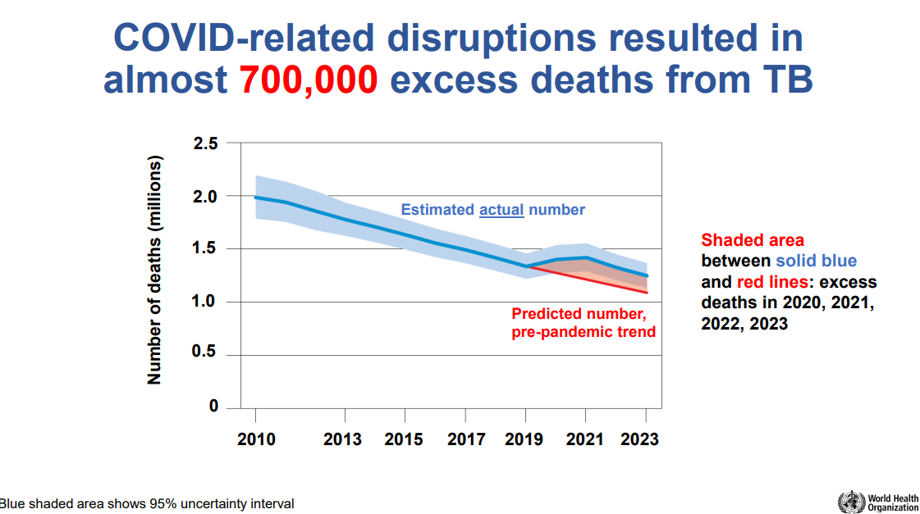
Notes:
WHO data

Slide 56
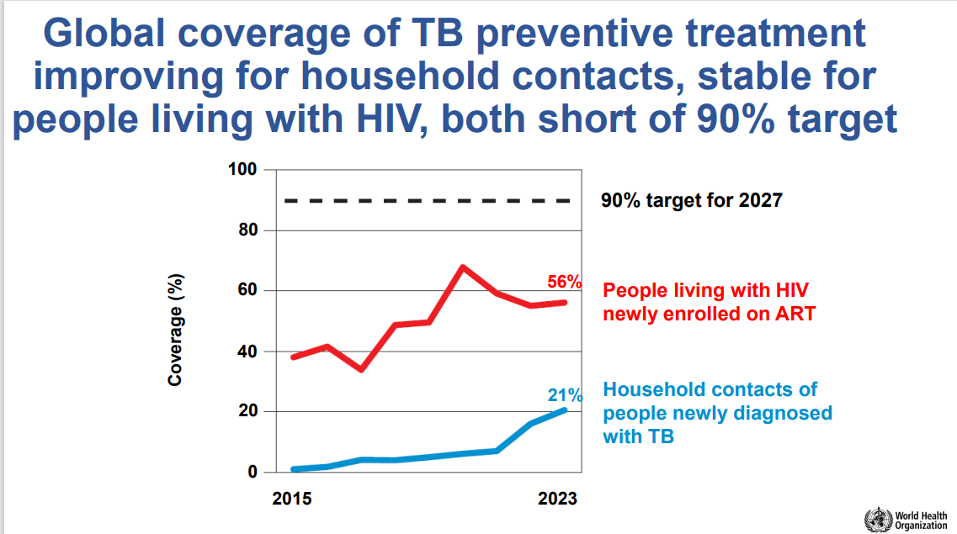

Slide 57
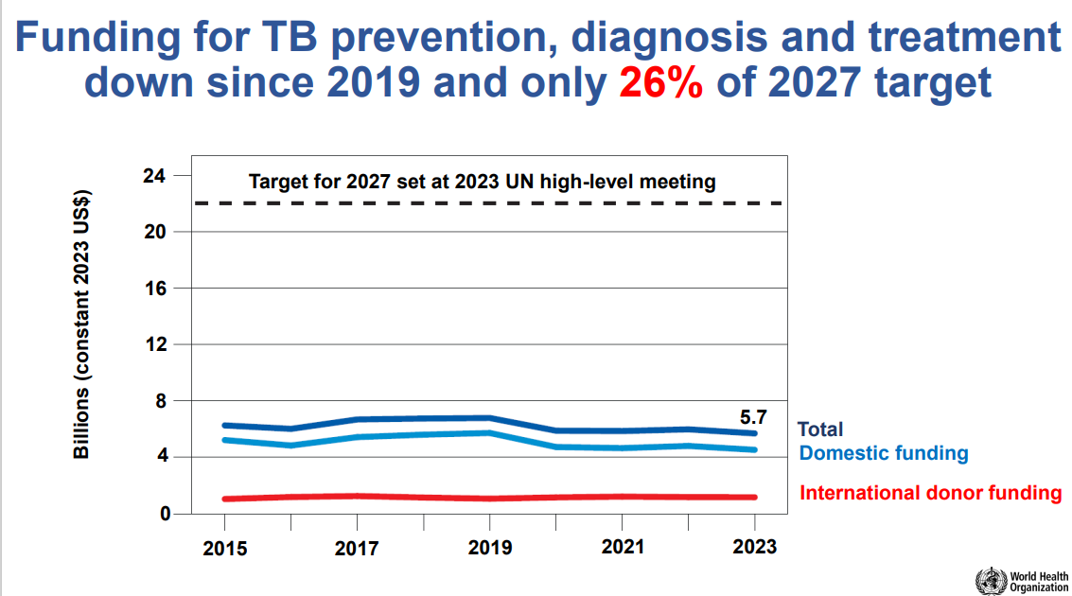

Slide 58
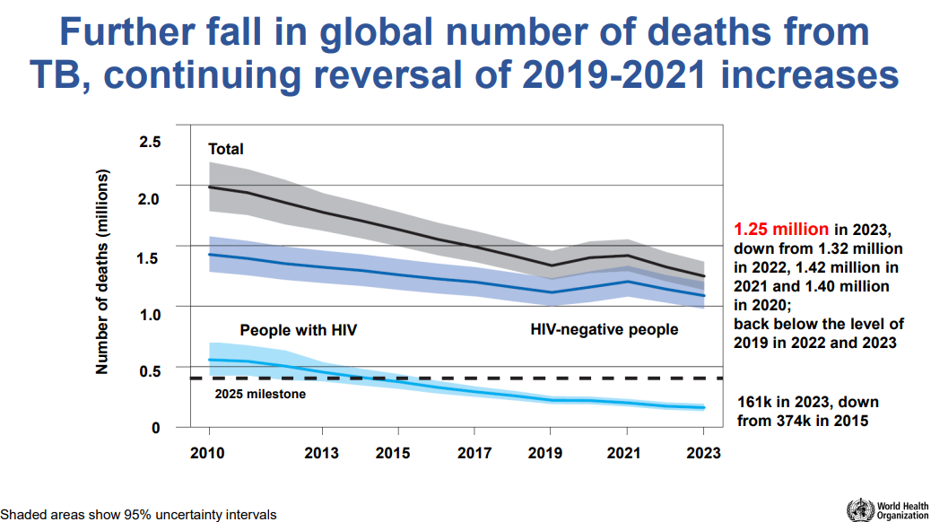

Slide 59
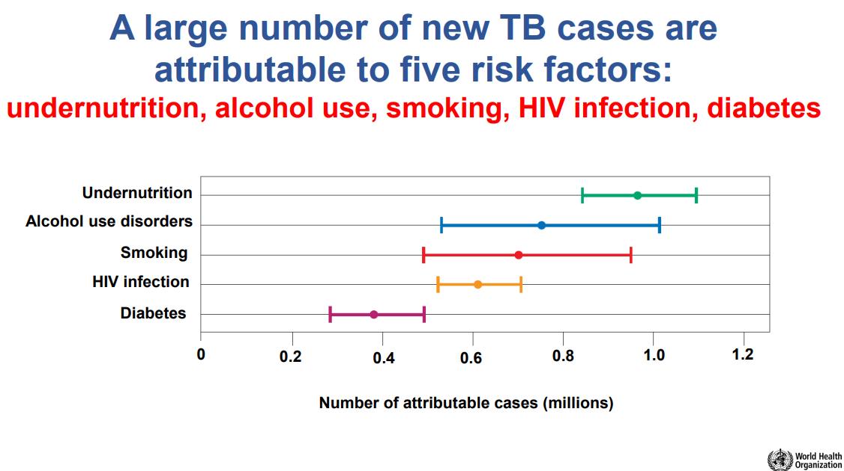

Slide 60
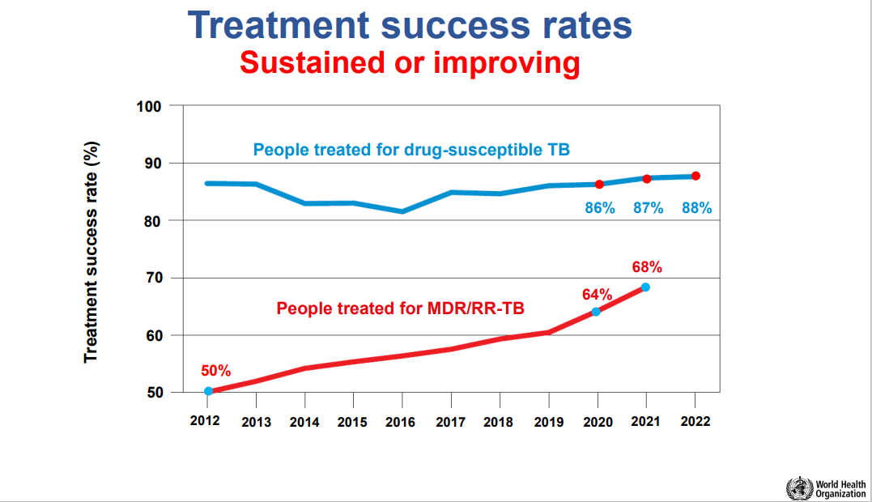

Slide 61
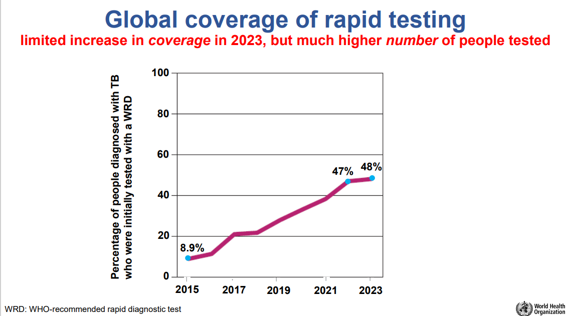

Slide 62
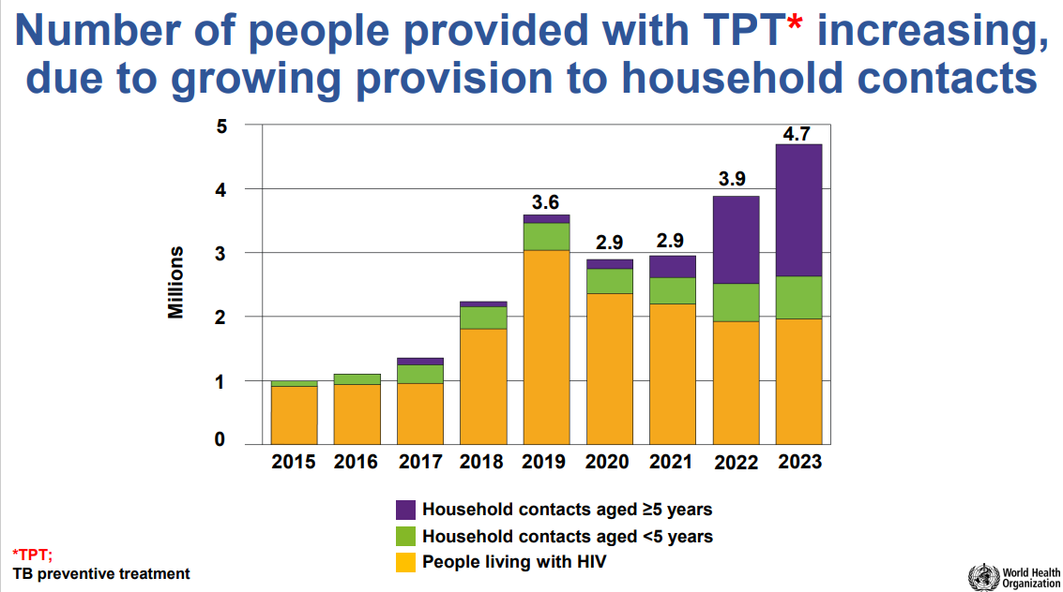
Notes:
Good news!

Slide 63
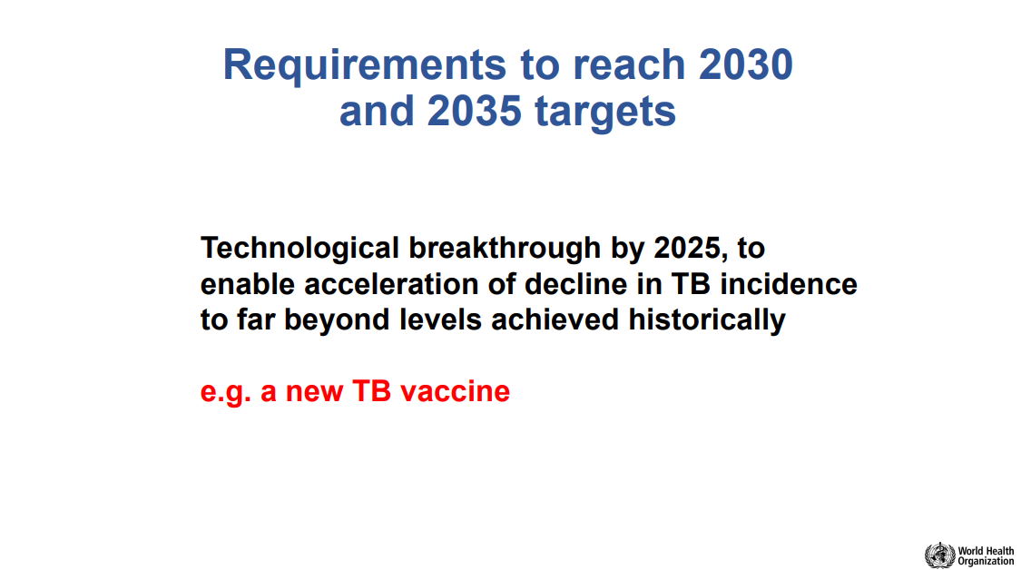

Slide 64
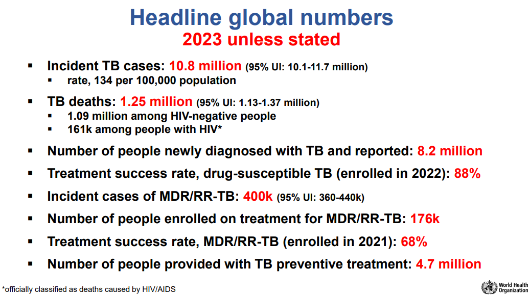

Slide 65

Risks and Benefits in TB Diagnosis
Benefits:
Knowledge of condition
Make life plans
Prevent transmission
Treatment?
Risks:
Stigma
Discrimination
Anxiety
Isolation
Goal: Maximize benefits, minimize risks

Slide 66
Latent TB Infection
Key ethical considerations include:
Informed Consent and Autonomy: Patients should be fully informed about the risks and benefits of LTBI testing and treatment, and their consent should be obtained before proceeding. This includes discussing potential side effects of treatment and the uncertainty regarding progression to active TB.
Equity and Justice: LTBI management should be accessible to all individuals, regardless of socioeconomic status. This includes ensuring that vulnerable populations, such as healthcare workers and those in high-risk settings, receive appropriate screening and treatment.
Minimizing Harm: The principle of non-maleficence requires that the least burdensome and most effective treatments be used. This includes considering shorter, less toxic treatment regimens when possible.
Confidentiality: Patient confidentiality must be maintained throughout the diagnosis and treatment process. This is particularly important in settings where stigma associated with TB can lead to discrimination.

Slide 67
Latent TB Infection
Community Engagement: Engaging communities in the design and implementation of LTBI programs helps ensure that interventions are culturally appropriate and ethically sound. This can improve adherence and outcomes.
Legal and Policy Frameworks: Ethical guidelines should be supported by clear legal and policy frameworks that protect individual rights while enabling effective public health interventions. This includes guidelines from the United States Centers for Disease Control and Prevention (CDC) and the National Tuberculosis Controllers Association, which recommend annual TB education and symptom screening for healthcare personnel with untreated LTBI.
These ethical principles guide the development and implementation of LTBI management policies to ensure they are fair, effective, and respectful of individual rights.

Slide 68

Distribution of Health Care Resources
Unlike TB, AIDS requires lifelong treatment, and no cure exists
Full course of TB medication cost $20 dollars vs. $100 per year for HIV medications in developing countries
20 million clinical trials for TB drugs vs. 300 million clinical trials for HIV drugs(2007)
Advocacy for HIV/AIDS is greater than TB
M.J. Selgelid IJTBLD 12(3);231-235 2008

Slide 69

SUMMARY: Social Justice
Social inequalities drive TB
TB drives many people deeper into poverty
The right to health is a fundamental right of every human being
Notes:
remember

Slide 70

Summary: Access to Care
Patient-centered approach means treatment is:
Accessible
Acceptable
Affordable
Appropriate

Slide 71
Summary: Access to Care (Diagnostics)
Prevents patients from receiving ineffective treatment to which they are resistant
Prevents additional spread of infection
Prevents further development of drug-resistance
Ensures patients are cured
Notes:
State that all aspects of TB care should be provided free of charge
Review slide content
It is also important to remove non-TB-specific financial barriers to accessing the health-care system, such as:
User fees which prevent poor people from receiving health-care services
Charges imposed on TB patients for the care of related conditions, e.g. HIV

Slide 72
SUMMARY: Access to Care (Treatment)
Including appropriate diagnosis and treatment of MDR/XDR-TB
Everyone with TB should have access to the innovative tools and services they need
Treatment significantly improve the health condition of individuals and the community by
Stopping the spread of a highly infectious disease.

Slide 73
TB diagnosis in the Absence of Treatment
Gap between number of patients diagnosed and enrolled on treatment
Should patients be diagnosed when there is no treatment available?
Should patients receive informed consent?

Slide 74
SUMMARY: Other Considerations
Need to reduce the human suffering and socioeconomic burden associated with TB
Ensuring treatment with dignity and compassion
Numerous ethical reasons for wealthy nations to do more to help improve health care in poor countries.
Infectious diseases fail to respect boundaries
Inadequate health care systems in poor countries threatens global public health
MDR/XDR-TB is a serious global health threat
Need to achieve universal access to diagnosis and patient centered treatment

Slide 75
THANK YOU
Hector I. Ocaranza, MD, MPH, FAAP
ocaranzah@elpasotexas.gov

Slide 76
LINKS/RESOURCES AND SOURCES/CITATIONS
https://code-medical-ethics.ama-assn.org/principles
https://codeofethics.ana.org/provisions
https://pnhp.org/news/getting-martin-luther-kings-words-right/
https://www.who.int/news-room/fact-sheets/detail/tuberculosis
Ethics guidance for the implementation of the End TB strategy. Geneva: World Health Organization; 2017. License: CC BY-NC-SA 3.0 IGO
Gostin LO, Powers M. What does social justice require for the public’s health? Public Health Ethics and Policy Imperatives. Health Aff (Millwood) 2006; 25(4):1053–60.
Mukerji R, Turan JM. Exploring Manifestations of TB-Related Stigma Experienced by Women in Kolkata, India. Ann Glob Health. 2018 Nov 5;84(4):727-735. doi: 10.9204/aogh.2383. PMID: 30779523; PMCID: PMC6748300.

Slide 77
LINKS/RESOURCES AND SOURCES/CITATIONS
Jaramillo E, Sahu S, Van Weezenbeek C. Ending TB-related stigma and discrimination. Int J Tuberc Lung Dis. 2017 Nov 1;21(11):2-3. doi: 10.5588/ijtld.17.0229. PMID: 29025478.
Courtwright A, Turner AN. Tuberculosis and stigmatization: pathways and interventions. Public Health Rep. 2010 Jul-Aug;125 Suppl 4(Suppl 4):34-42. doi: 10.1177/00333549101250S407. PMID: 20626191; PMCID: PMC2882973.
https://www.heartlandntbc.org/stopthestigma/
https://www.researchgate.net/publication/259978580_Voices_and_Images_Tuberculosis_Photovoice_in_a_Binational_Setting_Peer-Reviewed_Case_Study_Supervising_Faculty_member
Chang B, Wu AW, Hansel NN, Diette GB. Quality of life in tuberculosis: a review of the English language literature. Qual Life Res. 2004 Dec;13(10):1633-42. doi: 10.1007/s11136-004-0374-1. PMID: 15651535.

Slide 78
LINKS/RESOURCES AND SOURCES/CITATIONS
https://www.who.int/teams/global-tuberculosis-programme/tb-reports/global-tuberculosis-report-2023/financing-for-tb-prevention--diagnostic-and-treatment-services
https://www.who.int/westernpacific/activities/addressing-financial-burden-due-to-tb
Ghazy RM, El Saeh HM, Abdulaziz S, Hammouda EA, Elzorkany AM, Khidr H, Zarif N, Elrewany E, Abd ElHafeez S. A systematic review and meta-analysis of the catastrophic costs incurred by tuberculosis patients. Sci Rep. 2022 Jan 11;12(1):558. doi: 10.1038/s41598-021-04345-x. PMID: 35017604; PMCID: PMC8752613.
https://www.who.int/teams/global-tuberculosis-programme/tb-reports/global-tuberculosis-report-2023/financing-for-tb-prevention--diagnostic-and-treatment-services
WHO’s STOP TB website: http://www.who.int/tb/en/
WHO’s Ethics and Health website: http://www.who.int/ethics/en/
WHO’s activities on Ethics & TB: http://www.who.int/tb/challenges/mdr/ethics/en/
WHO Ethics guidance the End TB strategy 2017

Slide 79
LINKS/RESOURCES AND SOURCES/CITATIONS
*** great overview of TB funding:
https://www.kff.org/global-health-policy/fact-sheet/the-u-s-government-and-global-tuberculosis-efforts/
All about the UN’s Sustainable Goals (very exciting… amazing progress!)
https://sdgs.un.org/sites/default/files/2023-09/FINAL%20GSDR%202023-Digital%20-110923_1.pdf
https://cdn.who.int/media/docs/default-source/un-high-level-meeting-on-tb/who-ucn-tb-2023.3.pdf?sfvrsn=e7c6c3b3_5&download=true
*all* the TB things from the WHO:
The end TB strategy
https://www.who.int/activities/preparing-for-the-un-high-level-meeting-on-the-fight-against-tuberculosis--2023
WHO’s Ethics and Health website: https://www.who.int/health-topics/ethics-and-health#tab=tab_1
WHO Protecting human rights, ethics and equity for tuberculosis patients
WHO issues ethics guidance to protect rights of TB patients

