Slide 1
Partnering with Public Health Building Stronger Connections
Raul Alvarez, BSN, RN
Ersi Bucaria, BSN, RN

Slide 2

OObjectivesctives
Identify the role of your local public health in Tuberculosis (TB) prevention and care.
Discuss opportunities to collaborate with your local health department in the screening, testing, care and management of TB patients.

Slide 3
Public Health Role in TB Prevention and Care
Evaluate, diagnose, and treat patients with active TB disease.
Interview patients with TB to identify individuals who may have been exposed to TB – contact investigations.
Find, test, and treat individuals who have been exposed to TB (LTBI and/or active TB disease).
Collaborate with entities outside of HD including hospitals, health care providers, laboratories, schools, correctional facilities including jails and ICE facilities and other sources.
Evaluate, diagnose, and treat patients with active TB disease.
Interview patients with TB to identify individuals who may have been exposed to TB – contact investigations.
Find, test, and treat individuals who have been exposed to TB (LTBI and/or active TB disease).
Collaborate with entities outside of health dept including hospitals, health care providers, laboratories, schools, correctional facilities including jails and ICE facilities and other sources.

Slide 4
Public Health Role in TB Prevention and Care
Evaluate patients referred through the CDC’s Electronic Disease Notification (EDN) system and Status Adjusters (SA) through eMedical
* - B1s – suspicion of potential TB disease
* - B2s – LTBI
Screen, test and treat those in our community who have entered US on humanitarian VISAs who need TB tests.
Educate communities and healthcare providers about TB and LTBI.
Passive and active surveillance strategies for identifying TB cases.
Reporting of suspected and confirmed TB cases.

Slide 5

CEPDPH STATS 2025
STATS 2024
ACTIVE TB CASES | 40
SUSPECTED OF TB | 117
INITIATED LTBI TX | 120
REFUSED LTBI TX | 52
STATS 2025
ACTIVE TB CASES | 15
SUSPECTED OF TB | 72
INITIATED LTBI TX | 79
REFUSED LTBI TX | 5

Slide 6
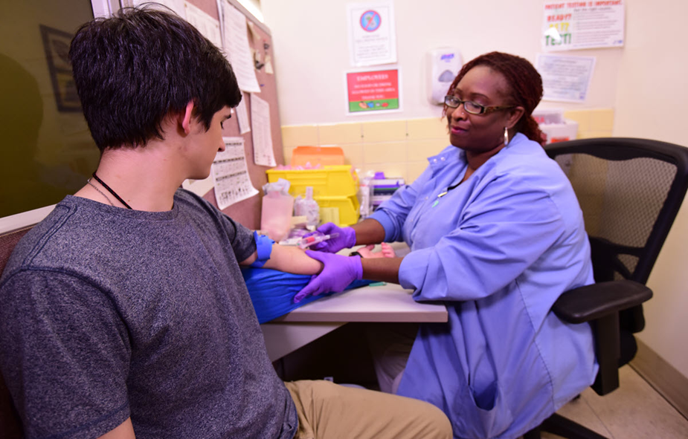
Opportunities for Collaboration
Early Detection and Screening
TB Testing and Diagnosis
Treatment and Medication Adherence
Case Management and Support Services
TB Training and Capacity Building
Surveillance and Reporting
Culturally Competent Care
Community Education and Awareness
Emergency Response and Outbreak Management

Slide 7
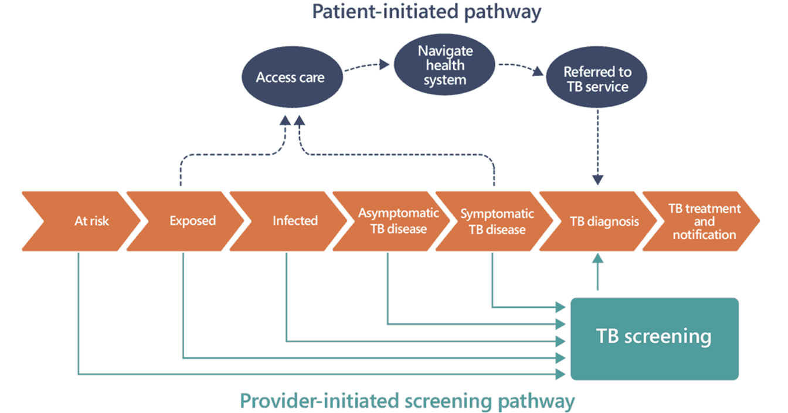
Early Detection and Screening – 2 Approaches for Detection of

Slide 8
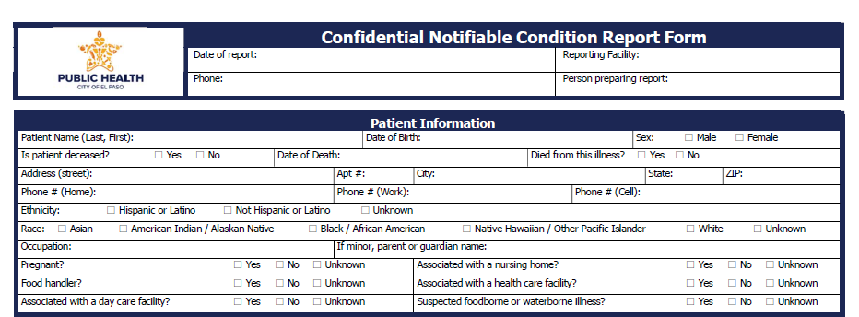
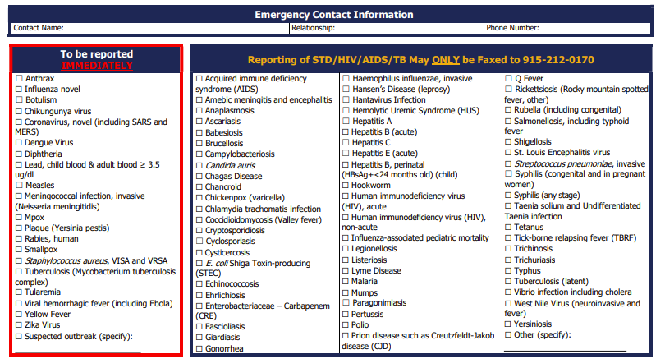
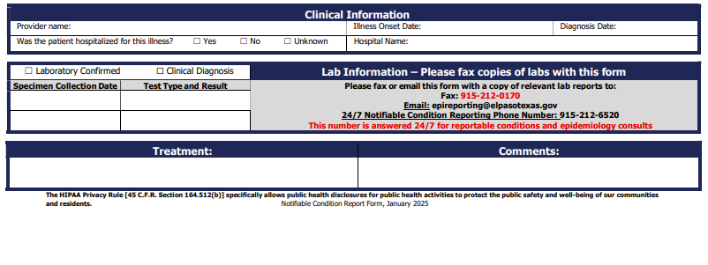
Referral Process
Reporting TB disease or TB infection is required by state statutes.
Active TB patients – Immediately
Patients suspected of having active TB – within 1 working day
Latent TB Infection – within 1 week
INCLUDE CXR report and TB Test report
Health Dept staff can act as a resource to let staff know exactly what is needed for reporting and follow-up.

Slide 9
Medical Consultation
Opportunities
Patients may have test results that are confusing or conflict with each other
O *Call CEPDPH TB Management Team for assistance with case review.
Patients may have complex co-morbidities, i.e. HIV, diabetes, cirrhosis
*Assist in assessing medication regimen interactions.
*Coordinate with TB expert consultants, i.e. Heartland
The Health Dept can assist with additional diagnostics:
*sputum collection
*specialized TB laboratories to support quicker diagnosis
Patients with unclear history of treatment for TB or TB infection.

Slide 10
Treatment and Medication Adherence
*A patient diagnosed with TB disease needs medical management.
Health Dept staff can manage the patient’s course of treatment in tandem with the referring provider.
The PCP remains the medical home.
The PCP will still manage other chronic conditions.
Patient education on importance of adherence to TB treatment
*Patients may be mobile.
Health Dept staff can refer patients who move to the receiving jurisdiction to complete treatment.
*Interjurisdictional Transfer Notification Form (IJN)
*National TB Coalition of America – State, Big City and Territory TB Program Contacts

Slide 11
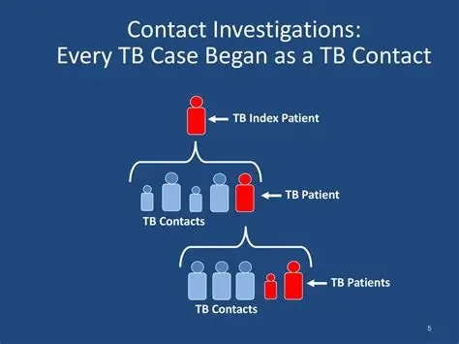
Contact Investigations
Contact Investigations (CI) are an essential part of TB elimination programs
CI’s help limit spread of TB.
Patients have contacts who may have been exposed to or have been infected with TB.
*Health Dept staff will:
Interview the patient
Contact contacts to set up screening and testing
Perform home visits to determine individuals who were exposed to TB
Provide treatment for those infected with LTBI
The information shared with the Health Dept is kept confidential.‎

Slide 12
Opportunities for Training and Education
Physicians new to the community or hospital may not have an extensive background in TB.
*Health Dept staff can act as a resource to discuss the diagnostic process and provide information to help clarify the diagnosis.
Community members who hear about a TB “outbreak” may become a little concerned.
*Health Dept staff work with community members and provide presentations and testing to those who may have been exposed to TB.

Slide 13

TB Training and Capacity Building
Education for healthcare workers
Workshops and conferences
Call WCCHD’s TB Management if you would like TB training for your staff either in person or virtually.
Education for healthcare workers
Workshops and conferences
Call CEPDPH TB Management if you would like TB training for your staff either in person or virtually.

Slide 14
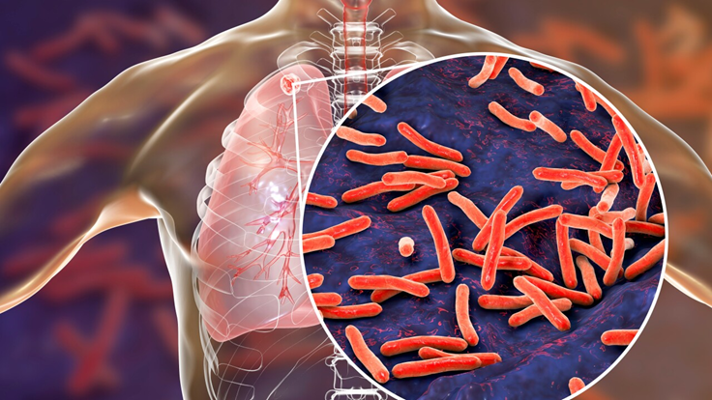
Emergency Response and Outbreak Management
TB outbreak response
*rapidly isolating suspected infectious TB cases
*conduct thorough CI
*provide immediate access to diagnostic testing and treatment
*raise awareness about transmission prevention
Coordination with congregate settings i.e.
correctional facilities and shelters

Slide 15

What the Health Dept Doesn’t Do
Take your patient away from you.
Treat the patient for other medical ailments that are discovered during the course of treatment for TB.
Arbitrarily test individuals for TB infection.
Require individuals to take LTBI treatment.
Indiscriminately lock up patients to force them to take TB treatment medications.

Slide 16
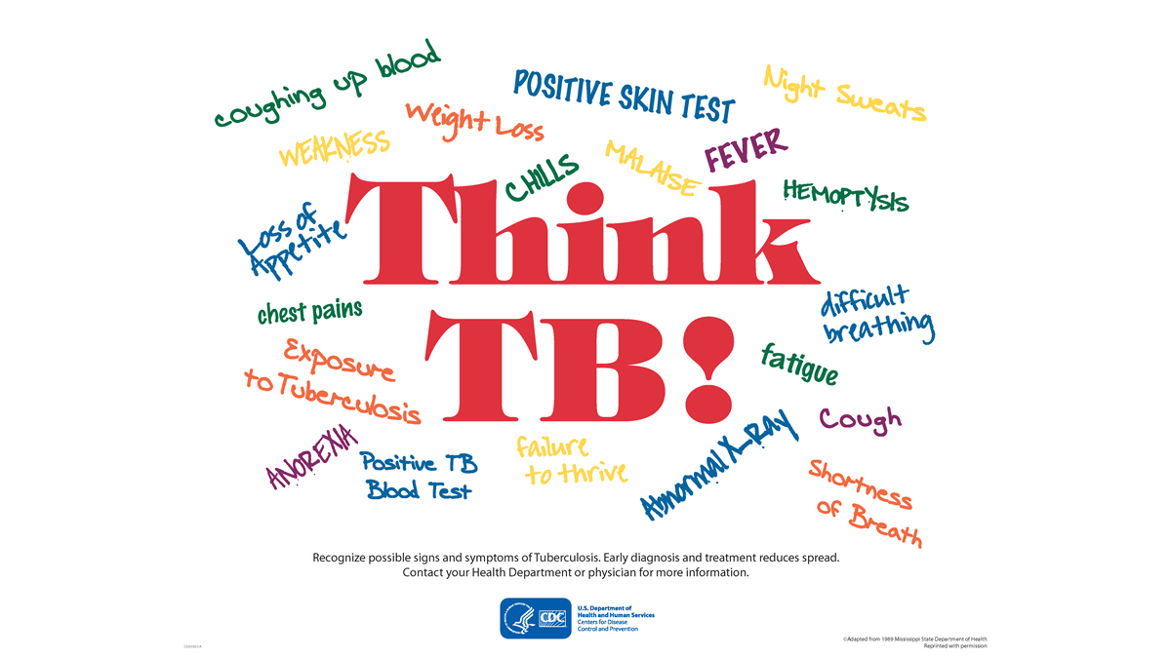
How You Can Help Us
*Do you know your patient’s TB status?
If referring your patient to the Health Dept, tell them the
Health Dept staff will contact them.
*Many people think we are scammers
Explain what TB infection is, that treatment is
available, and reinforce why treatment is important
Patient treatment refusals include:
*“I have immunity to TB due to the BCG vaccine”
*“My doctor says I don’t have TB disease”
*“My doctor said my CXR was normal so I’m good”

Slide 17

Conclusion….
The TB program of your local health dept is here:
To help you manage your patients diagnosed with TB or TB infection.
To act as a resource for TB related questions and problems that arise.
To build a solid foundation for public and private health partnership.

Slide 18
Thank you!
For more information:
City of El Paso Health Department
Respiratory Disease Clinic
P: (915) 212-6609
F: (915) 212-0172
Website: www.elpasotexas.gov

